Slide 1
About myself
Bachelor: 2010-2014
Master: 2014-2016
Worked at: LATNA (NRU HSE), Samsung Lab (PDMI RAS)
Currently:
Lecturer at NRU HSE
Middle Data Scientist in EPAM

Slide 2
My master degree experience
Continuing after bachelor
Deepening my knowledge in different areas: machine learning, optimization, statistics, discrete mathematicsTasks and homeworks that are closer to real cases
Solid set of lecturers
Comfortable time frame

Slide 3
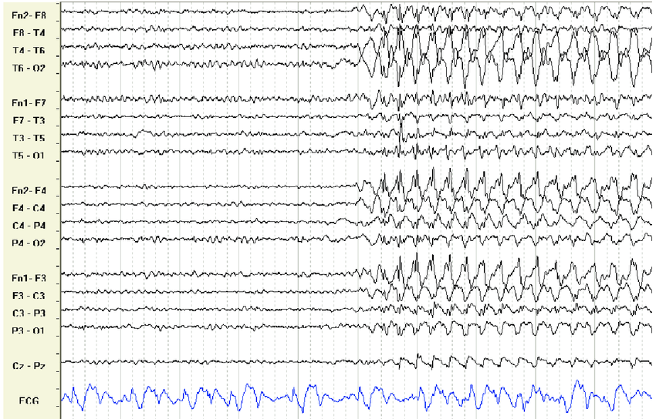
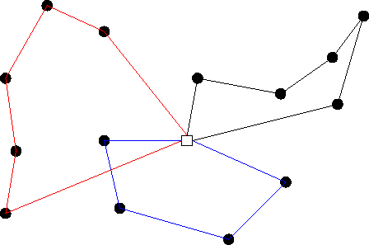
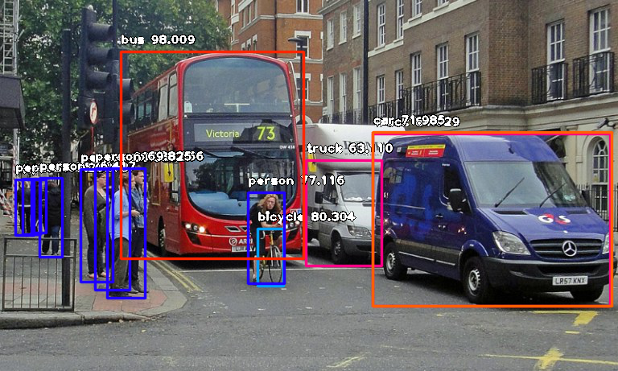
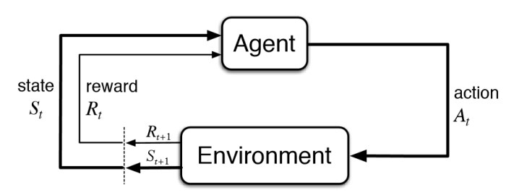
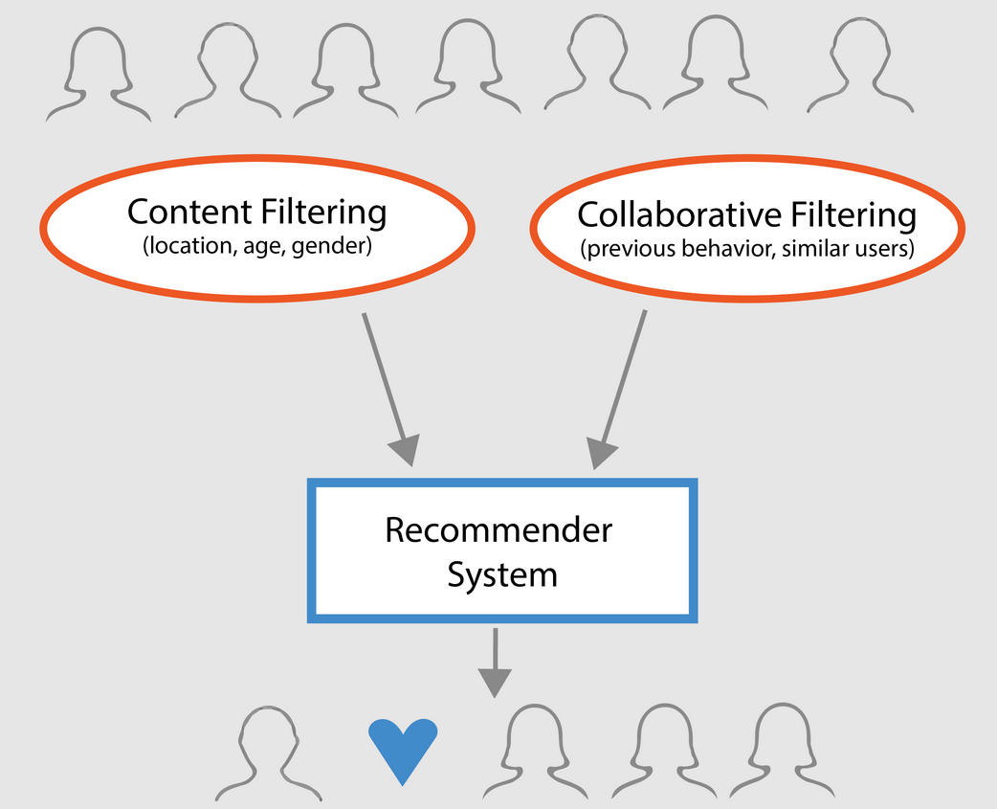
Projects
EEGs: graph theory, time series
VRP: optimization theory and algorithms
Object detection: deep NN architectures, CV
Recommendation engine: recommendation algorithms, neural networks, matrix factorization
Reinforcement learning: MuZero
Image super-resolution: CV, autoencoders, GANs
Product sales: regression, log-log model

Slide 4
Professional growth
Having basic background all-around helps:
Fast “onboarding” – entry to the project
Knowledge diversity – more ideas
Competence diversity – usefulness for company/organization
Creating contacts:
Teachers/Lecturers – as experts in respective areas
Groupmates – as future colleagues
Scientific background – helps to stay in touch with SOTA

