Slide 1

Modern Tasks OF Computer Vision Research
Andrey V. Savchenko
Dr. of Sci., Prof.,
HSE University, N. Novgorod, Russia
Email: avsavchenko@hse.ru
URL: www.hse.ru/en/staff/avsavchenko
March 3, 2022

Slide 2

Outline
Brief overview of 2D CV tasks
User Preference Prediction in Visual Data on Mobile Devices
Facial processing and emotion recognition
Food classification and restaurant recommendation
Understanding advertisements
Master of Computer Vision 2022

Slide 3
Brief overview of 2D CV tasks
фото
Master of Computer Vision 2022

Slide 4
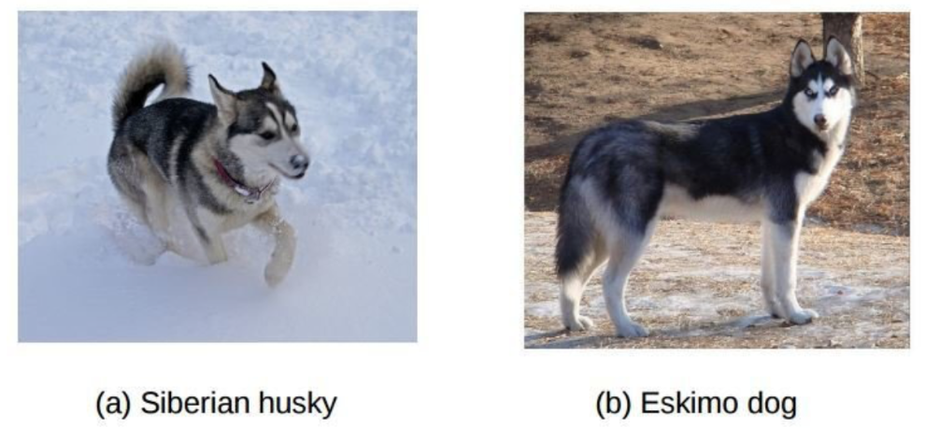
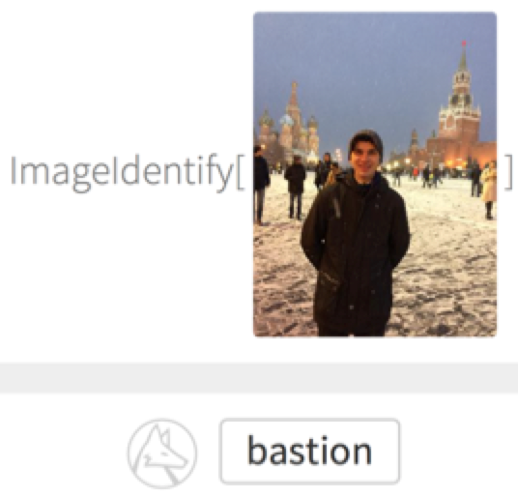
Image recognition
Wolfram ImageIdentify
Master of Computer Vision 2022

Slide 5
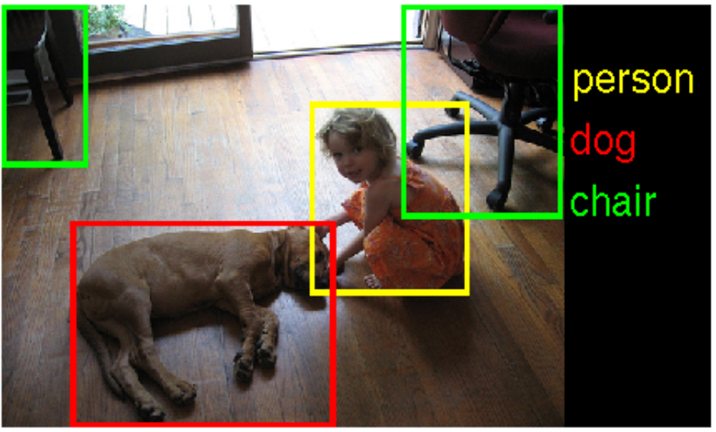
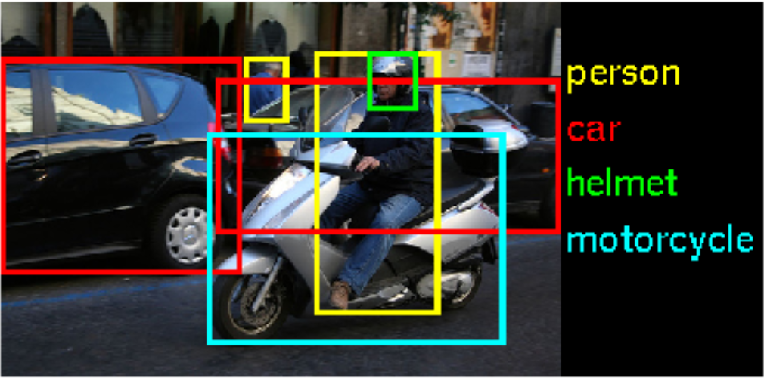
Object detection
Master of Computer Vision 2022

Slide 6
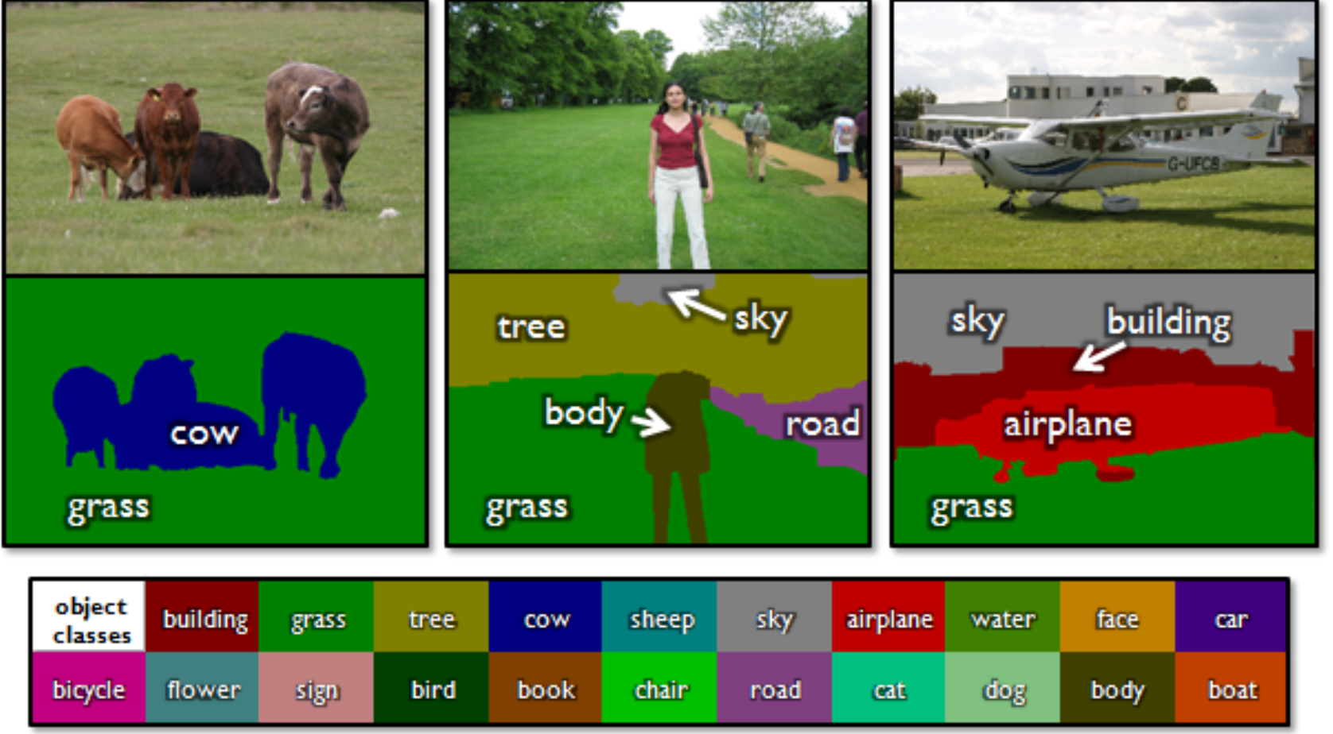
Semantic segmentation
Master of Computer Vision 2022

Slide 7
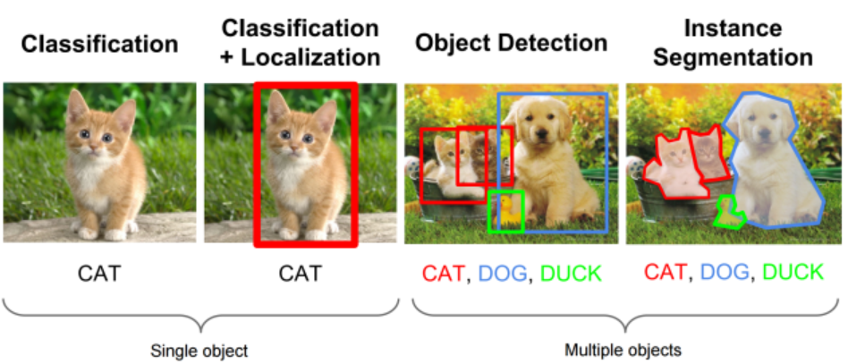
Classification, detection, segmentation,…
https://leonardoaraujosantos.gitbooks.io/artificial-inteligence/content/object_localization_and_detection.html
Master of Computer Vision 2022

Slide 8
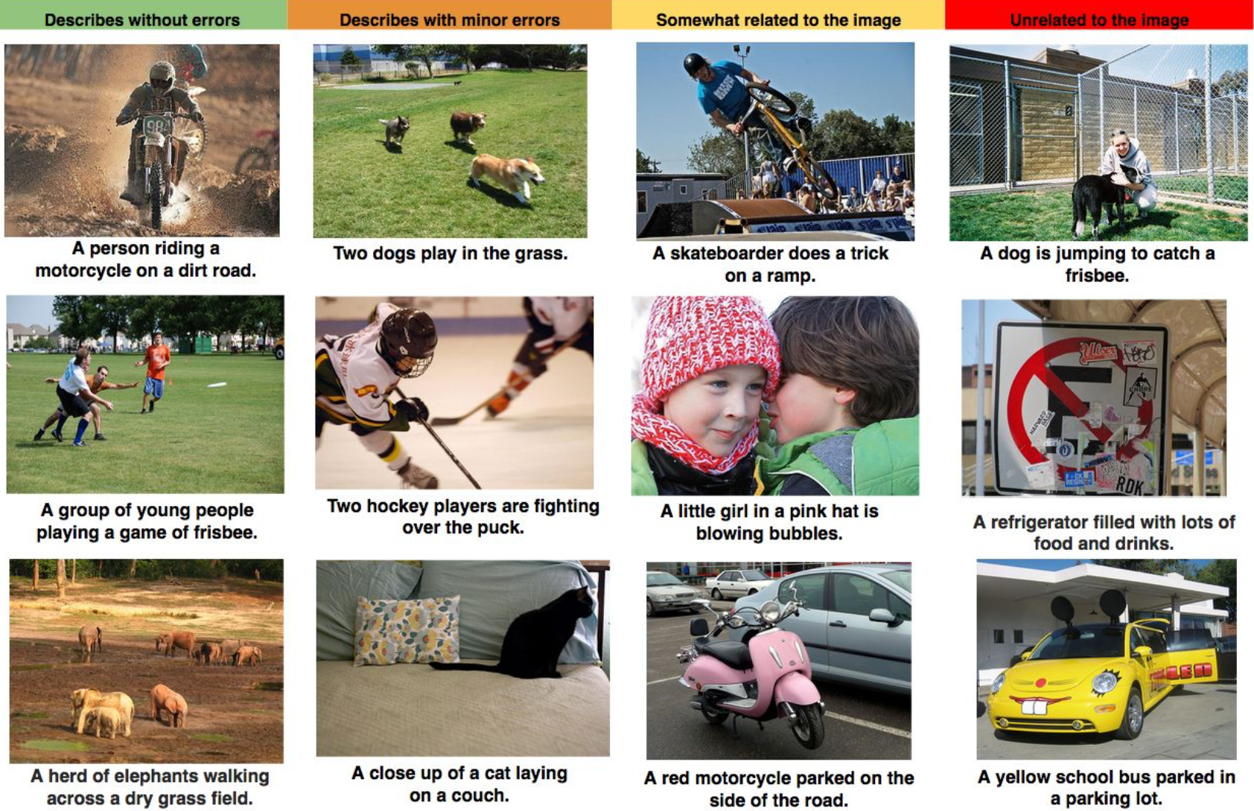
Image captioning
http://arxiv.org/abs/1411.4555 “Show and Tell: A Neural Image Caption Generator”
Master of Computer Vision 2022

Slide 9
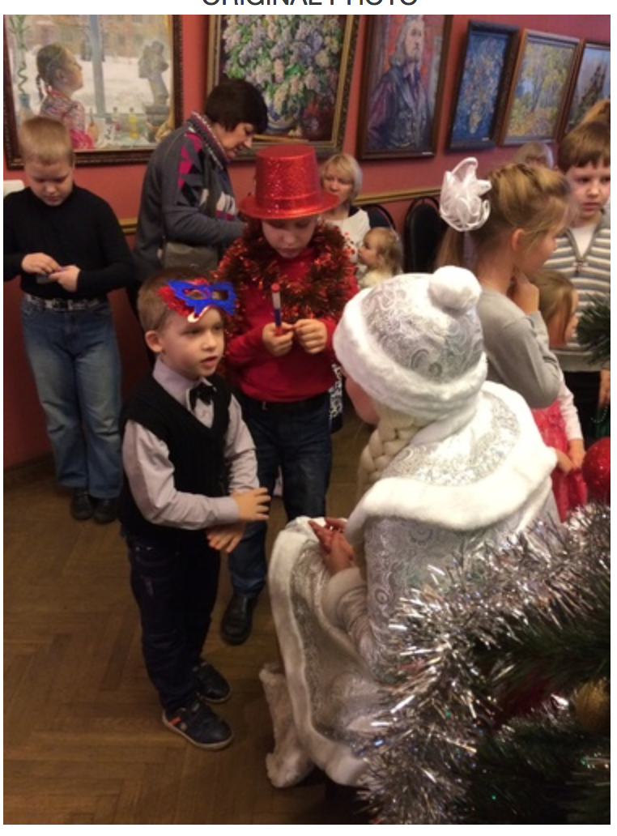
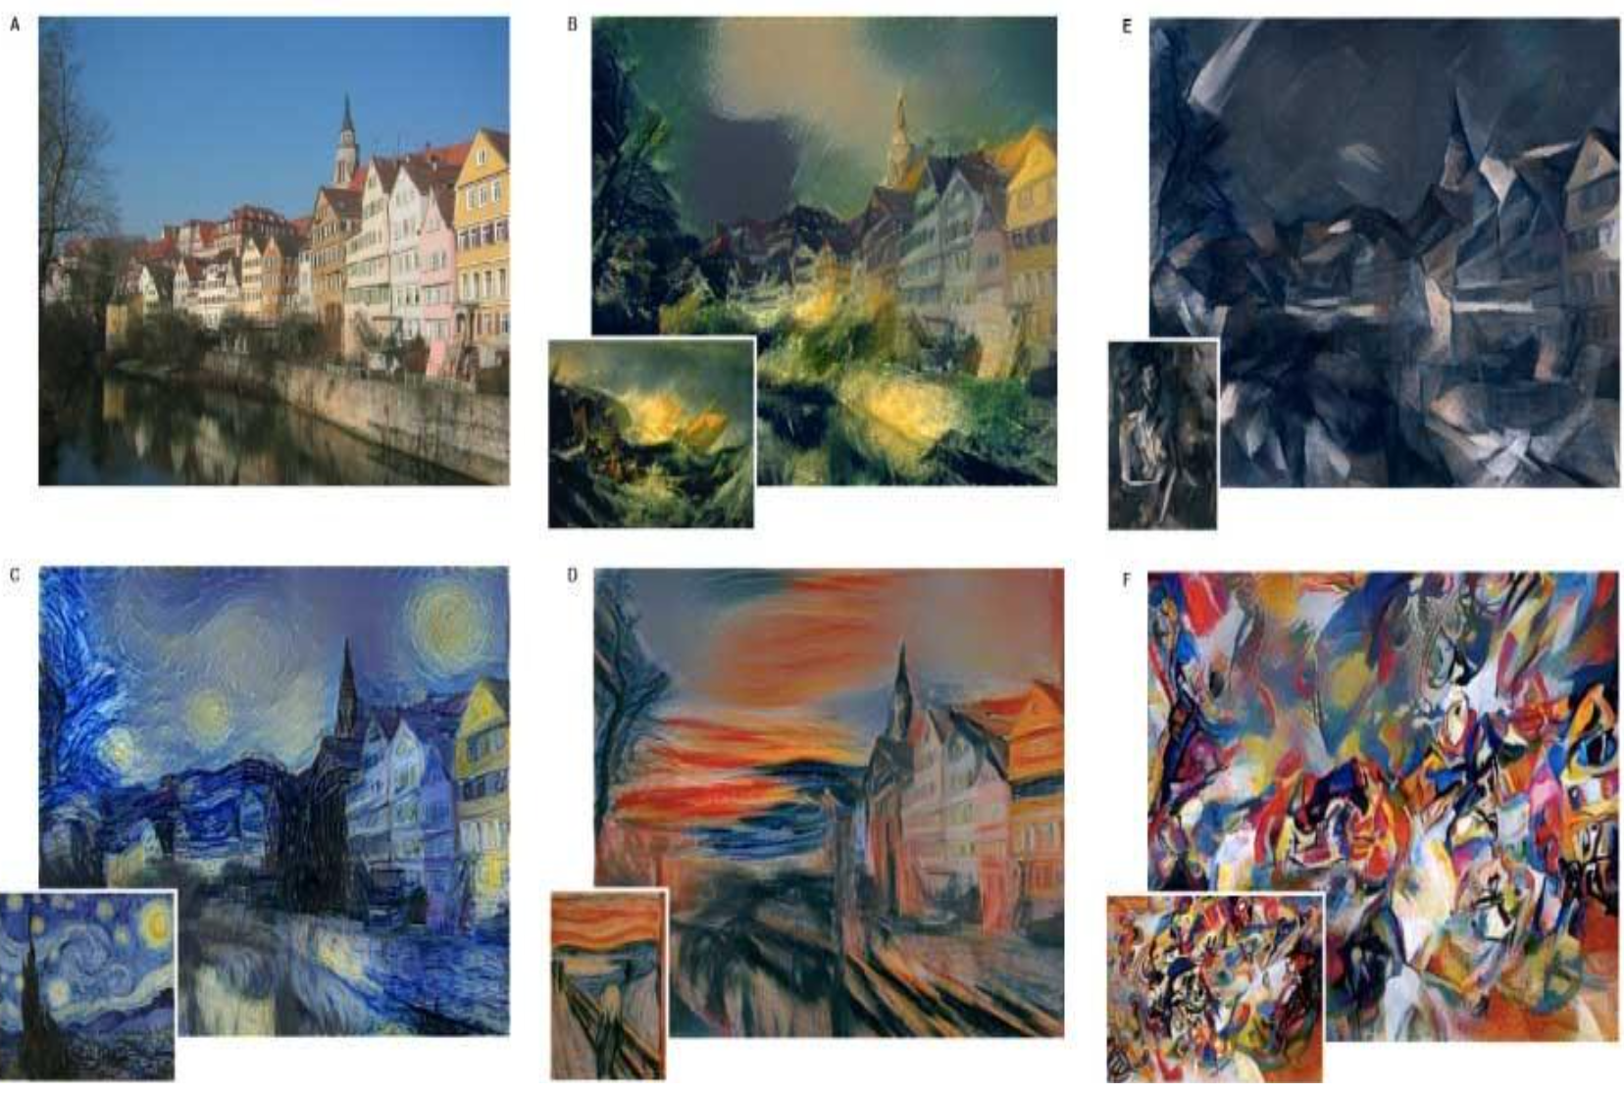
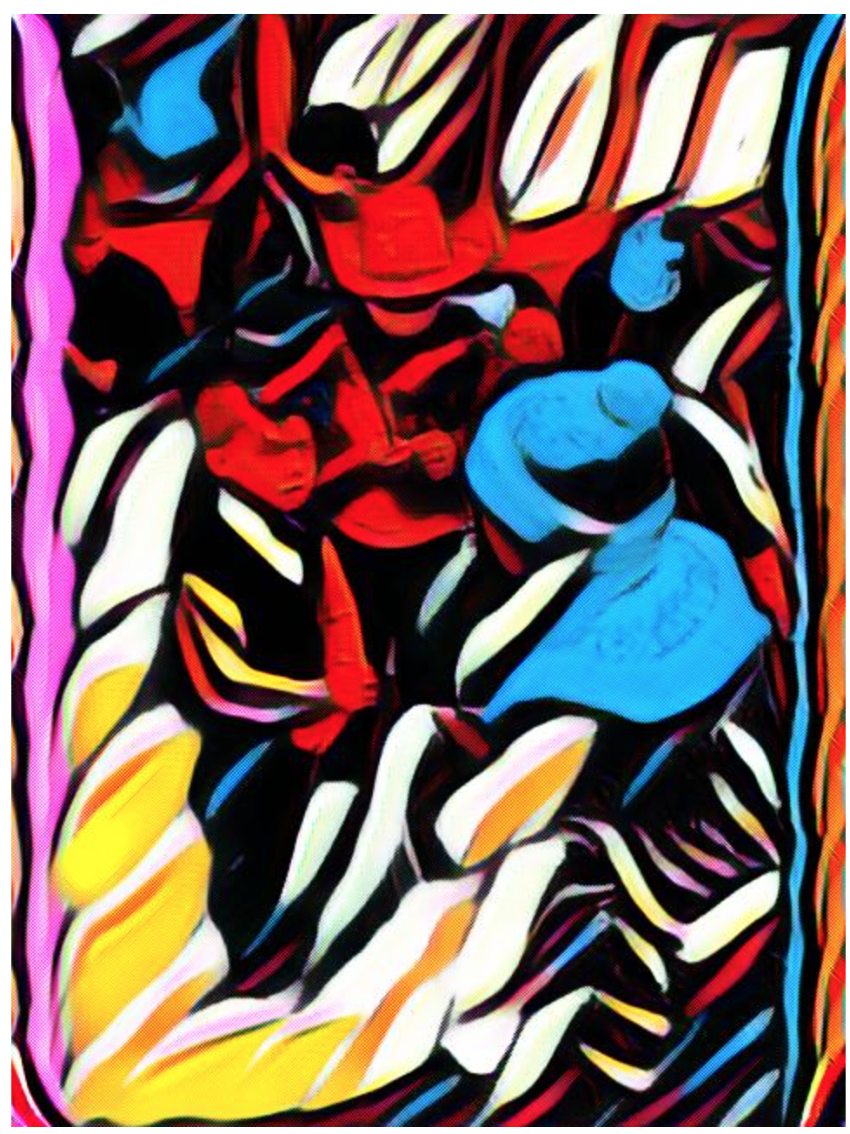
Style transfer
Prisma
https://arxiv.org/abs/1508.06576 “A Neural Algorithm of Artistic Style”
Master of Computer Vision 2022

Slide 10
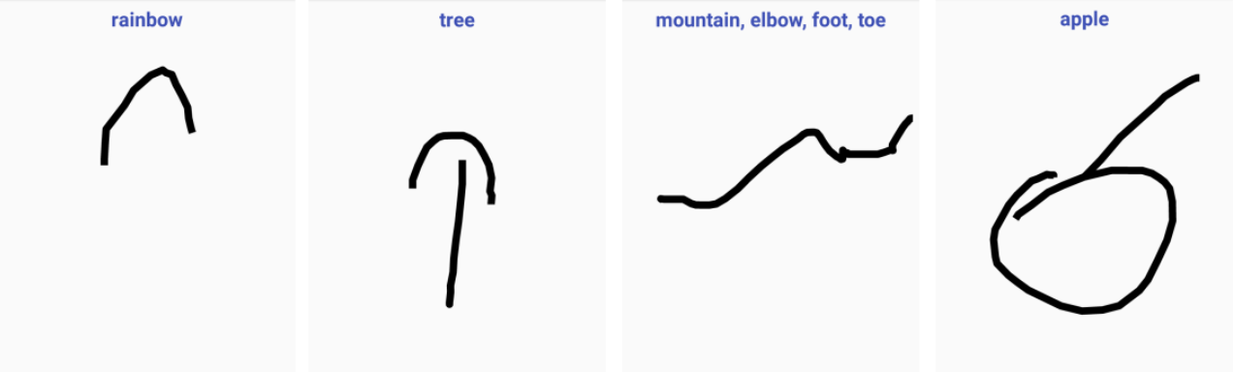
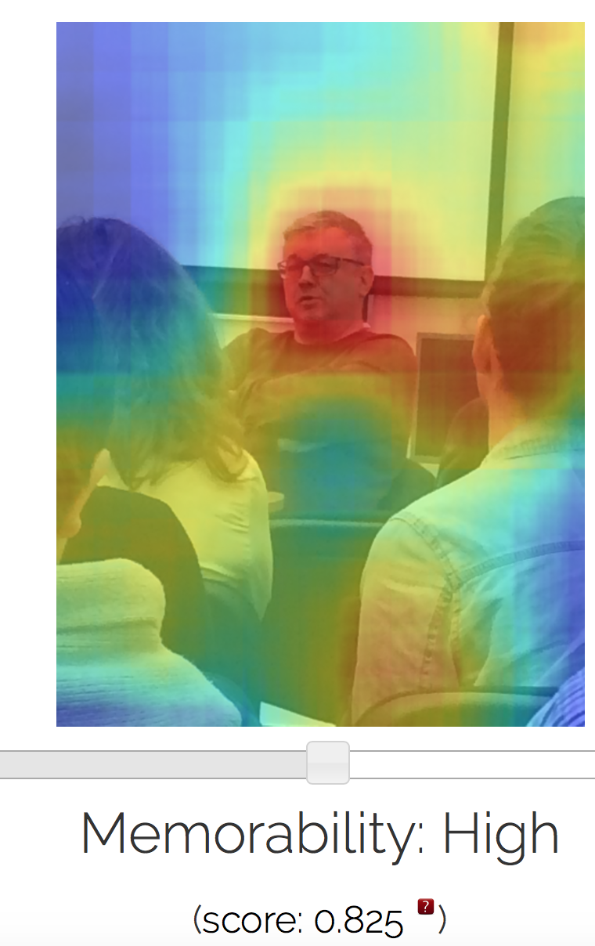
Other tasks
Recognition of paintings
Predicting Image Memorability
https://quickdraw.withgoogle.com/
https://github.com/tensorflow/docs/blob/master/site/en/r1/tutorials/sequences/recurrent_quickdraw.md
MemNet, https://arxiv.org/abs/1708.02209
LaMem, http://memorability.csail.mit.edu/demo.html
Master of Computer Vision 2022

Slide 11

User Preference Prediction in Visual Data on Mobile Devices
фото
  Savchenko, Demochkin, Grechikhin, Pattern Recognition 2022
  Savchenko, Kopeykina, RusAutoCon 2019, ITNT 2020
  Savchenko, Rassadin, ISNN 2019
  Grechikhin, Savchenko, IbPRIA 2019
  Savchenko, Samsung US Patent 2022
Master of Computer Vision 2022

Slide 12
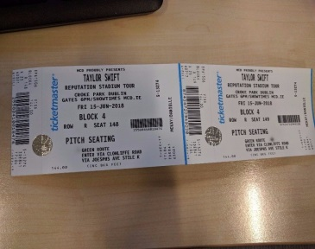
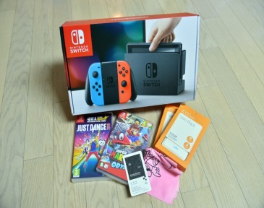
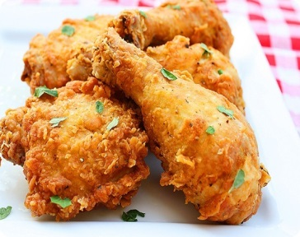
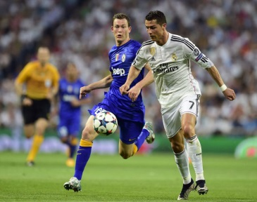
Deep understanding of user characteristics by analyzing user images and videos in a mobile device
Singer : Taylor Swift
Game : Nintendo Switch
Food : Fried Chichen
Sports : Soccer
Master of Computer Vision 2022

Slide 13
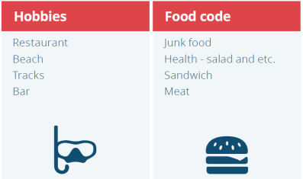
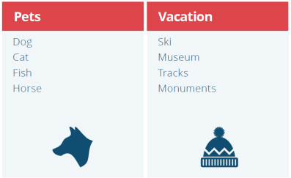
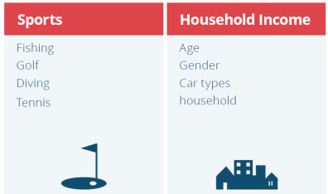

User’s profile
  Categorizing user’s characteristics (taxonomy, classification, demographics, hobbies, occupation, lifestyle, etc.) → Generate user profile
Master of Computer Vision 2022

Slide 14
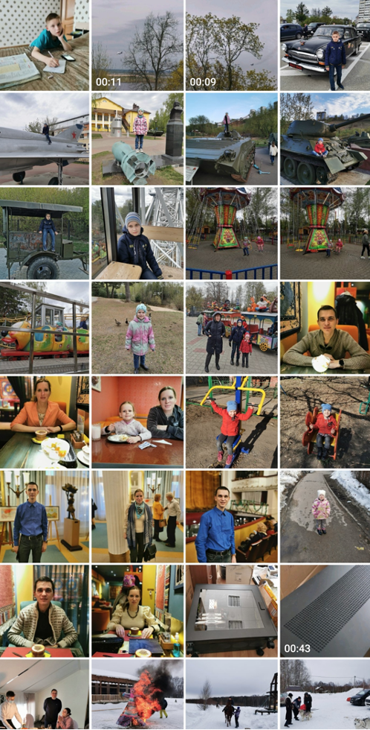
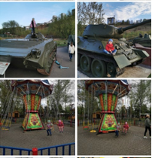
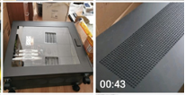



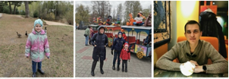
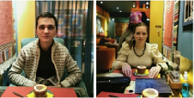

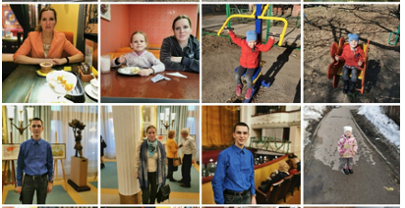
Privacy detection
Public photos
Private photos
Master of Computer Vision 2022

Slide 15
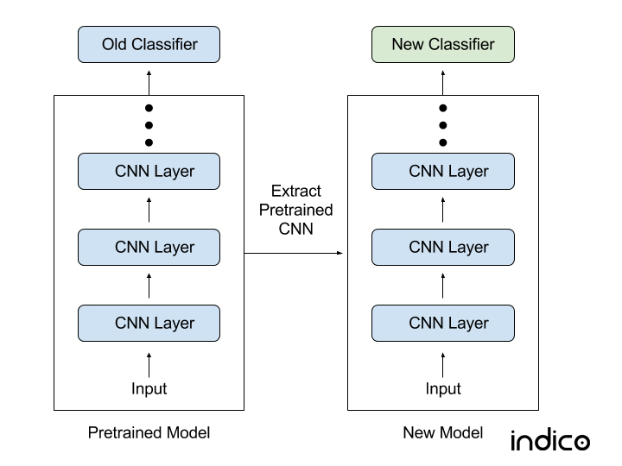
Image recognition problem
It is required to assign an observed image X to one of C classes. Training set contains N reference images (examples) {X_{n}}, n∈{1,… N}, with known class label c_{n}∈{1,… C}
1
Fine-tune convolutional neural network (CNN) pre-trained on ImageNet, Places, etc.
2
Classify embeddings (features) from one of the last CNN’s layers: D-dimensional feature vector x=[x₁,…, x_{D}]. Training set is associated with embeddings {x_{n}}
Master of Computer Vision 2022

Slide 16
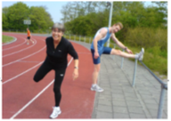
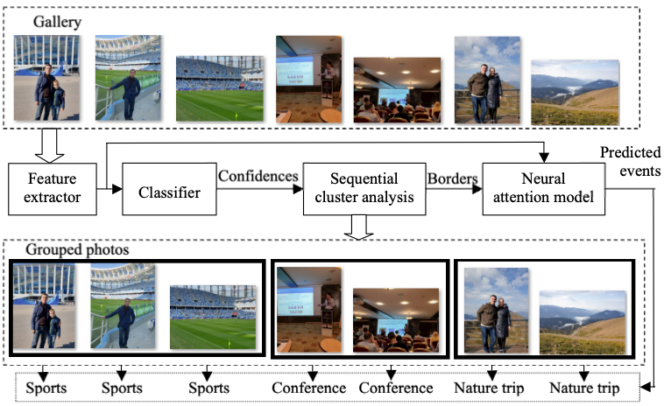
Classifier training using both visual features and results of object
detection
Scene recognition
Object detection
Sport
Nature
Athletic field
Embeddings
Person
Shoes
Tree
Scores
Ensemble (blending)
Master of Computer Vision 2022

Slide 17
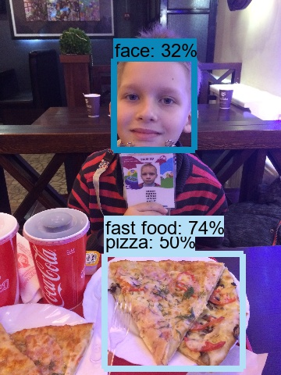
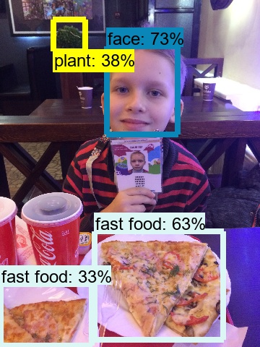
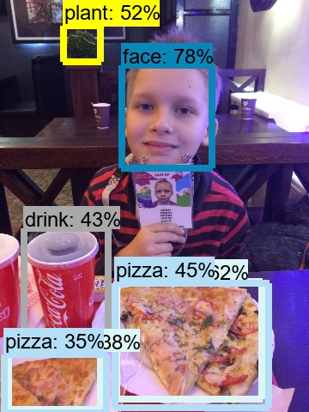
Example of object detection (1)
SSDLite+
MobileNet v2
Faster RCNN+
Inception v2
Faster RCNN+
InceptionResNet
4-й выездной семинар по машинному обучению ФКН, 2019

Slide 18
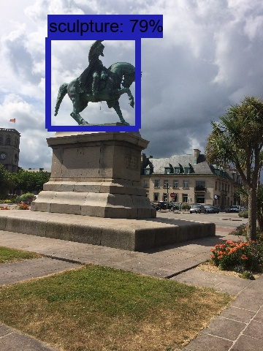
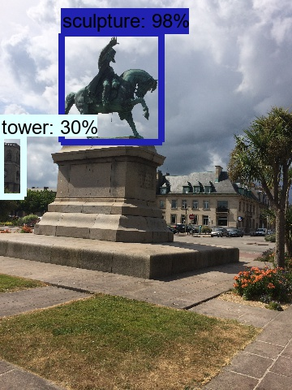
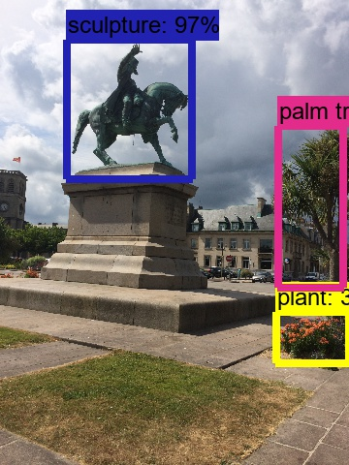
Example of object detection (2)
SSDLite+
MobileNet v2
Faster RCNN+
Inception v2
Faster RCNN+
InceptionResNet
4-й выездной семинар по машинному обучению ФКН, 2019

Slide 19
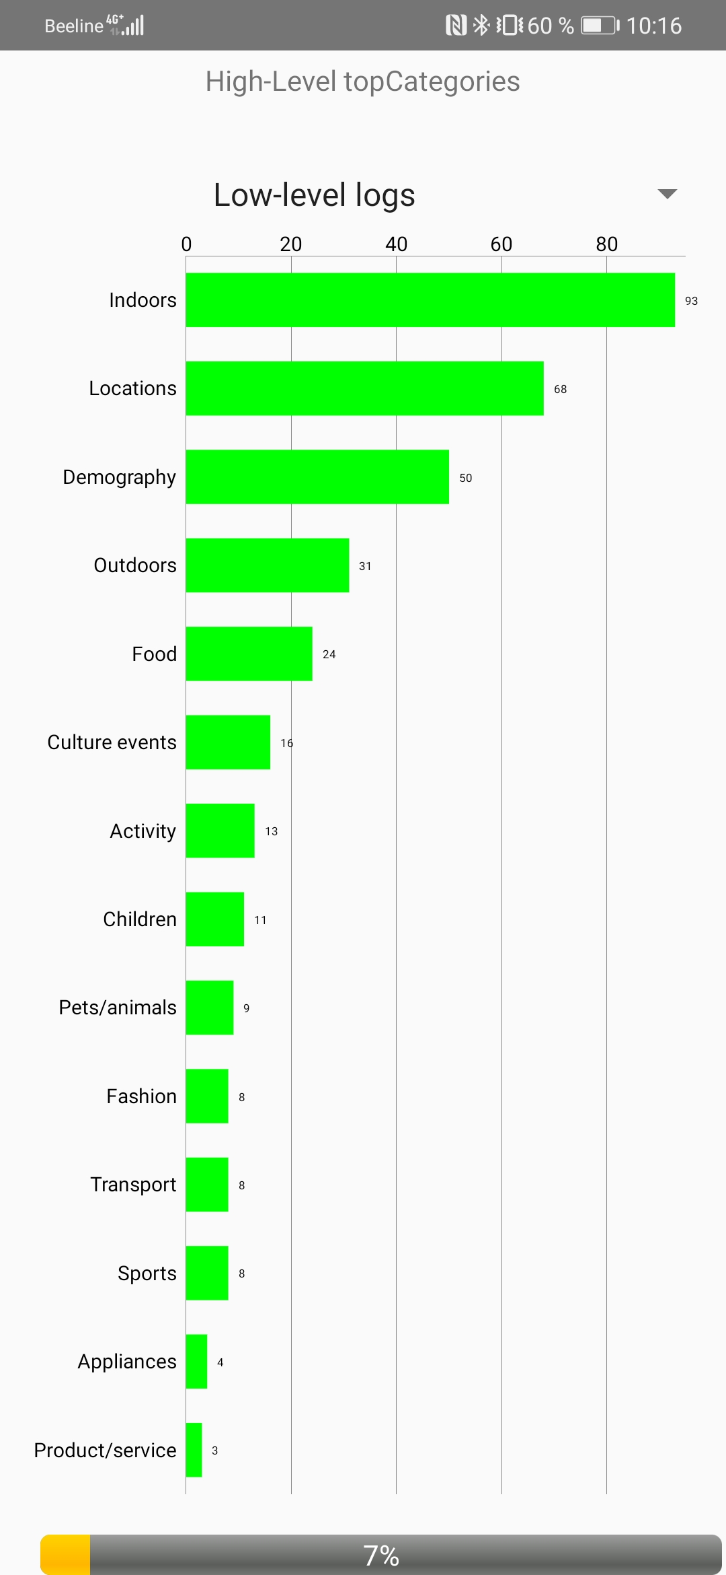
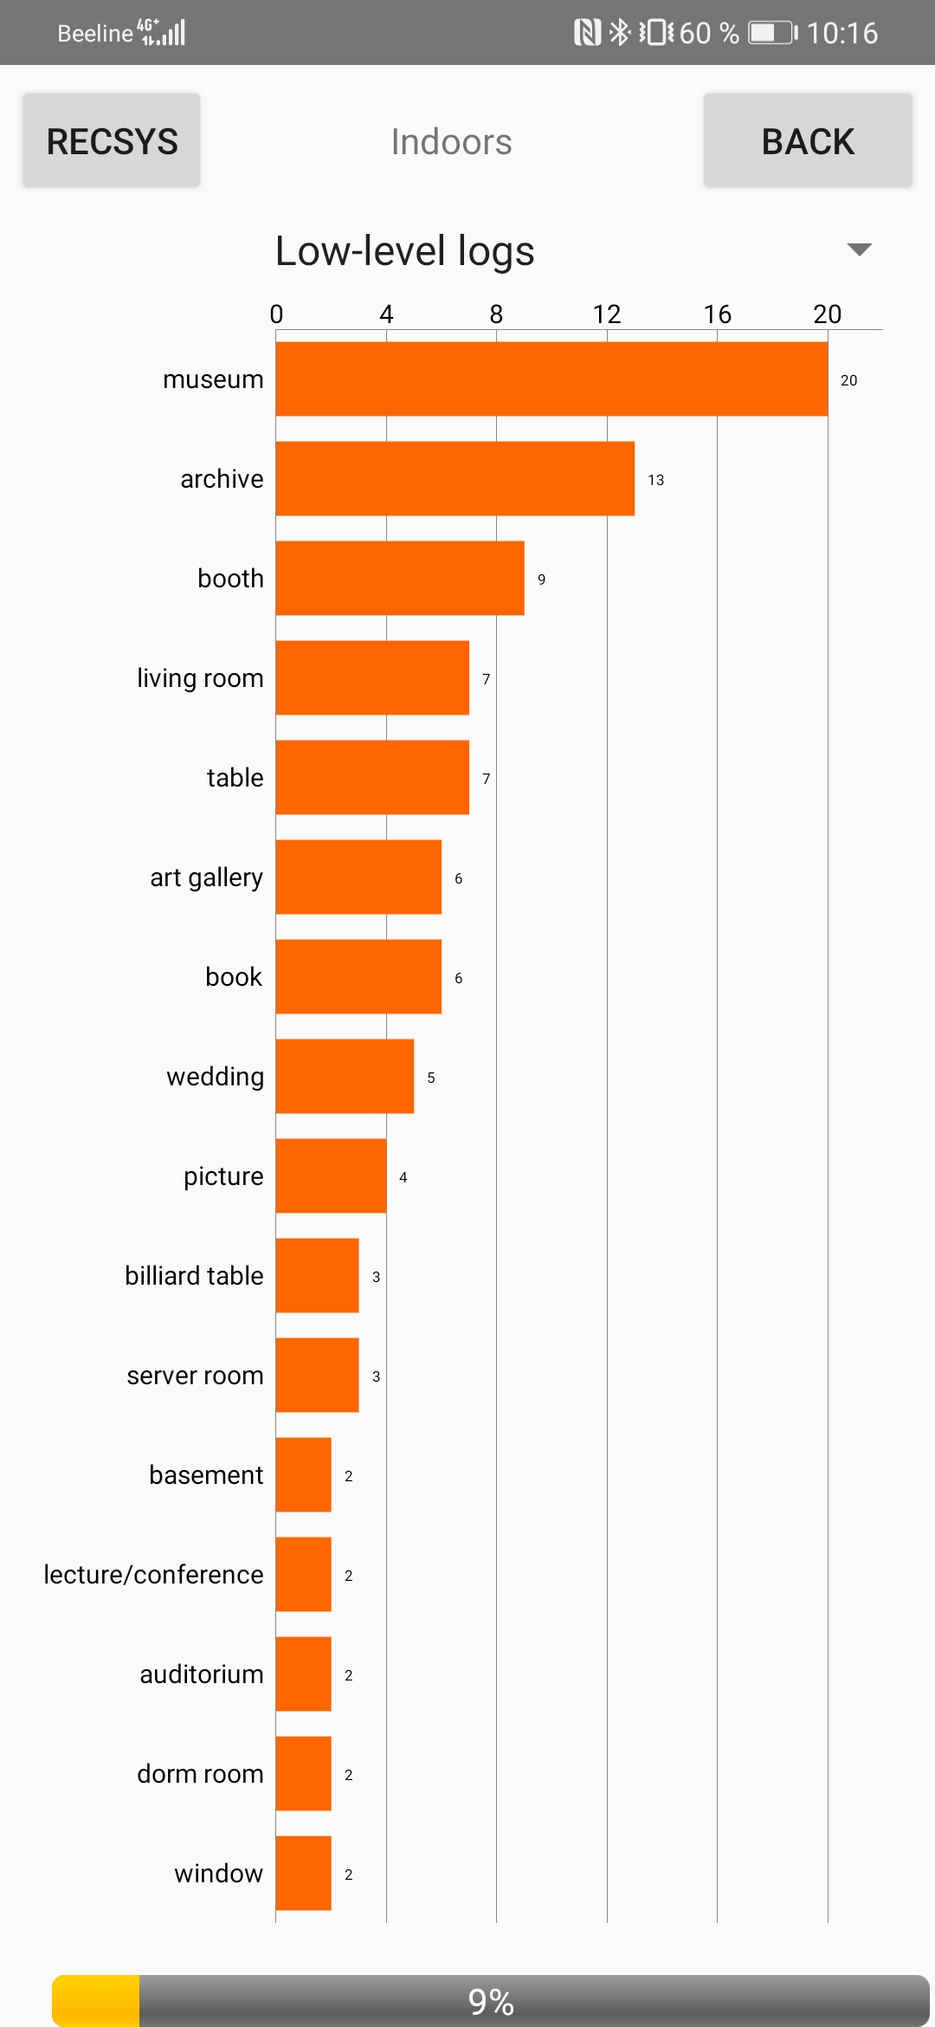
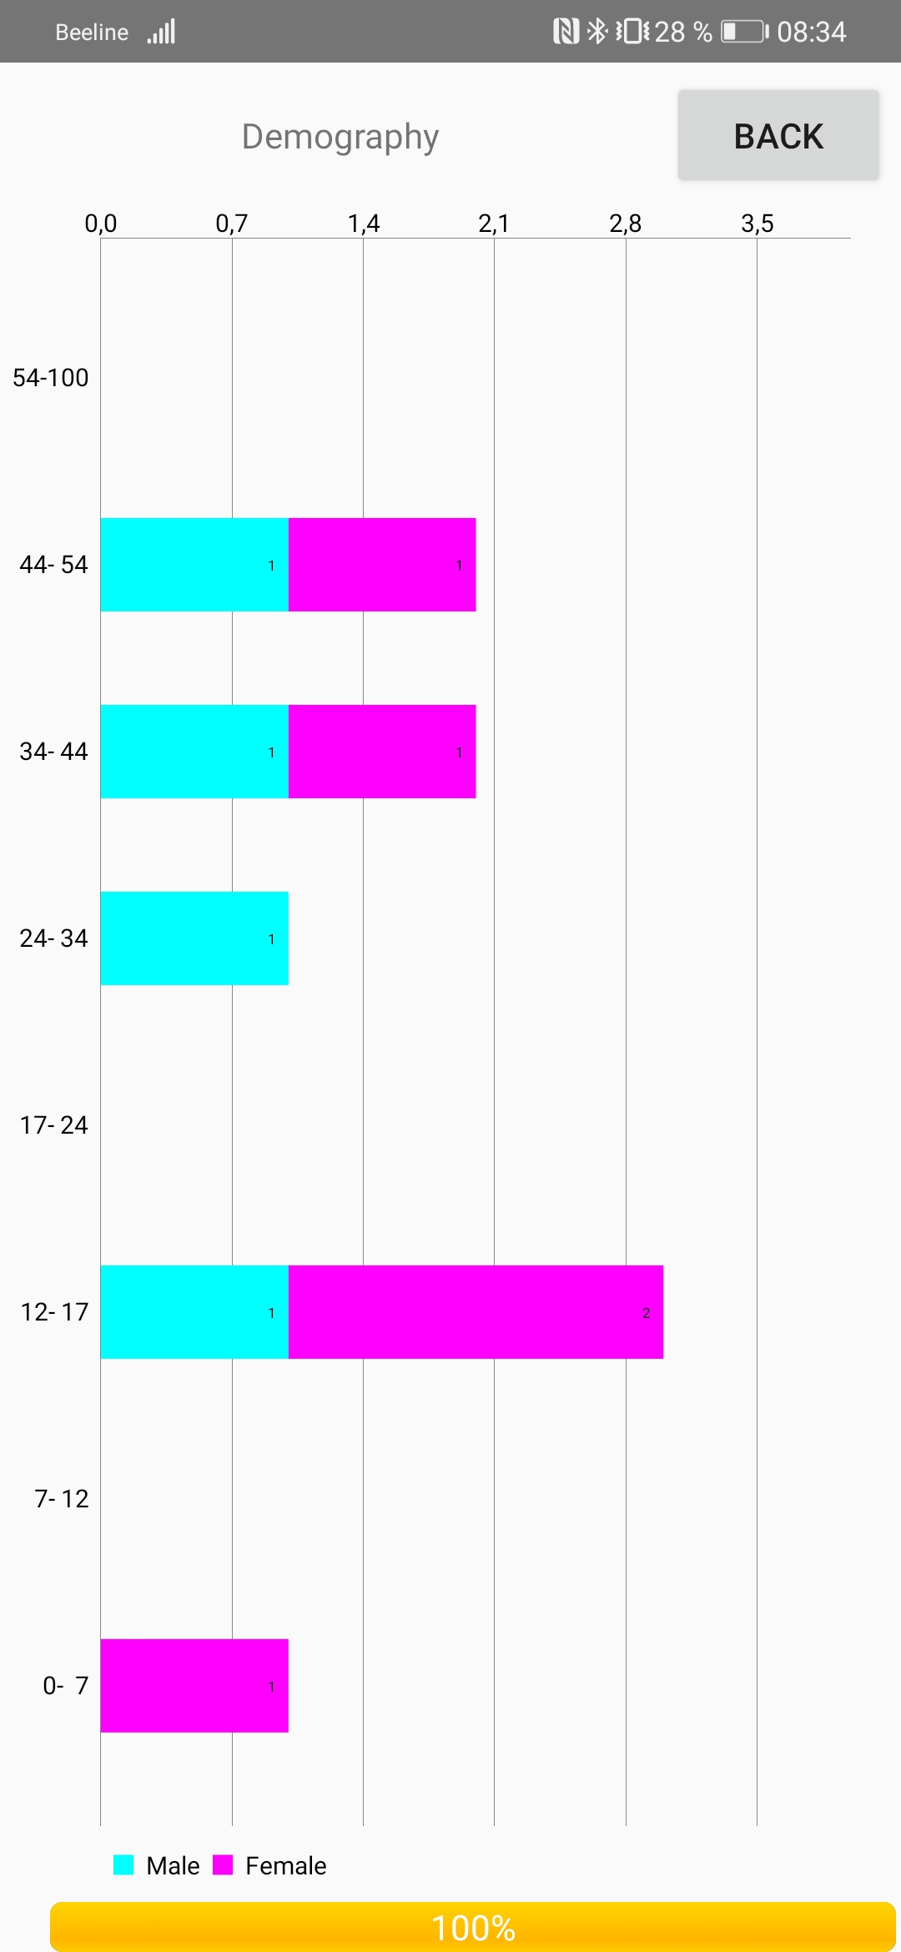
Mobile application (1)
https://drive.google.com/drive/folders/1rQkJZifq_89pu0sT_UnYXziuxutTpNEN
Master of Computer Vision 2022

Slide 20
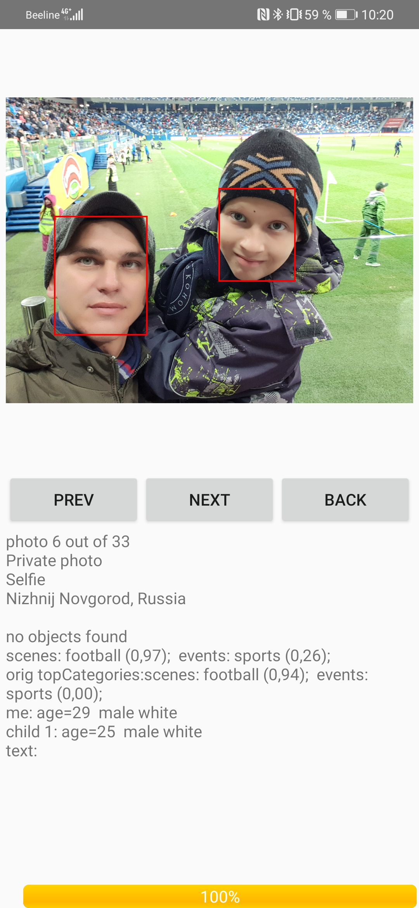
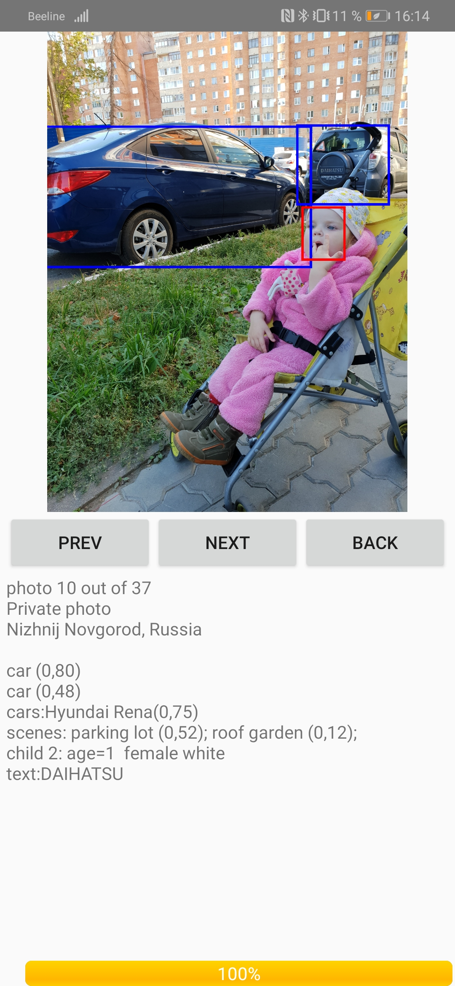
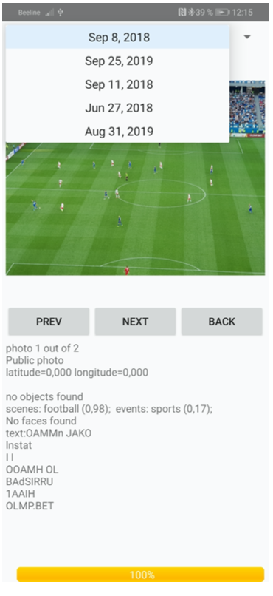
Mobile application (2)
Master of Computer Vision 2022

Slide 21
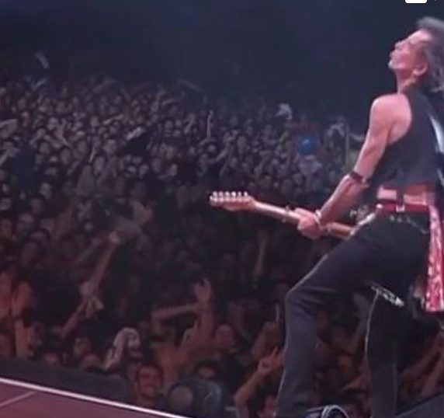
The Rolling Stones profile
Object detection
…
Scene recognition
Master of Computer Vision 2022

Slide 22
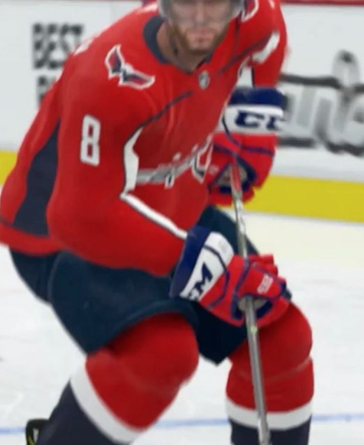
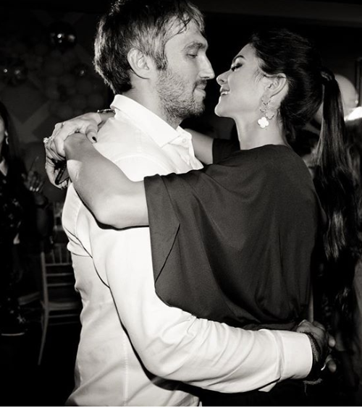
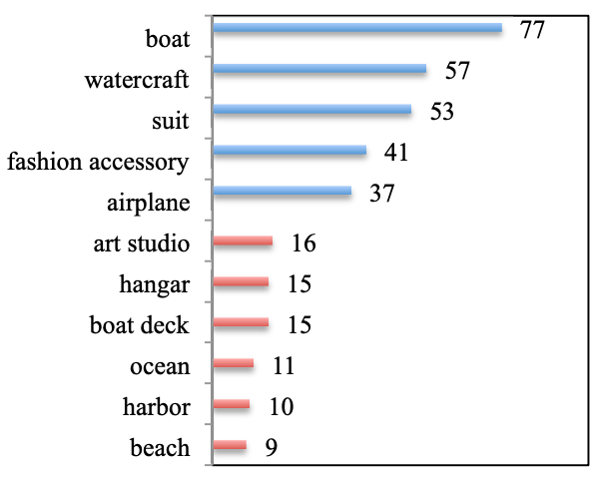
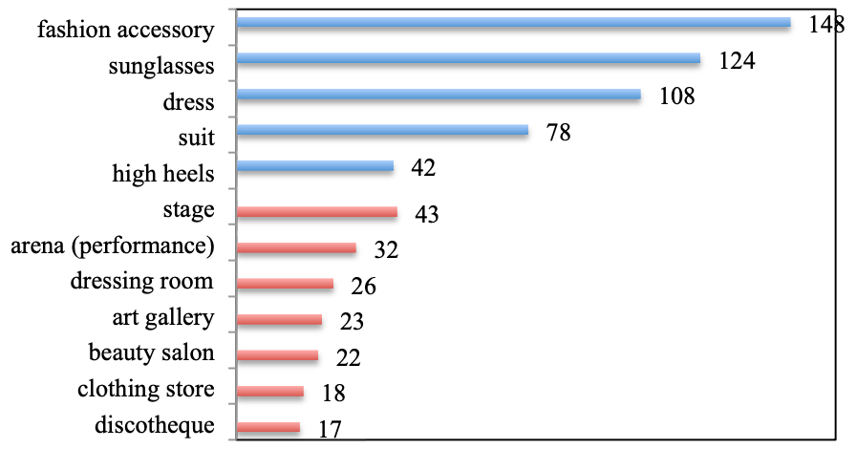
User’s profiles from Instagram (1)
Alex Ovechkin
…
Fedor Konyukhov
Beyonce
Master of Computer Vision 2022

Slide 23
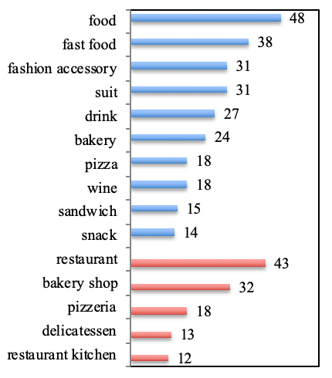
Profiles from Instagram (2)
Gordon Ramsay
Disneyland
Kehinde Wiley
Kim Kardashian
LeBron James
Master of Computer Vision 2022

Slide 24
Facial processing and emotion recognition
фото
  Kharchevnikova, Savchenko, PeerJ Computer Science 2021
  Sokolova, Savchenko, AIST 2017, 2019, ITNT 2018, OMNN 2020
  Demochina, Savchenko, ICPR Workshop 2021
  Churaev, Savchenko 2021
Master of Computer Vision 2022

Slide 25
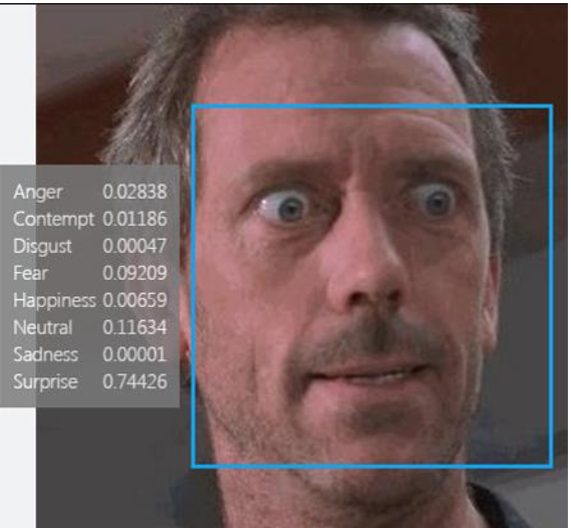
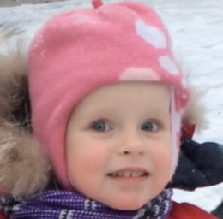
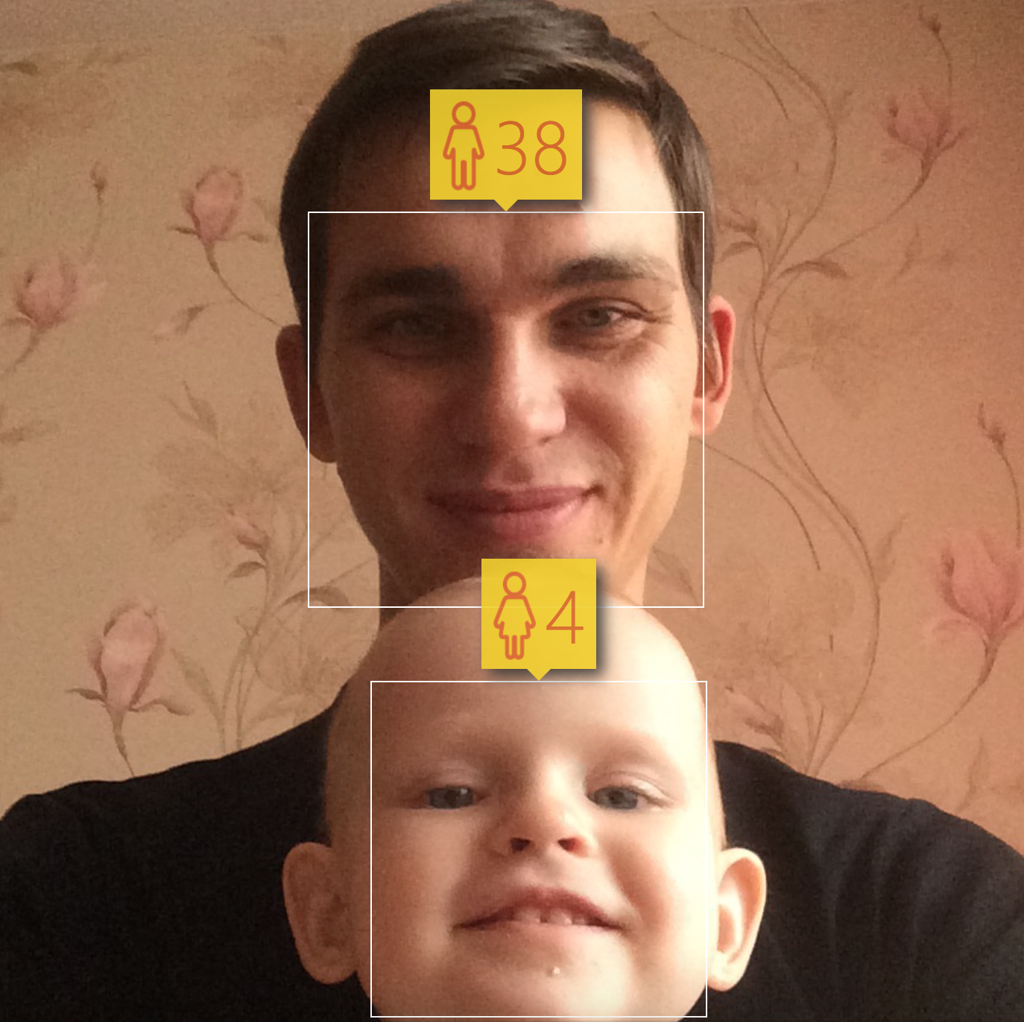


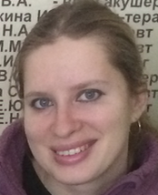



Facial processing tasks
Detection
Verification
Identification
Recognition of emotions, age, gender, race,…
Input photo or video sequence
Master of Computer Vision 2022

Slide 26



Emotion analysis and engagement prediction in videos
https://www.youtube.com/watch?v=kORwkI-Oq7o
Machine Learning and Artificial Intelligence Technologies Workshop 2021

Slide 27


AFEW (Acted Facial Expression In The Wild)
# of emotions: 7 (Neutral, Happy, Sad, Surprise, Fear, Anger, Disgust)
Training set: 773 short video clips
Validation set: 383 videos
https://sites.google.com/view/emotiw2019
Machine Learning and Artificial Intelligence Technologies Workshop 2021

Slide 28

VGAF (Video-level Group AFfect)
# of classes: 3 (Positive, Negative, Neutral)
Training set: 2661 videos
Validation set: 766 videos
https://sites.google.com/view/emotiw2020
Machine Learning and Artificial Intelligence Technologies Workshop 2021

Slide 29

EngageWild: student’s engagement prediction
# of engagement levels: 4 (0 – disengaged, 0.33, 0.66, 1 – highly engaged)
Training set: 147 videos (~ 5 minutes)
Validation set: 48 videos
Engagement level
https://sites.google.com/view/emotiw2020
Machine Learning and Artificial Intelligence Technologies Workshop 2021

Slide 30



CNN (Convolutional Neural Networks) and domain adaptation: Deep faces
Large training set of celebrities (VGGFace2, CASIA-WebFace, MS-Celeb-1M,…)
Representations
Fully connected layer
Deep CNN
…
[Wen et al, ECCV 2016]
Machine Learning and Artificial Intelligence Technologies Workshop 2021

Slide 31


Analysis of video conference
Machine Learning and Artificial Intelligence Technologies Workshop 2021

Slide 32



Android demo app
Master of Computer Vision 2022

Slide 33
Food classification and restaurant recommendation
фото
  Miasnikov, Savchenko, ICIAR 2020
Master of Computer Vision 2022

Slide 34



Food detection and recognition in a gallery of mobile device
Master of Computer Vision 2022

Slide 35



Restaurant recommendation
Master of Computer Vision 2022

Slide 36
Understanding advertisements
фото
  Savchenko, Alexeev, Nikolenko et al, COLING 2020
Master of Computer Vision 2022

Slide 37


Automatic Understanding of Image Advertisements
WWF anti-deforestation ad
Topic: environment.
Sentiment: alarmed.
Symbols: environment.
Audi ad: a new bad boy on the block
Topic: cars
Sentiment: inspired
Symbols: n/a.
http://people.cs.pitt.edu/~kovashka/ads/
Master of Computer Vision 2022

Slide 38



Symbolism in Image Advertisements
Master of Computer Vision 2022

Slide 39


OCR (optical character recognition)
Master of Computer Vision 2022

Slide 40


Pipeline
Master of Computer Vision 2022

Slide 41
Thank you!

