Slide 1
Комков Степан
кандидат физико-математических наук

Slide 2
Agenda
Task formulation
General facts of the Face Recognition models
Historical background
From the first steps to the top-1 at the NIST FRVT benchmark
Deceiving the Face Recognition system
Some of the author's results in this sphere

Slide 3
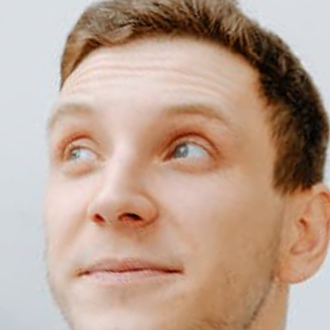
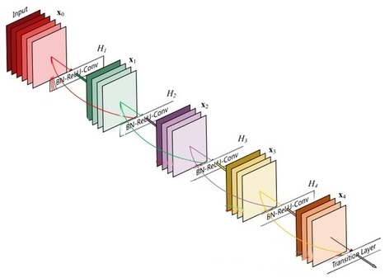
Introduction to Face Recognition
General pipeline for face processing
Deep CNN
…
Face alignment
Feature extraction
Face features
Input image
Face and Key points detection

Slide 4
Know your task Types of Face Recognition tasks
Face Verification / 1v1
Do images A and B belongs to the same person or not?

Slide 5
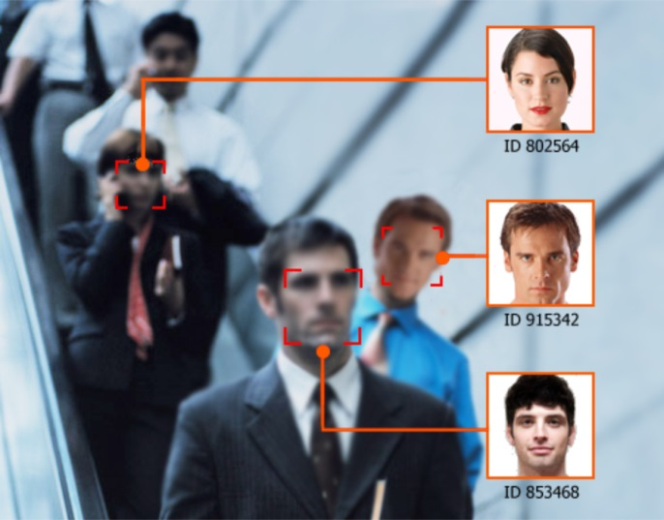
Know your task Types of Face Recognition tasks
Face Identification / 1vN
Who is this human?
Closed-set Face Identification protocol
We know all captured persons. We just need to recognize them
Open-set Face Identification protocol
We need to recognize only known people and separate others

Slide 6
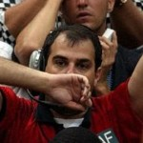
Open-set Face Identification protocol
We have a threshold to distinguish known persons and new ones
Threshold=0.2 for the example
Probe
N images to search from
Here we predict the top-1 class for the input image and the distance to this class is smaller than the threshold. So we correctly recognize the person
In this case, the distance to the top-1 class is bigger than the threshold. Thus, we correctly mark the person as an unknown
Note that we can add this unknown person as a new class to the gallery using the calculated feature vector
vs
[0.1 0.3 … 0.2]
[0.0 0.29 … 0.2]
[0.5 0.1 … 0.2]
[0.2 0.0 … 0.9]
[0.3 0.4 … 0.7]
0.1
0.5
0.9
1.2
Face features
distance
Probe
N images to search from
vs
[0.1 0.3 … 0.2]
[0.0 0.29 … 0.2]
[0.5 0.1 … 0.2]
[0.2 0.0 … 0.9]
0.5
0.9
1.2
Face features
distance

Slide 7
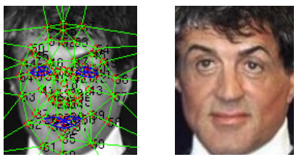
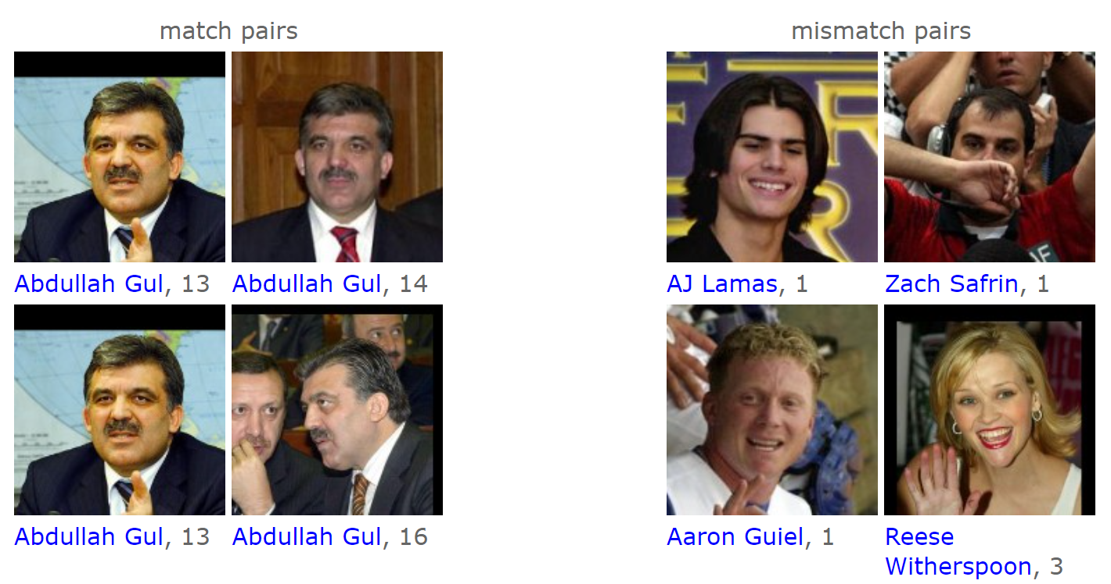
The very beginning DeepFace: Closing the Gap to Human-Level Performance in Face Verification by Facebook AI* (экстремисты) in 2014
A pretty straightforward approach:
The authors align a face by moving key points to the predefined positions first (Figure 1);
Process the aligned face by a simple CNN (Figure 2);
Normalize the obtained feature by the $l_{2}$-norm;
Train the weights using the softmax cross-entropy (CE) loss on 4.4 million labeled faces.
The main result: 97% on the LFW face verification benchmark (Figure 3).

Slide 8
The true beginning FaceNet: A Unified Embedding for Face Recognition and Clustering by Google Inc. in 2015
Google engineers introduce Metric Learning for Face Recognition:
The authors train a model to make embeddings so that all the embeddings for the same person are closer than all the embeddings of other persons. They achieve that using a Triplet loss:
This loss is motivated by the desired inequality:

Slide 9
The true beginning FaceNet: A Unified Embedding for Face Recognition and Clustering by Google Inc. in 2015
The trained dataset contains 200 million images of 8 million persons.
Therefore, the authors do not use any alignment.
It will take years until a similarly massive dataset becomes publicly available.
The model achieved 99.63% on LFW.
Even though the actual use of the Triplet loss is tricky (you need to gradually increase the complexity of triplets and re-estimate the complexity simultaneously), the paper gave birth to a wave of Metric Learning papers in Face Recognition.
13352 citations so far.

Slide 10
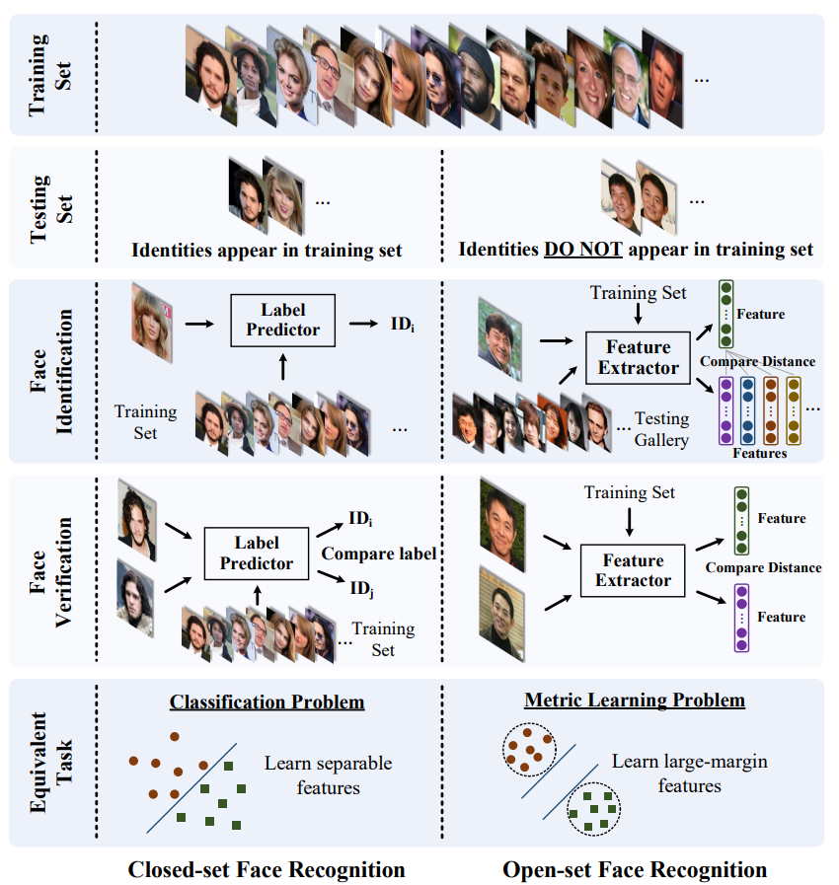
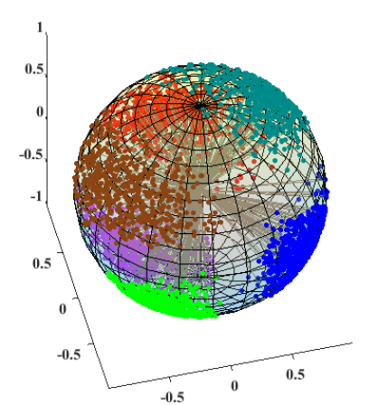
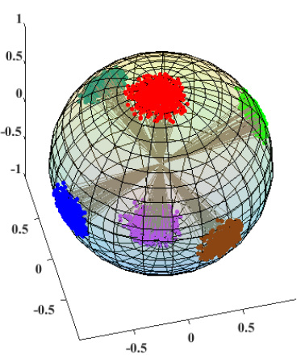
The beginning of angular supremacy SphereFace: Deep Hypersphere Embedding for Face Recognition by a group of universities in 2017
Despite the good results on LFW-like benchmarks, algorithms still struggled with the Open-Set Face Identification protocol.
The point is to have enough non-occupied areas in the feature space for all possible faces, even those not met during training.

Slide 11
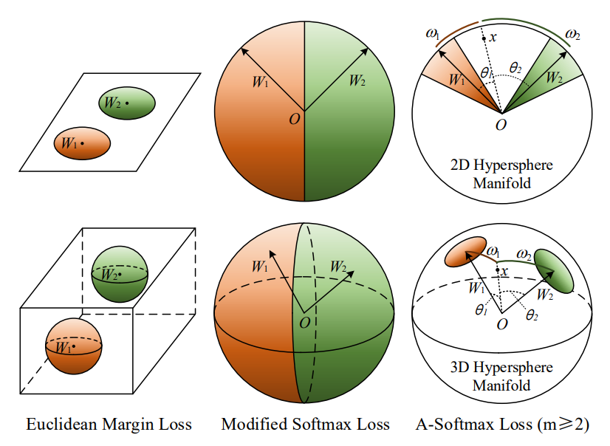
The beginning of angular supremacy SphereFace: Deep Hypersphere Embedding for Face Recognition by a group of universities in 2017
Let us modify the ordinary CE loss first:
Suggest that biases are zeros and $\left\|W_{j}\right\|=1:$
So, the authors propose an A-Softmax loss (the strictness is omitted here):

Slide 12
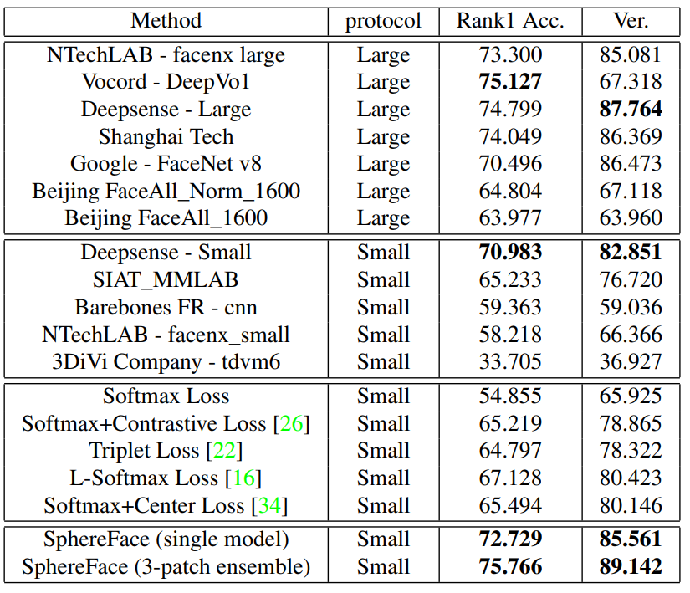
The beginning of angular supremacy SphereFace: Deep Hypersphere Embedding for Face Recognition by a group of universities in 2017
The authors even provide some theoretical necessities for the A-Softmax loss.
The presented model achieve the same results as FaceNet using only 494k images of 10,5k individuals from a publicly available dataset CASIA-WebFace.
Thus, from this moment, human-level recognition became achievable even with open-source code and data.
Starting from here, papers mostly use similarity transform as an alignment pre-processing transformation.
Moreover, SphereFace achieve strong results on the MegaFace benchmark (Open-Set Face Identification benchmark).
The results are for a True Acceptance Rate (TAR) with a threshold that corresponds to a ${10}^{−6}$ False Acceptance Rate (FAR).

Slide 13
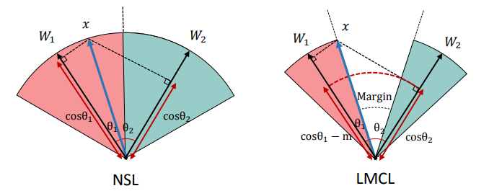
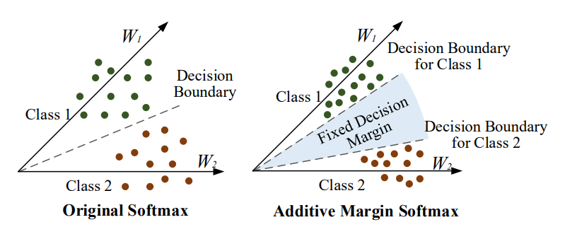
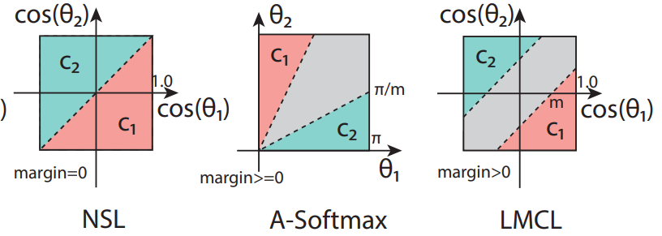
CosFace: Large Margin Cosine Loss for Deep Face Recognition and Additive Margin Softmax for Face Verification by Tencent AI Lab and UESTC in January 2018
Two papers with the same ideas:
The use of additive margin instead of multiplicative margin in A-Softmax.
Embeddings are normalized to a fixed length $s$.

Slide 14
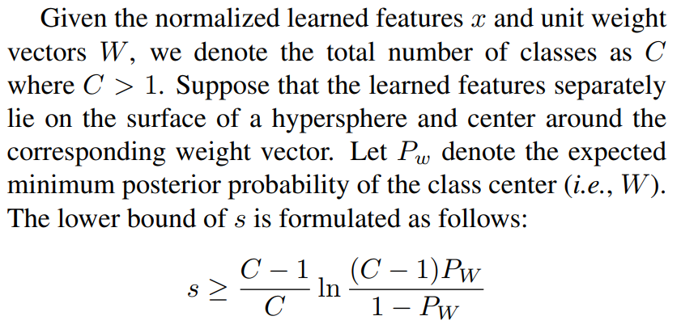
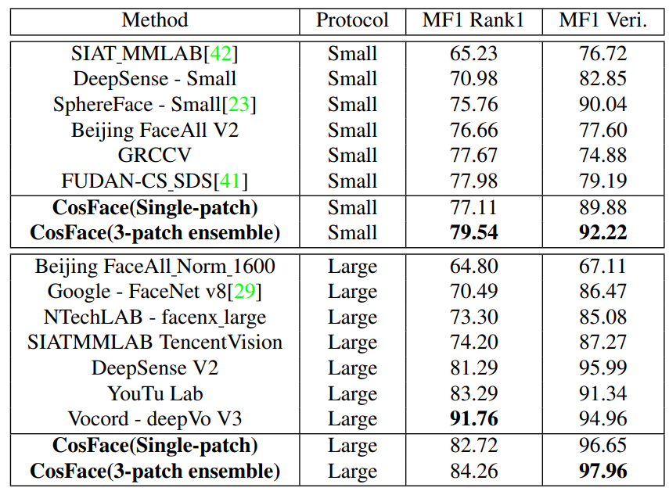
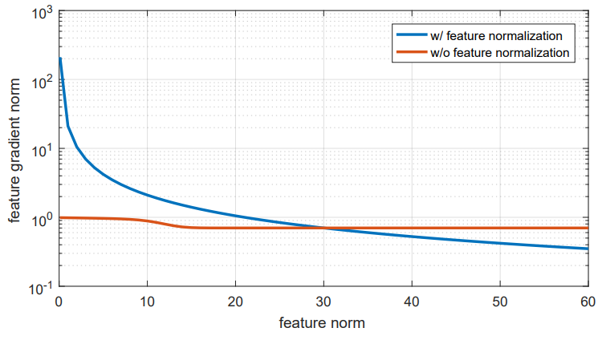
CosFace: Large Margin Cosine Loss for Deep Face Recognition and Additive Margin Softmax for Face Verification by Tencent AI Lab and UESTC within 5 days in 2018
The authors also provide theoretical necessities on the length of normalized feature vectors.
The results are the following (mostly to show the gap from the year-before results):

Slide 15
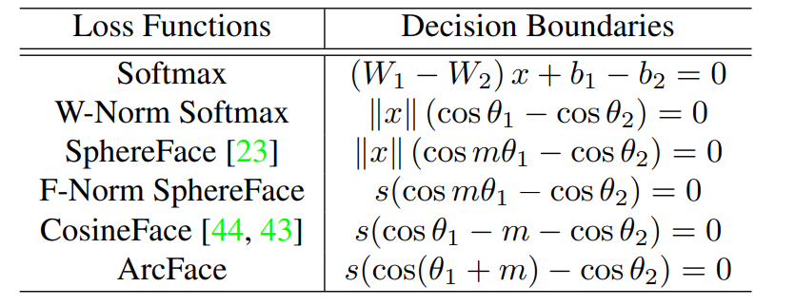
The completion of Metric Learning ArcFace: Additive angular margin loss for deep face recognition by Imperial College London in January 2018
The authors present ArcFace or Additive Angular Margin (AAM-) Softmax.
But why this paper earned 4,6k citations and more well-acclaimed than previous ones?

Slide 16
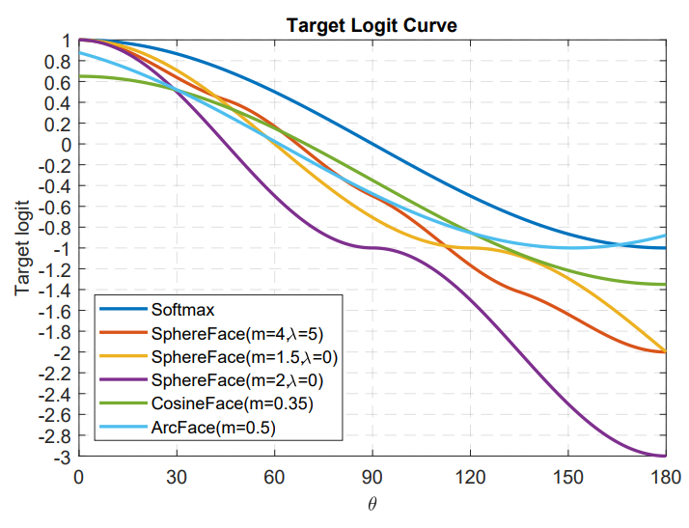
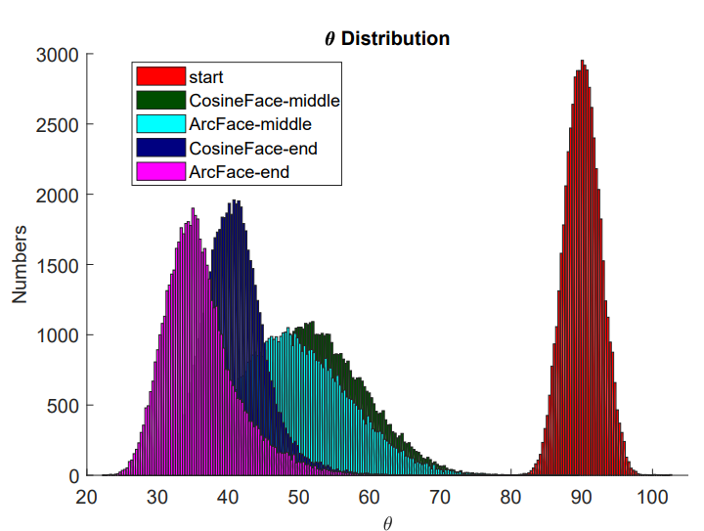
The completion of Metric Learning ArcFace: Additive angular margin loss for deep face recognition by Imperial College London in January 2018
The authors provide an analysis of why angular losses work.
AAM-Softmax provides stronger penalization at the final part of the training.
The authors make extensive research on common model hyperparameters, e.g. Weight Decay, Batch Norm placing, etc.
The authors clean the biggest publicly available face dataset MS-Celeb-1M (not available anymore) and share the cleaned version of it as well as scripts for cleaning.
The authors share a very accurate code for the reproduction and the pretrained models mentioned in the paper.
Previous works with open code still required resources for reproduction and often omit the data preprocessing parts (i.e., cleaning and alignment). The disclosed models hugely boosted the developments in face-related areas.

Slide 17
The completion of Metric Learning ArcFace: Additive angular margin loss for deep face recognition by Imperial College London in January 2018
The presented algorithm achieved 7th place in the NIST Face Recognition Vendor Test 2019, the most authoritative Face Recognition benchmark by the US government.
Moreover, the authors evaluate their model on almost all acclaimed benchmarks and achieve state-of-the-art on almost all of them using a single model.
The authors make research on the combination of angular losses which further improves the results.
The authors still update the initial paper on arXiv implementing and sharing more and more tricks.

Slide 18
Squeezing the last drops Circle Loss: A Unified Perspective of Pair Similarity Optimization by MEGVII in January 2020
The authors unify class-level and pairwise-level losses into one form:
If we consider class centroids $W_{i}, 1≤i≤C,$ and an input feature $x$ then there is a single positive pair and $C−1$ negative pairs:
But it also reduces to a triplet loss:

Slide 19
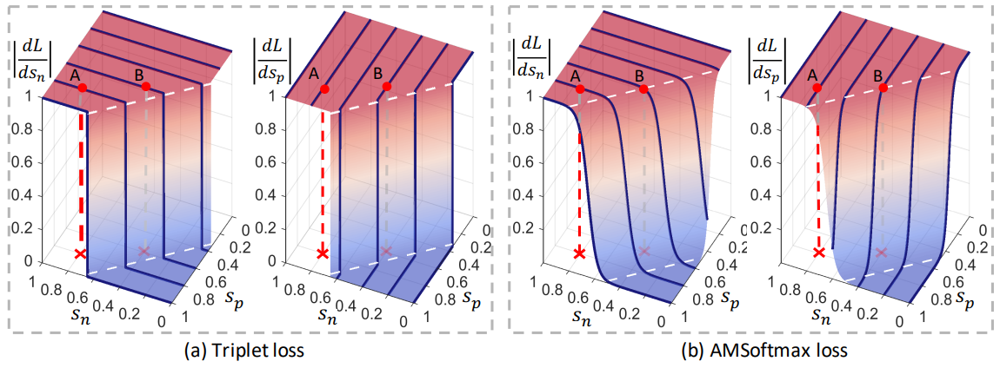
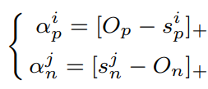
Squeezing the last drops Circle Loss: A Unified Perspective of Pair Similarity Optimization by MEGVII in January 2020
The authors analyze the gradients for the mentioned losses and emphasize their weak points using a toy example with a single positive and single negative pair.
The authors add scaling parameters for positive gradients and negative gradients that become larger when a similarity score deviates far from its optimum:

Slide 20
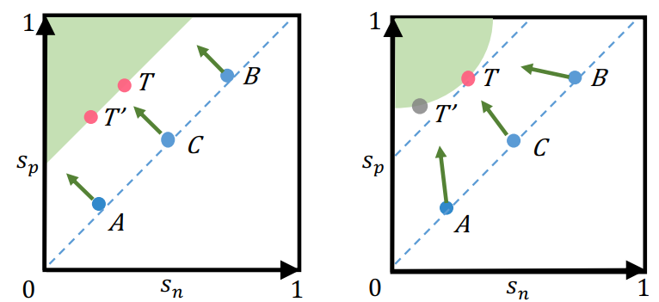
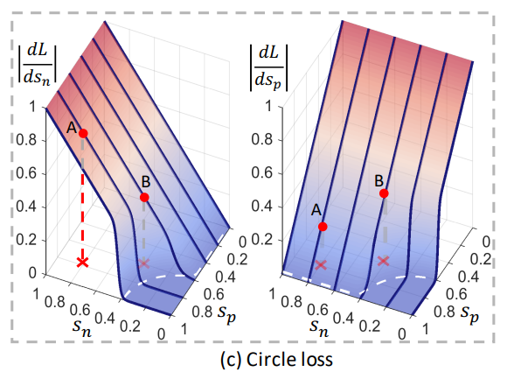
Squeezing the last drops Circle Loss: A Unified Perspective of Pair Similarity Optimization by MEGVII in January 2020
Since positive and negative similarities are used in an asymmetric way, the authors add separate margins to them.
The decision boundary for the toy example causes the name of the article.
The results are slightly better than ArcFace.

Slide 21
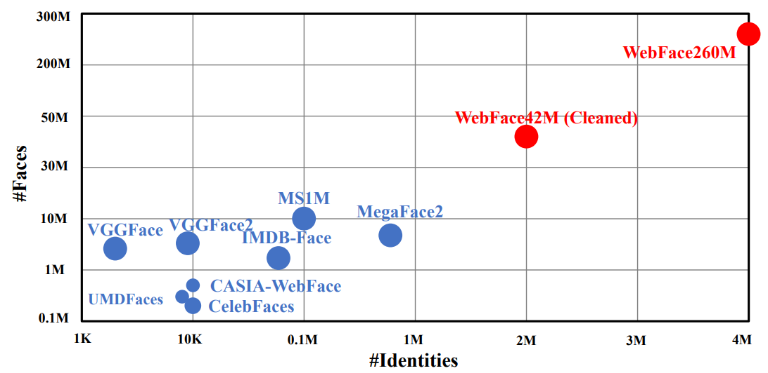
In March 2021, Tsinghua University together with London Imperial College reveal the WebFace260M dataset to open-source. It has two versions:
Cleaned version with 42M images of 2M identities.
Full noisy version with 260M images and 4M identities.

Slide 22
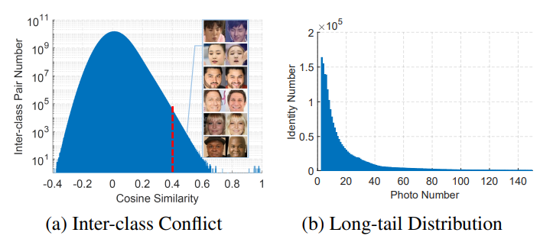
Killing Two Birds with One Stone: Efficient and Robust Training of Face Recognition CNNs by Partial FC by DeepGlint and InsightFace in 2022
Since we use an enormous dataset, we have to deal with issues that always exist for such an extensive dataset:
There are separate classes that actually belong to the same person.
Most of the classes are small and rarely appear in a batch, leading to the drifting of corresponding centroids.
For instance, these are charts for the WebFace42M dataset:

Slide 23
Killing Two Birds with One Stone: Efficient and Robust Training of Face Recognition CNNs by Partial FC by DeepGlint and InsightFace in 2022
Another problem comes from memory consumption.
Suppose we expand our dataset, and it has $4x$ more classes now: $4×C$ instead of $C$.
The last FC matrix $4C×W$ is too big to store on every GPU, so the common practice is to split this matrix among all GPUs uniformly.
Since the matrix become wider, we also need 4x more GPUs.
Since we extend the number of GPUs, then to fully utilize them, we need to make a batch size proportionally bigger: $4×B$ instead of $B$.
However, the last FC matrix gradient depends on all the images in the batch:
So, in our case, processes on each GPU consume more memory since the memory consumption is proportional to the total batch size even per a single GPU.

Slide 24
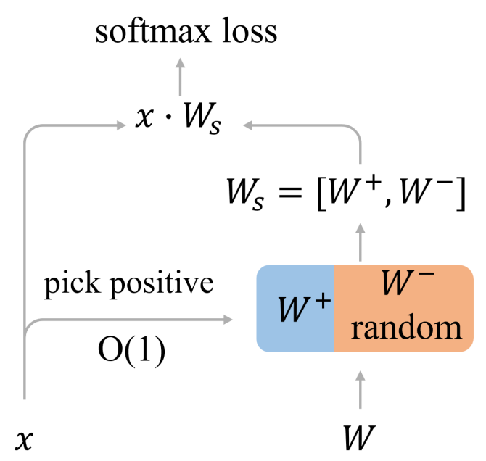
Killing Two Birds with One Stone: Efficient and Robust Training of Face Recognition CNNs by Partial FC by DeepGlint and InsightFace in 2022
To solve all the mentioned issues, the authors use PartialFC. That is, the authors use only a part of "negative" centroids during each step for softmax calculation.
Thus, we separate the updates of centroids belonging to the same class; reduce the drifting of rear classes; optimize the memory consumption.

Slide 25
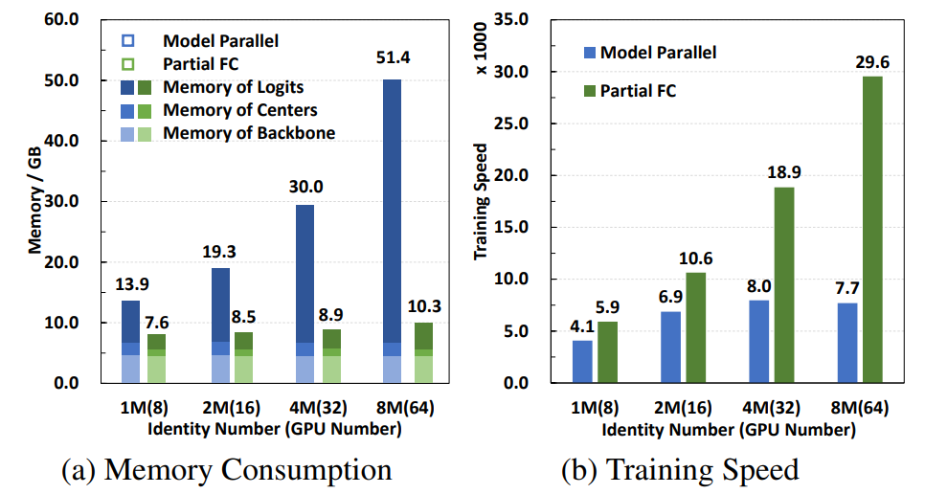
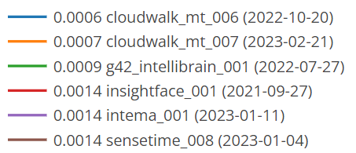
Killing Two Birds with One Stone: Efficient and Robust Training of Face Recognition CNNs by Partial FC by DeepGlint and InsightFace in 2022
Some measurements for the proposed method:
But what is more important:
And it is still in top-5 of all-time:

Slide 26
AdvHat: Real-World Adversarial Attack on ArcFace Face ID System (2019)
Stepan Komkov* and Aleksandr Petiushko
*main author
Presentation of the paper from the ICPR'20 conference

Slide 27
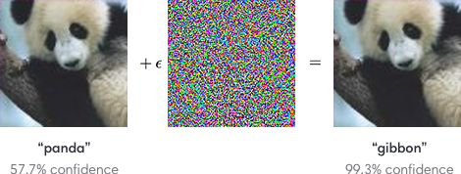
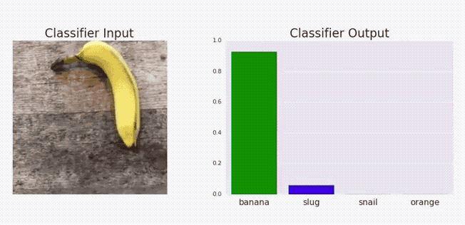
Adversarial Attacks
Neural networks are vulnerable to so-called Adversarial Attacks:
It is possible to negligibly modify an input image of a neural network in a way to make the network provide wrong predictions for this input
Moreover, Adversarial Attacks exist not only in the digital domain. They are also applicable to the real-world shooting

Slide 28
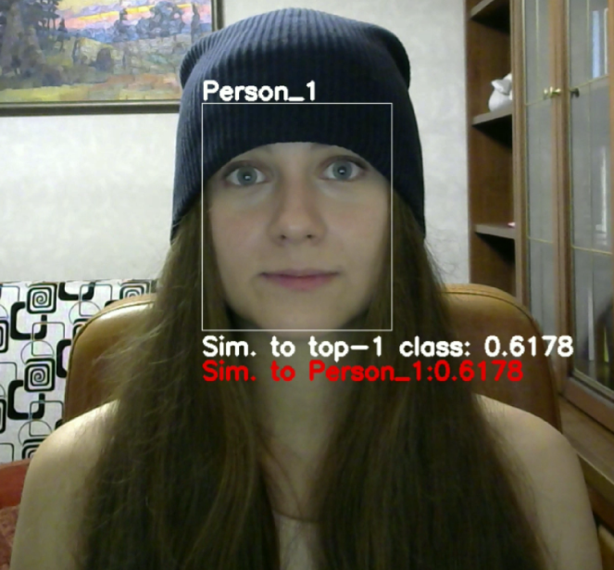
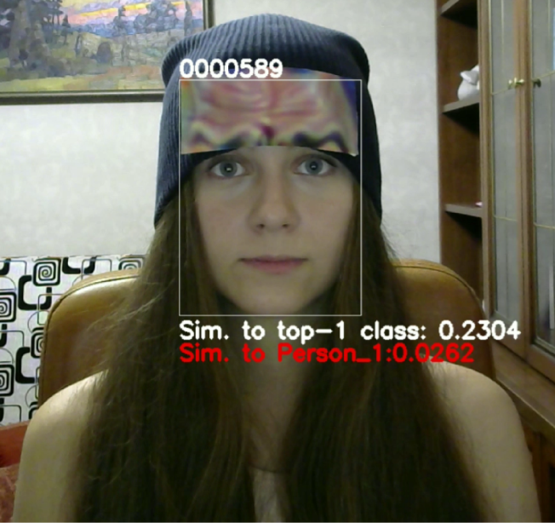
The main idea of the paper
We show that a carefully designed rectangular sticker placed on a hat may fool state of the art solutions in the FaceID domain

Slide 29
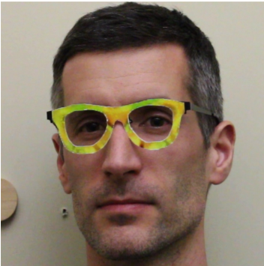
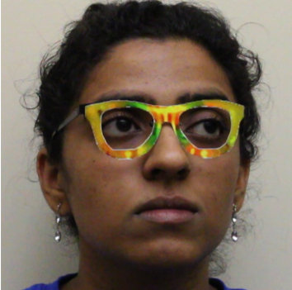
Prior Art
Mahmood Sharif et al. are the first who created real-world adversarial accessorizes that may fool the FaceID system in real life
Examples of accessories that make a person unrecognizable for the FaceID system from [1]
[1] Sharif M. et al. Accessorize to a crime: Real and stealthy attacks on state-of-the-art face recognition //Proceedings of the 2016 acm sigsac conference on computer and communications security. – 2016. – С. 1528-1540.

Slide 30
Prior Art
However, there are some drawbacks in [1] in the context of the current level of technique:
The attacks were prepared for the previous generation of FaceID models
Models for closed-set recognition were considered only
Shooting conditions varied weakly (e.g. angles of head and lightning condition)
You have to prepare a complex shape object to reproduce the attack
[1] Sharif M. et al. Accessorize to a crime: Real and stealthy attacks on state-of-the-art face recognition //Proceedings of the 2016 acm sigsac conference on computer and communications security. – 2016. – С. 1528-1540.

Slide 31
Our Work
We focus on ResNet 100E-IR, ArcFace@ms1m-refine-v2 model [2]
One of the strongest models for face recognition and at the same time publicly available
[2] Deng J. et al. Arcface: Additive angular margin loss for deep face recognition //Proceedings of the IEEE Conference on Computer Vision and Pattern Recognition. – 2019. – С. 4690-4699.

Slide 32
Our Work
We focus on ResNet 100E-IR, ArcFace@ms1m-refine-v2 model [2]
One of the strongest models for face recognition and at the same time publicly available
We use an open-set scenario, i.e. we concentrate on similarities between feature vectors instead of class probabilities
A common technique used for Face Recognition
[2] Deng J. et al. Arcface: Additive angular margin loss for deep face recognition //Proceedings of the IEEE Conference on Computer Vision and Pattern Recognition. – 2019. – С. 4690-4699.

Slide 33
Our Work
We focus on ResNet 100E-IR, ArcFace@ms1m-refine-v2 model [2]
One of the strongest models for face recognition and at the same time publicly available
We use an open-set scenario, i.e. we concentrate on similarities between feature vectors instead of class probabilities
A common technique used for Face Recognition
We estimate our attack in various shooting conditions
[2] Deng J. et al. Arcface: Additive angular margin loss for deep face recognition //Proceedings of the IEEE Conference on Computer Vision and Pattern Recognition. – 2019. – С. 4690-4699.

Slide 34
Our Work
We focus on ResNet 100E-IR, ArcFace@ms1m-refine-v2 model [2]
One of the strongest models for face recognition and at the same time publicly available
We use an open-set scenario, i.e. we concentrate on similarities between feature vectors instead of class probabilities
A common technique used for Face Recognition
We estimate our attack in various shooting conditions
Our method is easy to reproduce
See https://github.com/papermsucode/advhat for the instruction for reproduction
[2] Deng J. et al. Arcface: Additive angular margin loss for deep face recognition //Proceedings of the IEEE Conference on Computer Vision and Pattern Recognition. – 2019. – С. 4690-4699.

Slide 35
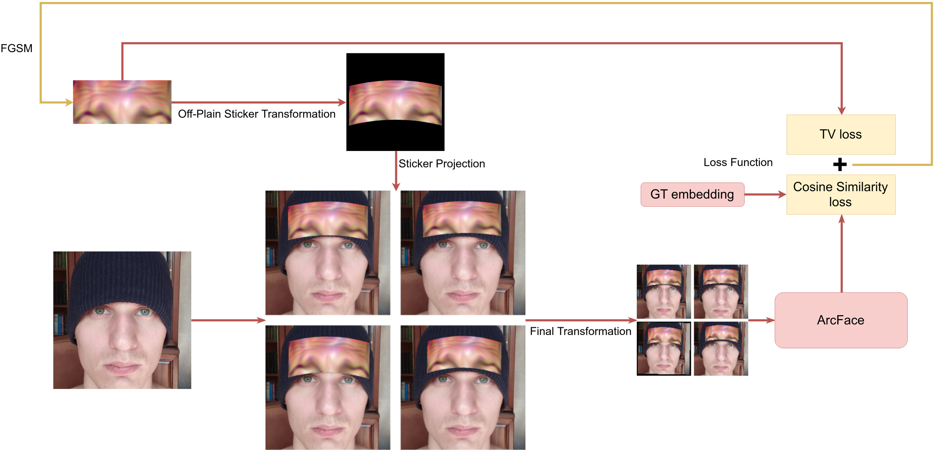
Our Method
The overall pipeline for sticker preparation is as follows:
MI-
Trainable part

Slide 36
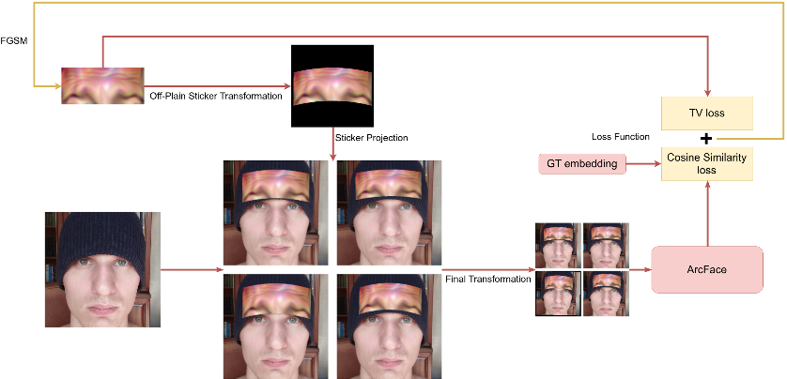
Off-Plain Sticker Transformation
When we put a rectangular sticker on a hat, it bends and rotates

Slide 37
Off-Plain Sticker Transformation
We simulate bending as a parabolic transformation of the sticker
The initial coordinates of the flat sticker are changed as follows during bending and rotation:
$$\left(\begin{matrix}x_{0} \\ y_{0} \\ 0\end{matrix}\right)⟼\left(\begin{matrix}x_{1} \\ y_{1} \\ z_{1}\end{matrix}\right)=\left(\begin{matrix}1 & 0 & 0 \\ 0 & \cos{θ} & −sinθ \\ 0 & sinθ & \cos{θ}\end{matrix}\right)⋅\left(\begin{matrix}{\left(b⋅\left(\left|x_{0}\right|⋅\sqrt{x_{0}^{2}+\frac{1}{4⋅b^{2}}}+\frac{1}{4⋅b^{2}}⋅\ln\left(\left|x_{0}\right|+\sqrt{x_{0}^{2}+\frac{1}{4⋅b^{2}}}\right)−\frac{1}{4⋅b^{2}}⋅\ln{\frac{1}{2⋅b}}\right)\right)}^{inv} \\ y_{0} \\ b⋅x_{1}^{2}\end{matrix}\right)$$
Then we render a new sticker image by projecting along the z-axis which is perpendicular to the initial plane of the sticker

Slide 38
Off-Plain Sticker Transformation
We implement the proposed transformation using conventional tensor operations in a fully differentiable way
We change the parabola rate and the angle of rotation a little during the attack preparation to make the attack more robust

Slide 39
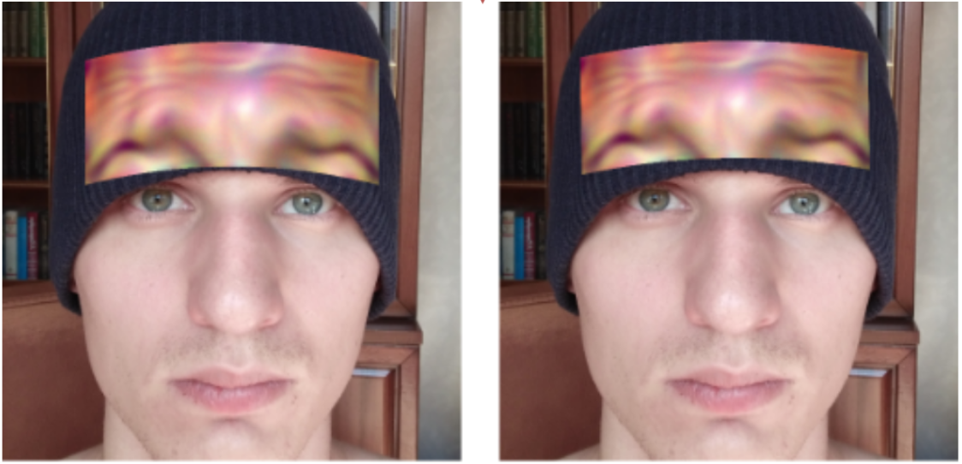
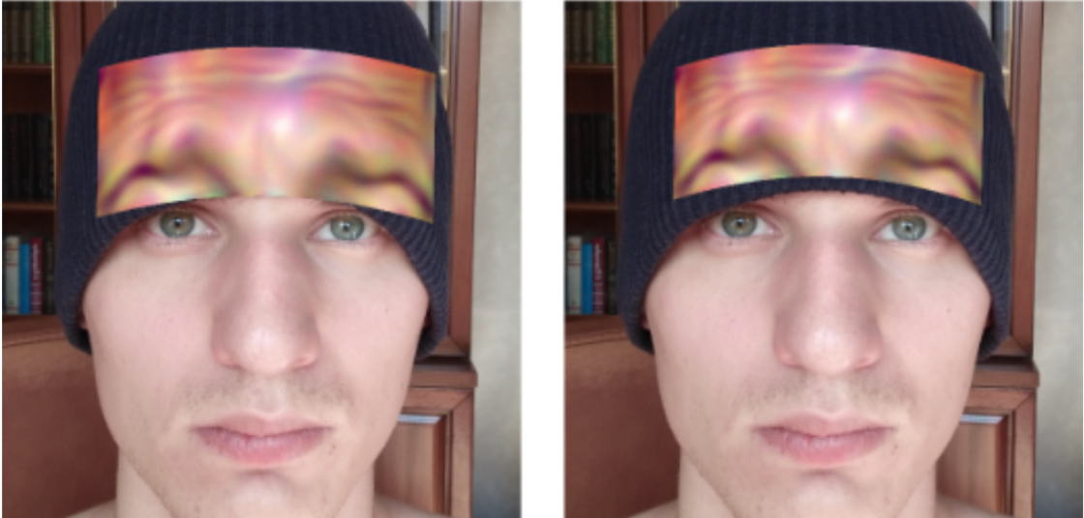
Sticker Projection
We use Spatial Transformer Layer (STL) [3] to project the obtained sticker on the image of face
We also slightly change the parameters of the projection during the attack preparation:
[3] Jaderberg M. et al. Spatial transformer networks //Advances in neural information processing systems. – 2015. – С. 2017-2025.

Slide 40
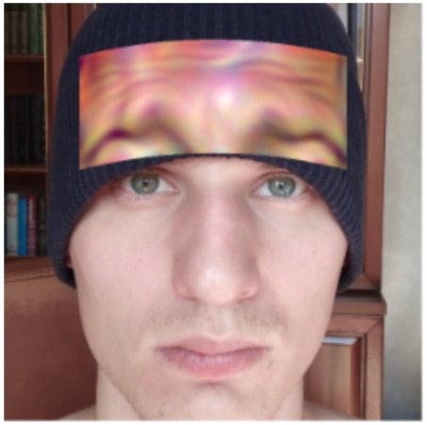
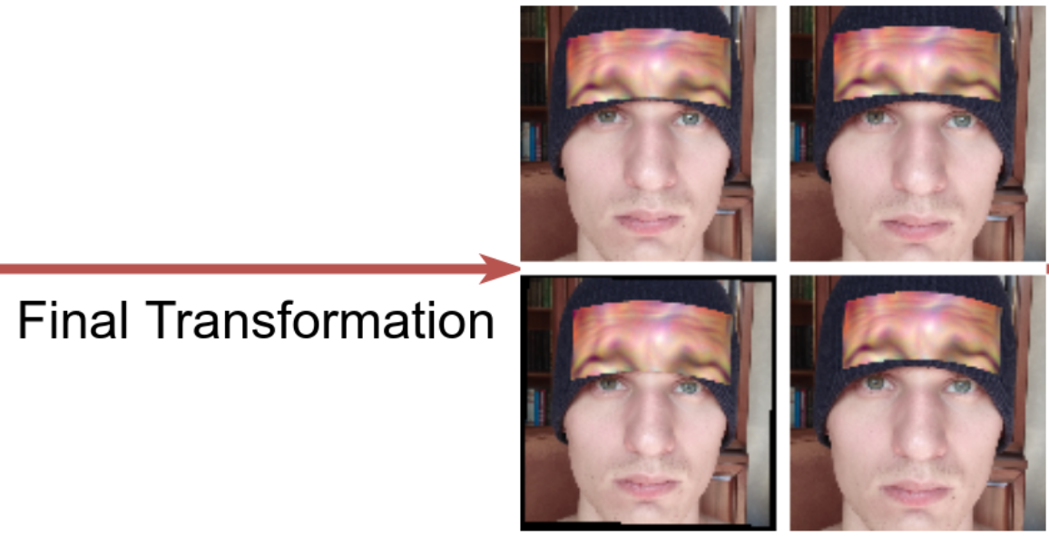
Final Transformation
We use STL [3] again to resize the obtained image to the size required by the FaceID model
We slightly jitter the whole image during this part
[3] Jaderberg M. et al. Spatial transformer networks //Advances in neural information processing systems. – 2015. – С. 2017-2025.

Slide 41
Loss Function
A batch of images with various projection parameters is fed to the ArcFace FaceID model to calculate their feature vectors
We minimize cosine similarity between evaluated feature vectors and the ground truth one using the first loss function:
Total Variation loss makes the sticker image smoother:
The final loss is the sum of the aforementioned losses:

Slide 42
Some Context
FaceID is an open-set task i.e. the known set of classes during inference can differ from the training ones
The common procedure of recognition of face:
Calculation of feature vector of the face
Similarity measurement to the stored feature vectors
If similarity to the top-1 class A is bigger than a threshold then the face is labeled as a face of person A
Thresholds are chosen based on the acceptable rate of false recognitions
For instance, a threshold for the ArcFace system varies from 0.328 to 0.823 according to the IJB-B benchmark [4]
[4] Whitelam C. et al. Iarpa janus benchmark-b face dataset //Proceedings of the IEEE Conference on Computer Vision and Pattern Recognition Workshops. – 2017. – С. 90-98.

Slide 43
Testing Scenario
The fooling rate depends on the chosen threshold crucially. That is why we show distributions of similarities to the ground-truth feature vector instead of some specific fooling rates
We use the first 1000 classes from the CASIA [5] face dataset as known classes
We calculate one average feature vector for each of these 1000 classes
Note that it is harder to fool the recognition system and make the top-1 class incorrect when the number of classes is small
We evaluate our approach for 10 people of different age and gender: four females of age 30, 23, 16, 5 and six males of age 36, 32, 29, 24, 24, 8
[5] Yi D. et al. Learning face representation from scratch //arXiv preprint arXiv:1411.7923. – 2014.

Slide 44
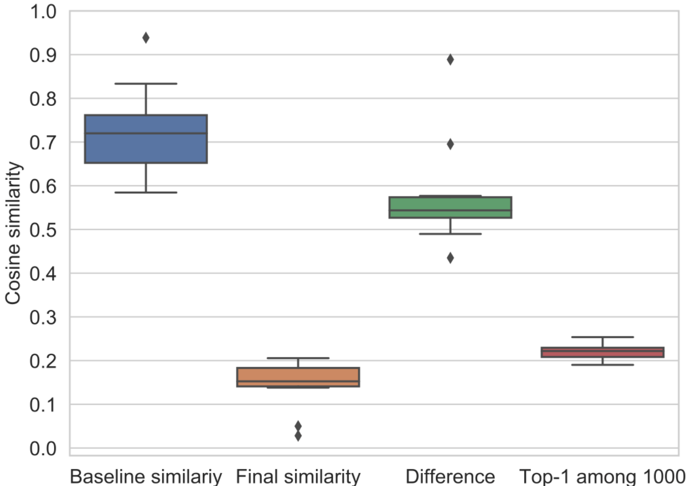
Experiments with fixed conditions
Blue: Cosine similarities between anchor images and images with a hat
Orange: Cosine similarities between anchor images and images with an adversarial sticker
Green: Differences between aforementioned similarities
Red: The top-1 similarity to the first 1000 classes from CASIA

Slide 45
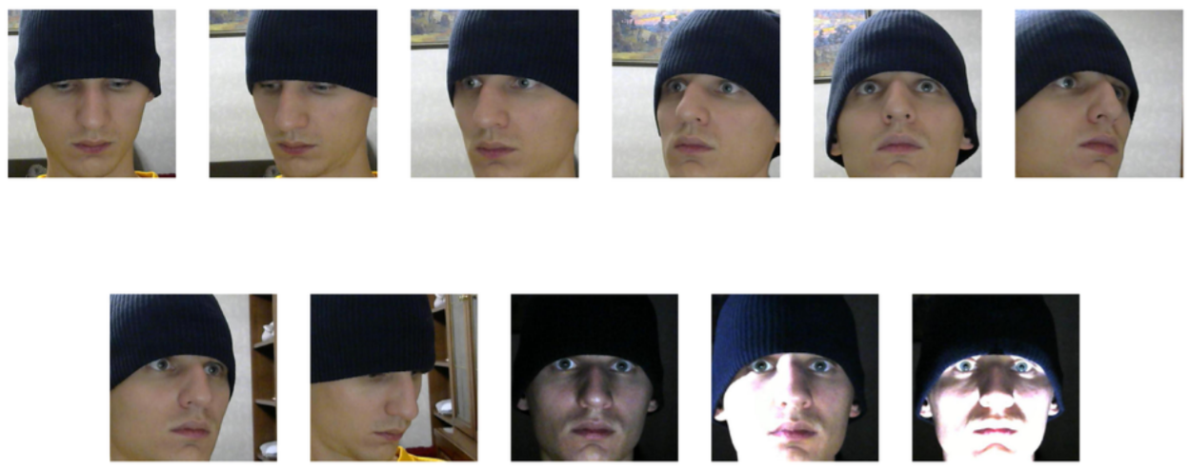
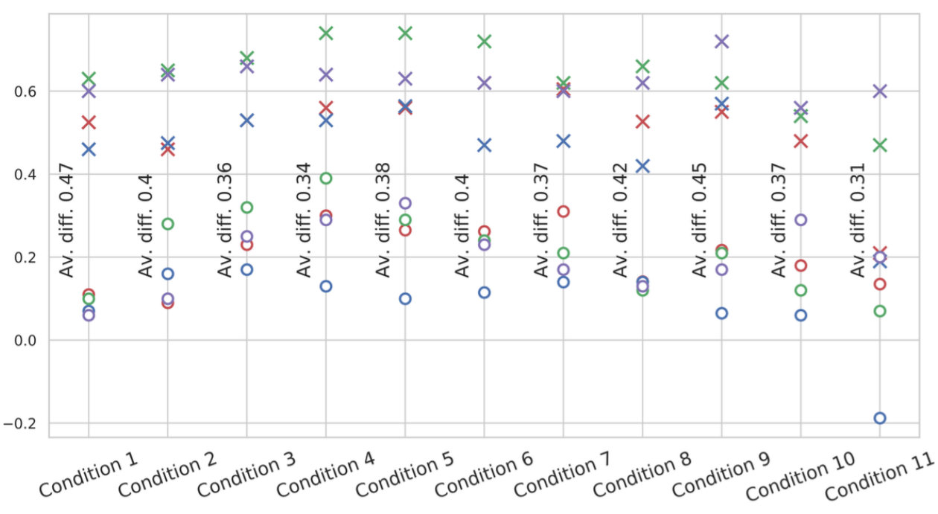
Experiments with various conditions
We also perform experiments with 11 non-trivial conditions to examine the robustness of our approach
The conditions are depicted on the right
Similarities to the ground-truth with (o) and without (x) adversarial sticker for these conditions

Slide 46
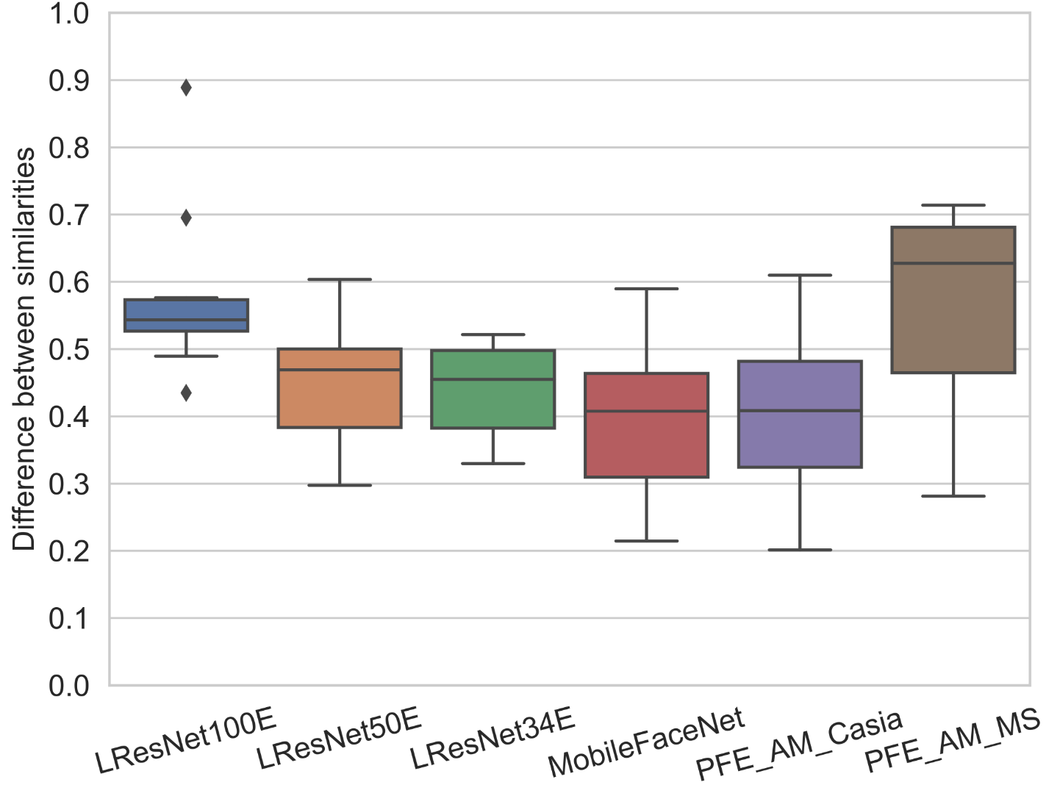
Experiments with transferability
We examine the transferability of the prepared attacks by using other FaceID models for embedding calculation
All the attacks are prepared using LResNet100E
Distributions of the differences between similarities before and after attacks are on the right

Slide 47
Demonstration
This is a speeded-up gif
The original video demonstration is available on https://www.youtube.com/watch?v=a4iNg0wWBsQ

Slide 48
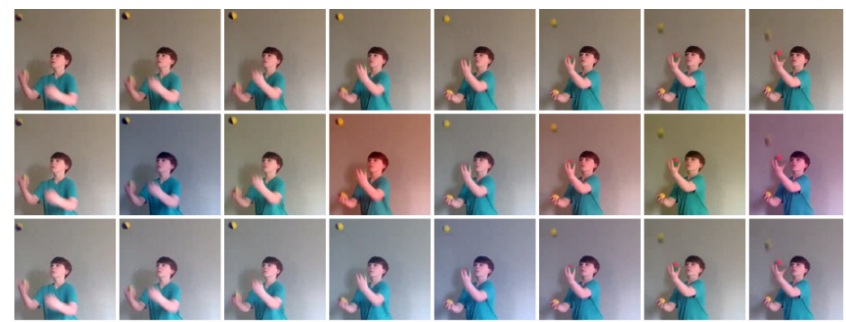
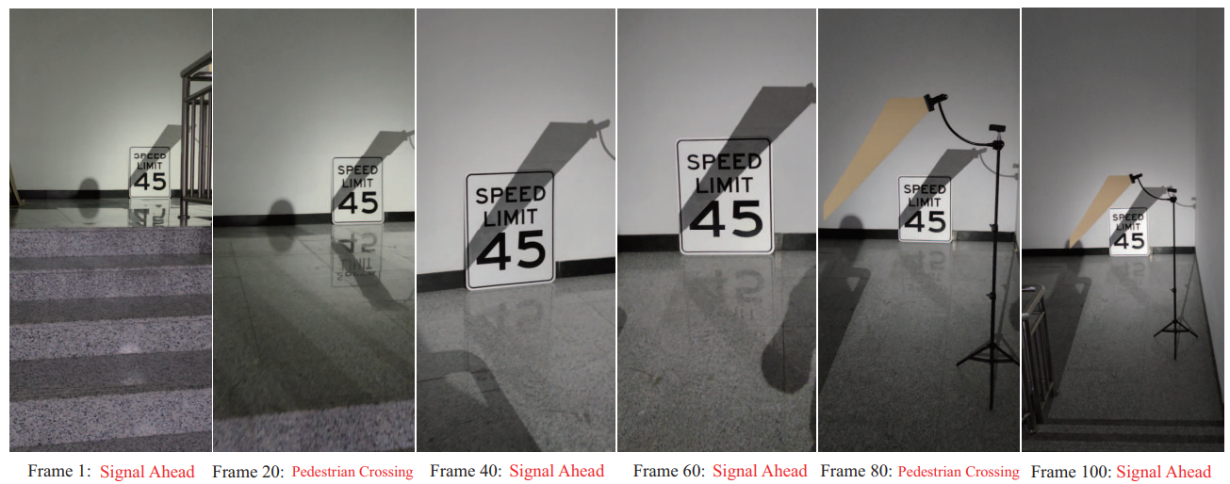
Afterword
Invisible Cloak
Nowadays, there are a lot of remarkable ways to attack the neural networks
Flickering Attack
Shadows Attack
etc.

Slide 49
Thank you!

