Slide 1
Growth Empirics
Key question in growth:
What are the underlying, fundamental causes of s, q, A?
How have some countries managed to attain high levels of efficiency and investment?
This question not likely to be settled purely theoretically – need to look at the data for answers
Some theories:
geography (Sachs, earlier)
genetics (Galor, others)
institutions (Acemoglu, others)

Slide 2
Growth Empirics
Geography theory (Sachs)
Can show geographic variables highly correlated with current income – e.g. latitude, land-locked, etc.
Can argue this matters through health and productivity (disease burden), through access to trade/markets, etc.
Beauty of this argument is that geography is clearly “exogenous” – there can be no reverse causality argument
Ex. Being rich does not affect your latitude, so latitude must affect being rich. (Not necessarily so with institutions)
(But even this can be argued: migration ⇒ endogenous geography)

Slide 3
Growth Empirics
Institutions
Acemoglu and others argued against geographic fundamentalism
2001 Acemoglu, Johnson, Robinson AER paper, arguably most famous paper of the decade – “AJR”
Basic argument: geography influenced institutions, which determined income.
So yes, geography mattered, but only in affecting institutions; institutions are the most important fundamental determinant of income.

Slide 4
Growth Empirics
AJR paper
How do they argue institutions matter?
Basic idea: Regress current income on current (or lagged) measures of institutions
Income = log PPP GDP/capita 1995
Institutional measure = Freedom from Risk of Expropriation
1985-95, from Political Risk Services company

Slide 5
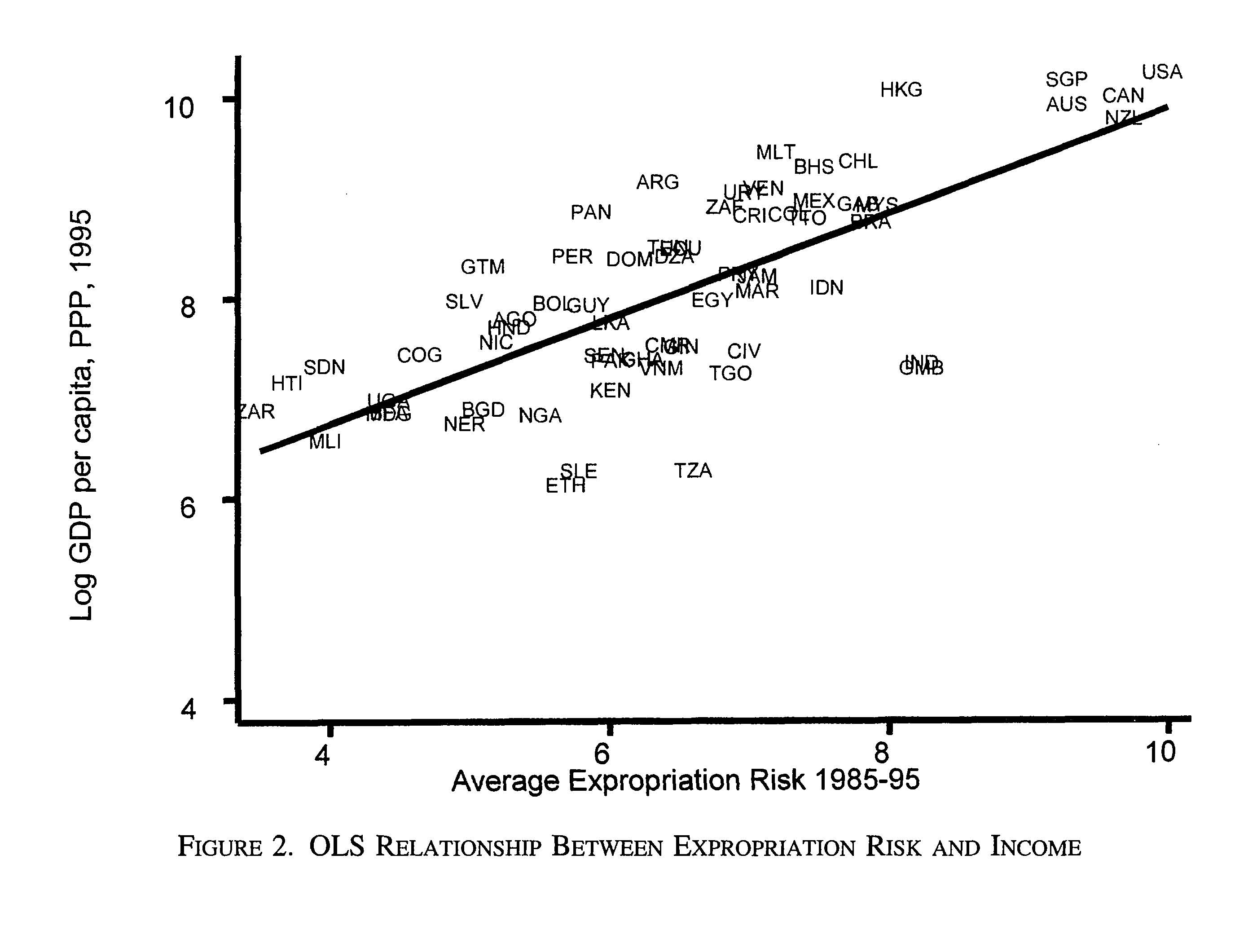
Growth Empirics
AJR paper

Slide 6
Growth Empirics
AJR paper
By itself this regression is problematic. Why?
1) Omitted Variables – are there third, unmeasured factors affecting both institutions and income? What might they be? Can they be fully controlled for? Can bias upward coefficient estimate
2) Reverse Causality – maybe richer countries can “afford” nicer institutions? Can bias upward coefficient estimate
3) Measurement error – hard to measure institutions, poor measurement can bias downward estimated coefficient

Slide 7
Growth Empirics
AJR paper
Their strategy is to instrument for institutions, i.e. to find an instrumental variable (IV)
What must an IV do? Two things.
Interested in the causal effect of X on Y. Z is a good instrumental variable for X if:
1) Z has a significant effect on X
Can check this through looking at goodness of fit measures from a regression of X on Z (plus …)
2) Z must affect Y only through its effect on X, cannot have an independent effect on Y – “Exclusion restriction”
Can’t perfectly check this, can argue for it

Slide 8
Growth Empirics
AJR paper
Their IV strategy uses the history of colonialism. They conjecture that
-- where colonizers could safely settle, they settled in large numbers and set up productive institutions that protected property rights and were conducive to decentralized market production
-- where colonizers could not safely settle, they did not settle much and set up extractive institutions meant to extract natural resources and stifle local enterprise and human capital
IV = colonial-era settler mortality rate – death rate of colonizing settlers in a given colony

Slide 9
Growth Empirics
AJR paper
IV = colonial-era settler mortality rate – death rate of colonizing settlers in a given colony
High death rate ⇒ low settlement rate ⇒ extractive institutions established ⇒ institutions persisted over time ⇒ low growth, low income today
And the reverse
To measure settler mortality, they comb historic records/books for occasionally reported mortality rates for soldiers, priests, settlers
They extrapolate from nearby countries when mortality rates are not found

Slide 10
Growth Empirics
AJR paper
Is this a valid instrument?
1) Does settler mortality have a significant effect on modern-day institutions?
They verify strong correlations, step by step:
settler mortality predicts historical institutions
historical institutions predict modern institutions
modern institutions predict current income

Slide 11
Growth Empirics
AJR paper
Is this a valid instrument?
2) Does settler mortality affect today’s income only through its effect on institutions?
How else could it matter?
(As a proxy for) modern-day health
(As a proxy for) modern-day geography
(As a proxy for) mix of modern-day European citizens
…
AJR address these concerns by including these other variables and showing they do not affect the relationship btw settler mortality, institutions, and income

Slide 12
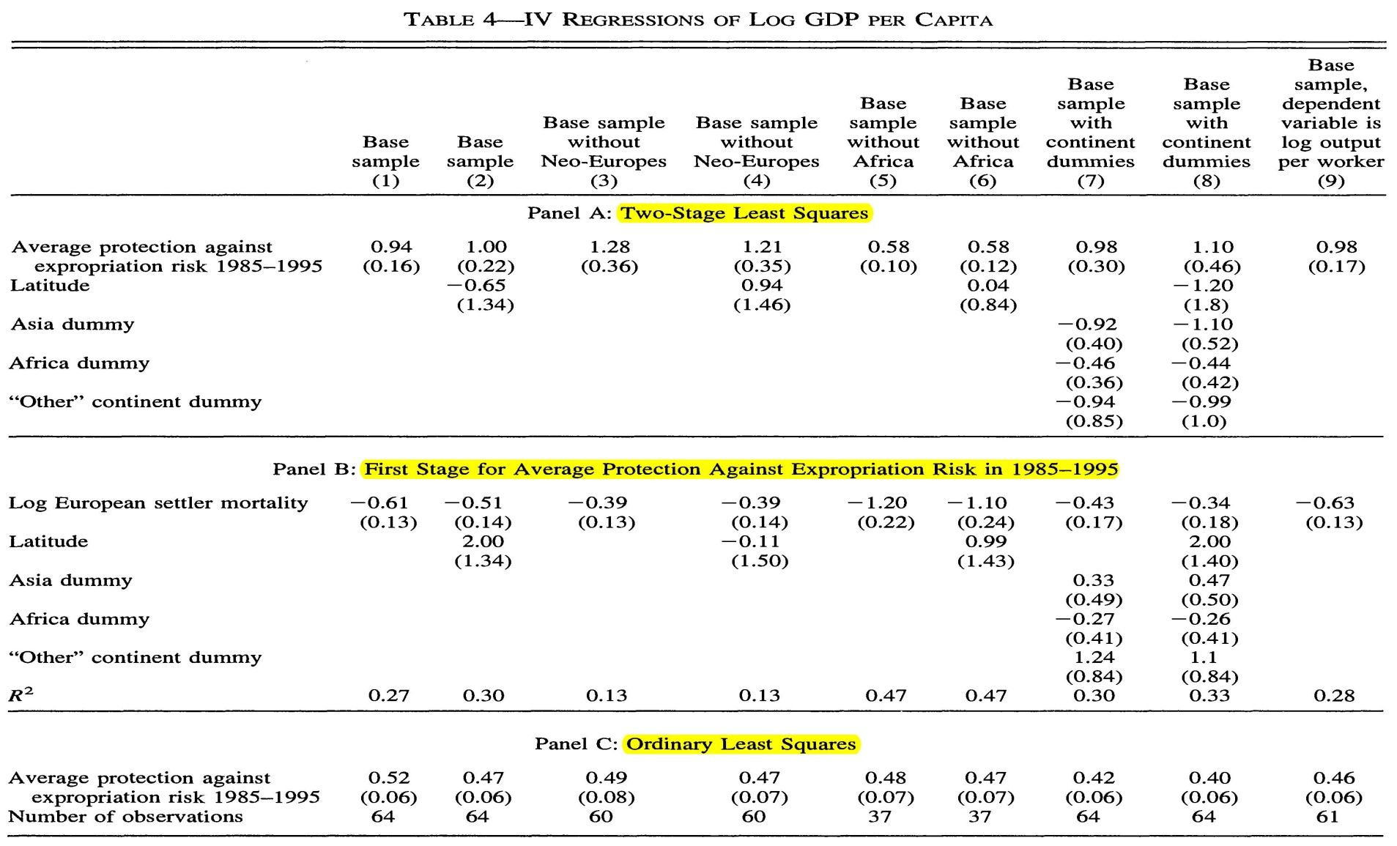
Growth Empirics
AJR paper

Slide 13
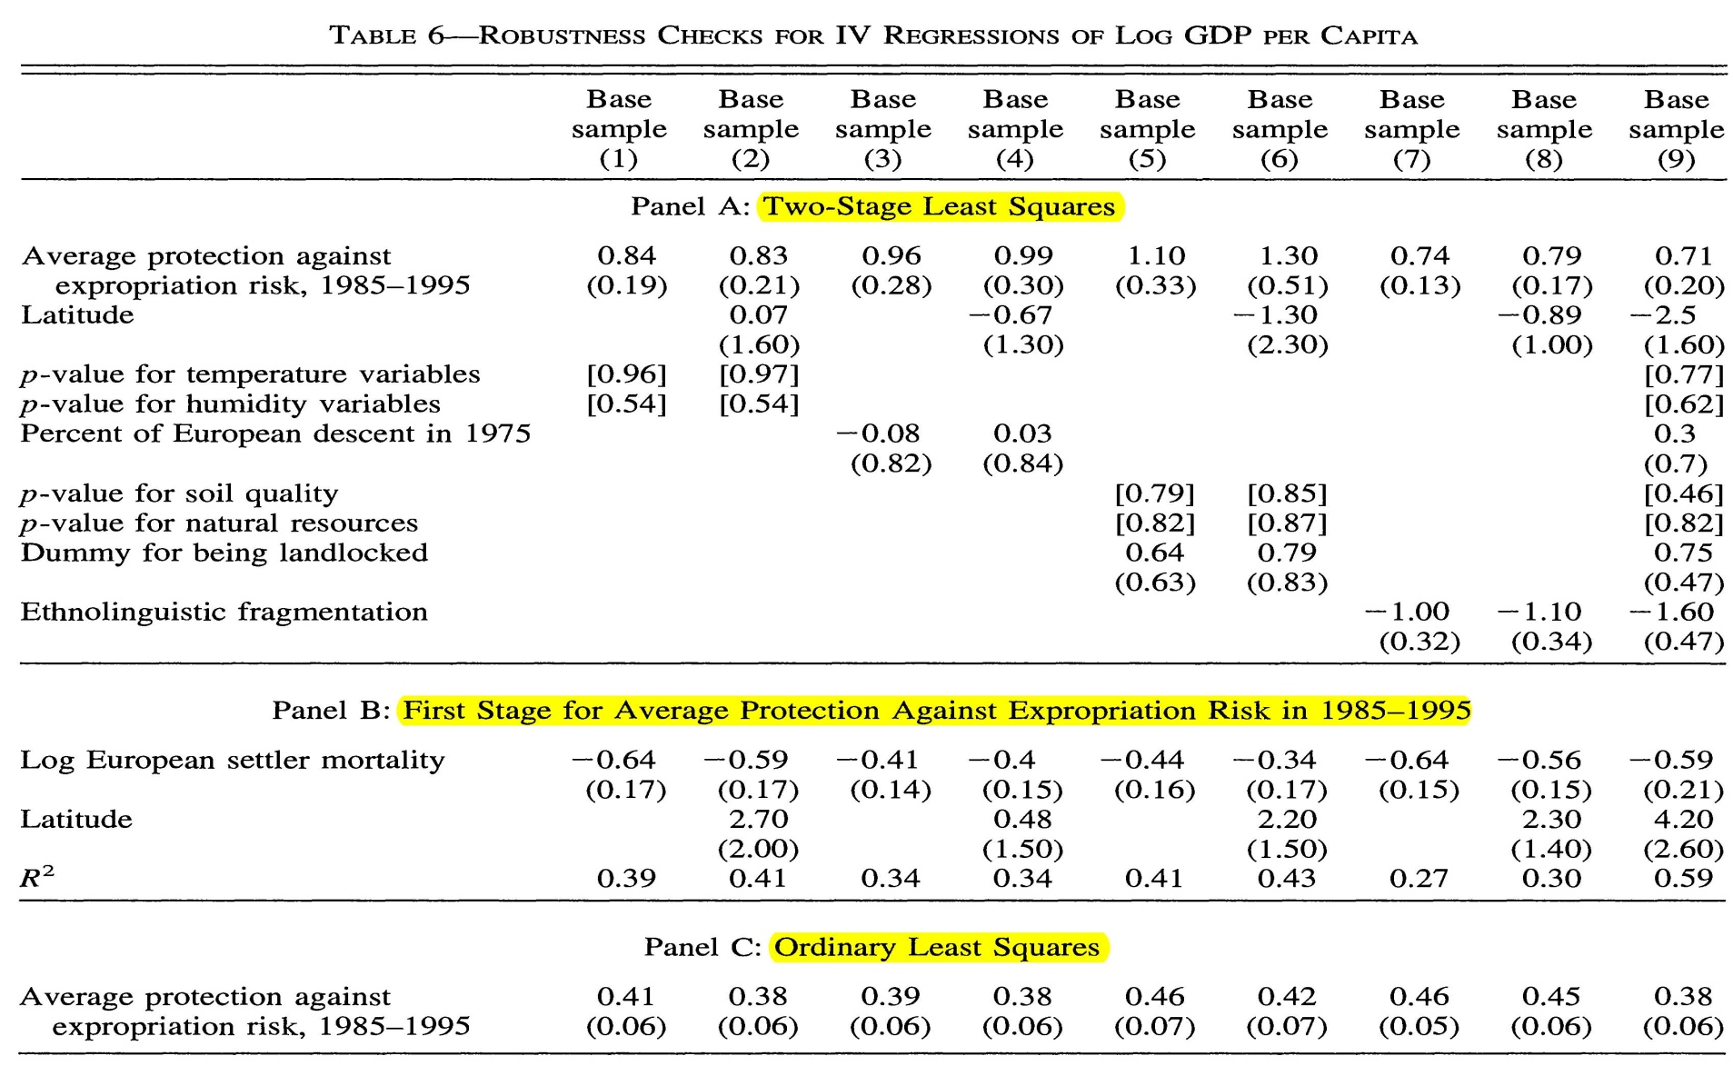
Growth Empirics
AJR paper

Slide 14
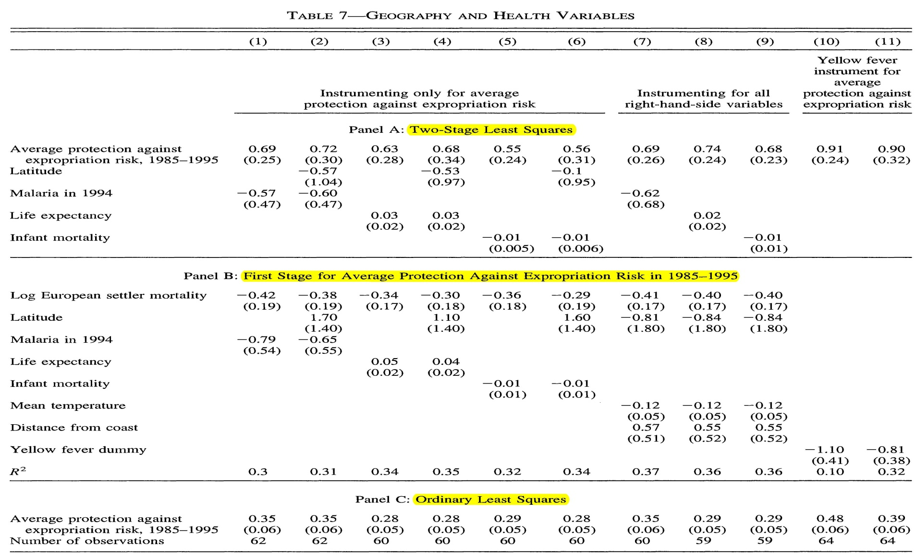
Growth Empirics
AJR paper

Slide 15
Growth Empirics
AJR paper
Why is IV estimate greater than OLS estimate?
They argue it is due to measurement error in institutions

Slide 16
Growth Empirics
AJR paper – Critiques
Albouy (2012, AER) critiques the settler mortality data
More than half the countries have data extrapolated from elsewhere
Mortality rates often not comparable – priests vs. soldiers in barracks vs. soldiers on campaign
Glaeser, Shleifer et al. (2004) critique two aspects
Measurement of institutions – better to use measures of constraints rather than outcome measures
Exclusion restriction – did settlers bring only institutions, or other factors that mattered for economic growth, income?
“guns, germs, and steel”, or human capital

Slide 17
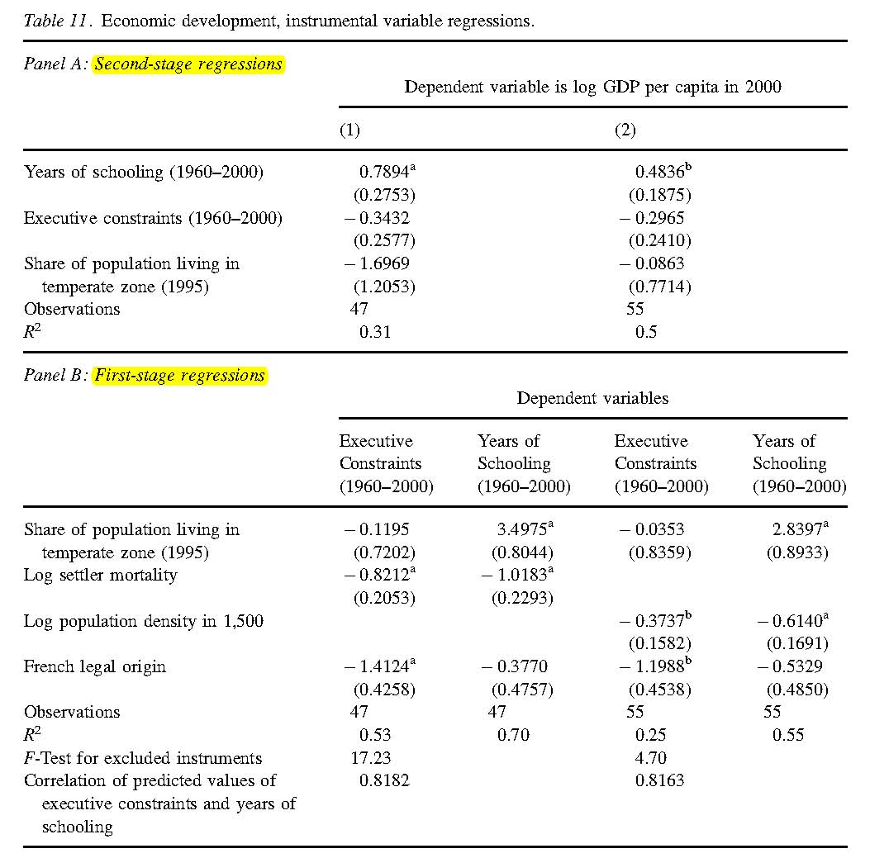
Growth Empirics
AJR paper – Critiques
Glaeser, Shleifer et al. use human capital instead of institutions

Slide 18
Growth Empirics
AJR paper – Critiques
Glaeser, Shleifer et al. (2004) show that settlers may not have just brought different institutions, but different amounts of human capital
Do AJR have an answer for this?
They show the relationship between settler mortality and current income is not driven by the current European-descent population
⇒ it is not the human capital settlers passed down to descendants
But, it could be the human capital that spilled over to the local population that is driving the relationship between settler mortality and current income … violating AJR’s exclusion restriction

Slide 19
Growth Empirics
In general: problems with cross-country growth research
OLS has problems due to omitted variables and/or reverse causality
Ex. Does high human capital cause high income, or the reverse?
One way to deal with this has been to run regressions in differences rather than levels: growth of income, rather than level of income (or fixed effect panel regressions)
But similar problems: do high rates of investment cause high growth, or does high growth induce high rates of investment?

Slide 20
Growth Empirics
In general: problems with cross-country growth research
(Partly drawing on Bazzi & Clemens 2013)
IV also has problems
1) Strength of instruments (Z should strongly predict X)
Recently, dynamic panel data models developed by Arellano, Bond, Bover, others have become popular in cross-country growth research
These use lagged levels of and differences of independent variables as instruments
Satisfy the exclusion restriction under plausible assumptions
But, often very weak in predicting the independent variable – weak instruments problem, biasing estimated coefficient

Slide 21
Growth Empirics
In general: problems with cross-country growth research
(Partly drawing on Bazzi & Clemens 2013)
IV also has problems
2) Exclusion restriction often likely to be violated
Very hard at the country level to say Z affects Y only through X – countries are complex, and rarely do we know there is only one kind of effect from a given variable
Ex. One of the most cited papers on corruption: Mauro (1995) shows that higher corruption associated with slower growth
Uses IV = ethnolinguistic fractionalization (probability two randomly chosen citizens belong to different ethnolinguistic groups)

Slide 22
Growth Empirics
In general: problems with cross-country growth research
(Partly drawing on Bazzi & Clemens 2013)
Ex. One of the most cited papers on corruption: Mauro (1995) shows that higher corruption associated with slower growth
Uses IV = ethnolinguistic fractionalization (“ELF”)
Idea: ELF affects corruption significantly, but affects growth only through its impact on corruption
But: ELF could affect other aspects, e.g. provision of public goods, human capital, transaction/trade costs, etc.
Indeed, later work found ELF significantly affects public good provision

Slide 23
Growth Empirics
In general: problems with cross-country growth research
(Partly drawing on Bazzi & Clemens 2013)
Sometimes an IV can be a victim of its own success!
This happens when later studies use an IV discovered/developed by an earlier paper.
Ex. Settler mortality, ethnolinguistic fractionalization, land gradient (instrumenting for dams, electricity placement, etc.)
The problem here is, if the IV works for one independent variable, it typically must work only for that one – if it works for others, then the exclusion restriction is violated
Conclusion: Much empirical work on growth and development is now at the microeconomic level, not the country level

