Slide 1
Robust Multi-Kernel Classification of Uncertain and Imbalanced Data
Theodore Trafalis (joint work with R. Pant)
Workshop on Clustering and Search Techniques in Large Scale Networks, LATNA, Nizhny Novgorod, Russia, November 4, 2014

Slide 2
Research questions
How can we handle data uncertainty in support vector classification problems?
Is it possible to develop support vector classification formulations that handle uncertainty and imbalance in data?

Slide 3
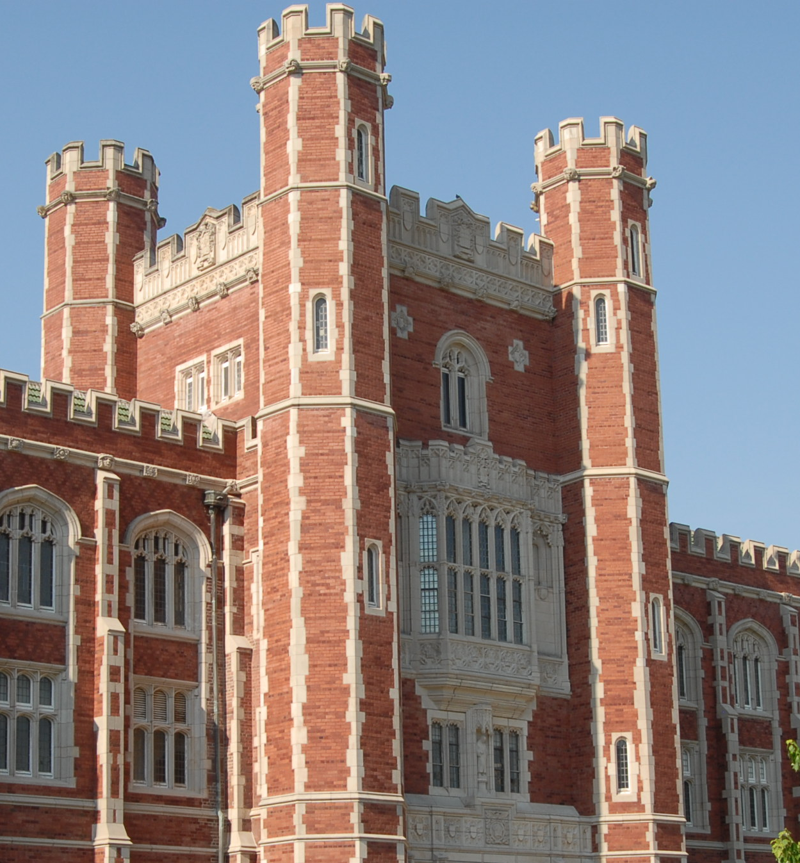
Overview & Problem Definition
Uncertainty and robustness
Imbalanced data
Data studies
Conclusions

Slide 4

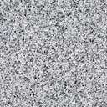
Overview: Kernel-based learning
Kernel
Design
Lower dimension
Input Space
Higher dimension
Feature Space
Kernel measures the similarity between data points
Kernel transformation helps in using in linear separation algorithm like Support Vector Classification (SVC) in higher dimensions

Slide 5
Overview: Multi-Kernel learning
Same data can have elements that show different patterns
Best kernel is a linear combination of different kernels

Slide 6
Problem Definition
Training sample
Nominal value
Data perturbation
Develop a SVC scheme that separates the data into two classes and accounts for the extreme nature of uncertainties

Slide 7
SVC approach
2-norm soft margin SVC
Dual
Support vectors
Vector of ones
Identity matrix
Misclassification error penalty
Vector of data labels
Symmetric matrix containing data and labels

Slide 8
Observations of SVC formulation
Observation 1
Positive Semi-definite matrix
Problem convex in these variables
Observation 2
Strong Duality

Slide 9
Multi-Kernel based learning
Since data is contained in the kernel matrix the learning algorithm can be improved by choosing the best possible kernel
Find the best kernel that optimizes SVC solution
Positive semi-definite property
Dual to the dual
Kernel optimization problem
Additional constrains that still preserve the problem convexity
Semi-definite Programming problem for binary class kernel learning

Slide 10
QCQP formulation
Theorem: Given a set of kernel matrices
the kernel matrix
that optimizes
the support vector classification problem is obtained by solving
where
Similar proofs exist in the works of Lanckriet et al. (2004) and Ye et al. (2007)

Slide 11
Overview & Problem Definition
Uncertainty and robustness
Imbalanced data
Data studies
Conclusions

Slide 12
SVC issues with uncertainty
Maximum margin classifier
Different hyperplane realized due to error and noise
Misclassified points
Uncertain ‘noise’
in data
Uncertainty is present in all data sets and the traditional formulations do not account for them
Robust formulations account for extreme cases of uncertainty and provide reliable classification

Slide 13
Handling uncertainty
Uncertainty exists is the data and needs to be transformed form input space to the feature space
Quadratic
kernel
Input space
Feature space
We use first order Taylor series expansion to transform uncertainty from input to feature space

Slide 14
Building a robust formulation
Spherical uncertainty
in data
Feasibility under extreme case of data uncertainty
QCQP problem is transformed into a larger Semi-definite Programming (SDP) problem

Slide 15
Overview & Problem Definition
Uncertainty and robustness
Imbalanced data
Data studies
Conclusions

Slide 16
Robustness and imbalance
In classical SVC only few point called support vectors determine the maximal hyperplane
In robust SVC all points are given some weight in determining the maximal hyperplane
For imbalanced data robust methods will consider rare outliers which will be missed by classical SVC

Slide 17
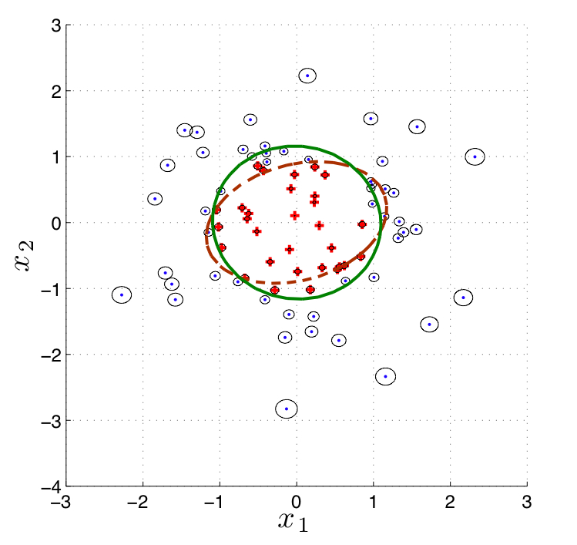
Robustness example
Example:
Separation hyperplane: x₁²+x₂² = 1
Each point has spherical uncertainty
Green ellipse: Robust SVC result
Red dotted ellipse: Classical SVM
Robust SVC separates better than Classical SVC

Slide 18
Overview & Problem Definition
Uncertainty and robustness
Imbalanced data
Data studies
Conclusions

Slide 19
Benchmark data tests
We consider there data sets: Iris, Wisconsin Breast Cancer, Ionosphere from the UCI repository
 | Iris | Breast Cancer | Ionosphere
# of +1 labels | 50 (33%) | 239(33%) | 125(33%)
# of -1 labels | 100 (66%) | 444(66%) | 226(66%)
Total | 150 (100%) | 685(100%) | 351(100%)
We add spherical uncertainties to data as a percentage of the data values
We selected 100 random samples of 80% data for training and 20% for testing
We use radial basis kernels with parameters varying from 0.00001 to 100

Slide 20
Maximum test accuracy
Comparison of maximum accuracy given by Classical SVM (CSVM) and the robust SDP-SVM (rSDP-SVM)

Slide 21
Average accuracy
Comparison of average accuracy given by Classical SVM (CSVM) and the robust SDP-SVM (rSDP-SVM)
Blue – CSVM
Black – rSDP-SVM

Slide 22
Computational Issues
Comparison of #Support Vectors and simulation time given by Classical SVM (CSVM) and the robust SDP-SVM (rSDP-SVM)
Robust methods increase computational complexity, but computational tractability of problem is still maintained

Slide 23
Overview & Problem Definition
Uncertainty and robustness
Imbalanced data
Data studies
Conclusions

Slide 24
Conclusions
Multi-kernel methods are the next step towards improved classification methods
The robust multi-kernel method adds to the SDP based development of SVC problems
Uncertainty and imbalance in data is addressed efficiently with presented method
Initial tests show results better than classical SVM
Problem size and computational complexity issues need improvement

Slide 25
Appreciation
The U.S. Federal Highway Administration under awards SAFTEA-LU 1934 and SAFTEA-LU 1702
The National Science Foundation, Division of Civil, Mechanical, and Manufacturing Innovation, under award 0927299
The Russian Science Foundation, grant RSF 14-41-00039

Slide 26
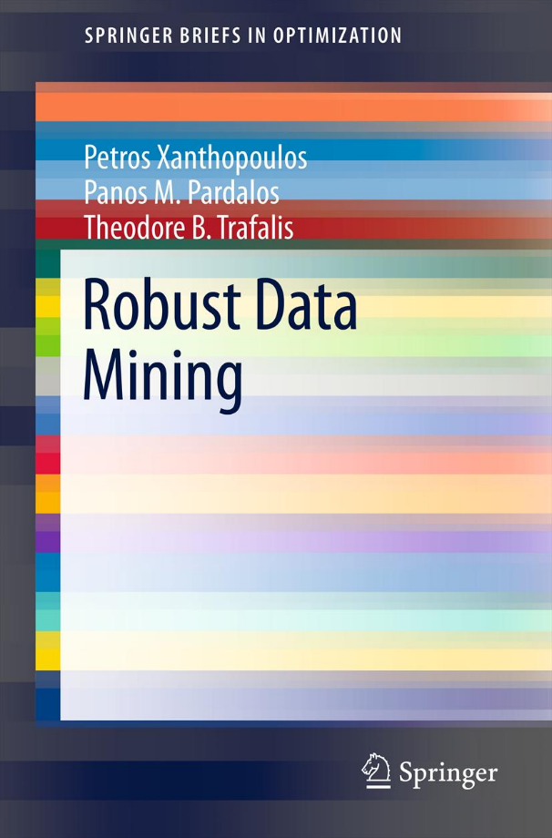

Slide 27


Slide 28

End of Presentation
Contact: ttrafalis@ou.edu

