Slide 1
A method of ontology-aided expertise matching for facilitating knowledge exchange
11.12.2014
НИУ ВШЭ – Нижний новгород
Eduard Babkin
Nikolay Karpov
Tatiana Babkina
National Research University Higher School of Economics

Slide 2
Agenda
Motivation
Principal design
Case study
Evaluation
Conclusion

Slide 3
Motivation
We believe that advanced methods of automatic knowledge management belong to critical scientific foundations of modernization the paradigm of information and knowledge exchange.
A specifically designed combination of automated text processing and ontology-based knowledge engineering may improve quality of information analysis and reduce university’s response time.

Slide 4
Ontology-aided improvement of information flow
The one of it is Media Information Logistics project (Media-ILOG) which is concerns the domain of mass media too. The goal of the Media-ILOG, was to improve information flow inside a local newspaper JonkopingsPosten
We propose to facilitate knowledge exchange by seeking relevant university experts for commenting actual information events expressed in the texts of news.

Slide 5
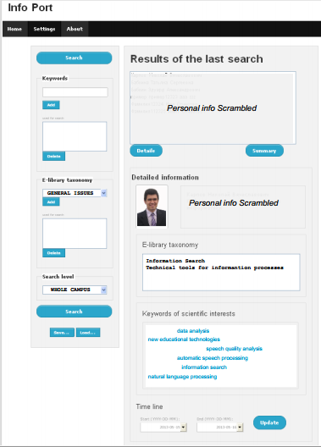
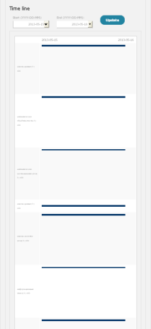
InfoPort User Interface
a) front page; b) enlarged view of personal time line

Slide 6
Algorithmically implementation
In one hand we have personal ontology which includes skills of university experts
In other hand we have unstructured text of news which are expressed
We analyze semantic in the news and match it with skills of experts
For semantic matching we choose newly designed a modification of Latent Dirichlet allocation (Momtazi and Naumann, 2013).
It is algorithmically implemented in the newly designed decision support system titled EXPERTIZE.

Slide 7
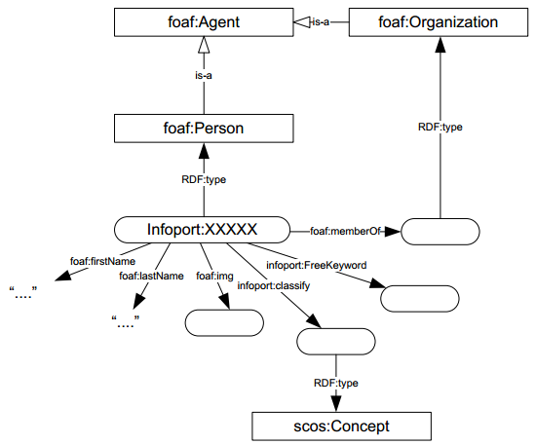
Personal ontology in InfoPort system
W3C FOAF (Friend of Friend) vocabulary specification
Researcher as a person.
Researcher as a skillful agent.
Researcher as a team member.

Slide 8
Interaction of EXPETIZE services with InfoPort platform
InfoPort
EXPETIZE system
Regular offline services
InfoPort platform
Native
REST-
Interface
Store Service
Online services
The EXPERTIZE system regularly monitors different text sources in the Internet, performs document analysis and provide university employees with critical information about relevant events according the specific relevance matching algorithm.

Slide 9
Principle design of the EXPERTIZE system
InfoPort
Store Service
Web GUI
RSS Newsfeed
REST-Interface
REST-Interface
Offline processing
Crawler Service
Data Modeler
Matcher
Online processing
Data Store
Temporal raw data
LDA model

Slide 10
Matcher using Latent Dirichlet allocation
Latent Dirichlet allocation model is distributions of probabilities.
We build it in offline
Online we count a probability for each category c and rank categories according to value.

Slide 11
Algorithm quality evaluation
The same approach (Momtazi and Naumann, 2013) on TREC 2005 and 2006 queries, shows 0.248 and 0.471 amount of MAP respectively.
We create our own queries and evaluate our algorithm
Algorithm type | Mean average precision
Document-based | 0.31
Candidate-based | 0.22
Topic-based | 0.43

Slide 12
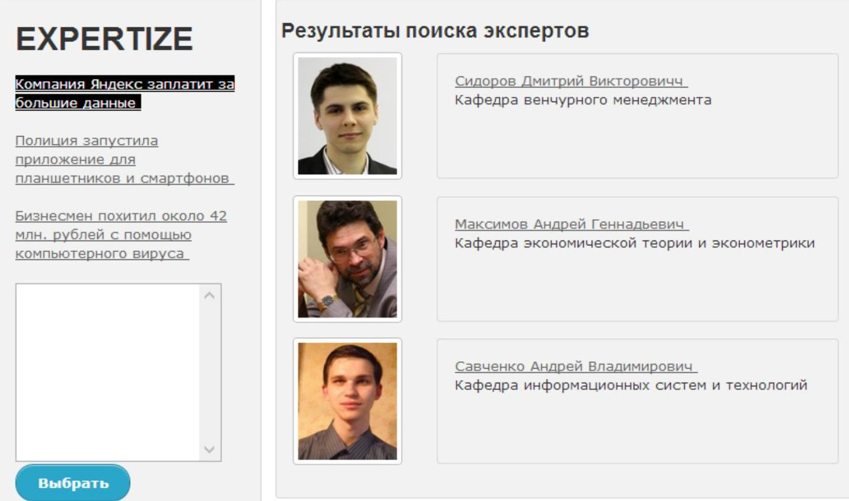
Graphical user interface of the EXPERTIZE system

Slide 13
Conclusion
An approach to ontology-aided expertise matching for improving knowledge exchange was presented.
A matching method between experts and actual information events based on Latent Dirichlet allocation techniques was implemented.
A software design of decision support system EXPERTIZE was developed for practical application of the method proposed.
The first use cases of the EXPERTIZE system show their ability to solve the task specified.
We can archive cross-language expertise retrieval by applying multi-language scientific ontology. It would be our prospective work

Slide 14
Thank you for your attention!
Nikolay Karpov
nkarpov@hse.ru

