Slide 1
Detecting New a Priori Probabilities of Data Using Supervised Learning
Karpov Nikolay
Associate professor
NRU Higher School of Economics

Slide 2
Agenda
Motivation
Problem statement
Problem solution
Results evaluation
Conclusion

Slide 3
Motivation
In many applications of classification, the real goal is estimating the relative frequency of each class in the unlabelled data (a priori probabilities of data).
Examples: prediction in election, happiness, epidemiology

Slide 4
Motivation
Classification is a data mining function that assigns each items in a collection to target categories or classes.
If we have labeled and unlabeled data when classification is usually solved via supervised machine learning.
Popular classes of supervised learning algorithms: Naïve Bayes, k -NN, SVMs, decision trees, neural networks, etc.
We can simply use a «classify and count» strategy to estimate priori probabilities of data
Is “classify and count” the optimal strategy to estimate relative frequency?

Slide 5
Motivation
A perfect classifier is also a perfect “quantifier” (i.e., estimator of class prevalence) but …
Real applications may suffer from distribution drift (or “shift”, or “mismatch”), defined as a discrepancy between the class distribution of Tr and that of Te
1. the prior probabilities p(ω _{j}) may change from training to test set
2. the class-conditional distributions (aka “within-class densities”) p(x| ω _{j}) may change
3. the posterior probabilities p(ω _{j}|x) may change
Standard ML algorithms are instead based on the assumption that training and test items are drawn from the same distribution
We are interested in the first case of distribution drift.

Slide 6
Agenda
Motivation
Problem statement
Problem solution
Results evaluation
Conclusion

Slide 7
Problem statement
We have training set Tr and test set Te with
p _{Tr} (ω _{j}) ≠ p _{Te} (ω _{j})
We have vector of variables X, and indexes of classes ω _{j}, j=1,J
We know indexes for each item in training set Tr
Task is to estimate p _{Te} (ω _{j}) , j=1,J

Slide 8
Problem statement
It may be also defined as the task of approximating a distribution of classes
Training set
 | f ₁ | f ₂ | … | ω
X1 |  |  |  | ω ₁
X2 |  |  |  | ω ₂
…..
p _{Train} (ω _{j}) ≠ p _{Test} (ω _{j})
Test set
Test | f ₁ | f ₂ | … | ω
X1 |  |  |  | ω ₁ | ω ₁
X2 |  |  |  | ω ₂ | ω ₁
X3 |  |  |  | ω ₂ | ω ₂
X4 |  |  |  | ω ₂ | ω ₂

Slide 9
Problem statement
Quality estimation:
Absolute Error
Kullback-Leibler Divergence
…

Slide 10
Agenda
Motivation
Problem statement
Problem solution
Results evaluation
Conclusion

Slide 11
Baseline algorithm
Adjusted classify and count
In the classifier task we predict the value of category . Trivial solution is to count the number of elements in the predicted classes. We can adjust this with the help of confusion matrix.
Standard classifier is tuned to minimize FP + FN or a proxy of it, but we need to minimize FP - FN
But we can estimate confusion matrix only with training set. p(ω _{j}) can be find from equations:

Slide 12
Which methods perform best?
Largest experimentation to date is likely:
Esuli, A. and F. Sebastiani: 2015, Optimizing Text Quantifiers for Multivariate Loss Functions. ACM Transactions on Knowledge Discovery from Data, 9(4): Article 27, 2015
Fabrizio Sebastiani calls this problem as Quantification
Different papers present different methods + use different datasets, baselines, and evaluation protocols; it is thus hard to have a precise view

Slide 13
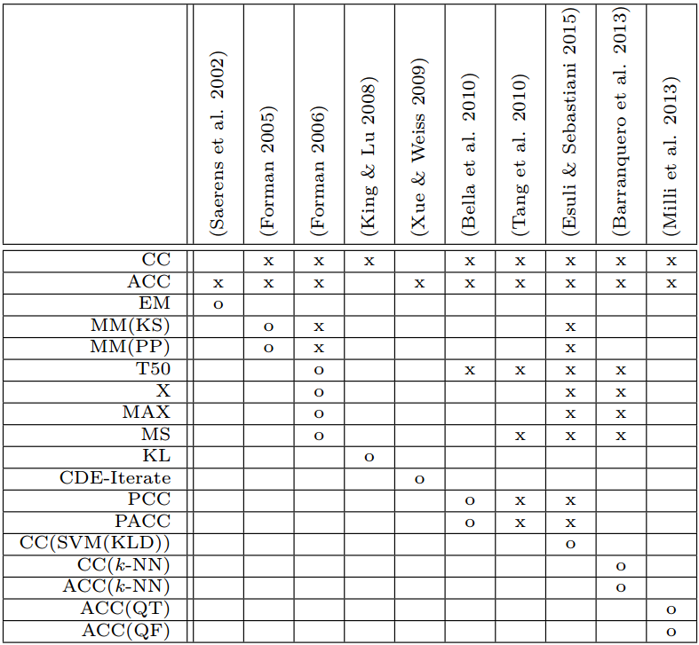
F. Sebastiani, 2015

Slide 14
Fuzzy classifier
Fuzzy classifier estimate the posteriori probabilities of each category on the basis of training set using vector of variable X.
If we have distribution drift of a priori probabilities
p _{Train} (ω _{j}) ≠ p _{Test} (ω _{j})
a posteriori probabilities should be retune. So, our classification results will change.

Slide 15
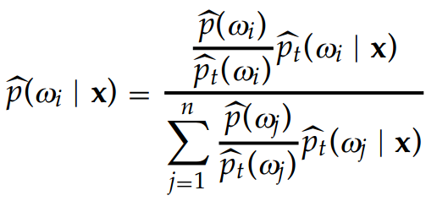
Adjusting to a distribution drift
If we know a new priori probability
we can simply count a new value for posteriori probabilities:
If we don’t know a priori probability we can estimate it iteratively as it propused in paper:
Saerens, M., P. Latinne, and C. Decaestecker: 2002, Adjusting the Outputs of a Classifier to New a Priori Probabilities: A Simple Procedure. Neural Computation 14(1), 21–41.

Slide 16
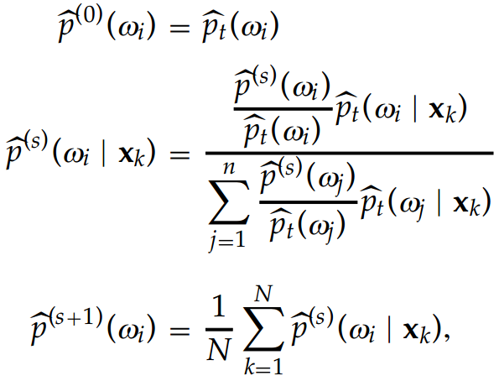
EM algorithm*
* Saerens, M., P. Latinne, and C. Decaestecker: 2002, Adjusting the Outputs of a Classifier to New a Priori Probabilities: A Simple Procedure. Neural Computation 14(1), 21–41.

Slide 17
Agenda
Motivation
Problem statement
Problem solution
Results evaluation
Conclusion

Slide 18
Results evaluation
We realize EM algorithm proposed by (Saerens, et al., 2002) and compare with others.
F. Sebastiani used baseline algorithms from George Forman
George Forman wrote algorithms for HP and he can’t share it, because it is too old!
We can compare results by using only same datasets from Esuli, A. and F. Sebastiani: 2015, and same Kullback-Leibler Divergence

Slide 19
F. Sebastiani, 2015

Slide 20
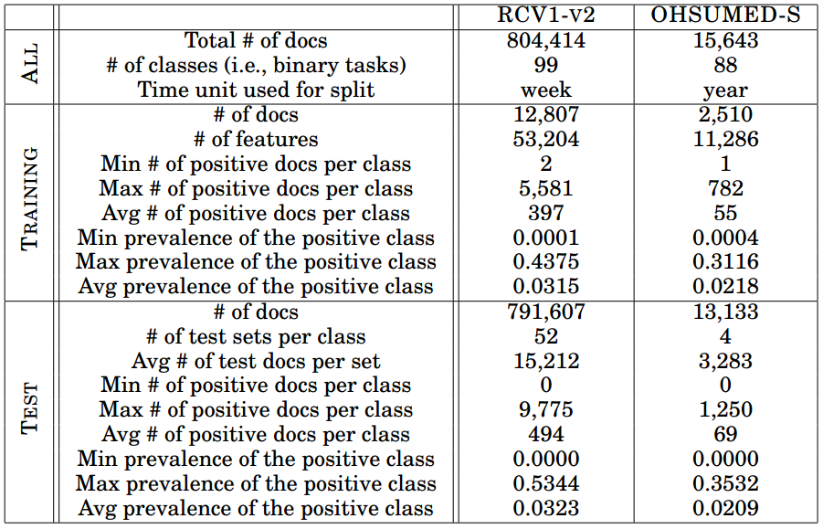
Testing datasets*
* Esuli, A. and F. Sebastiani: 2015, Optimizing Text Quantifiers for Multivariate Loss Functions. ACM Transactions on Knowledge Discovery from Data, 9(4): Article 27, 2015

Slide 21
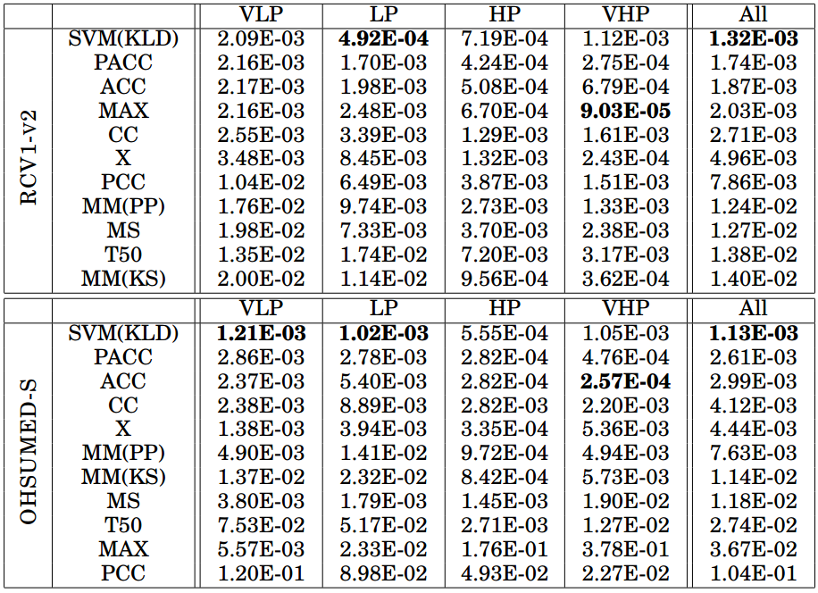
Results evaluation
Esuli, A. and F. Sebastiani: 2015

Slide 22
Results evaluation
OHSUMED-S
RCV1-V2
OHSUMED-S
 | VLD | LD | HD | VHD | total
EM | 1,17E-04 | 1,49E-04 | 3,34E-04 | 3,35E-03 | 9,88E-04
SVM(KLD) | 7,00E-04 | 7,54E-04 | 9,39E-04 | 2,11E-03 | 1,13E-03
 | VLP | LP | HP | VHP | total
EM | 4,99E-04 | 1,91E-03 | 1,33E-03 | 5,31E-04 | 9,88E-04
SVM(KLD) | 1,21E-03 | 1,02E-03 | 5,55E-03 | 1.05E-04 | 1,13E-03
RCV1-V2
 | VLD | LD | HD | VHD | total
EM | 3,32E-04 | 4,92E-04 | 1,83E-03 | 4,29E-03 | 1,32E-03
SVM(KLD) | 1.17E-03 | 1.10E-03 | 1.38E-03 | 1.67E-03 | 1,32E-03
 | VLP | LP | HP | VHP | total
EM | 6,52E-05 | 1,497E-05 | 1.16E-04 | 7,62E-06 | 1,32E-03
SVM(KLD) | 2,09E-03 | 4,92E-04 | 7,19E-04 | 1,12E-03 | 1,32E-03

Slide 23
Agenda
Motivation
Problem statement
Problem solution
Results evaluation
Conclusion

Slide 24
Conclusion
Explore the problem to detect new a priori probabilities of data using supervised learning
Realize EM algorithm when a priori probabilities counted as a spin off
Realize baseline algorithms
Test EM algorithm on the datasets and compare with baseline and sate of the art algorithms
EM algorithm shows good results

Slide 25
Results
Algorithms available at:
https://github.com/Arctickirillas/Rubrication
Thank you for your attention

