Slide 1
From biological experimental data
to regulatory and interaction networks
Mario R. Guarracino
joint work with Marina Piccirillo, Sonali Chavan, Parijat Triphati
Workshop on Clustering and search techniques in large scale networks
October 23rd – 25th, 2015
HSE – Nizhny Novgorod

Slide 2
Human and Mouse: Similarities

Slide 3
Human and Mouse: Differences
?

Slide 4
Summary
Biological networks
Data
Network construction
Applications
Open problems
Conclusions

Slide 5
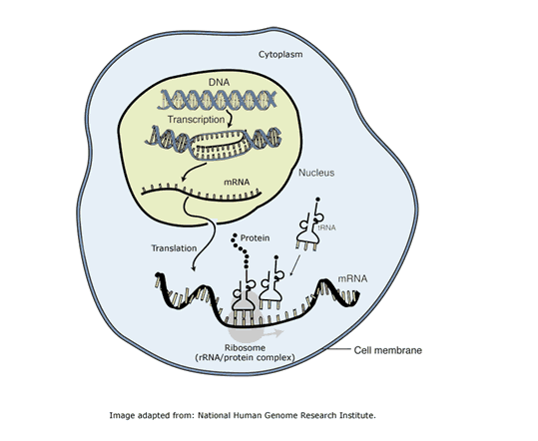
Gene expression
Gene expression is the process by which the genetic code – the nucleotide sequence of a gene – is used to direct protein synthesis and produce the structures of the cell. The process of gene expression involves two main stages:
Transcription: the production of messenger RNA (mRNA) by the enzyme RNA polymerase, and the processing of the resulting mRNA molecule.
Translation: the use of mRNA to direct protein synthesis, and the subsequent post-translational processing of the protein molecule.

Slide 6
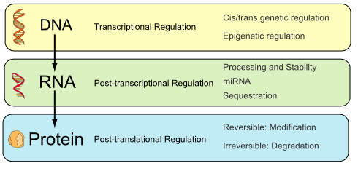
Gene regulation
Gene regulation is a name for the cellular processes that control the rate and timing of gene expression.
A complex set of interactions among genes, RNA molecules, proteins (including transcription factors) and other components of the expression system determining when and where specific genes are activated and the amount of protein or RNA product produced.

Slide 7
Gene regulatory networks : example
2
1
3
4
A simple gene regulatory network made up of four genes.
Each gene is transcribed and translated into a transcription factor (TF) protein, which in turn regulates the expression of other genes by binding to their respective promoter regions.
Image from Rau, A.: (2010) Reverse engineering gene networks using genomic time-course data. Ph.D. dissertation, Purdue University, USA

Slide 8
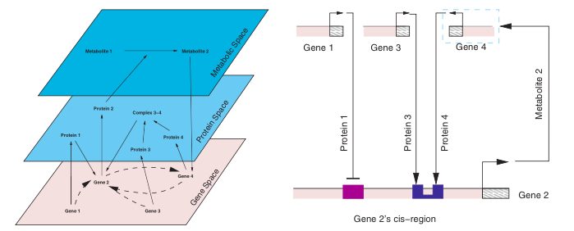
Gene regulatory networks: regulation
There are multiple levels at which genes are regulated by other genes, proteins and metabolites.

Slide 9
Gene Networks: applications
Gene networks can be used for gene classification, based on the localization of the gene’s influence on other genes, and vice versa.
In quantitative settings, they can be used to simulate various scenarios, and to predict the behavior of the system.
The regulatory interactions between genes can be studied at large-scales, allowing for example for understanding cascades of gene regulations (e.g during organism development).

Slide 10
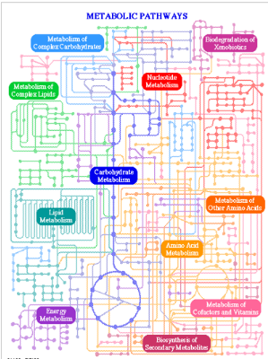
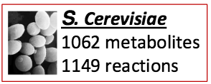
Other types of networks : metabolic networks
Reflect the set of biochemical reactions in a cell
Nodes: metabolites
􏰀Edges: biochemical reactions
Directed; weighted; hyperedges
Derived through:
Knowledge of biochemistry
Metabolic flux measurements
Homology?

Slide 11
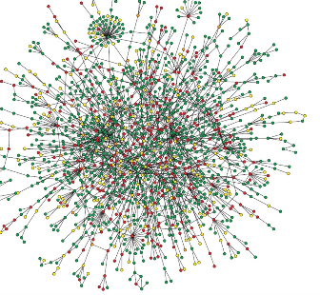
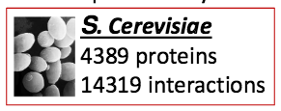
Protein-protein interaction (PPI) networks
Reflect the cell’s molecular interactions and signling pathways (interactome)
Nodes: proteins
Edges: interactions
Undirected
High-throughput experiments:
Protein Complex-IP (Co-IP)
Yeast two-hybrid
Computational predictions

Slide 12
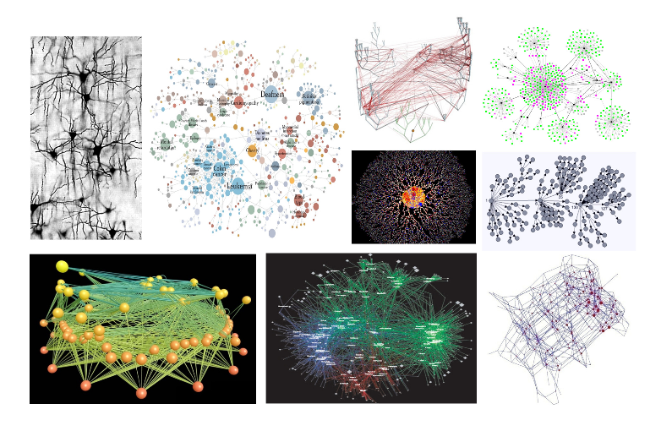
Other networks in biology/medicine

Slide 13
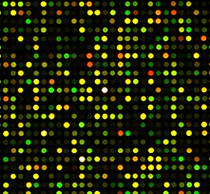
Data: Gene Expression Data
Expression level of genes in an individual that is measured through Microarray
Measure expression level for approximately 20,000 genes, each gene is represented by a single pixel called probe
Microarray Chip

Slide 14
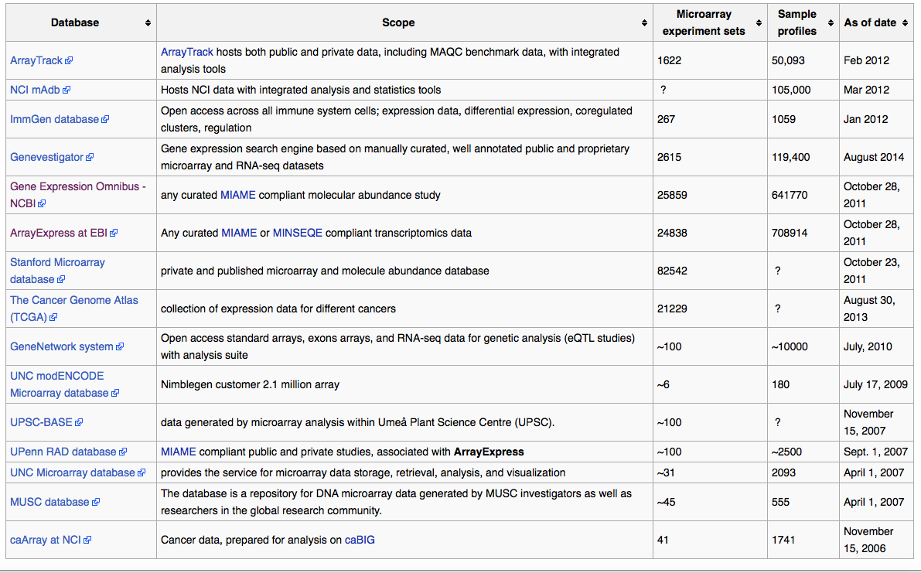
Data: repositories
https://en.wikipedia.org/wiki/Microarray_databases

Slide 15
Data: Gene Expression Data
DNA is present in (nearly) all cells of any organism, but these are not all the same
Many differences are due to the different subset of genes that are expressed in a given cell type
Microarrays detect the level of gene activation from the abundance of mRNA molecules in a cell
The abundance of each mRNA can provide information on the corresponding protein

Slide 16
Data: Missing and noisy data
In the process of extracting the intensity level from each spot, many values are missed or computed with an error
Solutions adopted: ignore sample, estimate or impute a value
Due to the cost of each experiment, missing values are estimated/imputed

Slide 17
An example of data file
P = Present
A = Absent

Slide 18
Data: Microarray applications
Gene expression data have proven to be highly informative on disease state
In the area of oncology, accurate diagnosis and appropriate treatment are critical
Studies on clinical samples have shown gene expression data can be used
to classify tumor types
detect subtypes
and to predict prognostic outcomes

Slide 19
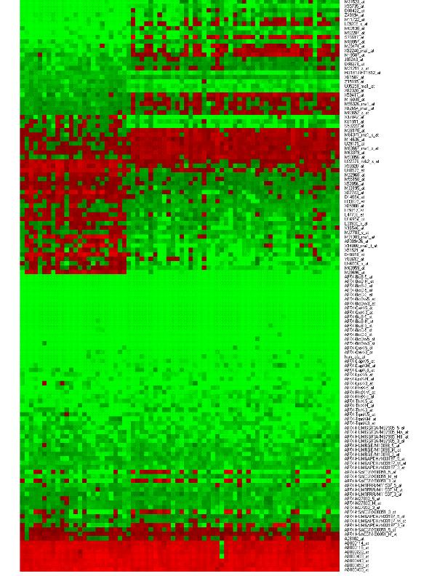
Data: Challenges
Data produced by microarrays are exponentially increasing
Datasets contain expression for tens of thousands genes
Data are incomplete and noisy
Current classification methods can over-fit the problem, providing models that do not generalize well

Slide 20
Perturbation Data
Genetic perturbation is an experimental manipulation of gene activity by manipulating either a gene itself or its product. Such perturbations include point mutations, gene deletions, overexpression, or any other interference with the activity of the product.
Each row in the matrix represents a gene expression profile.

Slide 21
Perturbation Data: repository
http://www.lincscloud.org

Slide 22
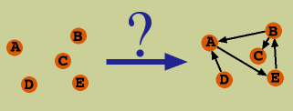
Biological network inference
Biological network inference is the process of making inferences and predictions about biological networks.
By measuring gene expression over time using high-throughput technologies, it may be possible to reverse engineer, or infer, the structure of the gene network involved in a particular cellular process.
These gene expression data typically have a high dimensionality and a limited number of biological replicates and time points.
Due to these issues and the complexity of biological systems, the problem of reverse engineering networks from gene expression data demands a specialized suite of statistical tools and methodologies.

Slide 23
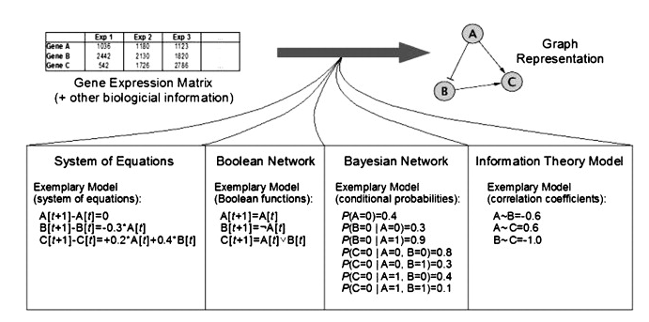
Network Modeling
There are different methodologies for modeling of gene networks.
These models range from very abstract (involving Boolean values only) to very concrete (including fully biochemical interactions with stochastic kinetics), depending on the biological level to be studied.
Image from Hecker M. et al. (2009) Gene regulatory network inference: Data integration in dynamic models—A review , 86–103

Slide 24
Physical vs. Combinatorial Models
Physical Models
Combinatorial Models
Can be used to run simulations and predict the future behaviour of the system.
Have many parameters, necessitating large number of experiments to fit them to the data.
Start from higher level features of the system by defining the caracteristics and features of interest, like the important observables , i.e. gene expression levels, and the nature of relationships

Slide 25
Dynamic vs. Static Models (1)
Describe the change of gene expression in time.
Tend to be more complete than static ones, in that they aim to characterize the interactions among the input signals, and offer quantitative predictions for the observable variables.
Require more input data in general because of the large number of parameters to fit, as well as some type of understanding of the nature of the aggregation function.
Most dynamic models are based on simplifications of differential rate equations for each node:
Examples of dynamic models are Boolean Networks

Slide 26
Dynamic vs. Static Models (2)
Static models do not have a time-component in them.
This means that static models yield only topologies, or qualitative networks of interactions between the genes, often specifying the nature of the interactions.
Examples of static models are: Graph Theoretic Models, Bayesian Networks, and Linear Additive Models

Slide 27
Deterministic vs. Stochastic Models
Deterministic Model
The expression states of the genes are either given by a formula or belong to a specific class.
The precision of the observed expression values, depends solely on the experimental setup and technological precision.
Start from the assumption that gene expression values are described by random variables which follow probability distributions.
Stochastic Model

Slide 28
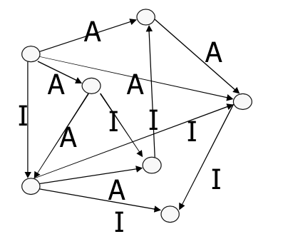
Static Graph Model
Network: directed graph G=(V,E), where V is set of vertices, and E set of edges on V.
The nodes represent genes and an edge between v_{i} and v_{j} symbolizes a dependence between v_{i} and v_{j}.
The dependencies can be temporal (causal relationship) or spatial (cis- trans specificity).
The graph can be annotated so as to reflect the nature of the dependencies (e.g. promoter, inhibitor), or their strength.
Properties:
• Fixed Topology (doesn’t change with time)
• Static
• Node States: Deterministic

Slide 29
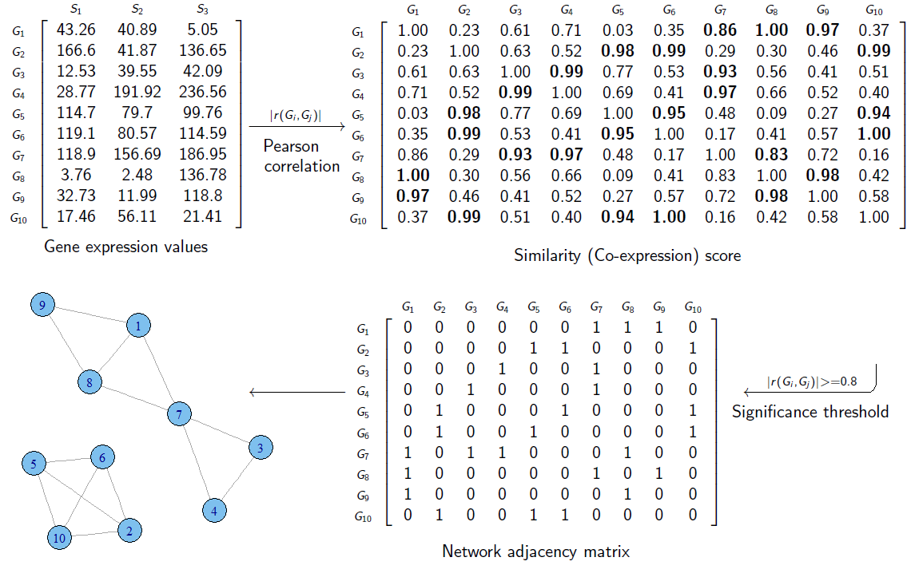
A gene co-expression network
A gene co-expression network (GCN) is an undirect graph, where each node corresponds to a gene,and a pair of nodes is connected with an edge if there is a significant co-expression relationship between them.
The two general steps for constructing a gene co-expression network: calculating co-expression measure, and selecting significance threshold.

Slide 30
Co-expression measures
For constructing gene co-expression networks there are four mostly used co-expression measures:
Pearson's correlation;
Partial correlation;
Mutual Information;
Spearman's rank correlation coefficient;
Euclidean distance.

Slide 31
Mutual Information
The mutual information between two random variables is a measure of the amount of information that one random variable contains about another.
It is defined as the relative entropy (or Kullback-Leibler distance) between the joint distribution and the product of the marginals:
Alternative formulations:

Slide 32
Mutual Information: ARACNE
ARACNE (Algorithm for the Reconstruction of Accurate Cellular Networks) is an algorithm which reverse engineers a gene regulatory network from microarray gene expression data.
ARACNE uses mutual information to compute the correlation between pairs of genes and infer a best-fit network of probable interactions
(I.E. an MI score of 0 between two genes implies they are independent of each other).
ARACNE algorithm first calculates the MI between each pair of all genes or a subset of genes and creates an adjacency matrix.
Afterwards, MI thresholding is applied using a specified MI threshold value or p-value of the MI score.
MI scores of gene pairs which fall below the MI threshold will be removed from the adjacency matrix.
Finally, the DPI(Data Processing Inequality) tolerance is used to reduce the number of genes which do not interact directly but were missed in the MI thresholding step.
A.A. Margolin, I. Nemenman, K. Basso, C. Wiggings , G. Stolovitzky, R. Dalla-Favera, A. Califano ARACNE: An Algorithm for the Reconstruction of Gene Regulatory Networks in a Mammalian Cellular Context . BMC Bioinformatics. 2006; 7(Suppl 1): S7.

Slide 33
Static Graph Model from perturbations
Motivation: perturbing a gene network one gene at a time and using the effected genes in order to discriminate direct vs. indirect gene-gene relationships
Perturbations: gene knockouts, over-expression, etc.
Method:
For each gene g_{i}, compare the control experiment to perturbed experiment (gene g_{i}) and identify the differentially expressed genes
Use the most parsimonious graph that yields the graph of 1. as its reachability graph.

Slide 34
A single gene perturbation affects multiple genes. The question is which of them directly?

Slide 35
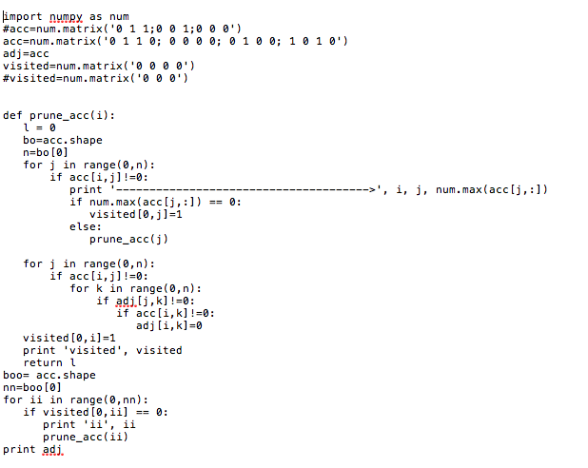
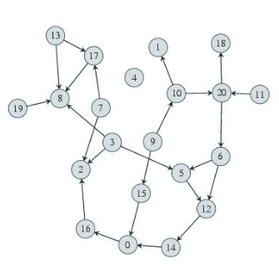
Wagner algorithm
The algorithm is based on a graph representation consisting of nodes and direct edges; the nodes of the graph correspond to genes numbered from 0 through 19 and two genes are connected by an arrow if they influence each other’s activity directly.
A. Wagner. (2001) How to reconstruct a large genetic network from n gene perturbations in fewer than n² easy step 17(12):1183-97.
Notes:
In the first approach we try to implement Wagner’s algorithm in Python language to construct genetic networks starting from gene expression's dataset containing profiles of cancer cells that have been exposed to genetic perturbations; this algorithm is based on a graph representation consisting of nodes and direct edges; the nodes of the graph correspond to genes numbered from 0 through 19 and two genes are connected by an arrow if they influence each other’s activity directly. In this first our approach we tried to build the characteristics of secretory patway starting from LINCS data.

Slide 36
Bayesian Networks: Definition(I)
A n-dimensional Bayesian network (BN) is a triplet B = (X, G, Θ) where:
X is a n-dimensional finite random vector where each random variable X_{i} ranges over a finite domain D_{i}. Henceforward, we denote the joint domain by D
G = (N,E) is a directed acyclic graph (DAG) with nodes N = {X₁, ..., X_{n}} and edges E representing direct dependencies between the variables.
encodes the parameters
of the network, where
denotes the set of parents of X_{i} in G,
denotes the joint domain of
the variables in
,
is the k-th value of Xi and
is the j-th
configuration of

Slide 37
Bayesian Networks: Definition(II)
A Bayesian Network defines a unique joint probability distribution over X given by
A Bayesian network encodes the independence assumptions over the component random variables of X.
An edge (j, i) in E represents a direct dependency of X_{i} from X_{j}.
The set of all Bayesian networks with n variables is denoted by B_{n}.

Slide 38
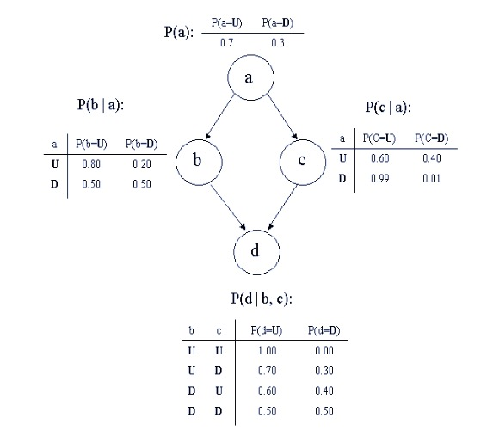
Bayesian Network: Example
The probability distributions at the nodes imply the dependencies of nodes only on their parent nodes. The joint probability can be computed directly from the graph, for any instance of the node values.
Eg. P(a = U, b = U, c = D, d = U) = = P(a = U)P(b = U|a = U)P(c = D|a = U)P(d = U|b = U,c = D) = = 0.7 ∗ 0.8 ∗ 0.4 ∗ 0.7 = 16%.

Slide 39
Learning Bayesian Network (I)
Learning a BN:
The problem of learning a BN given data T consists on finding the B_{N} that best fits the data T.
In order to quantify the fitting of a B_{N} a scoring function φ is considered.
Definition. Learning a Bayesian network
Given a data T = {y1, . . . , yN } and a scoring function φ, the problem of learning a Bayesian network is to find a Bayesian network B ∈ B_{n} that maximizes the value φ(B, T).

Slide 40
Learning Bayesian Network (II)
The standard methodology for addressing the problem of learning Baysian Networks becames heuristic search, based on scoring metrics optimization, conducted over some search space.
Compute the posterior probability distribution, starting from a prior probability distribution on the possible networks, conditioned to data T , that is, P (B|T).
The best network is the one that maximizes the posterior probability.
Since the term P (T) is the same for all possible networks, in practice, for comparative purposes, computing P (B, T) is sufficient.
As it is easier to work in the logarithmic space, the scoring functions use the value log(P (B, T )) instead of P (B, T).

Slide 41
Differential Equations Models and Linearization
Differential equations (DE) are continuous and deterministic modeling formalisms, capable of describing non-linear and emerging phenomena of complex dynamical systems.
DE models of gene networks are based on rate equations.
The general form of the equations, one for each of n genes, is:
where each x_{j} is a continuous function, representing the gene expression of gene j.

Slide 42
Linearized Additive Models (LAM)
The simplest interesting form that the f_{i}(· )’s can take are linear additive functions, for which
becomes:
The term ext_{i}(t) indicates a (possible) controlled external influence on gene i, like a perturbation for example, and is directly observable.

Slide 43
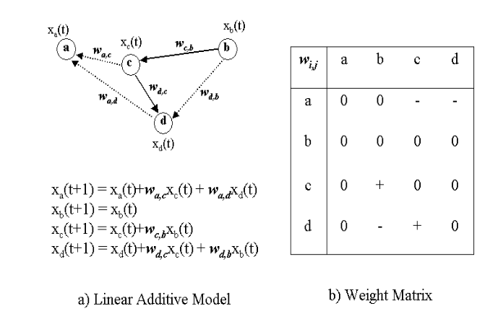
Linearized Additive Models (LAM)…(I)
A linear Additive Model for a four Node Gene Networks

Slide 44
Comparison of Models
 | Graph | Bayes | Boolean | LAM
Nodes | Genes | Random Variables | Discretized Expression | Continuous Expression
Edges | Causality | Conditional Dependency | Arguments in Boolean Functions | Arguments in Regulatory Functions
Additional Parameters | Activation, Inhibition | Activation, Inhibition | Boolean Function | Weight Matrix
Properties | Static topology | Static topology, Stochastic | Dynamic, Biologically Realistic | Dynamic, Steady - state realistic
Inference | Biological Parsimony, Optimization | Bayes Scoring, ML, Optimization | Optimization, Information Theory | Linear Regression, Optimization
Data Requirement | O(log n) − O(n) | ? | O(2^{k} k log n) | O(kn log n)

Slide 45
Network analysis
Typical data mining tasks can be performed on biological networks:
Supervised learning:

Slide 46
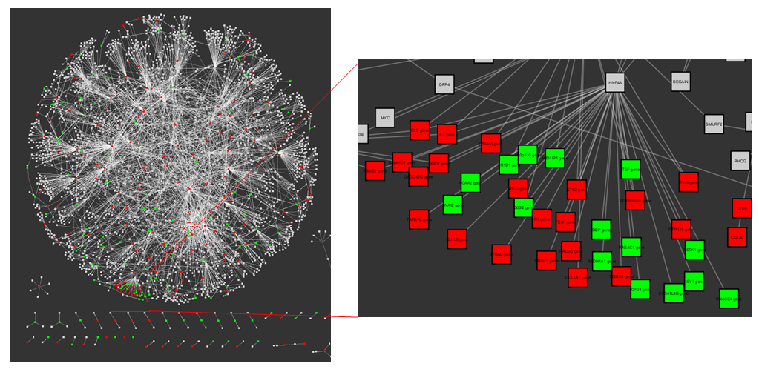
Network analysis: Differentially-Expressed Subnetworks
Search for sub-networks that contain a significant number differentially-expressed genes (nodes)
All genes in sub-network interact…
SO these highly differentially-expressed sub-networks may represent a critical pathway or complex involved in a condition of interest

Slide 47
Differentially-Expressed Subnetworks
jActive algorithm:
Searches for sub-networks that contain a significant number differentially-expressed genes (or nodes)
Heuristic – won’t always find the optimal result
Z-score signifies how likely to find a subnetwork with a similar number of DE genes.

Slide 48
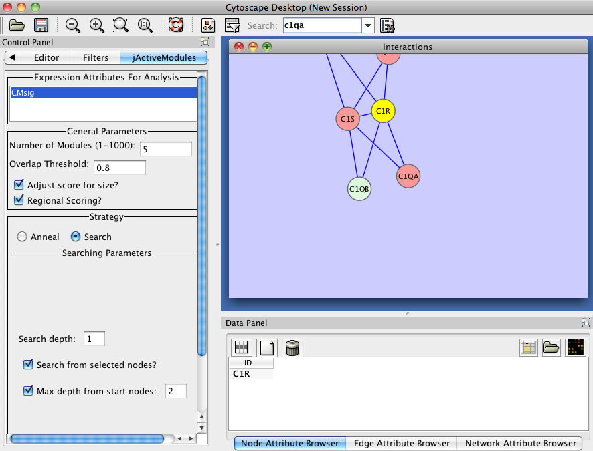
jActive - Inputs
Select expression significance (p-values)
Search from highlighted nodes

Slide 49
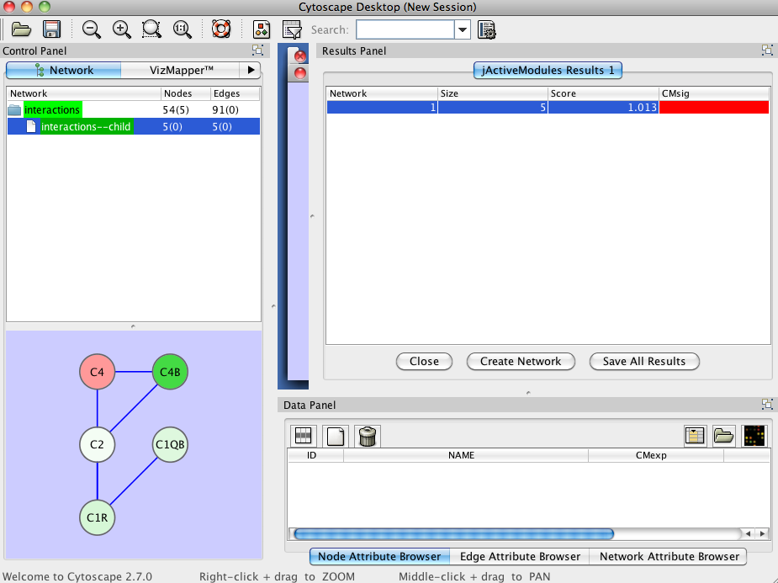
jActive - Results
Subnetworks listed here
Highlight result and click “Create Network”

Slide 50
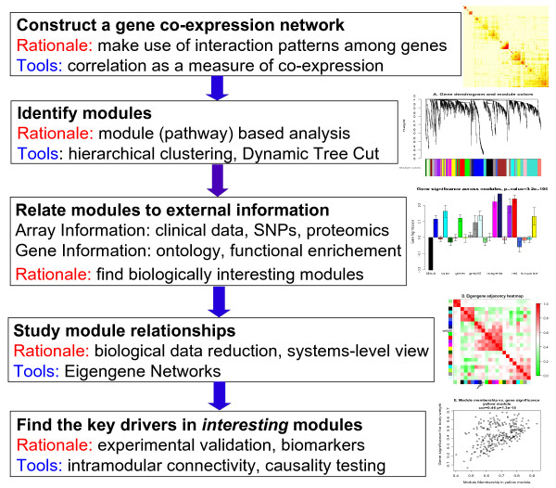
Weighted correlation network analysis (WGCNA)
WGCNA is a widely used data mining method especially designed for studying biological networks based on pairwise correlations between variables.
It allows one to define modules (clusters), intramodular hubs, and network nodes with respect to module membership, to study the relationships between co-expression modules, and to compare the network topology of different networks (differential network analysis).

Slide 51
Open Questions
Network reconstruction:
Are the available data sufficient for large-scale network reconstruction (dimensionality curse), and are the formal statements of the models very over-constrained?
How much is in the data, i.e. do the experiments capture relevant events or not?
It is very important to extend the gene network modeling to other levels of physical interactions
How to put together information from heterogeneous empirical data?

Slide 52
Open Questions
Network analysis:
Are the available technique robust and capable to distinguish natural variability from noise?
How to incorporate prior knowledge in the analysis?
When a statistically / mathematically / computer science result is biologically relevant?

Slide 53
Conclusions
Biological data are large, high dimensional and freely available.
Networks provide rich representation of biological molecules, functions and processes.
Many problems are still open and might provide a workbench for developing / applying computational methods.

