Slide 1
Applying bitwise operations for solving combinatorial optimization problems
Mikhail Batsyn¹, Larisa Komosko ¹, Alexey Nikolaev ¹, Pablo San Segundo²
¹LATNA Laboratory, Higher School of Economics, Russia
² Centro de Automática y Robótica (CAR), UPM-CSIC, Spain

Slide 2
Bitwise operations
Binary data can be represented as bit strings
CPU has such bitwise operations as:
V – or
& – and
– xor
popcnt – population count (number of 1-bits)
lsb/msb – least/most significant bit index
128 bits in 1 operation (fraction of nanosecond)

Slide 3
Bitwise operations
Find the first neighbour: lsb
Leave only neighbours: &
Add neighbours: V
Hamming distance: , popcnt
Crossover in GA: V

Slide 4
Vertex colouring problem
Independent set partition problem
Clique partition problem
SF (Smallest-First) algorithm
GIS (Greedy Independent Sets) algorithm
BnB (Branch and Bound) algorithm

Slide 5
Bitwise SF algorithm
c_{i} – the colour of vertex i
F – the matrix of forbidden colours. If F_{ki}=1 then colour k is forbidden for vertex i.
F = 0
for i = 1..n
c_{i} = min{k | F_{ki} = 0}
Fc_{i} = Fc_{i} V A_{i}
end

Slide 6
Bitwise GIS algorithm
____
B = A – the matrix of non-neighbours
c_{i} = 0, k = 1
while ∃i c_{i} = 0
while B_{i} ≠ 0
j* = min{j | B_{ij} = 1}
c_{j*} = k
B_{i} = B_{i} & B_{j*}
end
k = k + 1
end

Slide 7
Bitwise branch and bound
Same operations as in bitwise SF algorithm
Different colours are checked for every vertex

Slide 8
Computational results for SF
|V| | 500 | 1000 | 5000
Density | Speedup
0.01 | 3.2 | 3.4 | 3.4
0.10 | 3.0 | 3.3 | 3.7
0.20 | 3.5 | 3.9 | 4.5
0.30 | 4.0 | 4.5 | 5.1
0.40 | 4.2 | 4.9 | 5.5
0.50 | 4.3 | 4.9 | 5.2
0.60 | 3.8 | 4.5 | 4.5
0.70 | 3.3 | 3.9 | 3.8
0.80 | 2.7 | 3.3 | 3.4
0.90 | 2.2 | 2.5 | 3.0
0.99 | 1.8 | 1.9 | 2.9

Slide 9
Computational results for SF
G(V,E) | |V| | |E| | Speedup
brock200_1 | 200 | 14834 | 2.8
brock200_2 | 200 | 9876 | 3.2
brock200_3 | 200 | 12048 | 5.3
brock200_4 | 200 | 13089 | 2.7
brock400_1 | 400 | 59723 | 3.0
brock400_2 | 400 | 59786 | 2.8
brock400_3 | 400 | 59681 | 3.0
brock400_4 | 400 | 59765 | 2.7
brock800_1 | 800 | 207505 | 3.9
brock800_2 | 800 | 208166 | 4.0
brock800_3 | 800 | 207333 | 3.8
brock800_4 | 800 | 207643 | 4.4
c-fat200-1 | 200 | 1534 | 1.6
c-fat200-2 | 200 | 3235 | 2.7
c-fat200-5 | 200 | 8473 | 2.0

Slide 10
Computational results for SF
On Erdos-Renyi graphs the average speedup is greater for bigger graphs: 3.3 times for 500 vertices, 3.7 – for 1000, and 4.1 – for 5000.
Average speedup on DIMACS is 2.6 times.

Slide 11
Maximum clique problem
Objective: find a complete subgraph of maximum size
5
6
4
13
7
12
14
3
16
8
11
15
2
9
1
10

Slide 12
Maximum clique problem
5
6
4
13
7
12
14
3
16
8
11
15
2
9
1
10

Slide 13
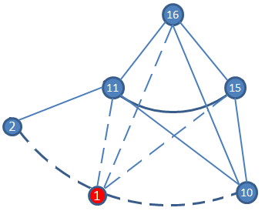
Branch and bound
Current clique: {1}
Subgraph of candidates: {2, 10, 11, 15, 16}

Slide 14
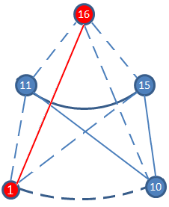
Branch and bound
Current clique: {1, 16}
Subgraph of candidates: {10, 11, 15}

Slide 15
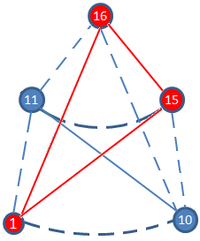
Branch and bound
Current clique: {1, 16, 15}
Subgraph of candidates: {10, 11}

Slide 16
BnB algorithm
Q – the current clique (initially Q = ∅)
C – the candidates to the current clique (C = V)
Clique (Q, C)
for v ∈ C
C = C \ {v}
Q’ = Q’ ∪ {v}
C’ = C ∩ N_{v}
if C’ ≠ ∅
Clique (Q’, C’)
else if |Q’| > |Q*|
Q* = Q’

Slide 17
Computational results
Instance | MCS | BBMCXRS | Speedup
brock400_1 | 384,74 | 167,81 | 2,3
brock400_2 | 166,36 | 70,15 | 2,4
brock400_3 | 269,29 | 119,62 | 2,3
brock400_4 | 134,36 | 69,71 | 1,9
brock800_1 | 5215,95 | 2568,36 | 2,0
brock800_2 | 4713,61 | 2346,49 | 2,0
brock800_3 | 3152,91 | 1660,29 | 1,9
brock800_4 | 2333,28 | 1101,47 | 2,1
gen400_p0.9_55 | 35013,1 | 22296,73 | 1,6
gen400_p0.9_65 | 65290 | 107577,9 | 0,6
gen400_p0.9_75 | 93551 | 90351,98 | 1,0
keller5 | 77010,2 | 52797,5 | 1,5
MANN_a45 | 105,52 | 44,62 | 2,4
p_hat300-3 | 1,58 | 0,75 | 2,1
p_hat500-3 | 56,31 | 36,48 | 1,5
p_hat700-3 | 1337,55 | 689,46 | 1,9

Slide 18
Computational results
Instance | MCS | BBMCXRS | Speedup
p_hat1000-2 | 116,08 | 71,97 | 1,6
p_hat1000-3 | 540000 | 208854,6 | 2,6
p_hat1500-1 | 2,68 | 2 | 1,3
p_hat1500-2 | 9040,29 | 6824,25 | 1,3
sanr200_0.9 | 16,25 | 9,32 | 1,7
sanr400_0.7 | 104,27 | 51,28 | 2,0
san1000 | 1,05 | 0,59 | 1,8
frb30-15-1 | 36000 | 970,29 | 37,1
frb30-15-2 | 36000 | 675,46 | 53,3
frb30-15-3 | 36000 | 314,88 | 114,3
frb30-15-4 | 36000 | 1002,85 | 35,9
frb30-15-5 | 36000 | 673,13 | 53,5

