Slide 1
High Performance Deep Learning on Intel® Architecture
Ivan Kuzmin
Engineering Manager for AI Performance Libraries
December 19, 2016

Slide 2
Fast Evolution of Technology
Bigger Data
Better Hardware
Smarter Algorithms
Image: 1000 KB / picture
Audio: 5000 KB / song
Video: 5,000,000 KB / movie
Transistor density doubles every 18 months
Cost / GB in 1995: $1000.00
Cost / GB in 2015: $0.03
Advances in neural networks leading to better accuracy in training models
Notes:
Three major drivers of why machine learning or AI is now have a resurgence . The combination of large data set that is now available (thanks to the digitalization of our lives and all the sensor data that is being collected), combined with great strides in hardware performance and capabilities along with some recent research in the field of Artificial intelligence. AI is going to become an increasingly important workload that will be run both in the data center and in the edge devices (cars, phones, cameras etc.)

Slide 3
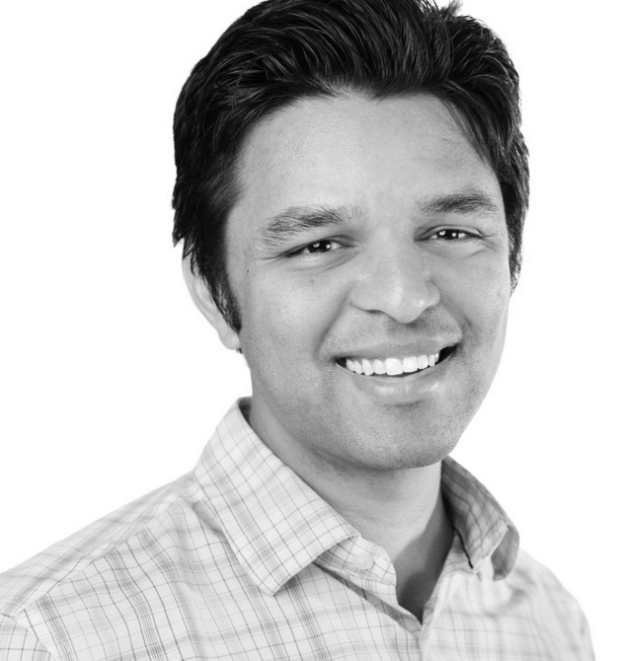
Classical Machine Learning
$$N×N$$
CLASSIFIER
SVM
Random Forest
Naïve Bayes
Decision Trees
Logistic Regression
Ensemble methods
$$(f_{1},f_{2},…, f_{K})$$
Arjun
Notes:
Naveen
Traditionally, if you have an image that is say 600x600 pix, and you would first use your domain knowledge of how to differentiate faces by engineering a smaller set of K features. These features can be for example: distance between the eyes, or distance between the nose and the mouth, or total face area. Then you apply your favorite algorithms to learn to associate these pattern of these features with an identity – Arjun.
In this approach, we are using our domain knowledge of faces to convert the image into an informative representation. But sometimes we don’t know exactly what are the useful features to extract, or they may be difficult to define in terms of pixels. Often these features are also complicated to compute.

Slide 4
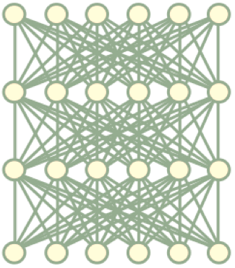
Deep learning
A method of extracting features at multiple levels
of abstraction
Features are discovered from data
Performance improves with more data
High degree of representational power
Notes:
Naveen
High degree of representational power - can represent more complex datasets like video, time series data

Slide 5
End-to-End Deep Learning
$$N×N$$
Arjun
~60 million parameters
But old practices apply:
Data Cleaning, Exploration, Data annotation, hyperparameters, etc.
Notes:
Naveen
Instead deep learning models are end-to-end, in the sense that we pass the NxN raw pixels directly to a deep neural network as input, and we provide the desired output labels, and given enough data, the model will automatically find the right features from the data.
This represents a conceptual shift in thinking, from: "how do you engineer the best features?" to
"how do you guide the model towards finding the best features?
But many old practices from machine learning still apply!

Slide 6
Automating previously “human” tasks
ImageNet Error Rate
Speech Error Rate
Human Performance
Using Deep Learning
Using Deep Learning
2010
Present
2000
Present
Notes:
Naveen

Slide 7
Deep Learning Challenges
( 1 ) Large compute requirements for training
Compute/data
O(exaflops) / O(Terabytes)
Training one model is ~ 10 exaflops
Baidu Research
Notes:
Naveen
Deep learning has many technical challenges, however. It has high arithmetic density – the ratio of compute to data is between exaflops of compute and terabytes of data.
Training one model requires about 10 exaflops of compute-- and remember, to develop a good solution, the model has to be trained many times with different settings and hyperparameters.
For this reason, a variety for hardware exists today for executing DL workloads, from the Xeon Phi to FPGAs and NVIDIA GPUs, and our forthcoming nervana ASIC.

Slide 8
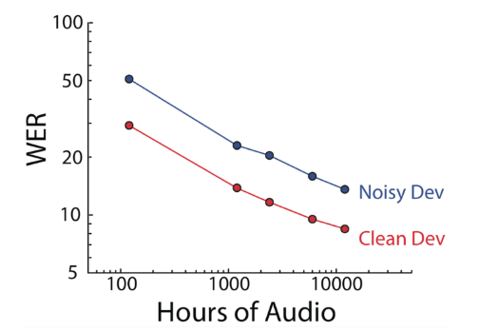
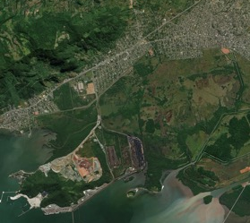
Deep Learning Challenges
( 2 ) Performance scales with data
Google’s YouTube-8M
Baidu DS2
Spacenet
Imagenet
Notes:
Naveen
Not only is training these models compute-intensive, but performance also scales with the amount of data.
Here is a plot of the WER of Baidu’s speech recognition system compared to the amount of training data. With only 100 hours of data, existing non-DL approaches can use domain knowledge and priors to compensate for the lack of data, and thus outperform Baidu's model. However, with enough data, Baidu’s Deep Speech 2 model can surpass existing systems and reach human-level performance. Of course, this comes with an incredible amount of compute.
And the datasets are getting larger. Imagnet released in 2012 has 1 million images, which was a landmark dataset at its time. Google recently release YouTube-8M, consisting of 8 million youtube videos with category labels. We also have superresolution satellite multi-spectral imagery datasets, where each image is 20K x 20K pixels and half a gig in size.
So while the mathematical concepts behind neural networks have been around for decades, it is only the recent combination of 1) enough compute to build sufficiently expressive networks and 2) enough data to train generalizable networks, that has given rise to deep learning.

Slide 9
Scaling is I/O Bound
Nervana technology:
Better communication
fabric, near
linear scaling
Industry standard: Communication overhead =
performance ceiling
Learning speed
# of processors
Notes:
Naveen

Slide 10
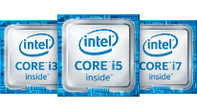
Intel Provides the Compute Foundation for DL
Deep Learning Frameworks
Caffe
Intel® Math Kernel Library for Deep Neural Networks (MKL-DNN)
DL Multi-node Scaling Library
Computational Primitives
Communication Primitives
+ Network
+ Memory + Storage
Datacenter
Endpoint
Notes:
Intel has used our expertise and software from High Performance Computing to accelerate the low level capabilities.
Our MKL DNN open source library creates a common API for the DL frameworks, and provides customized implementations for all the Intel HW, including support for the Altera FPGAs. This allows …
In addition we are building on top of the Intel MPI implementation to provide a communication library to distribute and scale compute across multiple nodes in the data center.
Lets look at each of these

Slide 11
INTEL® MKL-DNN

Slide 12
Deep learning with Intel® MKL-DNN
Deep Learning Frameworks
Caffe
Variety of popular Deep Learning frameworks
Intel® MKL-DNN
Faster optimization of frameworks by linking Intel® MKL-DNN directly, C/C++ API
New algorithms ahead of Intel® MKL productization
Collaboration across Intel and community to reuse new algorithms, accept contributions
Vehicle for collaboration with researchers on algorithmic innovation on Intel® CPU
Open Source Apache 2.0 License
Intel® Math Kernel Library
(Intel® MKL)
Intel®
MKL-DNN
Host & Offload
Intel® MKL
SW building block to extract maximum performance on Intel® CPU
Provide common interface to all Intel® CPUs.
Intel® Xeon®
Intel® Xeon Phi™
FPGA
Intel® MKL-DNN and Intel® MKL – path to bring performance to DL frameworks on Intel® CPU
*Other names and brands may be claimed as property of others.
Notes:
MKL DNN is highly optimized using industry leading techniques and low level assembly code where appropriate. The API has been developed with feedback and interaction with the major framework owners, and as an opensource project will track new and emerging trends in these frameworks. Intel is using this internally for our work in optimizing industry frameworks, as well as supporting the industry in their optimizations.

Slide 13
Deep learning with Intel® MKL-DNN
Intel® MKL-DNN
Tech preview, https://01.org/mkl-dnn
Demonstrates interfaces and the library structure for accepting external contributions
Single precision
Plan to enable more primitives to support additional topologies
Plan more optimizations for latest generation of Intel® CPU
Deep Learning primitives in Intel® MKL-DNN | For support of topologies | Optimized for
Direct (3-D) convolution Fully connected Max/Avg/Min Pooling Rectifier Linear Unit (reLu) Local Response Normalization (LRN) 3-D convolution+ reLu | AlexNet, VGG, GoogleNet, ResNet | Intel(R) Xeon(R) processor E5-xxxx v3 (codename Haswell) Intel(R) Xeon(R) processor E5-xxxx v4 (codename Broadwell)

Slide 14
Deep learning with Intel® MKL-DNN
/* Initialize CPU engine */
auto cpu_engine = mkldnn::engine(mkldnn::engine::cpu, 0);
/* Create a vector of primitives */
std::vector<mkldnn::primitive> net;
/* Allocate input data and create a tensor structure that describes it */
std::vector<float> src(2 * 3 * 227 * 227);
mkldnn::tensor::dims conv_src_dims = {2, 3, 227, 227};
/* Create memory descriptors, one for data and another for convolution input */
auto user_src_md = mkldnn::memory::desc({conv_src_dims},
mkldnn::memory::precision::f32, mkldnn::memory::format::nchw);
auto conv_src_md = mkldnn::memory::desc({conv_src_dims},
mkldnn::memory::precision::f32, mkldnn::memory::format::any);
/* Create convolution descriptor */
auto conv_desc = mkldnn::convolution::desc(
mkldnn::prop_kind::forward, mkldnn::convolution::direct,
conv_src_md, conv_weights_md, conv_bias_md, conv_dst_md,
{1, 1}, {0, 0}, mkldnn::padding_kind::zero);
/* Create a convolution primitive descriptor */
auto conv_pd = mkldnn::convolution::primitive_desc(conv_desc, cpu_engine);
/* Create a memory descriptor and primitive */
auto user_src_memory_descriptor
= mkldnn::memory::primitive_desc(user_src_md, engine);
auto user_src_memory = mkldnn::memory(user_src_memory_descriptor, src);
/* Create a convolution primitive and add it to the net */
auto conv = mkldnn::convolution(conv_pd, conv_input, conv_weights_memory,
conv_user_bias_memory, conv_dst_memory);
net.push_back(conv);
/* Create a stream, submit all primitives and wait for completion */
mkldnn::stream().submit(net).wait();
Intel® MKL-DNN Programming Model
Primitive – any operation (convolution, data format re-order, memory)
Operation/memory descriptor - convolution parameters, memory dimensions
Descriptor - complete description of a primitive
Primitive – a specific instance of a primitive relying on descriptor
Engine – execution device (e.g., CPU)
Stream – execution context

Slide 15
Intel® Xeon Phi ™ processor 7250 up to 400x performance increase with Intel Optimized Frameworks compared to baseline out of box performance
Up to 400x
Normalized Images/Second on Intel® Xeon Phi™ processor 7250 baseline
Higher is better
Configuration details available in backup
Optimization Notice: Intel's compilers may or may not optimize to the same degree for non-Intel microprocessors for optimizations that are not unique to Intel microprocessors. These optimizations include SSE2, SSE3, and SSSE3 instruction sets and other optimizations. Intel does not guarantee the availability, functionality, or effectiveness of any optimization on microprocessors not manufactured by Intel. Microprocessor-dependent optimizations in this product are intended for use with Intel microprocessors. Certain optimizations not specific to Intel microarchitecture are reserved for Intel microprocessors. Please refer to the applicable product User and Reference Guides for more information regarding the specific instruction sets covered by this notice. Notice Revision #20110804
Software and workloads used in performance tests may have been optimized for performance only on Intel microprocessors. Performance tests, such as SYSmark and MobileMark, are measured using specific computer systems, components, software, operations and functions. Any change to any of those factors may cause the results to vary. You should consult other information and performance tests to assist you in fully evaluating your contemplated purchases, including the performance of that product when combined with other products. For more complete information visit: http://www.intel.com/performance Source: Intel measured as of November 2016

Slide 16
Intel® Xeon Phi ™ processor Knights Mill up to 4x estimated performance improvement over Intel® Xeon Phi™ processor 7290
Estimated normalized performance on Intel® Xeon Phi™ processor 7290 compared to Intel® Xeon Phi™ Knights Mill
Up to 4x
Configuration details available in backup
Knights Mill performance: Results have been estimated or simulated using internal Intel analysis or architecture simulation or modeling, and provided to you for informational purposes. Any differences in your system hardware, software or configuration may affect your actual performance.
Optimization Notice: Intel's compilers may or may not optimize to the same degree for non-Intel microprocessors for optimizations that are not unique to Intel microprocessors. These optimizations include SSE2, SSE3, and SSSE3 instruction sets and other optimizations. Intel does not guarantee the availability, functionality, or effectiveness of any optimization on microprocessors not manufactured by Intel. Microprocessor-dependent optimizations in this product are intended for use with Intel microprocessors. Certain optimizations not specific to Intel microarchitecture are reserved for Intel microprocessors. Please refer to the applicable product User and Reference Guides for more information regarding the specific instruction sets covered by this notice. Notice Revision #20110804
Software and workloads used in performance tests may have been optimized for performance only on Intel microprocessors. Performance tests, such as SYSmark and MobileMark, are measured using specific computer systems, components, software, operations and functions. Any change to any of those factors may cause the results to vary. You should consult other information and performance tests to assist you in fully evaluating your contemplated purchases, including the performance of that product when combined with other products. For more complete information visit: http://www.intel.com/performance Source: Intel measured baseline Intel® Xeon Phi™ processor 7290 as of November 2016

Slide 17
INTEL® Machine Learning Scaling Library

Slide 18
Intel® Machine Learning Scaling Library (MLSL)
Deep learning abstraction of message-passing implementations.
Built on top of MPI, allows other communication libraries to be used
Optimized to drive scalability of communication patterns
Works across various interconnects: Intel® Omni-Path Architecture, InfiniBand, and Ethernet
Common API to support Deep Learning frameworks (Caffe, Theano, Torch etc.)
Alltoall
Reduce
Scatter
L
A
Y
E
R
1
L
A
Y
E
R
2
L
A
Y
E
R
N
FORWARD PROPAGATION
Allreduce
Allreduce
Allreduce
BACK PROPAGATION
Alltoall
Allgather
Allreduce
Scaling Deep Learning to 32 nodes and beyond.

Slide 19
Intel® Xeon Phi™ Processor 7250 GoogleNet V1 Time-To-Train Scaling Efficiency up to 97% on 32 nodes
Number of Intel® Xeon Phi™ Processor 7250 nodes
Data pre-partitioned across all nodes in the cluster before training. There is no data transferred over the fabric while training.
Configuration details available in backup
Optimization Notice: Intel's compilers may or may not optimize to the same degree for non-Intel microprocessors for optimizations that are not unique to Intel microprocessors. These optimizations include SSE2, SSE3, and SSSE3 instruction sets and other optimizations. Intel does not guarantee the availability, functionality, or effectiveness of any optimization on microprocessors not manufactured by Intel. Microprocessor-dependent optimizations in this product are intended for use with Intel microprocessors. Certain optimizations not specific to Intel microarchitecture are reserved for Intel microprocessors. Please refer to the applicable product User and Reference Guides for more information regarding the specific instruction sets covered by this notice. Notice Revision #20110804
Software and workloads used in performance tests may have been optimized for performance only on Intel microprocessors. Performance tests, such as SYSmark and MobileMark, are measured using specific computer systems, components, software, operations and functions. Any change to any of those factors may cause the results to vary. You should consult other information and performance tests to assist you in fully evaluating your contemplated purchases, including the performance of that product when combined with other products. For more complete information visit: http://www.intel.com/performance Source: Intel measured as of November 2016

Slide 20
NeON framework

Slide 21
Neon: DL Framework with Blazing Performance
Customer Solution
Neon Solutions
Customer Models
Neon Models
Customer Algorithms
Neon Deep Learning Functions
Hardware Agnostic
Hardware-Specific Transformers
High-performance
execution.
Notes:
In addition, Intel has its own framework, the Nervana Neon DL framework.
This framework allows us to innovate in both HW and SW to bring blazing performance to deep learning.
Our Neon team works closely with Customers on solutions in multiple domains which yields insights to improve our own implementations as well as those in the industry.

Slide 22
Intel® Nervana™ Graph Compiler
Intel® Nervana™ Graph Compiler: High-level execution graph for neural networks to enable optimizations that are applicable across multiple HW targets.
Customer Solution
Neon Solutions
Customer Models
Neon Models
Customer Algorithms
Neon Deep Learning Functions
Efficient buffer allocation
Training vs inference optimizations
Efficient scaling across multiple nodes
Efficient partitioning of subgraphs
Compounding of ops
Intel® Nervana™ Graph Compiler
Hardware Agnostic
coming soon
Hardware-Specific Transformers
MKL-DNN
Notes:
Our next innovation in this area is the Nervana graph compiler. This optimization phase is HW independent and sits below the other deep learning functions and above the MKL DNN HW specific layer. Graph compilation brings advanced capabilities to deep learning frameworks. In concept it builds a directed graph of operations and then optimizes that graph. It can combine or compound operations, partition graphs for efficiency and distribution across multiple nodes.

Slide 23
Intel® Nervana™ Graph Compiler as the performance building block…
Deep Learning Frameworks
Caffe
Intel® Nervana™ Graph Compiler
common high-level execution graph format for neural networks
Hardware Targets
…to accelerate all the latest DL innovations across the industry.
Notes:
We are developing this graph compiler to accelerate industry frameworks as well as our own. We are defining the high level interface to facilitate adoption by other deep learning frameworks and still abstract the HW targets below through MKL DNN or similar solutions

Slide 24
INTEL® DEEP Learning SDK

Slide 25
Intel® Deep Learning SDK Accelerate Your Deep Learning Solution
A free set of tools for data scientists and software developers to develop, train, and deploy deep learning solutions
“Plug & Train/Deploy”
Maximum Performance
Increased Productivity
Simplify installation & preparation of deep learning models using popular deep learning frameworks on Intel hardware
Optimized performance for training and inference on Intel® Architecture
Faster Time-to-market for training and inference,
Improve model accuracy,
Reduce total cost of ownership
How to setup Intel Caffe guide

Slide 26
Deep Learning Training Tool Intel® Deep Learning SDK
Simplify installation of Intel optimized Deep Learning Frameworks
Easy and Visual way to Set-up, Tune and Run Deep Learning Algorithms:
Create training dataset
Design model with automatically optimized hyper-parameters
Launch and monitor training of multiple candidate models
Visualize training performance and accuracy
Trained Model
Data Scientist
DL Training Tool
Label
Install
Configure
Run
Accuracy
Utilization
Model
.prototxt .caffemodel
Dataset
DL Framework
MKL-DNN
Datacenter

Slide 27
Deep Learning Deployment Tool Intel® Deep Learning SDK
Unleash fast scoring performance on Intel products while abstracting the HW from developers
Imports trained models from all popular DL framework regardless of training HW
Compresses model for improved execution, storage & transmission (pruning, quantization)
Generate Inference HW-Specific Code (C/C++, OpenVX, OpenCL, etc.)
Enables seamless integration with full system / application software stack
Trained Model
.prototxt .caffemodel
Import
Real-time Data
Validation Data
Model Optimizer
FP Quantize
Model Compress
Application Logic
Model Analysis
Forward
Result
Inference Run-Time
MKL-DNN
OpenVX
End-Point SW Developer
Deploy-ready model
27

Slide 28
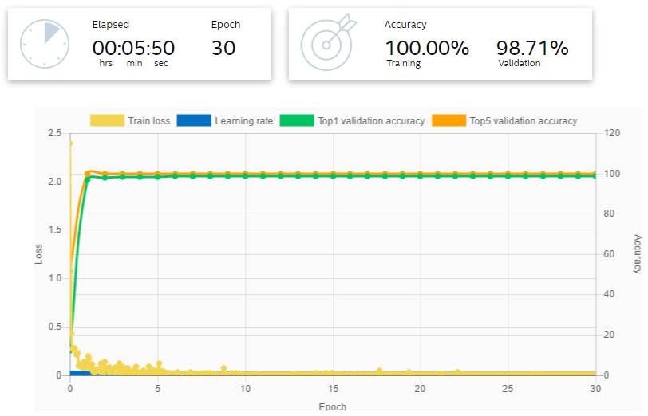
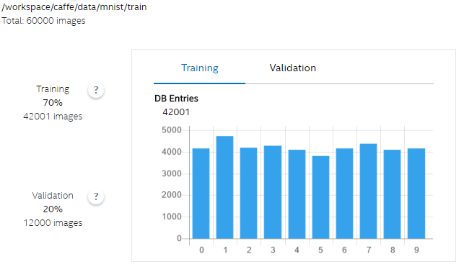
Deep Learning Tools for End-to-End Workflow Intel® Deep Learning SDK
Intel DL Training Tool
Intel DL Deployment Tool
configure_nn(fpga/,…)
allocate_buffer(…)
fpga_conv(input,output);
fpga_conv(…);
mkl_SoftMax(…);
mkl_SoftMax(…);
…
INSTALL / SELECT IA-Optimized Frameworks
PREPARE / CREATE Dataset with Ground-truth
DESIGN / TRAIN Model(s) with IA-Opt. Hyper-Parameters
MONITOR Training Progress across Candidate Models
EVALUATE Results and ITERATE
IMPORT Trained Model (trained on Intel or 3rd Party HW)
COMPRESS Model for Inference on Target Intel HW
GENERATE Inference HW-Specific Code (OpenVX, C/C++)
INTEGRATE with System SW / Application Stack & TUNE
EVALUATE Results and ITERATE
MKL-DNN Optimized Machine Learning Frameworks
Optimized libraries & run-times (MKL-DNN, OpenVX, OpenCL)
Data acquisition (sensors) and acceleration HW (FPGA, etc)
Xeon (local or cloud)
Target Inference Hardware Platform (physical or simulated)

Slide 29
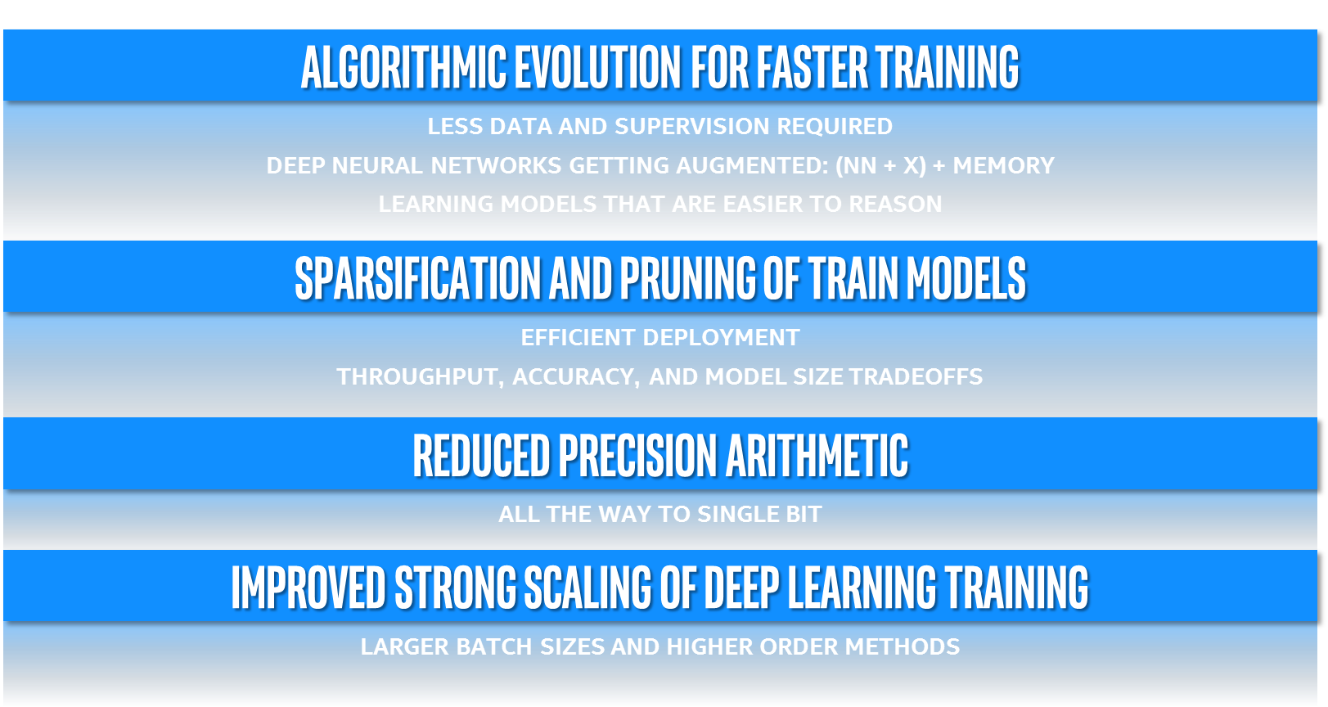
Leading AI research

Slide 30
Summary
Intel provides highly optimized libraries to accelerate all DL frameworks
Intel® Machine Learning Scaling Library (MLSL) allow to scale DL to 32 nodes and beyond
Nervana graph compiler, next innovation for DL performance
Intel® Deep Learning SDK make it easy for you to start exploring DeepLearning
Intel is committed to provide algorithmic, SW and HW innovations to get best performance for DL on IA
Get more details at: https://software.intel.com/en-us/ai/deep-learning

Slide 31
Legal Disclaimer & Optimization Notice
INFORMATION IN THIS DOCUMENT IS PROVIDED “AS IS”. NO LICENSE, EXPRESS OR IMPLIED, BY ESTOPPEL OR OTHERWISE, TO ANY INTELLECTUAL PROPERTY RIGHTS IS GRANTED BY THIS DOCUMENT. INTEL ASSUMES NO LIABILITY WHATSOEVER AND INTEL DISCLAIMS ANY EXPRESS OR IMPLIED WARRANTY, RELATING TO THIS INFORMATION INCLUDING LIABILITY OR WARRANTIES RELATING TO FITNESS FOR A PARTICULAR PURPOSE, MERCHANTABILITY, OR INFRINGEMENT OF ANY PATENT, COPYRIGHT OR OTHER INTELLECTUAL PROPERTY RIGHT.
Software and workloads used in performance tests may have been optimized for performance only on Intel microprocessors. Performance tests, such as SYSmark and MobileMark, are measured using specific computer systems, components, software, operations and functions. Any change to any of those factors may cause the results to vary. You should consult other information and performance tests to assist you in fully evaluating your contemplated purchases, including the performance of that product when combined with other products.
Copyright © 2016, Intel Corporation. All rights reserved. Intel, Pentium, Xeon, Xeon Phi, Core, VTune, Cilk, and the Intel logo are trademarks of Intel Corporation in the U.S. and other countries.
Optimization Notice
Intel’s compilers may or may not optimize to the same degree for non-Intel microprocessors for optimizations that are not unique to Intel microprocessors. These optimizations include SSE2, SSE3, and SSSE3 instruction sets and other optimizations. Intel does not guarantee the availability, functionality, or effectiveness of any optimization on microprocessors not manufactured by Intel. Microprocessor-dependent optimizations in this product are intended for use with Intel microprocessors. Certain optimizations not specific to Intel microarchitecture are reserved for Intel microprocessors. Please refer to the applicable product User and Reference Guides for more information regarding the specific instruction sets covered by this notice. Notice revision #20110804
31

Slide 33
Configuration details
BASELINE: Caffe Out Of the Box, Intel® Xeon Phi™ processor 7250 (68 Cores, 1.4 GHz, 16GB MCDRAM: cache mode), 96GB memory, Centos 7.2 based on Red Hat* Enterprise Linux 7.2, BVLC-Caffe: https://github.com/BVLC/caffe, with OpenBLAS, Relative performance 1.0
NEW: Caffe: Intel® Xeon Phi™ processor 7250 (68 Cores, 1.4 GHz, 16GB MCDRAM: cache mode), 96GB memory, Centos 7.2 based on Red Hat* Enterprise Linux 7.2, Intel® Caffe: : https://github.com/intel/caffe based on BVLC Caffe as of Jul 16, 2016, MKL GOLD UPDATE1, Relative performance up to 400x
AlexNet used for both configuration as per https://papers.nips.cc/paper/4824-Large image database-classification-with-deep-convolutional-neural-networks.pdf, Batch Size: 256

Slide 34
Configuration details
BASELINE: Intel® Xeon Phi™ Processor 7290 (16GB, 1.50 GHz, 72 core) with 192 GB Total Memory on Red Hat Enterprise Linux* 6.7 kernel 2.6.32-573 using MKL 11.3 Update 4, Relative performance 1.0
NEW: Intel® Xeon phi™ processor family – Knights Mill, Relative performance up to 4x

Slide 35
Configuration details
Public
32 nodes of Intel® Xeon Phi™ processor 7250 (68 Cores, 1.4 GHz, 16GB MCDRAM: flat mode), 96GB DDR4 memory, Red Hat* Enterprise Linux 6.7, export OMP_NUM_THREADS=64 (the remaining 4 cores are used for driving communication) MKL 2017 Update 1, MPI: 2017.1.132, Endeavor KNL bin1 nodes, export I_MPI_FABRICS=tmi, export I_MPI_TMI_PROVIDER=psm2, Throughput is measured using “train” command. Data pre-partitioned across all nodes in the cluster before training. There is no data transferred over the fabric while training. Scaling efficiency computed as: (Single node performance / (N * Performance measured with N nodes))*100, where N = Number of nodes
Intel® Caffe: Intel internal version of Caffe
GoogLeNetV1: http://static.googleusercontent.com/media/research.google.com/en//pubs/archive/43022.pdf, batch size 1536

