Slide 1
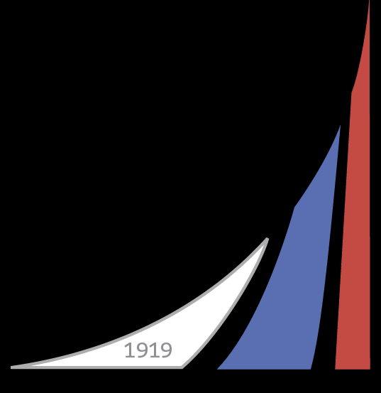
The 7th International Conference on Network Analysis June 22-24, 2017 Nizhny Novgorod
Developing a Model of Topological Structure Formation for
Power Transmission Grids Based on the Analysis of the UNEG
Financial University
under the Government of the Russian Federation
Sergey Makrushin, PhD in Econ.
SVMakrushin@fa.ru

Slide 2
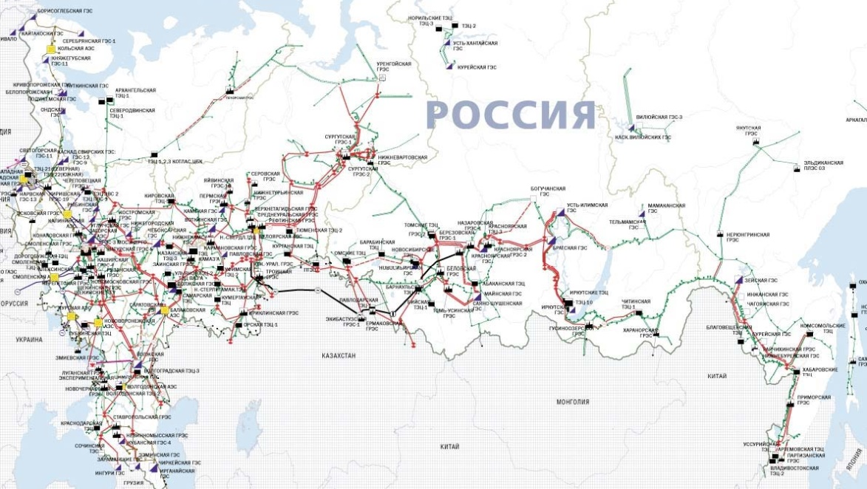
INFRASTRUCTURE NETWORKS AS RESEARCH SUBJECT
2
Without models of spatial and topological structure of infrastructure networks we are not able to adequately solve the problem of finding optimal balance between capital expenditure, operational expenditure and availability of network services, their reliability and quality of service.
Costs
Optimal level
Total
costs
CAPEX
Inaccessibility of service
Losses from accidents
OPEX
Federal Grid Company
of the United Energy System
Volume of network infrastructure
UNEG – United National Electricity Grid
(Russian power transmission grid 220-750 kV)
All components of total costs of infrastructure networks are dependent on their topology and spatial structure

Slide 3
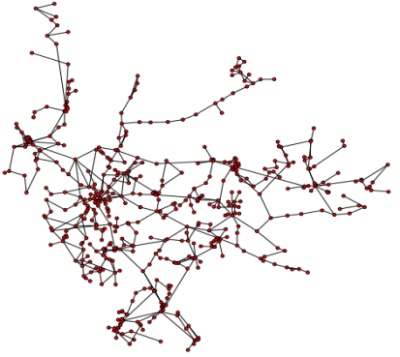
REASON FOR DEVELOPING MODELS OF NETWORK FORMATION
3
The model of topological structure formation for power transmission grids will give a tool for advanced analysis of networks and will help to build up long-term forecasts of the network development.
Transmission
grid
Metrics of CNT
Models of CNT
Correct comparison
of networks
Models of topological
structure formation
Discovering individual characteristics of the network compared to the class of networks with the same topological structure
Discovering the rules which manage the growth of the network
Correct analysis of network properties which are defined by their topology
Forecast and management of the long-term network topology development
Notes:
Актуализировать

Slide 4
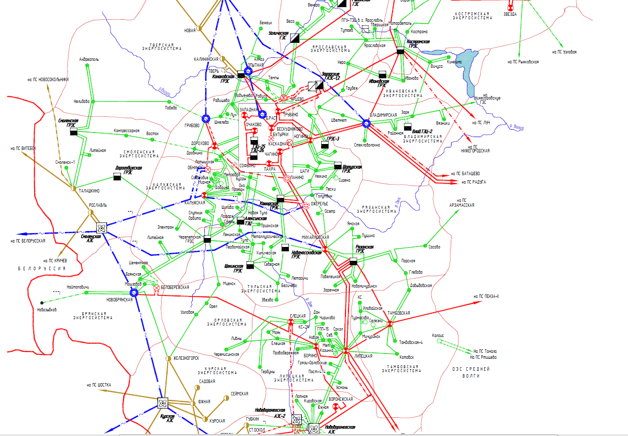
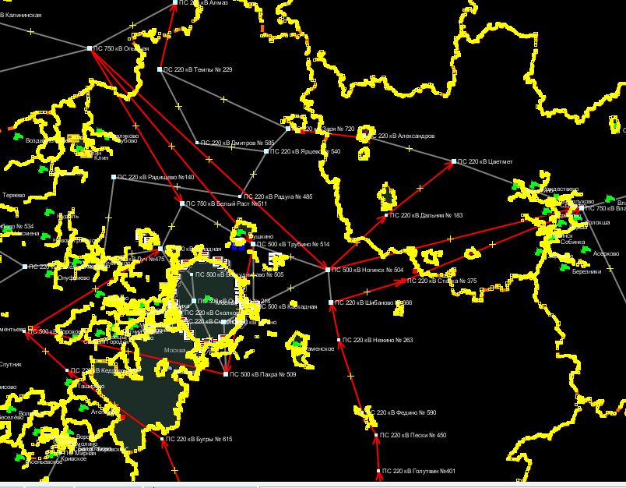
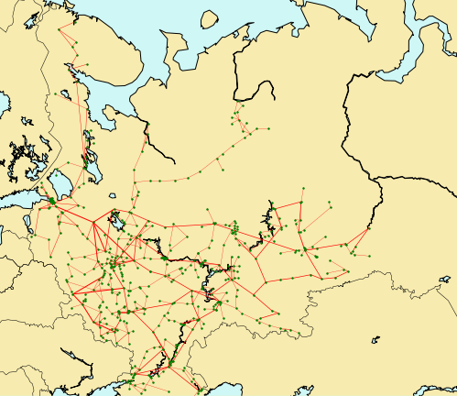
UNEG RESEARCH: DATA GATHERING AND PREPARING
4
In 2013 our group started research of the UNEG with methods of complex network
theory.
1. UNEG network map from an official source
2. UNEG model in GIS based
on Open street map
3. UNEG computer model prepared for the research
514 network nodes (power substations and power stations )
614 network links (high-voltage power lines )
Network elements attributes: geographic coordinates for nodes, region binding, voltage levels, substation power

Slide 5
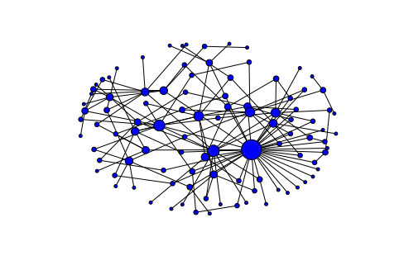
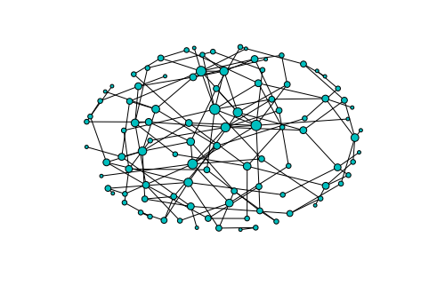
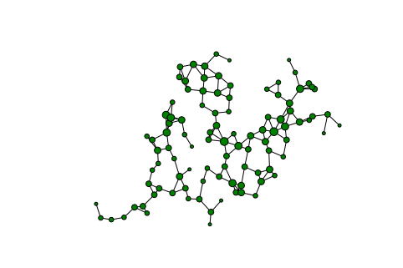
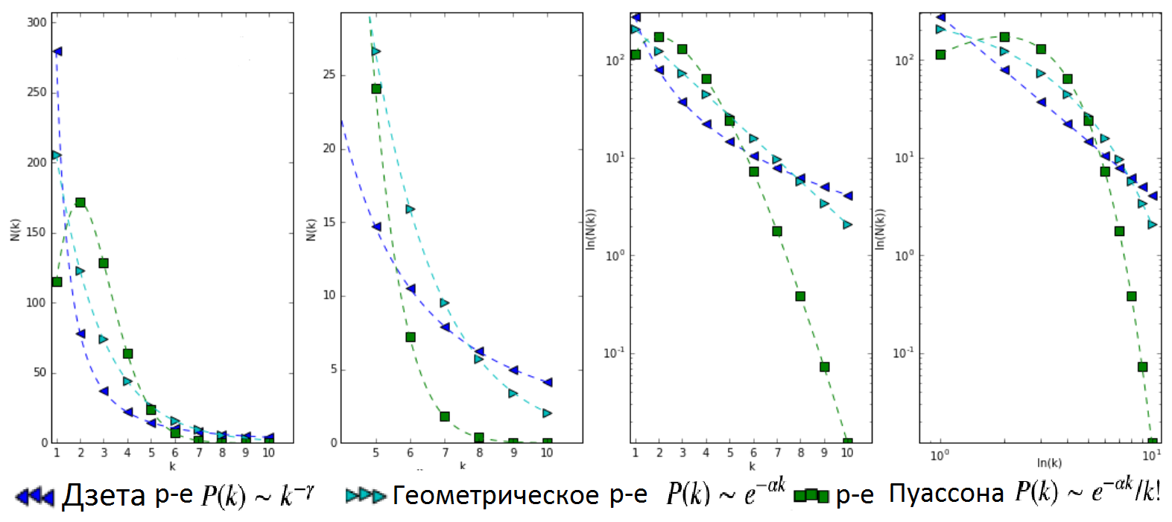
NODES DEGREE DISTRIBUTION IN MODELS OF COMPLEX NETWORKS
5
Scale free network
Growing random network
Random geometric graph
Network growth rules:
Nodes are born over time and form attachments to existing nodes…
Nodes are connected only if their distance in metric space is in a given range.
… with preference for connections to hubs.
… randomly.
Nodes degree distribution for the models (shown in different coordinate axes)
nodes with
low degree
hubs
Zeta distribution
Geometric distribution
Poisson distribution

Slide 6
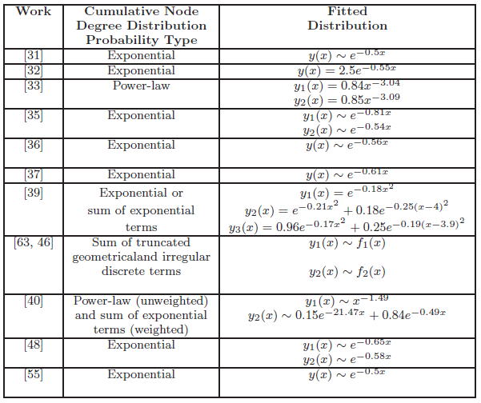
RESULTS OF PREVIOUS RESEARCHES AND METHODS CHOICE
6
In previous researches of power transmission grids a regression model was used and the geometric (exponential) distribution was obtained. However, despite the high value of $R^{2}$ the regression model appears to be less correct than methods based on maximum likelihood.
Degree distributions law from the previous researches*
Nodes degree distribution for the UNEG network (empirical analog of probability mass function)
2 points contains information about 65% of all nodes
$$P\left(k\right)\sim e^{−0,59k}$$
R² = 0,9453
Using of a regression model for the probability mass function of discrete random variable is incorrect, because of the violation of the Gauss–Markov theorem assumption about homoscedasticity of errors. Akaike information criterion (AIC) and Bayesian information criterion (BIC) could be used instead of the regression model .
*G. A. Pagani, M. Aiello The Power Grid as a Complex Network: a Survey // Physica A: Statistical Mechanics and its Applications 05/2011; 392 (11)

Slide 7
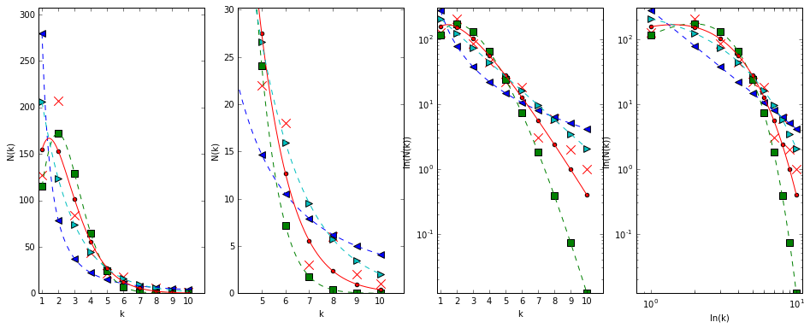
UNEG NODES DEGREE DISTRIBUTION ANALYSIS
7
Poisson distribution could well approximate the empirical UNEG distribution for low
degrees of nodes, and Geometric distribution – for high degrees of nodes. Negative binomial distribution could have a head like a Poisson distribution and a tail like a Geometric distribution and better approximate the UNEG nodes degree distribution. Nevertheless,
chi-square test rejects using all of them for the UNEG.
UNEG nodes degree distribution approximation (shown in different coordinate axes)
Zeta distribution
Geometric distribution
Poisson distribution
Сеть ЕНЭС (факт)
$$P\left(k\right)= C_{r+k−1}^{r−1}{\left(1−p\right)}^{k}p^{r}$$
Empirical UNEG distribution
Negative binomial distribution
Distribution | Parameters | ln of likelihood function | AIC | BIC | $$χ^{2}$$ | P-value
Zeta | $γ$= 1.83 | -1025,7 | 2053,4 | 2057,6 | 430,5 | 7,73E-91
Geometric | p= 0.40 | -864,3 | 1730,6 | 1734,8 | 95,1 | 5,57E-19
Poisson | $λ$= 1.49 | -856,8 | 1715,6 | 1719,8 | 88,2 | 1,57E-17
Negative binomial | r=3, p=0.67 | -834,4 | 1672,8 | 1681,3 | 33,1 | 1,13E-06

Slide 8
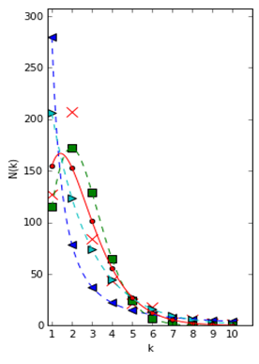
SPECIAL ROLE OF TRANSIT NODES IN POWER TRANSMISSION GRIDS
8
High proportion of transit nodes with degree of 2 is a consequence of high occurrence of chain patterns in power transmission grids. A chain of transit nodes forms a long power line route which effectively transmits electricity for long distances and is usually built within one project.
Even the Poisson distribution (which is typical for a random geometrical graph) could not form a network with a sufficient proportion of transit nodes.

Slide 9
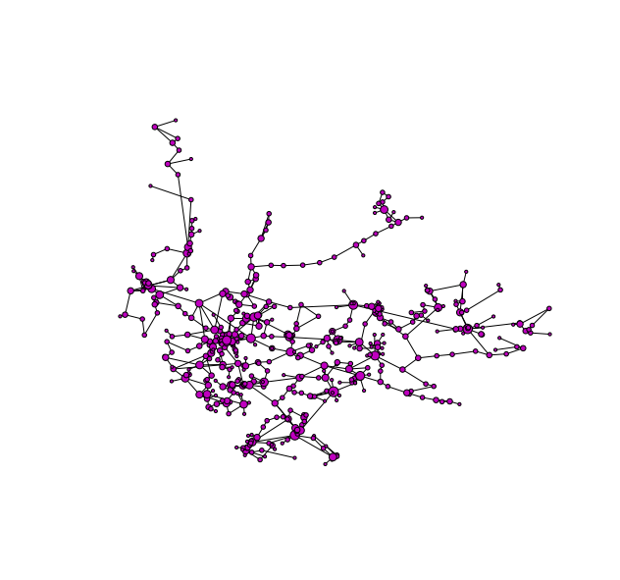
POWER GRID GROWTH PRINCIPLES
9
The analysis shows that model of topological structure formation for the UNEG should be based on a composite of geometrical and historical network formation principles and take into account the special role of transit nodes.
Geometrical principle of network growth:
link creation is defined by metric distance between nodes.
Historical principle of network growth:
nodes are added sequentially and the degree of a node is dependent on the life span of a node.
Zeta distribution of nodes degree
Geometric distribution of nodes degree
For nodes with low degree
For nodes with high degree
Random geometric graph
UNEG network
Growing random network
Notes:
Добавить про особую роль степени 2

Slide 10
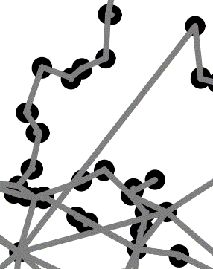
RANDOM GROWTH MODEL (RGM)* ALGORITHM
10
Analysis of ad-hoc models of topological structure formation for power transmission grids showed that RGM stands out among other models, because it implements the historical and the spatial principles and even has a mechanism for the formation of chain patterns. This algorithm is a development of the growing random network with a focus on spatial links length optimization.
Rules of sequential network growth***
Geometrical principle of network growth in the RGM
Link creation process minimizes either link spatial length $d_{S}\left(n_{i},n_{j}\right)$, or ratio of increasing of reliability to its costs**: $f_{RC}(n_{i},n_{j})= \frac{{(d_{G}\left(n_{i},n_{j}\right)+1)}^{r}}{d_{S}(n_{i},n_{j})}$, $d_{G}$ – distance in hops.
node addition
s
1-s
=0,28
OR
=0,72
splitting an existing link
connection to the nearest node
Historical principle of network growth in the RGM
Like in the model of growing random network there are two stages of formation:
creation of small connected kernel of a network: minimal spanning tree is enforced by links with max $f_{RC}(n_{i},n_{j})$.
growth of the network due to sequential addition of new nodes (realization of the historical principle).
Addition of a link which
increases reliability
p
q
=0,03
=0,44
for the new node
for network
$$n^{∗}$$
$$n^{∗}$$
$$\max{f_{RC}(n^{∗},n_{j})}$$
$$\max{f_{RC}(n_{i},n_{j})}$$
*Schultz P., Heitzig J., Kurths J. A Random Growth Model for Power Grids and Other Spatially Embedded Infrastructure Networks // Eur. Phys. J. – 2014
** Except case of splitting line for adding a new node *** Second stage of network formation

Slide 11
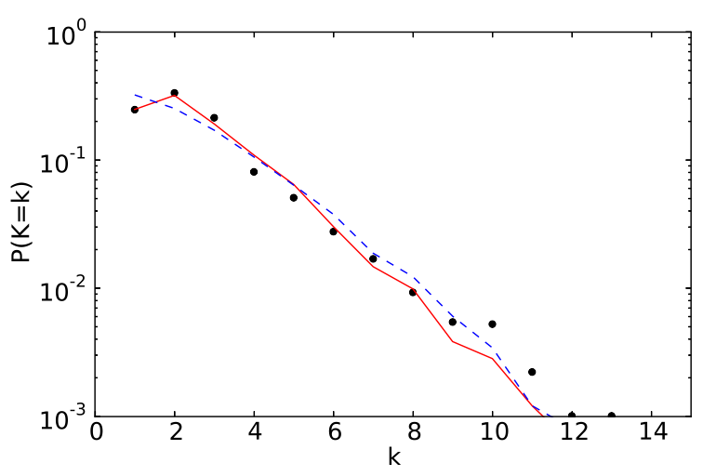
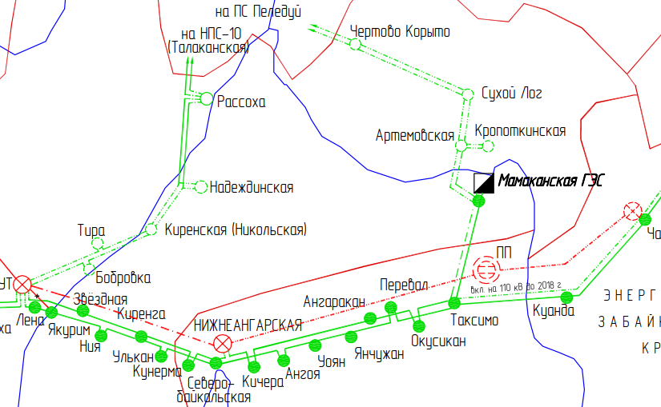
TRANSIT NODES CREATION TECHNIQUE
11
High accuracy of RGM is based on the creation of a large quantity of transit nodes as a result of splitting power transmission lines. But in practice most transit nodes are formed as a result of projects of long power line routes creation. Unfortunately difference between this variants couldn’t be seen on the nodes degree distribution.
Creation of transit nodes as the result of:
splitting a power transmission line (link)
by a new substation (node)
a project of a long power line route creation
Nodes degree distribution for
Western US power grid* (6,6 thous. nodes)
Example from the UNEG development program
Empirical distribution
RGM with a link splitting probability of 0%
RGM with a link splitting probability of 28%
*Schultz P., Heitzig J., Kurths J. A Random Growth Model for Power Grids and Other Spatially Embedded Infrastructure Networks // Eur. Phys. J. – 2014

Slide 12
OPTIMIZATION: GLOBAL, LOCAL AND «PROJECT» LEVEL
12
The analysis has shown that the most prospective way of developing a model of topological structure formation for power transmission grids is to further develop RGM algorithm by adding new “project” stage of network formation. This stage is a transition from global to local optimization level and could show correctly large-scale projects of network development.
NEW MODEL OF FOMATION OF TOPOLOGY OF POWER TRANSMISSION GRIDS
RGM ALGORITHM
global optimization
local optimization
Prevails on the early stage of network growth
(I stage in RGM)
Prevails on the
late stage of network growth
(I I stage in RGM)
«project» optimization
Spatial density of a network
Prevails on the intermediate stage of network growth
(absent in RGM)

Slide 13
The 7th International Conference on Network Analysis June 22-24, 2017 Nizhny Novgorod
Спасибо за внимание!
THANK YOU FOR ATTENTION!
Financial University
under the Government of the Russian Federation
Sergey Makrushin, PhD in Econ.
SVMakrushin@fa.ru

