Slide 1
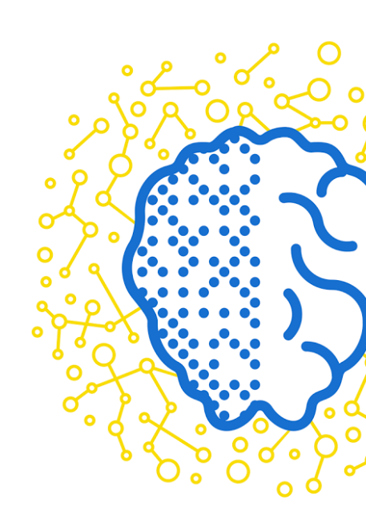
iPavlov: Conversational Intelligence Project
Mikhail Burtsev, PhD
Moscow Institute of Physics and Technology
(MIPT)

Slide 2
Everybody has a dream

Slide 3
A dream about AI.

Slide 4
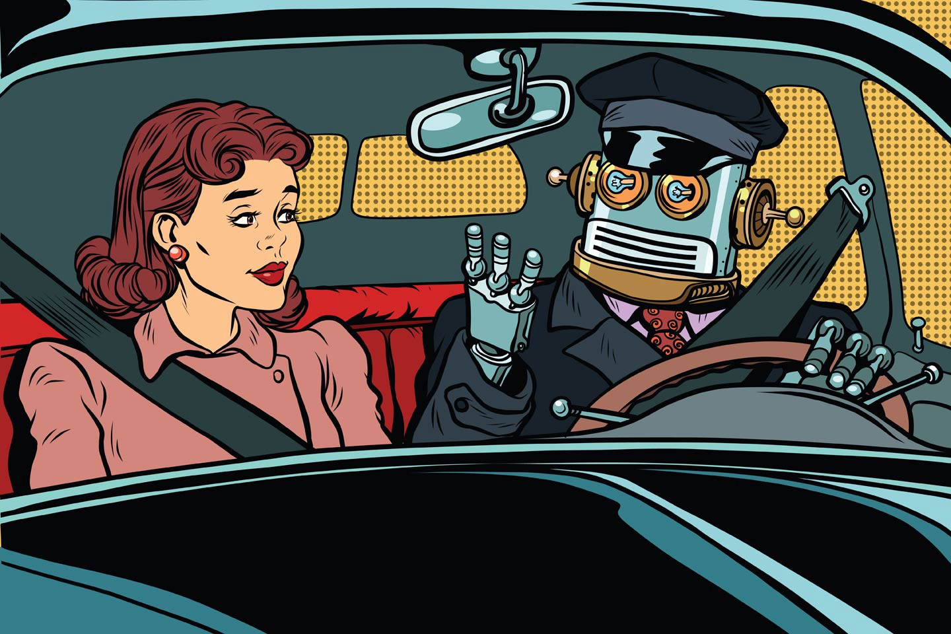
What is the shortest path to AI?

Slide 8
R&D Landscape in Conversational Intelligence
Conversational Intelligence
Complex real world problem
Can be decomposed into simpler tasks - NLU, DM, NLG
Big amount of data is available
Immediate application in industry
A step towards solving AI
Promise of deep learning :
recurrent neural networks for the generation of sequences, and
attention and reinforcement learning for the dialogue planning .

Slide 9
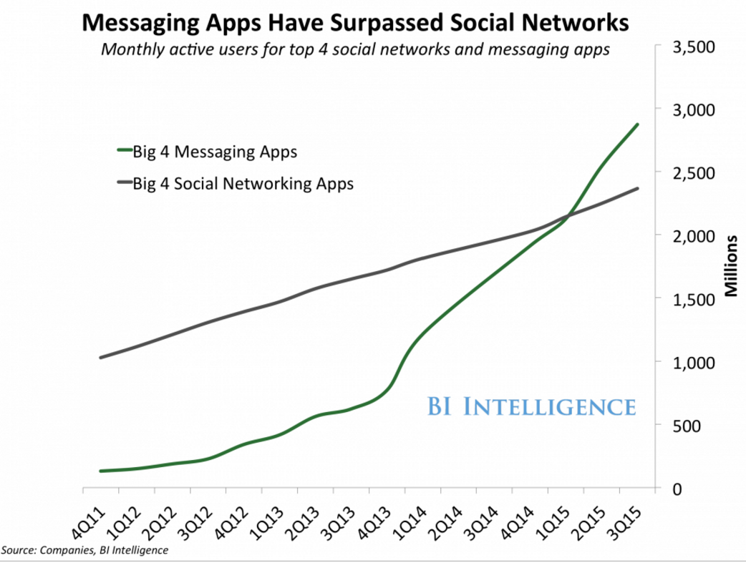
Textual exchange dominates digital communication

Slide 10
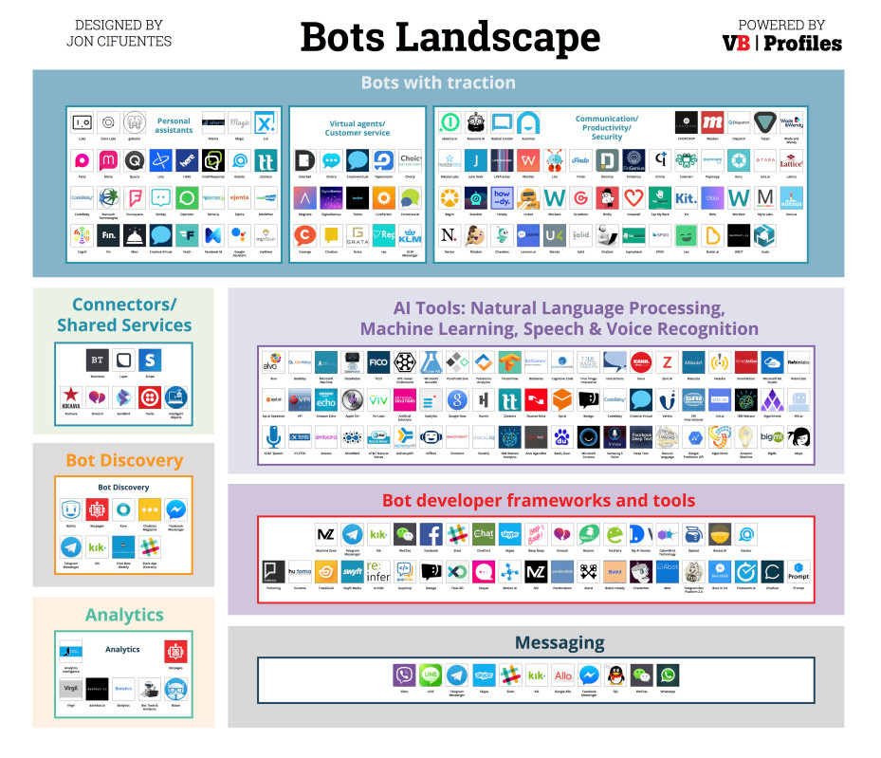
Conversational interface to seamlessly plug in human communication

Slide 11
iPavlov project

Slide 12
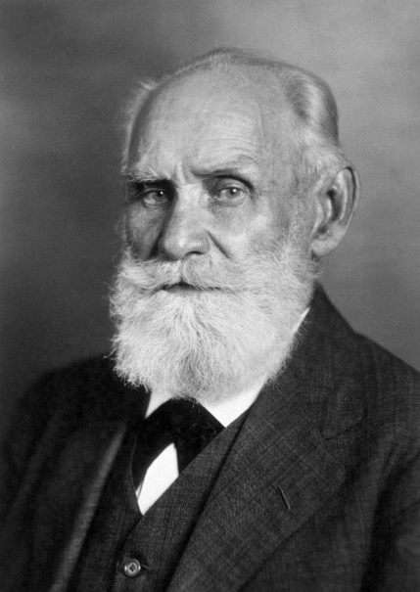
iPavlov project
Deep learning architectures for the conversational intelligence
The major lab project for the 2017-2019
Joint project with Sberbank the largest bank in Russia (operating income $20 billion, total assets $400 billion (2014))
20 researchers and engineers
Ivan Petrovich Pavlov
(1849 –1936)
Russian physiologist known for his work in classical conditioning.

Slide 13
Stakeholders
iPavlov
MIPT
Sberbank
Startup ecosystem
AI Research Center
Researchers
backend for AI powered applications
instruments for fast prototyping of models
tools for rapid development of chat-bots

Slide 14
iPavlov project
Technology outcomes
Opensource deep learning NLP library DeepPavlov.
AI platform DeepReply implementing NLP services on top of DeepPavlov library for the chat-bot and dialogue systems products.
Technology Stack | Project Outcome | Description | Examples
AI APPLICATIONS | Out of the scope of iPavlov project | Third party AI applications in the domain of conversational intelligence. | Google Now, Digital Genius
AI SERVICES | DeepReply | AI conversational services to the neural network models trained for specific domains. | API.ai, wit.ai, Google NLP API
DEEP LEARNING ARCHITECTURES | DeepPavlov | Core components for neural conversational intelligence. Basic NLP functions and major neuroarchitectures for the dialogue systems. | MemNN, HRED
CORE DEEP LEARNING ALGORITHMS |  |  | Seq2seq, CNN, RNN, LSTM
COMPUTATIONAL LIBRARIES | Out of the scope of iPavlov project |  | ThensorFlow (Google), Torch(Facebook),
DRIVERS GPU/FPGA |  |  | C/C++,Python, Julia…
CPU/GPU/FPGA |  |  | NVIDIA GPU, Intel CPU, Google TPU

Slide 15
Workpackages
Research
Development DeepPavlov open source library
Applications DeepReply services
Neural architectures for dialogue systems
Repository of dialogue agents’ models for variety of tasks
Conversational agents for specific business cases
Neural networks and reinforcement learning for planning
Lego-like modules for the fast prototyping of dialogue systems
API for separate NLU, DM, NLG tasks
Service NLP functions

Slide 16
Modular dialog system
Are there any comedy movies to see this weekend?
text data
NLU
(Natural Language Understanding)
Domain detection
Intent detection
Entities detection
intent = request_movie
entities = { genre = ‘комедии’,
date = ‘выходные ’ }
semantic frame
Where are you?
text data
NLG
(Natural Language Generation)
Generative models
Templates
DM
(Dialogue manager)
Состояние диалога
Политика поведения
action = request_location
system action

Slide 17
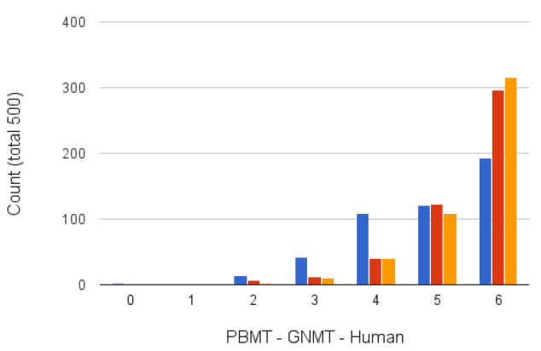
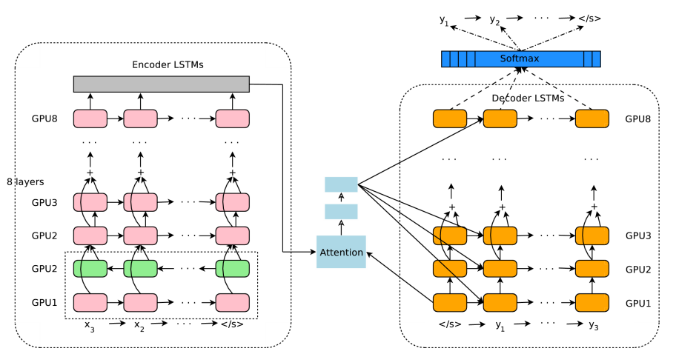
Promise of deep neural nets
Google Neural Machine Translation
Google's Neural Machine Translation System: Bridging the Gap between Human and Machine Translation https://arxiv.org/abs/1609.08144 , Mon, 26 Sep 2016

Slide 19
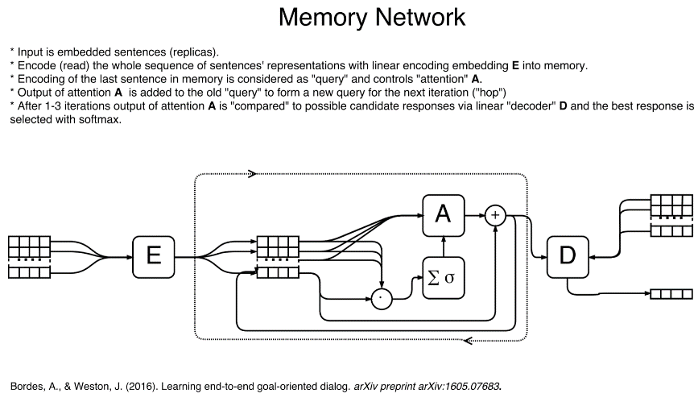
Evolution of Neuro NLP Architectures

Slide 20
Traditional pipeline in neural network implementation
Natural Language Understanding
Dialog State Tracker
Natural Language Generation
Policy
Embedding or Encoder:
mapping of input data to multidimensional space with desired properties resulting in vector representation
Memory:
history or context of the process represented as a set of vector representations
Attention:
given vector representation of the current input and memory controls hidden state of the system
Decoder or Action generator:
given hidden state of the system generates output

Slide 21
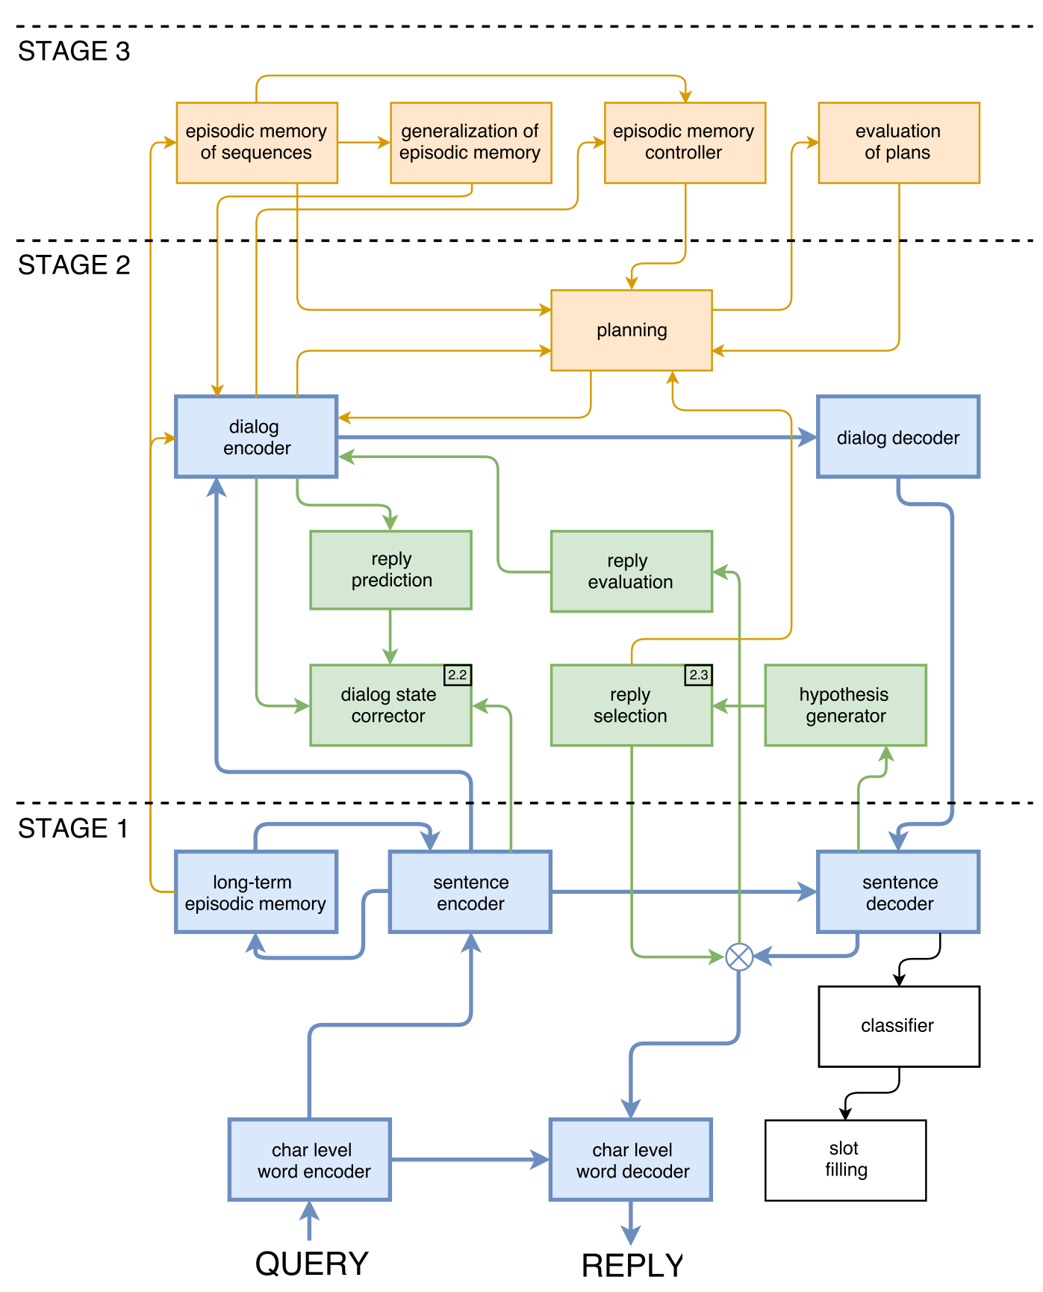
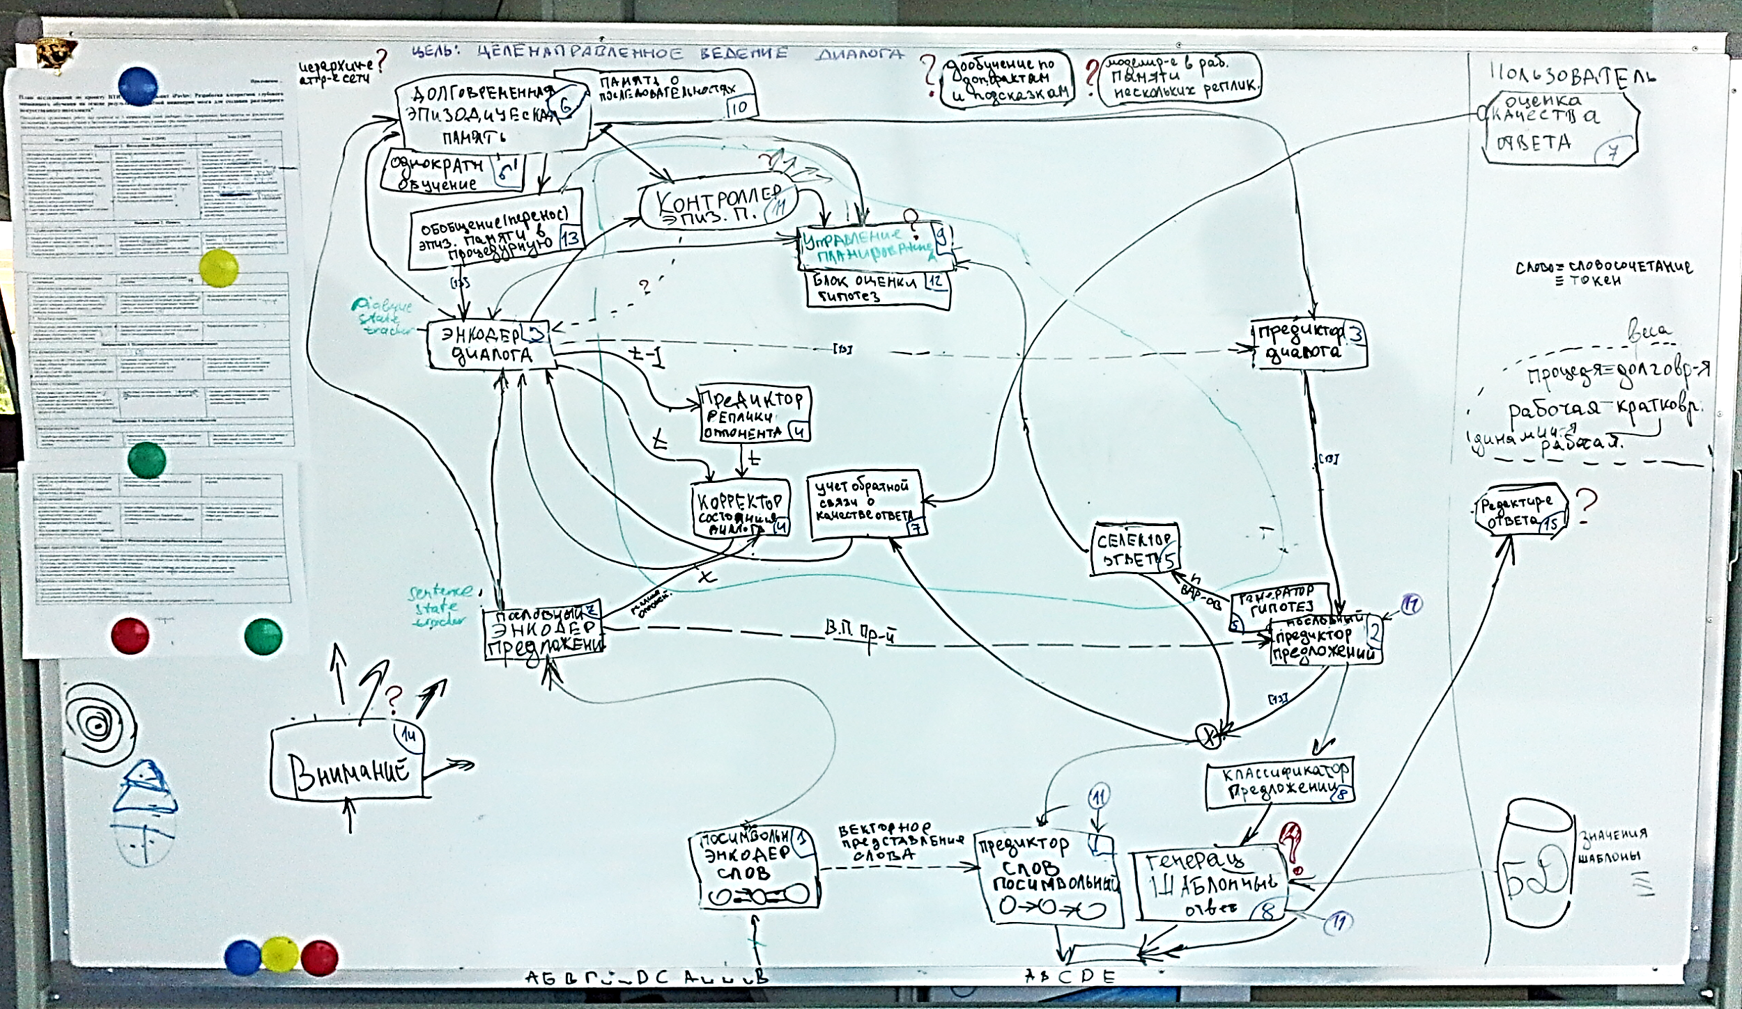
Sketch of the integrated architecture
A year ago

Slide 22
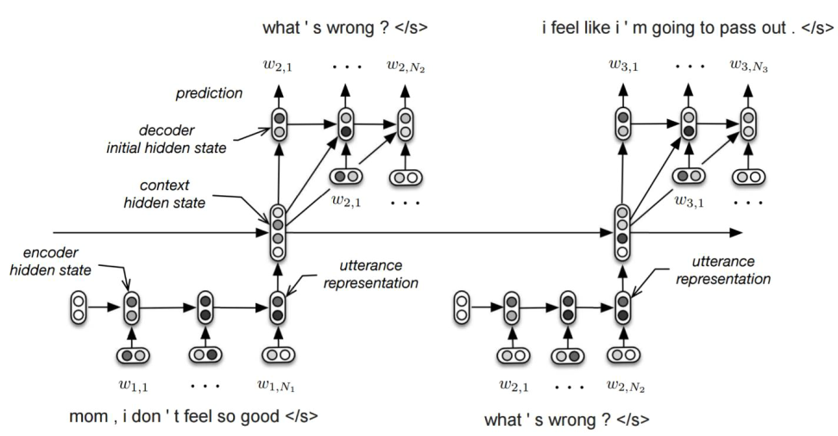
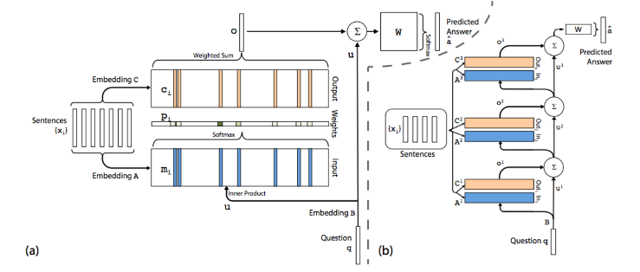
Sketch of the integrated architecture
Memory Networks (Weston et.al., 2015)
HRED (Serban et.al., 2016)

Slide 23
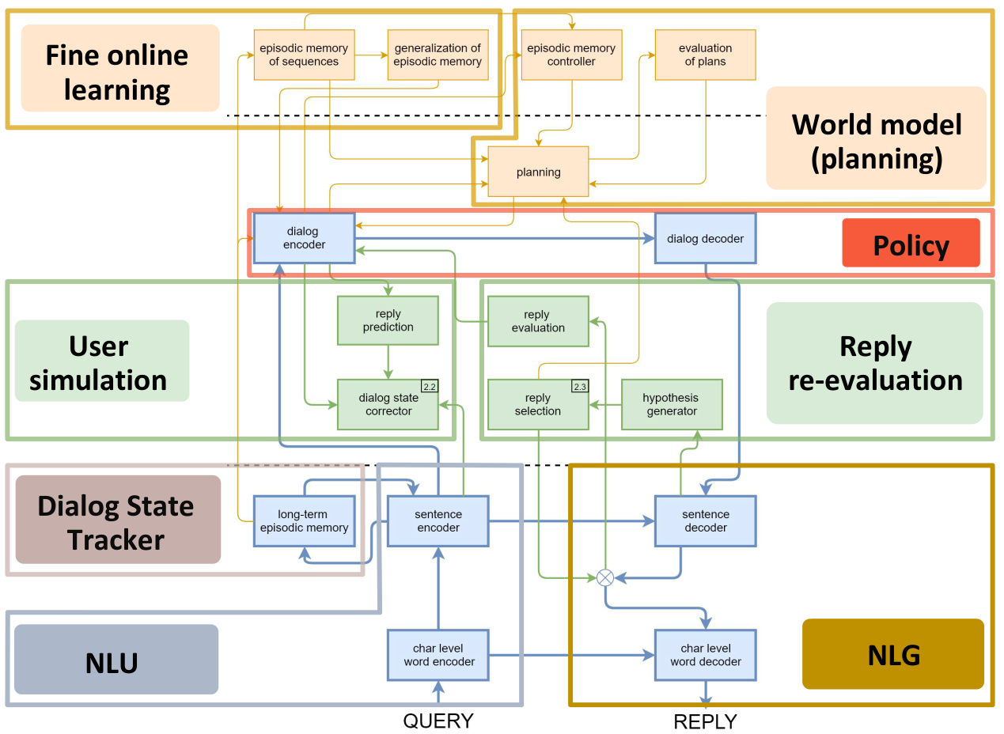
Sketch of the integrated architecture

Slide 24
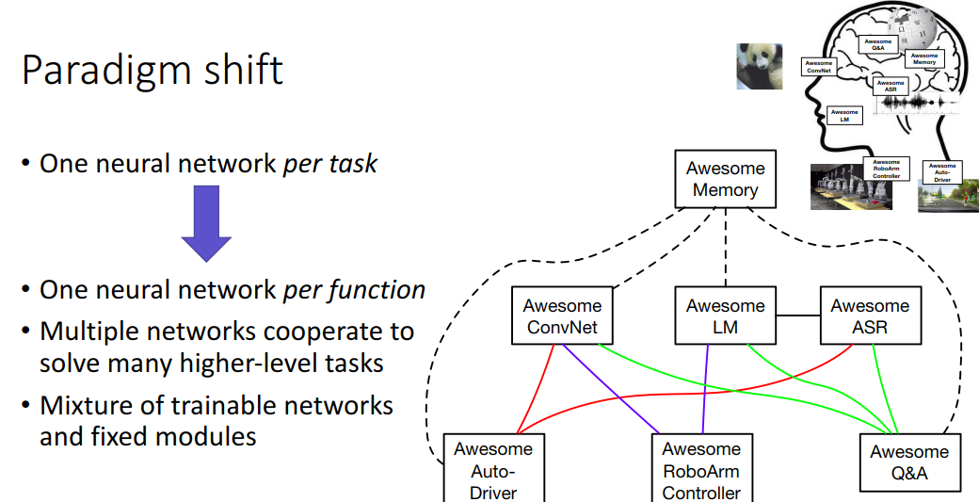
Modularity
Kyunghyun Cho (2017) Deep Learning: a Next Step?
https://drive.google.com/file/d/0B16RwCMQqrtdVWVGTE5LcWtwTzA/view

Slide 25
DeepPavlov
S Agent
T Agent
F Agent
C Agent
 | Task-Oriented | Factoid | Chit-Chat
Named Entity Recognition | √ | √
Coreference resolution | √ | √
Paraphrase detection | √ | √
Insults detection | √ |  | √
Q&A |  | √
Interactive Querying | √ | √
Memory | √ |  | √
Dialogue Policy | √ |  | √
…
 | DSTC-2 | SQuAD | reddit
Modules

Slide 26
DeepPavlov Open Source Library

Slide 27
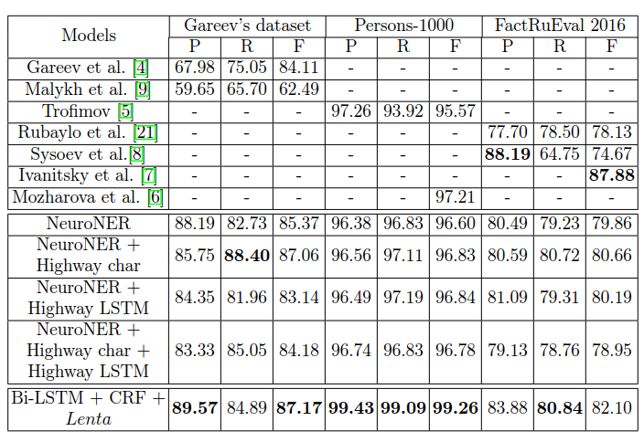
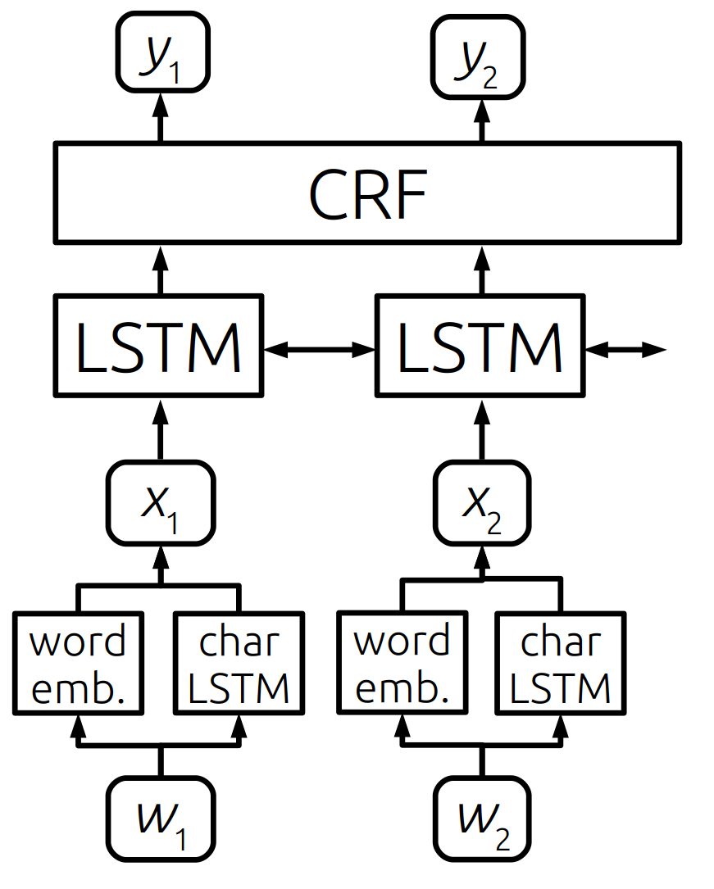
Some results
Named entity recognition in Russian
Anh L., Arkhipov M., Burtsev M. Application of a Hybrid Bi-LSTM-CRF model to the task of Russian Named Entity Recognition // In proc. AINL, 2017

Slide 28
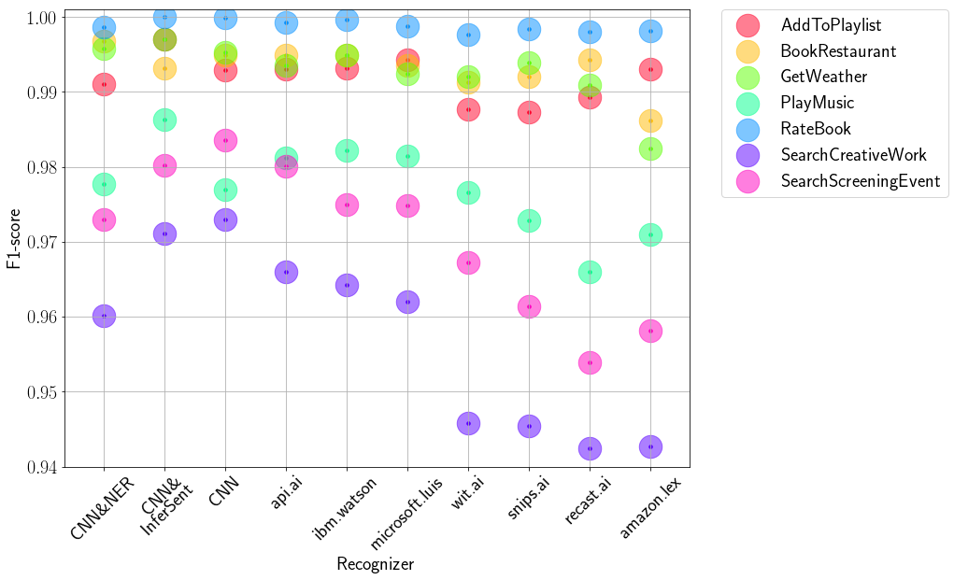
Some results
Intent recognition
DeepPavlov

Slide 29
Challenges
How to set goals in Task-Oriented neural end-to-end system?
How to build a user model and integrate it with a dialogue agent?
How to plan a dialogue with NN and RL implementation?
How to evaluate dialogue systems?
How to balance goal-directedness with engagement?
How to integrate external information from DB, KB, IR un a dialogue?
How to integrate modules and train integrated system?
How to transfer knowledge from task to task?
How to learn on-line?

Slide 30
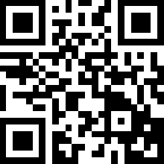
Telegram @ConvaiBot
http://t.me/ConvaiBot
Web page http://convai.io
Dialog dataset http://convai.io/data/

Slide 31
Summary
Textual user interface is becoming more and more intelligent
Conversational intelligence evolves from modular towards end-to-end architectures
iPavlov is R&D project with the goal to speed up prototyping of dialogue system for business and research
DeepPavlov is an open source framework for the conversational intelligence
Repository of architectures for dialogue agents
Neural network components implementing NLU, DST, Policy, NLG and their combinations
NIPS conversational challenge is an attempt to address the problem with dialogue systems evaluation
Integration of IR and CI is the next step towards AI

Slide 32
https://github.com/deepmipt/deeppavlov/

