Slide 1

Smart/Green Manufacturing: Data Enabled Decision Making and Optimization Applications
Panos M. Pardalos
http://ww.ise.ufl.edu/pardalos
https://nnov.hse.ru/en/latna/
March 2018

Slide 2
Introduction
Smart manufacturing (Industry 4.0) is the fourth industrial revolution. With advances in information and telecommunication technologies and data enabled decision making, smart manufacturing can be an essential component of sustainable development.
We are going to discuss some successes and focus on data enabled decision making and optimization applications. In addition, we will discuss future research directions and new challenges to society.
2

Slide 3
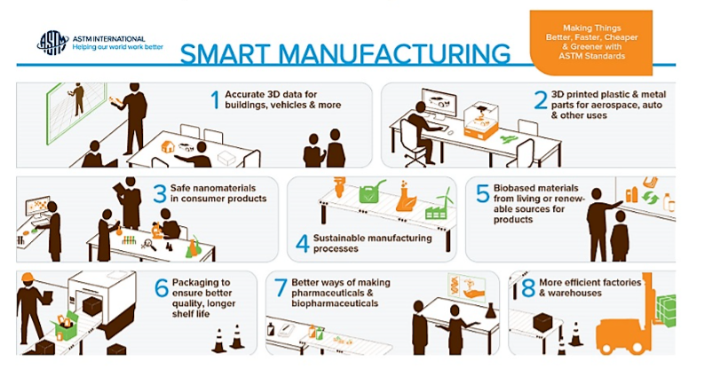
Smart Manufacturing is defined as “fully-integrated, collaborative manufacturing systems that respond in real time to meet changing demands and conditions in the factory, in the supply network, and in customer needs.”—— Kang, et al. (2016)
Smart Manufacturing aims for a sustainable growth via management of major manufacturing factors, such as productivity, quality, delivery, and flexibility based on technology convergence and various elements over societies, humans, and environment.
3

Slide 4
Green Manufacturing is defined as “systems that integrate product and process design issues with manufacturing planning and control to identify, quantify, assess, and manage the flow of environmental waste with the goal of reducing and ultimately minimizing environmental impact while trying to maximize resource efficiency”. —— Govindan, Diabat, & Shankar (2015)
Generally, remanufacture, reduce, and reuse/recycle are the main strategies of green manufacturing, which includes activities such as reducing hazardous waste volume, and calculating proper energy mixes to ensure a sustainable energy source.
The next generation of smart/green manufacturing processes and equipment, such as automation, distributed sensing, and advanced control systems need to be optimized to enable cost-effective and agile manufacturing of high-tech products and systems.
4

Slide 5
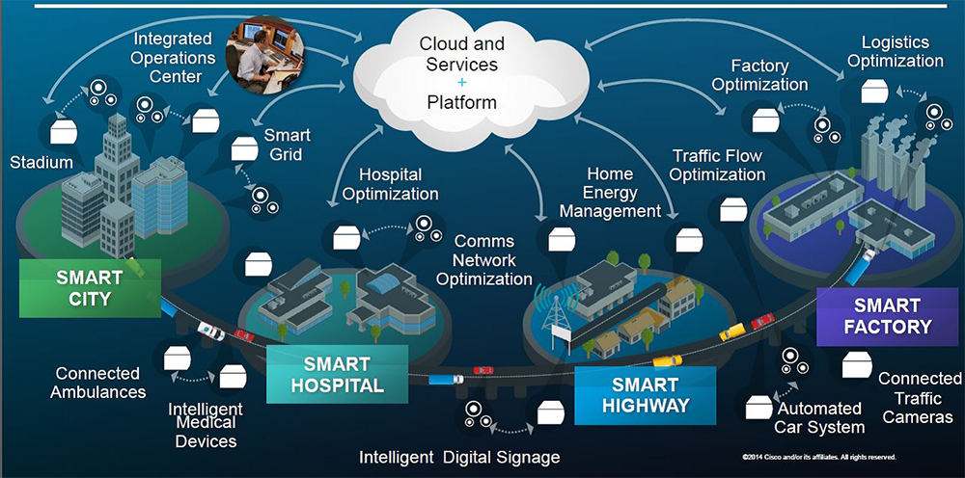
Currently, the information and communication technology (ICT) have experienced progresses in various fields, including hardware and software, and may bring a renaissance or a new revolution to the manufacturing industry.
Advanced manufacturing countries have been developing technologies (such as the IoT, Cloud and Cyber-Physical System) to realize smart manufacturing over the past few years.
5

Slide 6
What is Big Data?
"Big data" is high-volume, -velocity and -variety information assets that demand cost-effective, innovative forms of information processing for enhanced insight and decision making.
Volume - scale of data
Velocity - analysis of streaming data
Variety- different form of data
Newer definitions of big data have also added a fourth “V” - “veracity” - which describes the quality of captured data that can vary influence its analysis.
Veracity - data uncertainty
6

Slide 7
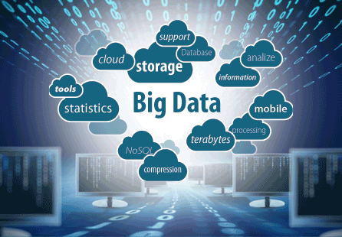
There is more:
The Fifth V: Viability - hidden relationships among variables
The Sixth V: Value – present and predict
We have to rewrite the rules of how and where data is stored, managed, and processed. In addition, new technologies such as grid computing, cloud computing, quantum computing are used.
See: https://www.wired.com/insights/2013/05/the-missing-vs-in-big-data-viability-and-value/
Wu, X., Zhu, X., Wu, G.-Q. & Ding, W. (2014). Data Mining with Big Data. IEEE Transactions on Knowledge and Data Engineering, 26, 97-107.
7

Slide 8
The 42 V's of Big Data and Data Science.
https://www.elderresearch.com/company/blog/42-v-of-big-data
Vagueness: The meaning of found data is often very unclear, regardless of how much data is available.
Validity: Rigor in analysis (e.g., Target Shuffling) is essential for valid predictions.
Valor: In the face of big data, we must gamely tackle the big problems.
Value: Data science continues to provide ever-increasing value for users as more data becomes available and new techniques are developed.
Vane: Data science can aid decision making by pointing in the correct direction.
Vanilla: Even the simplest models, constructed with rigor, can provide value.
Vantage: Big data allows us a privileged view of complex systems.
Variability: Data science often models variable data sources. Models deployed into production can encounter especially wild data.
Variety: In data science, we work with many data formats (flat files, relational databases, graph networks) and varying levels of data completeness.
Varifocal: Big data and data science together allow us to see both the forest and the trees.
Varmint: As big data gets bigger, so can software bugs!
Varnish: How end-users interact with our work matters, and polish counts.
Vastness: With the advent of the Internet of Things (IoT), the "bigness" of big data is accelerating.
Vaticination: Predictive analytics provides the ability to forecast. (Of course, these forecasts can be more or less accurate depending on rigor and the complexity of the problem. The future is pesky and never conforms to our March Madness brackets.)
Vault: With many data science applications based on large and often sensitive data sets, data security is increasingly important.
Veer: With the rise of agile data science, we should be able to navigate the customer's needs and change directions quickly when called upon.
8

Slide 9
The 42 V's of Big Data and Data Science.
https://www.elderresearch.com/company/blog/42-v-of-big-data
Veil: Data science provides the capability to peer behind the curtain and examine the effects of latent variables in the data.
Velocity: Not only is the volume of data ever increasing, but the rate of data generation (from the Internet of Things, social media, etc.) is increasing as well.
Venue: Data science work takes place in different locations and under different arrangements: Locally, on customer workstations, and in the cloud.
Veracity: Reproducibility is essential for accurate analysis.
Verdict: As an increasing number of people are affected by models' decisions, Veracity and Validity become ever more important.
Versed: Data scientists often need to know a little about a great many things: mathematics, statistics, programming, databases, etc.
Version Control: You're using it, right?
Vet: Data science allows us to vet our assumptions, augmenting intuition with evidence.
Vexed: Some of the excitement around data science is based on its potential to shed light on large, complicated problems.
Viability: It is difficult to build robust models, and it's harder still to build systems that will be viable in production.
Vibrant: A thriving data science community is vital, and it provides insights, ideas, and support in all of our endeavors.
Victual: Big data — the food that fuels data science.
Viral: How does data spread among other users and applications?
Virtuosity: If data scientists need to know a little about many things, we should also grow to know a lot about one thing.
Viscosity: Related to Velocity; how difficult is the data to work with?
Visibility: Data science provides visibility into complex big data problems.
9

Slide 10
The 42 V's of Big Data and Data Science.
https://www.elderresearch.com/company/blog/42-v-of-big-data
Visualization: Often the only way customers interact with models.
Vivify: Data science has the potential to animate all manner of decision making and business processes, from marketing to fraud detection.
Vocabulary: Data science provides a vocabulary for addressing a variety of problems. Different modeling approaches tackle different problem domains, and different validation techniques harden these approaches in different applications.
Vogue: "Machine Learning" becomes "Artificial Intelligence", which becomes...?
Voice: Data science provides the ability to speak with knowledge (though not all knowledge, of course) on a diverse range of topics.
Volatility: Especially in production systems, one has to prepare for data volatility. Data that should "never" be missing suddenly disappears, numbers suddenly contain characters!
Volume: More people use data-collecting devices as more devices become internet-enabled. The volume of data is increasing at a staggering rate.
Voodoo: Data science and big data aren't voodoo, but how can we convince potential customers of data science's value to deliver results with real-world impact?
Voyage: May we always keep learning as we tackle the problems that data science provides.
Vulpine: Nate Silver would like you to be a fox, please.
10

Slide 11
Big (Massive) Data Analysis in Smart Manufacturing
Manufacturing is getting smart. Companies are increasingly using sensors and wireless technologies to capture data at all stages of a product's life.
Shifting entire business sectors around the globe is daunting, Yet, industry is unprepared for the incoming changes.
Big data is a long way from transforming manufacturing. Most companies do not know what to do with the data they have, let alone how to interpret them.
Data science is rarely taught in engineering or business degrees. Companies do not know what to measure or when.
See: https://www.nature.com/news/smart-manufacturing-must-embrace-big-data-1.21760
11

Slide 12
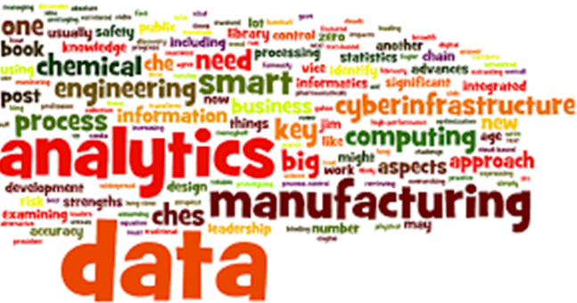

The proliferation of massive datasets brings with it a series of special computational challenges.
This data avalanche arises in several aspects of smart manufacturing.
With rapid advances in computer and information technologies, many of these challenges are beginning to be addresses.
J. Abello, P.M.Pardalos, M.G.C. Resende (Eds.).
Handbook of Massive Data Sets, Kluwer Academic Publishers, 2002.
12

Slide 13

What is Innovation?
“Innovation is the specific tool of entrepreneurs, the means by which they exploit change as an opportunity for a different business or a different service. It is capable of being presented as a discipline, capable of being learned, capable of being practiced. Entrepreneurs need to search purposefully for the sources of innovation, the changes and their symptoms that indicate opportunities for successful innovation. And they need to know and to apply the principles of successful innovation.”
—— Peter Drucker
Innovation is not only a tool - it is also a transformer!
13

Slide 14
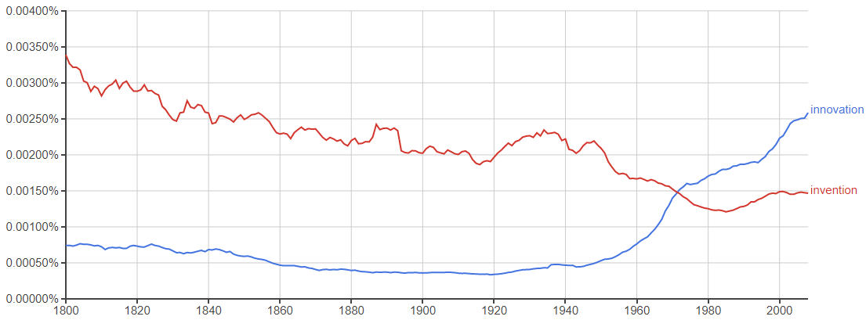
Innovation Vs Invention
Mentions of innovation and invention in English corpus over time
—— Source: Google Books Ngram viewer
14

Slide 15
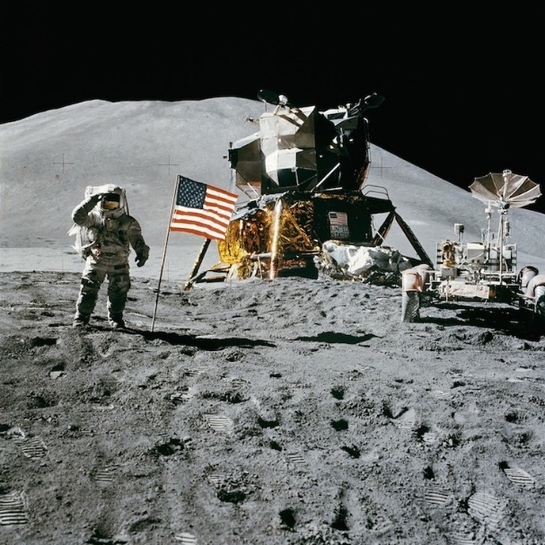
World’s Top 50 Innovators…
… from the Industries of the Future.
Industries to be examined:
Robotics and Artificial Intelligence
Genomics and Digital Health
Big Data
3D and 4D Printing
New Energy Technologies
Blockchain Technologies and Digital Money
Cybersecurity
Space Technologies
Holograms, Virtual and Augmented Reality
Autonomous Vehicles
Smart Sensors
15

Slide 16
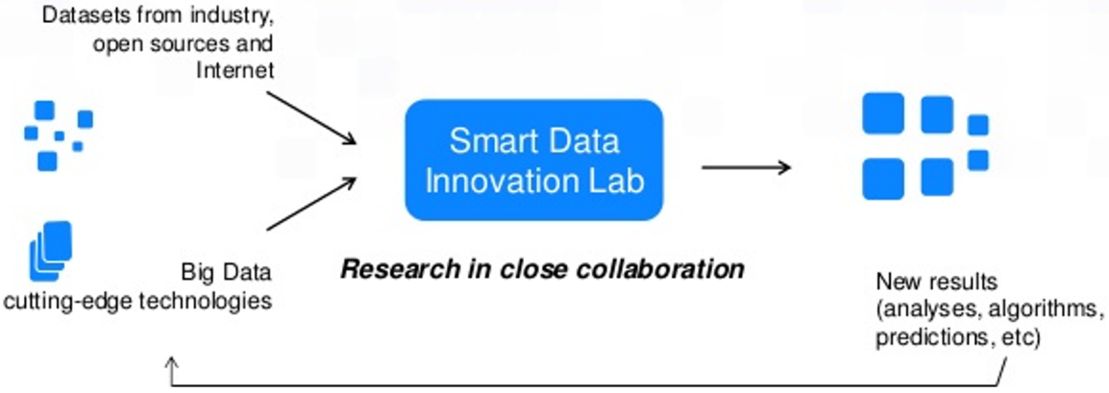
The five gaps in Innovation:
  Adopt strategies. Smart manufacturing systems must evolve as information is gathered.
  Improve data collection, use and sharing. Here, most companies lack experience.
  Design predictive models. Corporations want to know that a new product will meet customer expectations before they manufacture it.
  Study general predictive models. Models need to be able to handle uncertainties.
  Connect factories and control processes. Most software is designed for use by a single corporation.
16

Slide 17
In the past five years, several regional initiatives for smart manufacturing have been set up. (US-based Smart Manufacturing Leadership Coalition, Germany's Plattform Industrie 4.0)
Three practical steps need to be taken to plug knowledge gaps and enable smart manufacturing:
  Establish networks to define problems: online forums where practitioners and researchers can discuss, develop and publish specifications of emerging industrial problems.
  Develop platforms for modelling, sharing and innovation, where experts and practitioners can interact to develop technical solutions and models.
  Enact smart manufacturing policies: governments should fill gaps or support areas too risky for private investment.
17

Slide 18
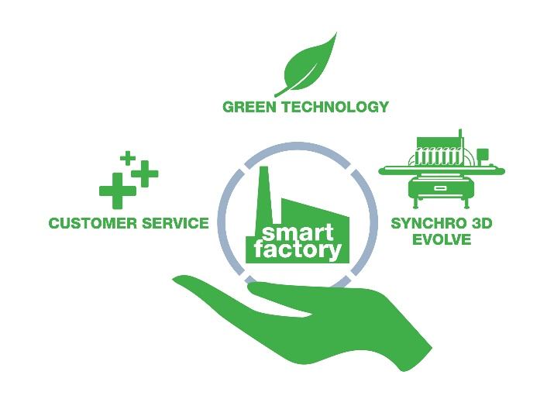
Research Progress
Vision, Direction, and Technology of Smart Manufacturing
Conceptual and technical studies: including the expected challenges, the required technologies and strategies to realize Smart Manufacturing.
Industry 4.0 could be realized through cloud computing, big data, 3D printing, … —— Brettel, M., et al. (2014)
Realization process and approaches: eg. A system-based phased application of digital manufacturing;
Dynamic optimization model and algorithm for supply chain scheduling in a smart factory. (Ivanov et al. 2015)
18

Slide 19
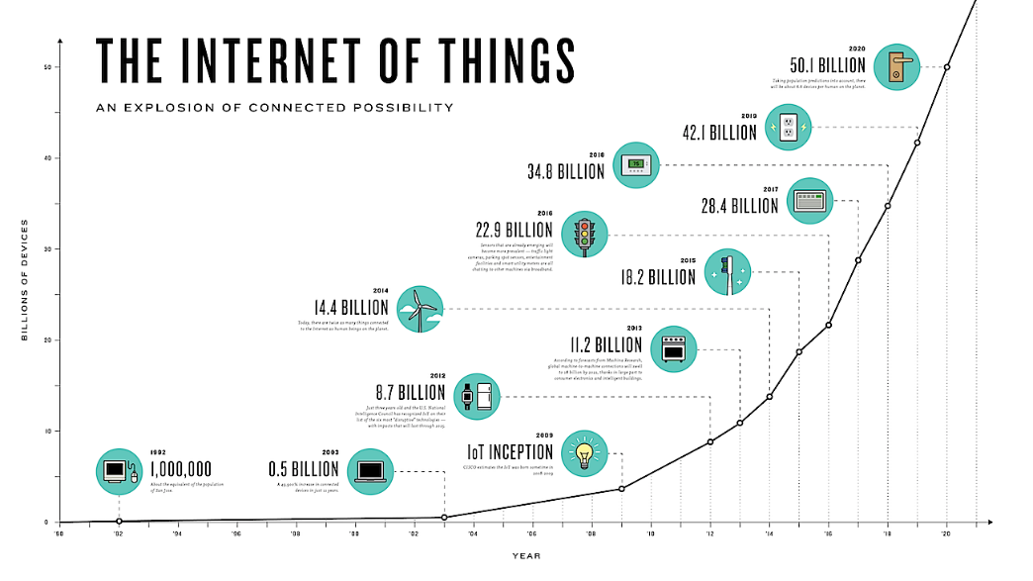
Smart Sensor and Internet of Things
The sensor collects and controls data in real time.
Architectures of a wireless network: star network, mesh network and hybrid star-mesh network;
Standards: IEEE802.11x, Bluetooth (IEEE802.15.1 and .2), IEEE802.15.4, ZigBee, and IEEE1451.5, …
IoT makes objects sensed or controlled through a network infra, supports integration between physical real world and computer-based systems, and brings various effects such as improved productivity or economy in manufacturing.
19

Slide 20
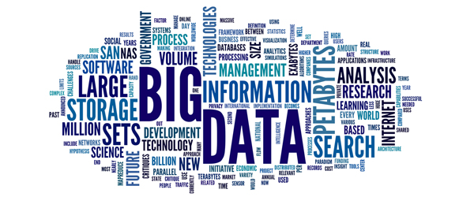
Big Data Analytics and Cloud Computing
Smart/Green Manuf. requires effective visualization and analysis of various data from product development and manuf. system engineering processes and manuf. sites to be utilized for modeling and predictions. —— Lee et al. (2015)
Cloud Manuf. exploits on-demand access to a shared collection of diversified and distributed resources to form temporary and reconfigurable production lines that enhance efficiency, reduce product lifecycle costs in response to variable-demand customer generated tasking.
20

Slide 21
Applied and Additional Technologies
Additive Manufacturing (3D Printing): Additive Manuf. is a way to convert a 3D model, such as a CAD file, into a physical object by bonding or joining materials through light, ultrasonic vibration, laser, and electron beam.
Hologram: Hologram is one of the visualization methods and is generally being applied to design, robotics, factory layout planning, system maintenance, and assembly design and operation planning in collaboration environment.
Energy Saving: Previous studies include FEMS (Factory Energy Management System), BEMS (Building Energy Management System), and the studies on efficiency increased through energy consumption monitoring and analysis.
21

Slide 22
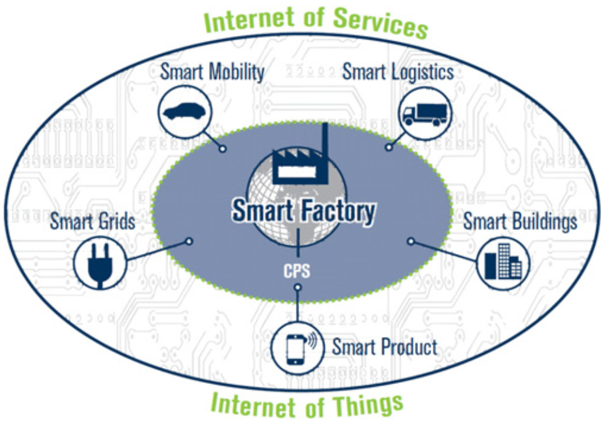
Government programs
The German government announced Industry 4.0 which constructs new business models, and resolves various social problems by linking the things inside and outside a factory and services through the communication networks based on Cyber-Physical System, IoT and IoS (Internet of Services).
Fig. Industry 4.0 and smart factories as part of the IoT and IoS
22

Slide 23
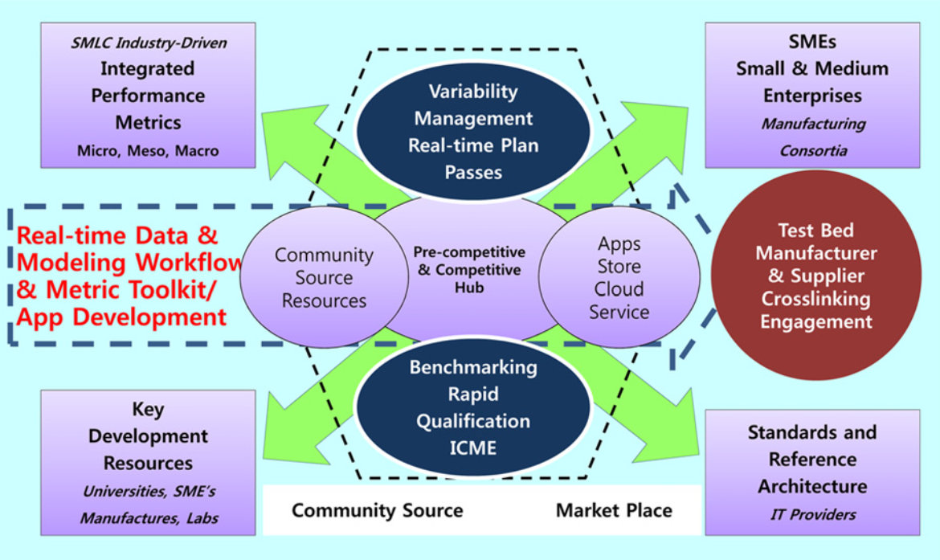
The U.S. focus on key technology assignments to respond aggressively to the innovative manufacturing environment change. The government launched Smart Manufacturing Leadership Coalition (SMLC), who performs concrete action plans, such as concept establishment, technological goals, a roadmap, and role assignment.
Fig. Smart manufacturing platform
23

Slide 24
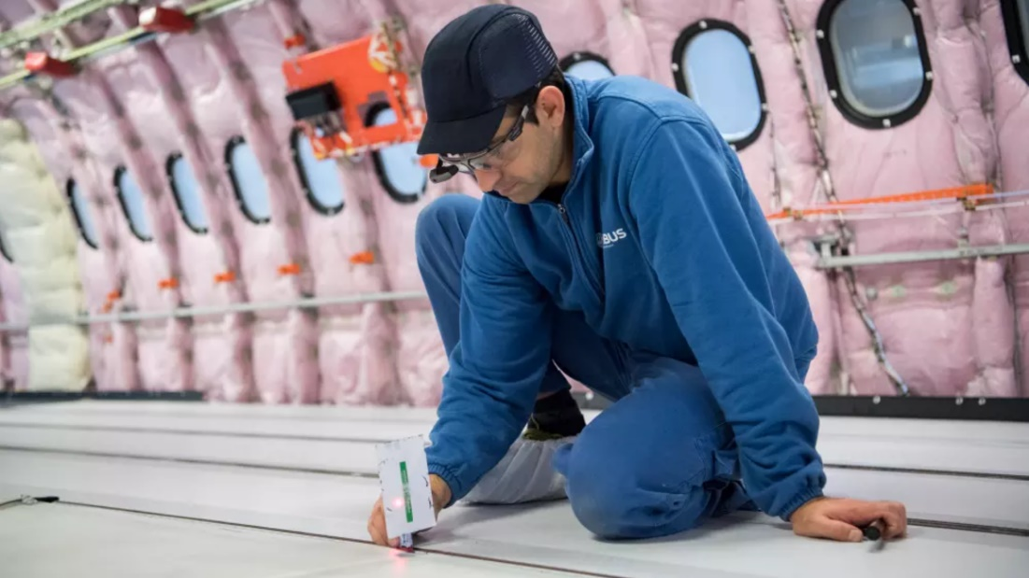
Successful Applications
Airbus Uses Smart Glasses to Improve Manuf. Efficiency
Airbus technicians have been using “smart glasses” to enable millimeter-precise positioning during the cabin installation marking process.
“Smart glasses” – enable greater efficiency and time savings during the aircraft outfitting process.
24

Slide 25
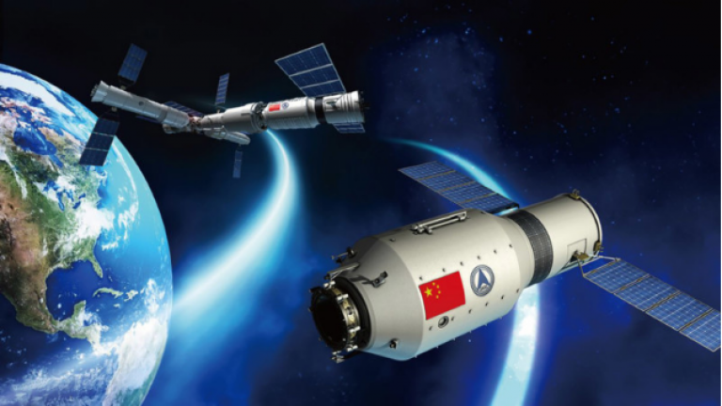
China to perform space brain-machine interaction experiments on Tiangong-2
“The brain-computer interaction will eventually be the highest form of human-machine communication”. eg., Brain-computer interaction can transmit the astronauts' thoughts into operations, and observe their neurological functions. —— Ming Dong, leader of the research team
China's Launched Second Space Lab Tiangong-2
25

Slide 26

NTT to develop global platform for Toyota connected vehicles
The areas of collaboration include:
The development of a platform for data collection, accumulation, and analysis;
Internet of things networks and data centers;
Next-generation communication technologies, such as 5G, edge computing; and
User-friendly services, such as voice integration tech based on artificial intelligence.
NTT is working with Toyota to develop a global telecommunications platform for connected cars
26

Slide 27
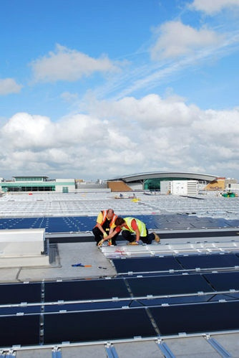
IKEA With Eco-Conscious Production Processes
IKEA uses sustainable forestry techniques, which means that the minimalist yet stylish nightstand you just bought didn’t cost the planet a piece of a rainforest. The company is also investing in solar and wind energy to an unprecedented degree.
27

Slide 28
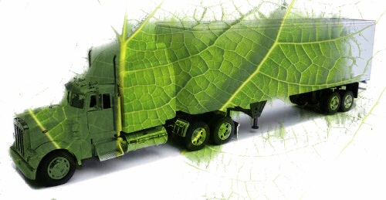
Green Supply Chain and Logistics
Logistics Trends, Challenges, and Needs for Further research
Sustainable logistics and transport solutions are vital for societal acceptance. Challenges arise from a competitive environment, social or ecological concerns, as well as deficits in knowledge transfer or integrated ICT applications.
Globalization and logistics;
Demography and logistics;
Energy and logistics;
Information technology, the internet and logistics.
28

Slide 29
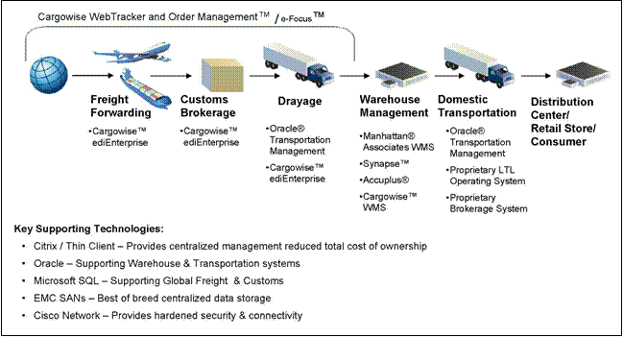
Business Models for Advanced ICT in Logistics
How can ICT together with an innovative business approach enhance supply chains? The focus of the business models is on the key elements that characterize the value-creation links between the involved actors in the Logistics Reference Value Chain. —— Boschian, & Paganelli, (2016)
Logistics connectivity and interoperability;
Planning and decision support;
Actors in logistics value chain;
Value delivered by ICT innovations.
29

Slide 30
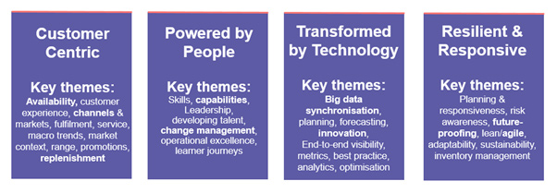
Future-Proofing Supply Chains
Due to the rapidly changing environment and the changing customer behavior, companies will have to rethink the way they deliver their products and services.
Changing environment;
Changing consumer behavior;
Changing logistics;
Future-proofing diagnosis of the supply chain.
30

Slide 31
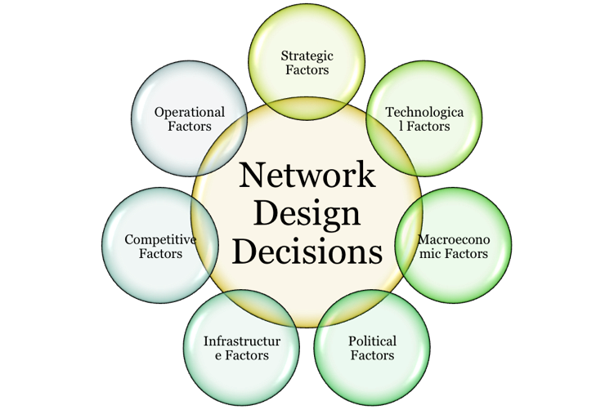
Supply Chain Network Design
There are some challenges affecting the supply chain: regulations and customs, fluctuation of prices, point-to point transfers, knowledge of local collaborators, strategic sourcing, logistics network, bullwhip effect, reliability, …
—— Wang, et al. (2011)
Qualitative issues: customs and personnel;
Qualitative issues: Locations of industrial development zones; Effect in lead-time and cost;
Location of warehouses.
31

Slide 32
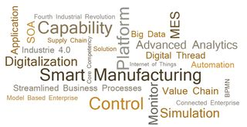
Major Challenges
Building the Smart Manufacturing Platform requires significant technical integration and cross industry collaboration, and includes technical and business risks that the Serving Mobile Location Center (SMLC) is addressing.
Challenge 1: Workforce, Cyber and Physical Intelligence
Physical test beds in full scale factory;
Supply chain demonstrations of applied manufacturing intelligence;
Scalable, secure, selective data and model interoperability;
Configurable distributed workforce and physical system framework;
Configurable integrated performance metrics.
32

Slide 33
Challenge 2: Source to Customer Optimization Framework
Multidimensional integration of manufacturing enterprise data, process control, and optimization infrastructures;
Architectures for integrated data collection, management and modeling;
Secure interoperability with shared service hubs.
Challenge 3: Multi-Dimensional Ecosystem
Real-time syncing virtual models and physical operations;
Integrated service framework;
Real-time validation and measurements;
Actionable windows in time and computational tractability.
Challenge 4: Dynamic Supply Chain Intelligence
Supply chain source modeling innovation and simulation assimilation;
Common infrastructure for real-time data-driven models;
Composable data, modeling and metrics ‘apps’;
33

Slide 34
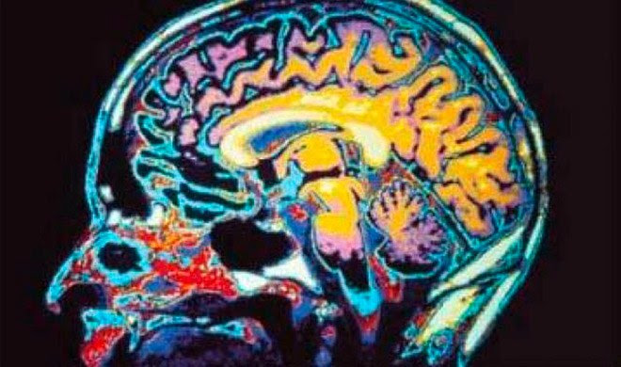
Human Brain: the next domain of warfare
https://www.wired.com/2012/12/the-next-warfare-domain-is-your-brain/
Smart/Green Manuf.: Data Enabled Deci Making and Optmi. Appl.
34

Slide 35
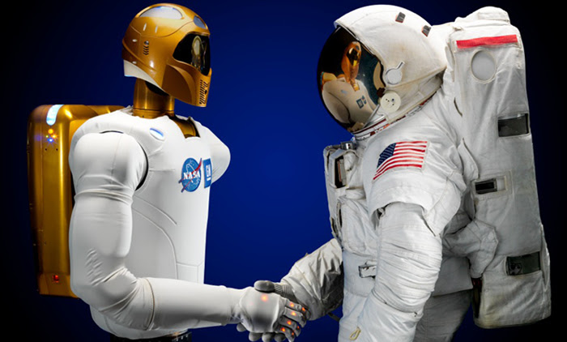
Human-Robot Interface
The Digital Revolution & Artificial Intelligence steal people’s jobs
Ford M. Rise of the Robots: Technology and the Threat of a Jobless Future. Basic Books; 2015 May 5. https://www.psychologytoday.com/blog/the-human-beast/201510/the-human-robot-interface
35

Slide 36

Human-Robot Interface
36

Slide 37
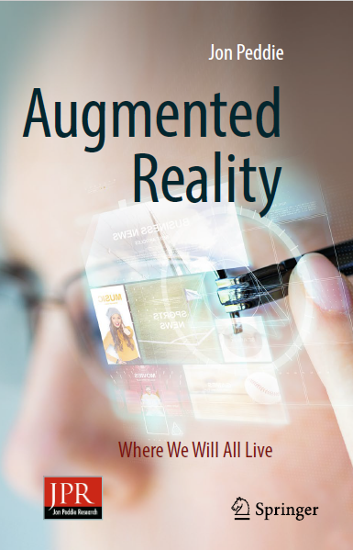
Augmented Reality
37

Slide 38
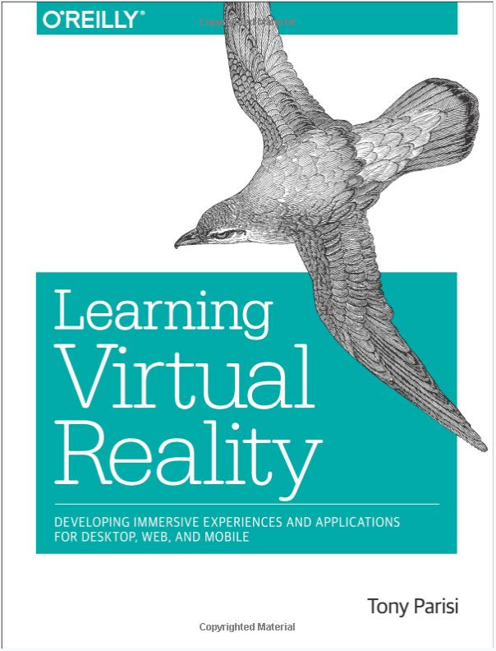
Virtual Reality
38

Slide 39
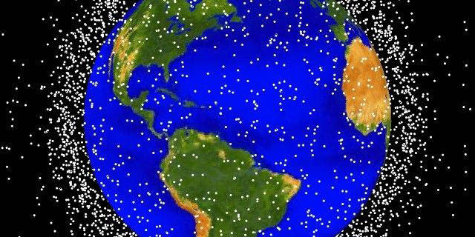
Space Debris
https://www.nasa.gov/mission_pages/station/news/orbital_debris.html
39

Slide 40
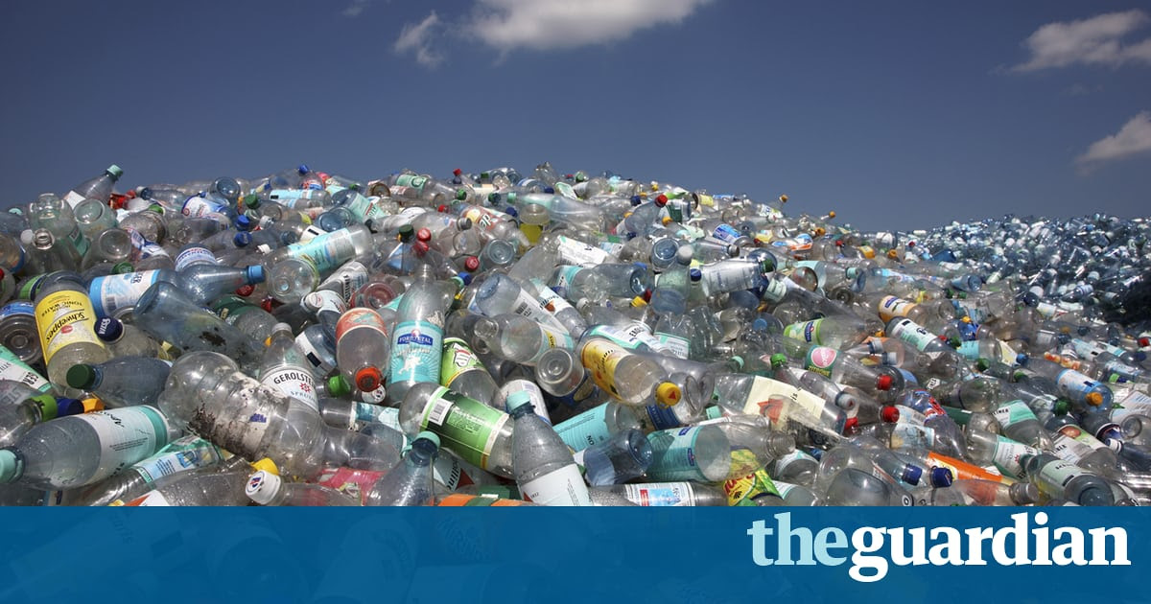
The Plastic Bottle Horror
http://foresternetwork.com/daily/waste/waste-sorting/the-plastic-bottle-horror/
40

Slide 41
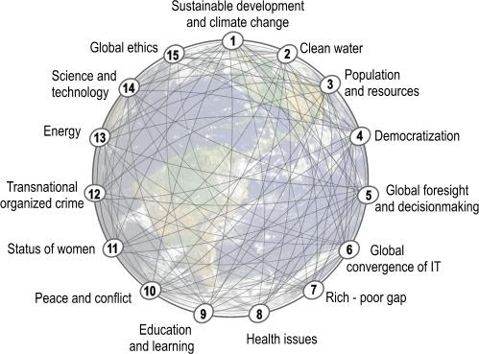
Global Challenges
The 15 Global Challenges provide a framework to assess the global and local prospects for humanity.
http://www.millennium-project.org/millennium/challenges.html
41

Slide 42
Application Challenges
Business Model
Manufacturers face threats from digital disruptors that are often quicker to adapt traditional products and exploit new opportunities through the latest technology.
Data and Security
Smart manuf. is heavily reliant on technology and data which brings with it the challenges of protecting that data and ensuring it is secure. Smart manuf. systems and the data they generate might also be targets for cyber attacks.
Operations
Manufacturers need to be agile and respond more quickly to update their technology. Connecting different systems together to get an end-to-end picture of the manufacturing process, supply chain and product usage is a further challenge.
42

Slide 43
Concluding Remarks
The Oeconomicus (Greek: ΟΙΚΟΝΟΜΙΚΟΣ) by Xenophon (c. 430-354 BC) is one of the earliest works on economics.
The opening framing dialogue is between Socrates and Critoboulus, the son of Crito.
There Socrates discusses the meaning of wealth and identifies it with usefulness and well-being, not merely possessions.
43

Slide 44
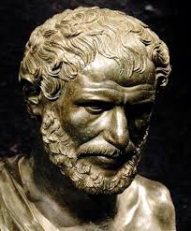
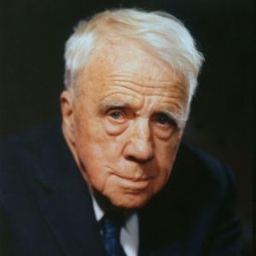
ΧΡΥΣΟΝ ΓΑΡ ΟΙ ΔΙΖΗΜΕΝΟΙ ΓΗΝ ΠΟΛΛΗΝ ΟΡΥΣΣΟΥΣΙ ΚΑΙ ΕΥΡΙΣΚΟΥΣΙΝ ΟΛΙΓΟΝ
“Seekers after gold dig up much earth and find little”
“The lord whose oracle is at Delphi neither speaks nor conceals, but gives signs”
—— Heraclitus
I shall be telling this with a sigh
Somewhere ages and ages hence:
Two roads diverged in a wood, and I,
I took the one less traveled by,
And that has made all the difference.
—— Robert Frost
44

Slide 45
References
[1] Govindan, K., Diabat, A., Shankar, K. M. (2015). Analyzing the drivers of green manufacturing with fuzzy approach. Journal of Cleaner Production, 96:182-193.
[2] Kang, H. S., Lee, J. Y., Choi, S., Kim, H., et al. (2016). Smart manufacturing: Past research, present findings, and future directions. International Journal of Precision Engineering and Manufacturing-Green Technology, 3(1):111-128.
[3] Brettel, M., et al. (2014). How Virtualization, Decentralization and Network Building Change the Manufacturing Landscape: An Industry 4.0 Perspective. International Journal of Science, Engineering and Technology, 8(1): 37-44.
[4] Choi, S., Kim, B. H., and Noh, S. D. (2015). A Diagnosis and Evaluation
Method for Strategic Planning and Systematic Design of a Virtual Factory in Smart Manufacturing Systems. Int. J. Precis. Eng. Manuf., 16(6), 1107-1115.
[5] Ivanov, D., et al. (2015). A Dynamic Model and an Algorithm for Short-Term Supply Chain Scheduling in the Smart Factory Industry 4.0. Int. J. of Prod. Res., DOI: 10.1080/00207543.2014.999958.
[6] Lee, J., Bagheri, B., & Kao, H.-A. (2015). A Cyber-Physical Systems Architecture for Industry 4.0-Based Manufacturing Systems. Manuf. Letters, 3: 18-23.
[7] Boschian, V., & Paganelli, P. (2016). Business models for advanced ICT in logistics. InSustainable Logistics and Supply Chains, pp. 15-51. Springer International Publishing.
[8] Wang, F., Lai, X., & Shi, N. (2011). A multi-objective optimization for green supply chain network design. Decision Support Systems, 51(2): 262-269.
[9] Kusiak, A. (2017). Smart manufacturing must embrace big data. Nature, 544(7648): 23.
45

Slide 46
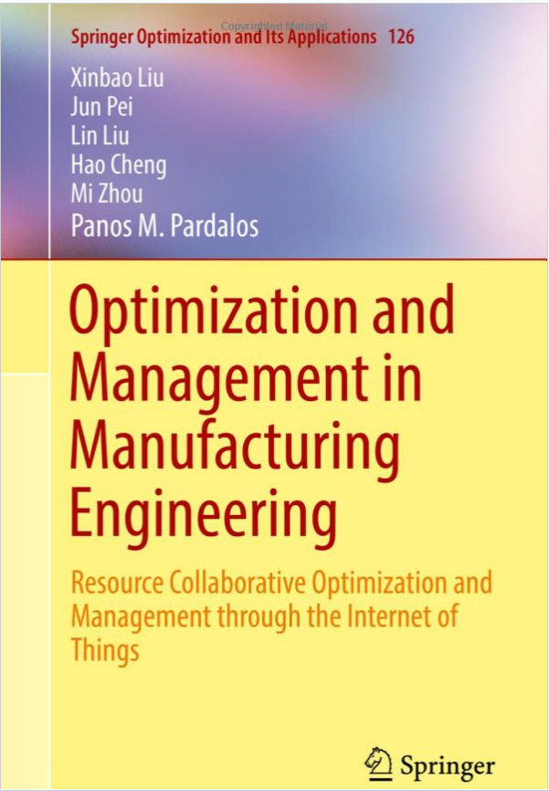
46

