Slide 1

Laboratory of Algorithms and Technologies for Network Analysis (LATNA)
Facial analytics in mobile applications
Andrey V. Savchenko
Dr. of Sci., Prof.
Email: avsavchenko@hse.ru
URL: www.hse.ru/en/staff/avsavchenko
3rd Winter School on Data Analytics (DA 2018)

Slide 2

Outline
Tasks of facial analytics
Mobile AI
Face identification
Video-based age and gender recognition
Group-level emotion recognition
Organizing Photo and Video Albums
3rd Winter School on Data Analytics (DA 2018)

Slide 3
Tasks of facial analytics
фото
3rd Winter School on Data Analytics (DA 2018)

Slide 4
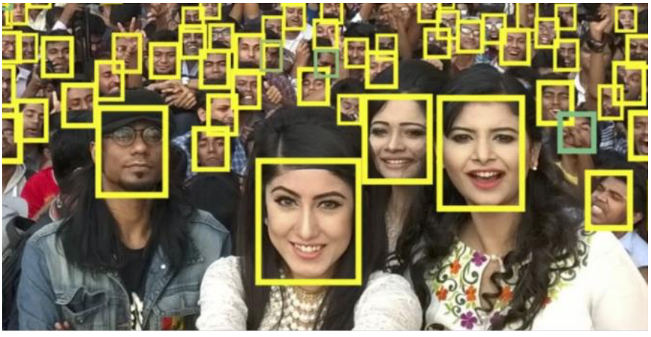
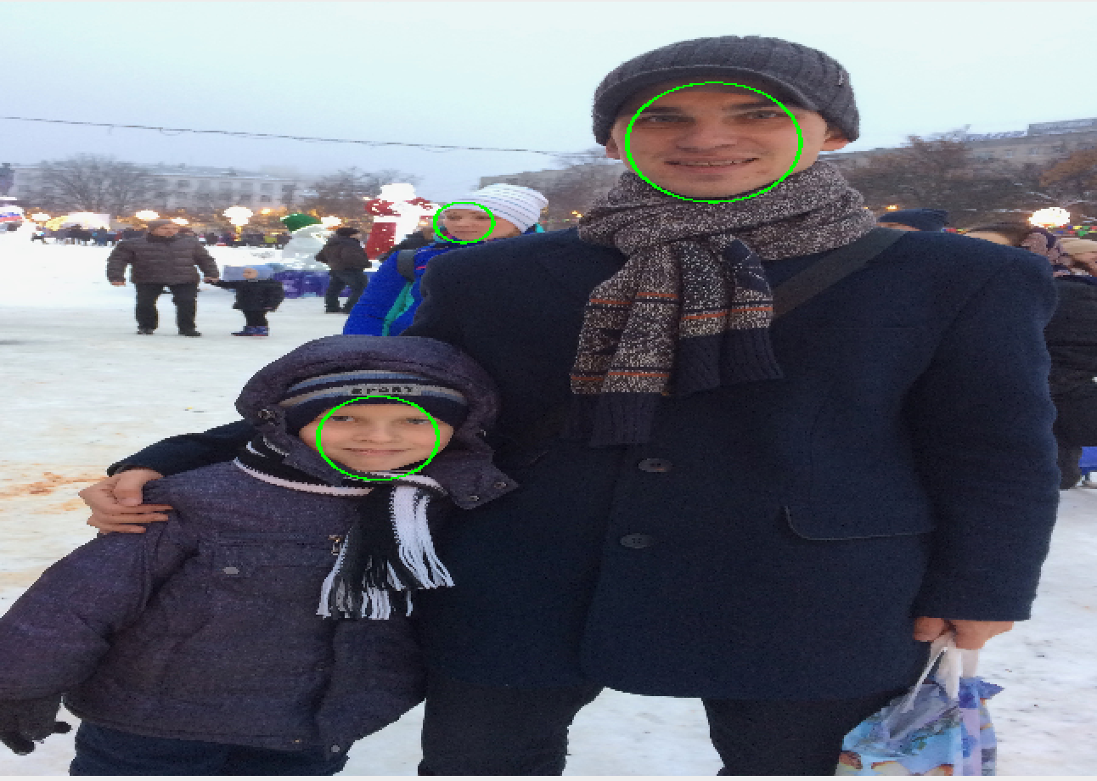
Face detection
3rd Winter School on Data Analytics (DA 2018)

Slide 5
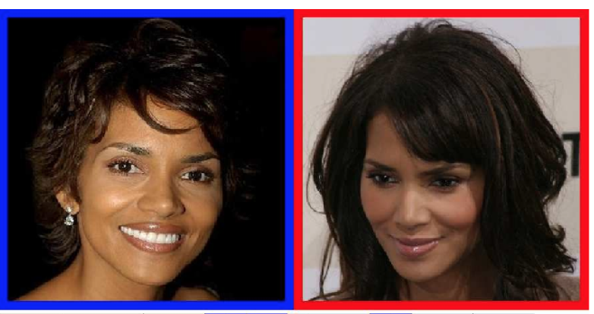
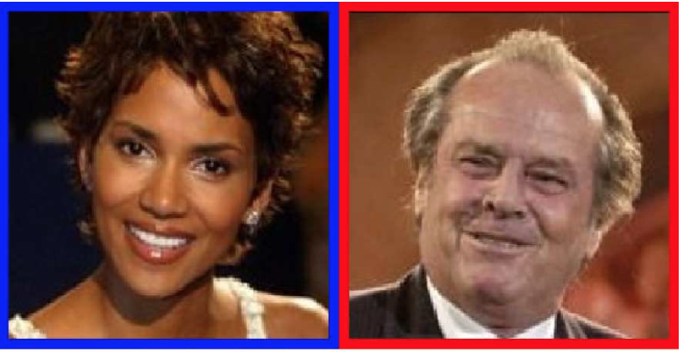
Face verification
Kumar et al, TPAMI, 2011
3rd Winter School on Data Analytics (DA 2018)

Slide 6
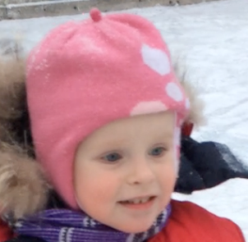
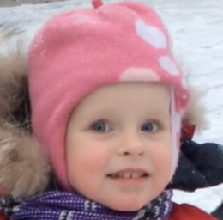
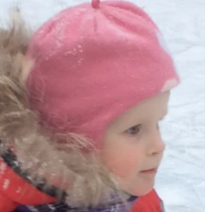
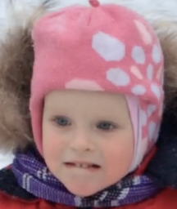
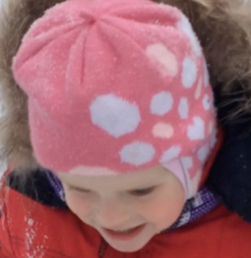

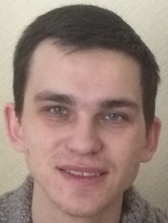
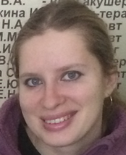
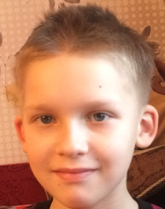
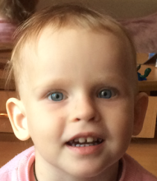
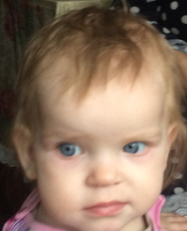
Face identification (recognition)
Input video sequence
Reference images
3rd Winter School on Data Analytics (DA 2018)

Slide 7
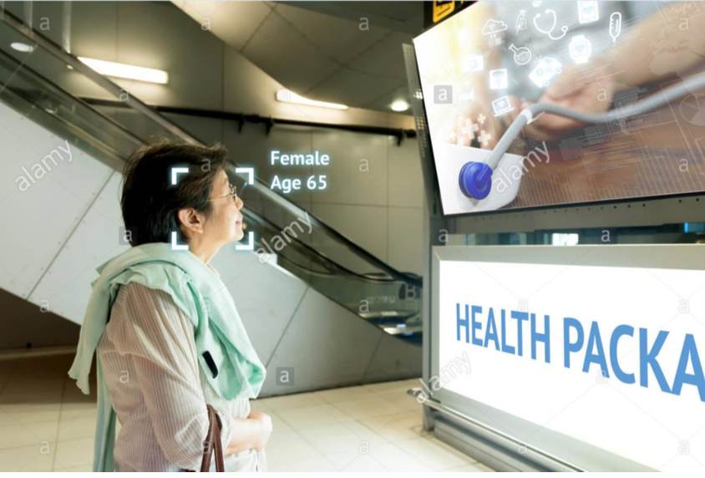
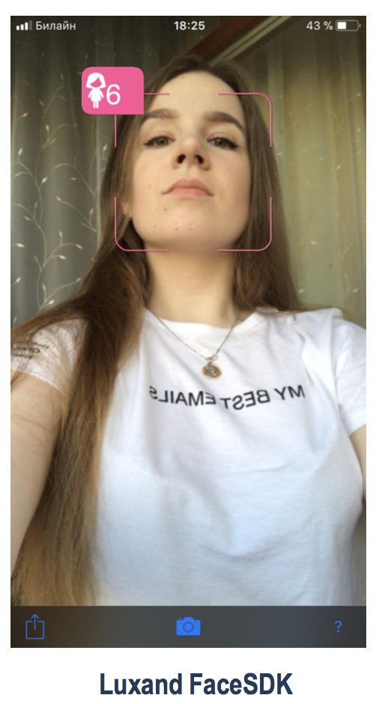
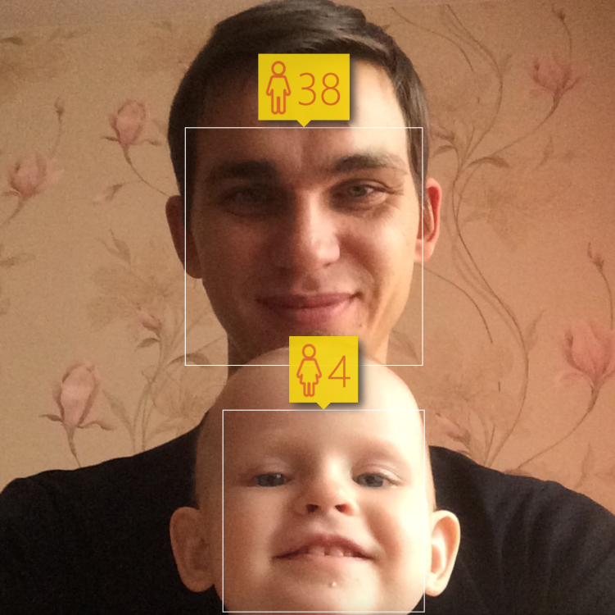
Age, gender, ethnicity recognition
TMPA School 2018 Kostroma

Slide 8
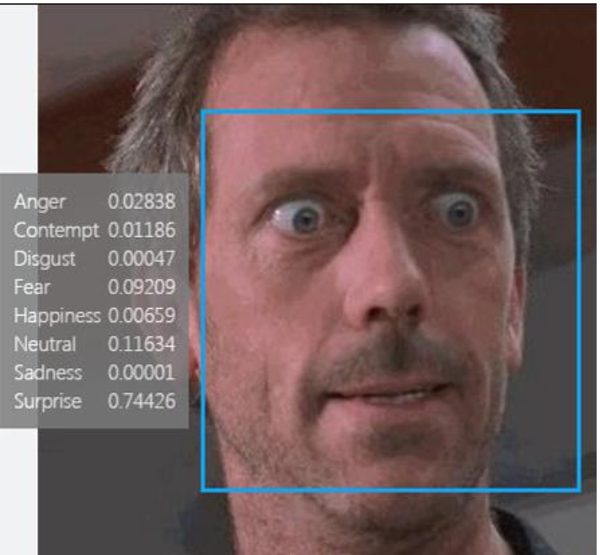
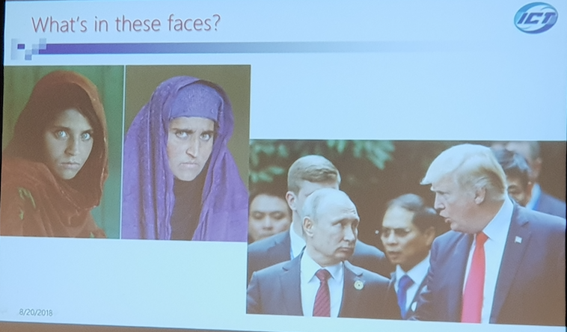
Emotion recognition
Xilin Chen: Challenges in facial expression understanding, ICPR18
3rd Winter School on Data Analytics (DA 2018)

Slide 9
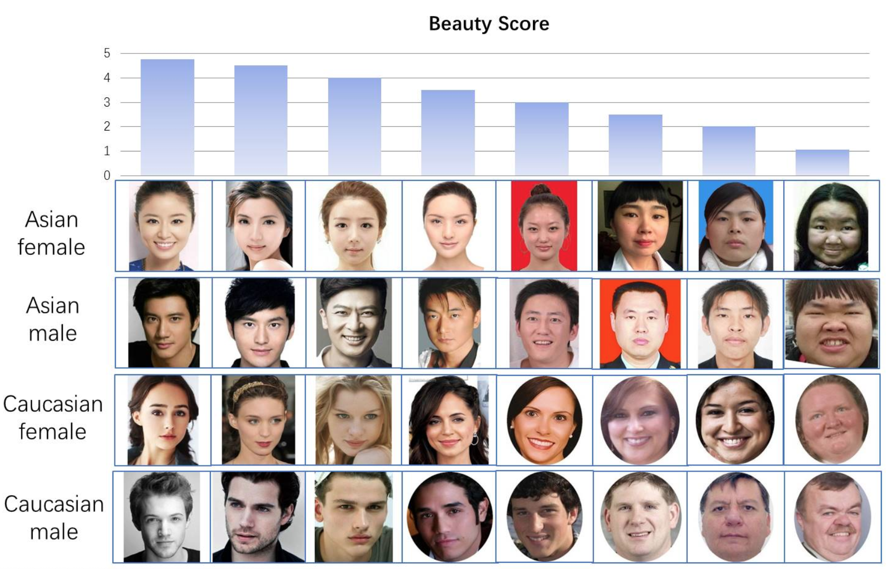
Beauty prediction
https://github.com/HCIILAB/SCUT-FBP5500-Database-Release
3rd Winter School on Data Analytics (DA 2018)

Slide 10
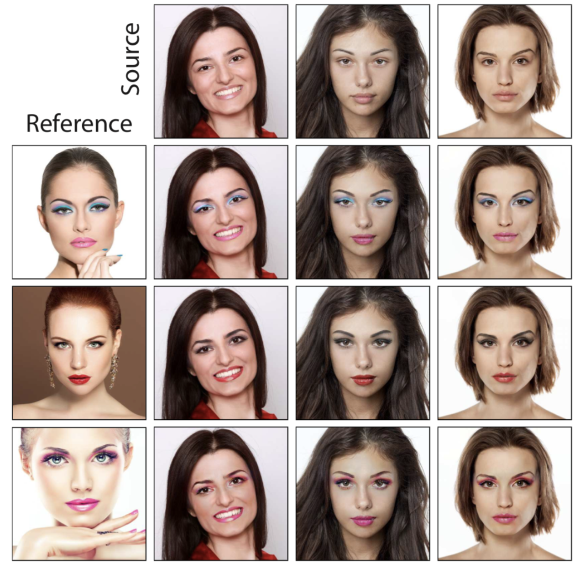
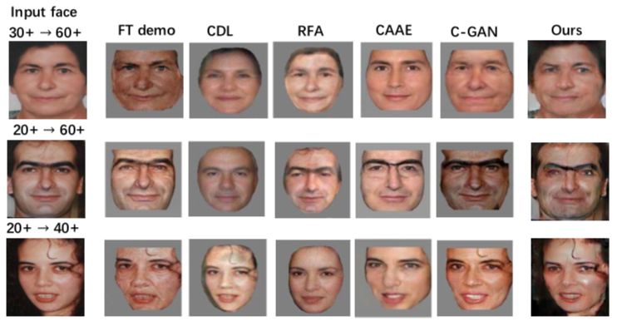
Face synthesis
Global and Local Consistent Age Generative Adversarial Networks, ICPR18
PairedCycleGAN: Asymmetric Style Transfer for Applying and Removing Makeup, CVPR18
3rd Winter School on Data Analytics (DA 2018)

Slide 11
Mobile AI
фото
3rd Winter School on Data Analytics (DA 2018)

Slide 12
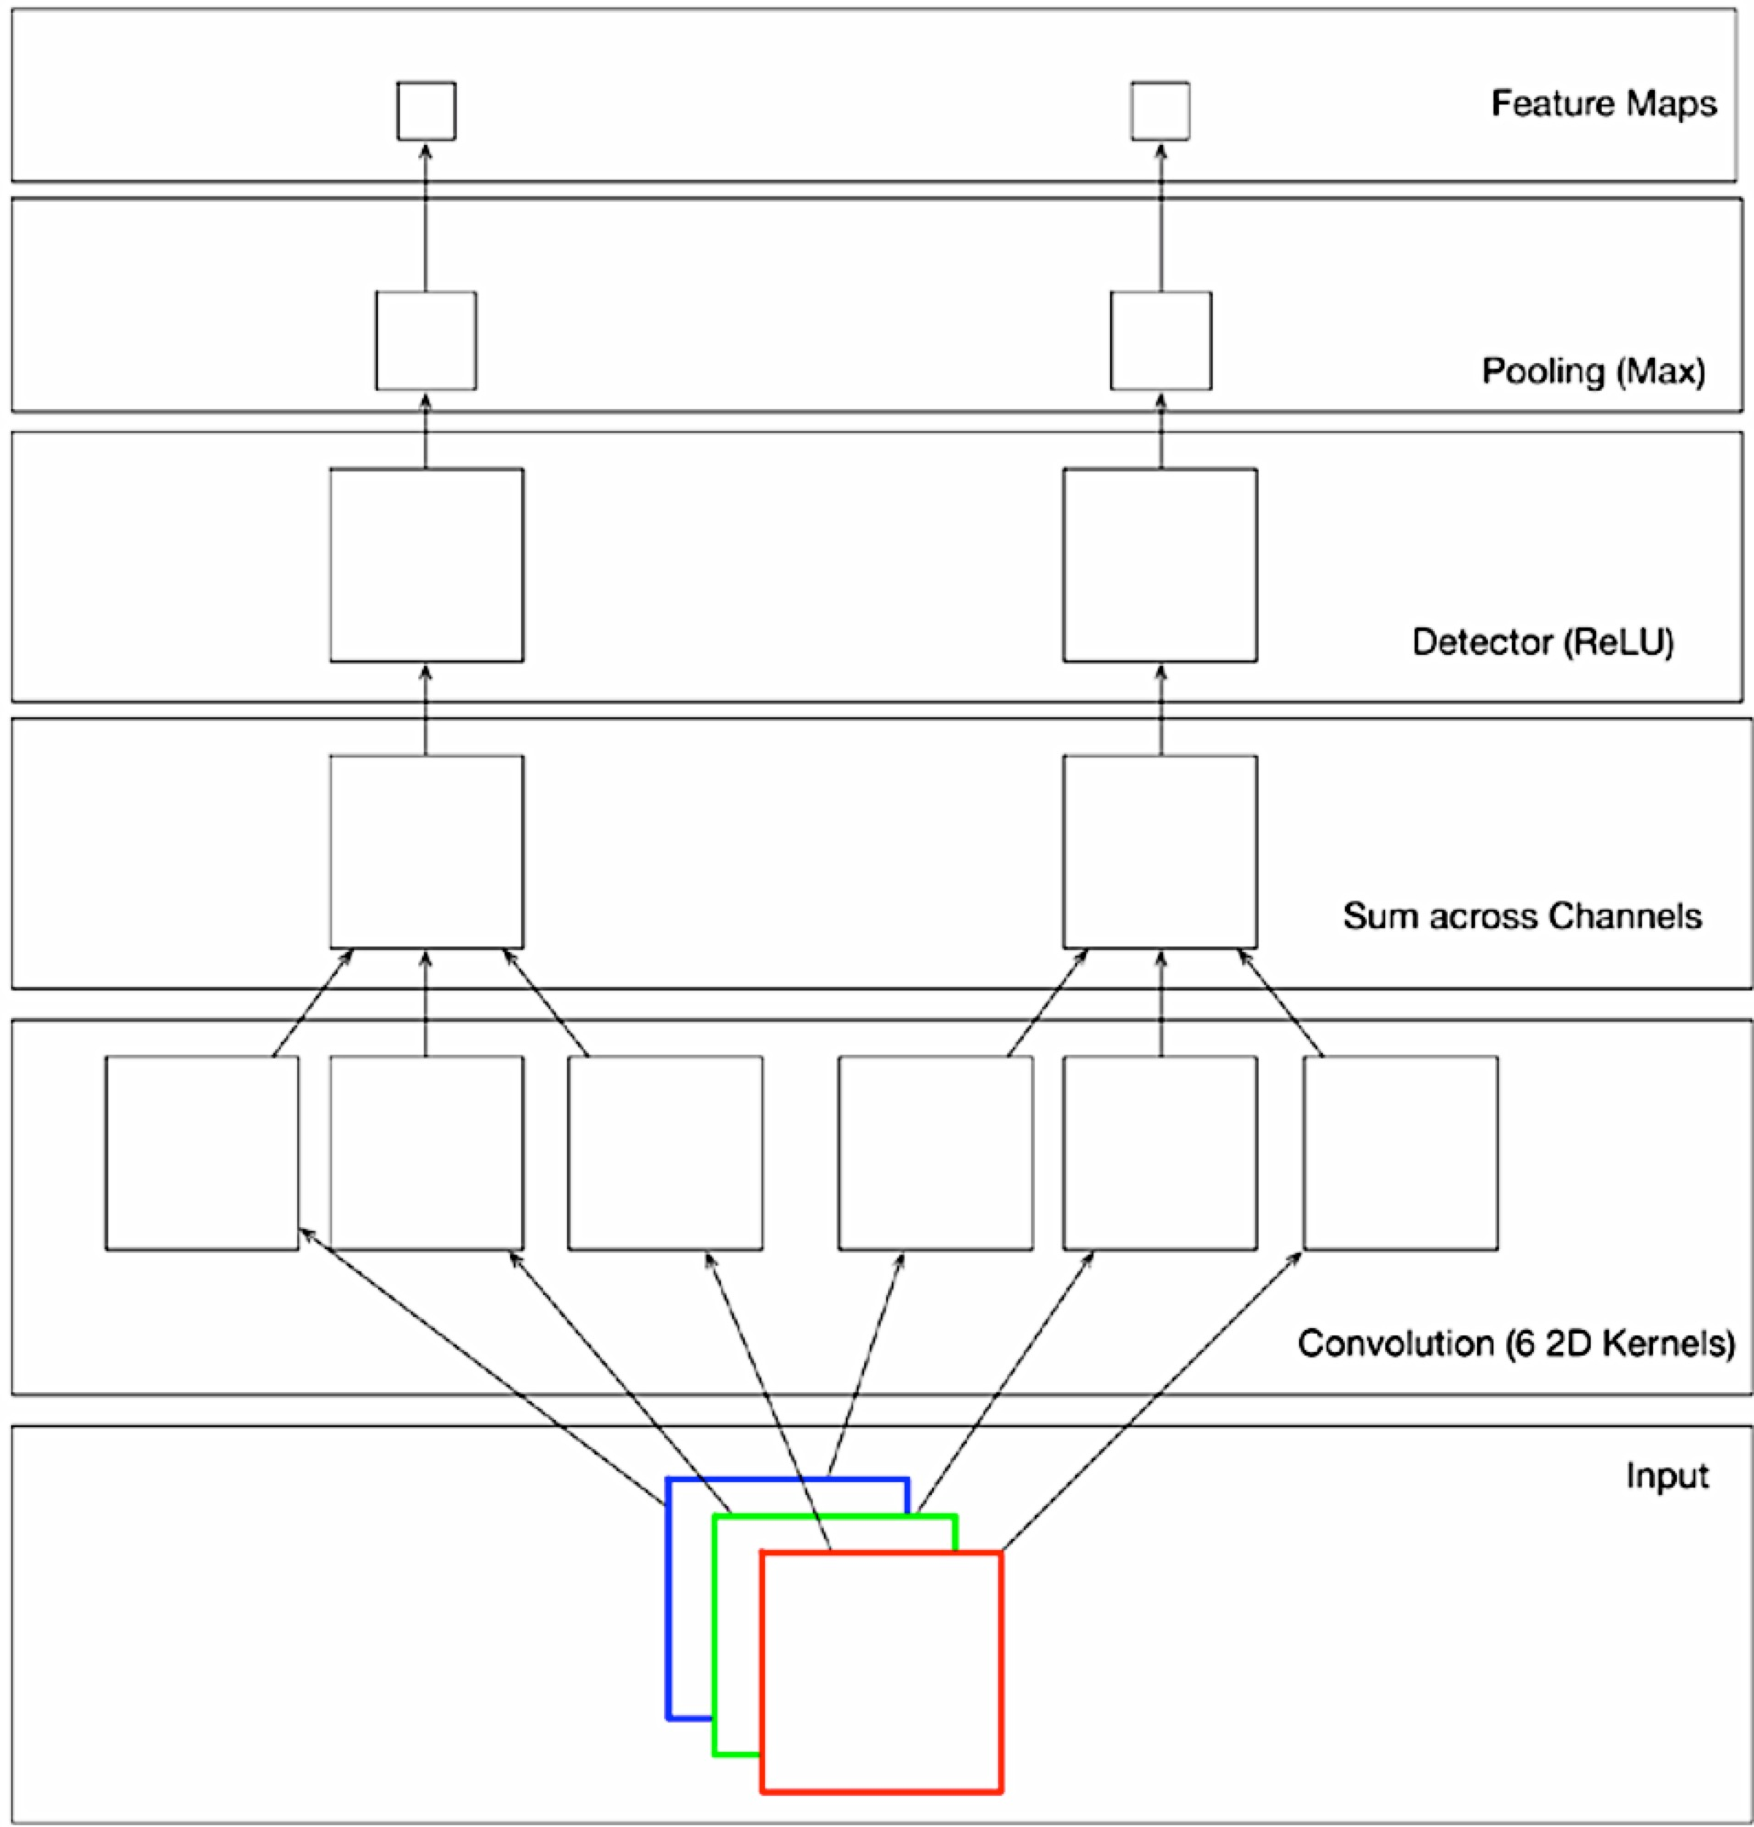
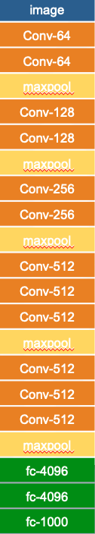
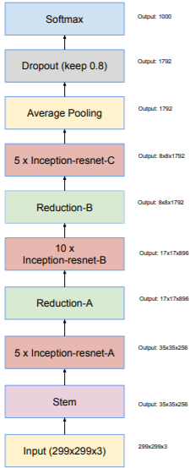
Convolutional Neural Networks (CNN)
VGGNet
(16-19 layers)
InceptionResNet (550 layers)
3rd Winter School on Data Analytics (DA 2018)

Slide 13
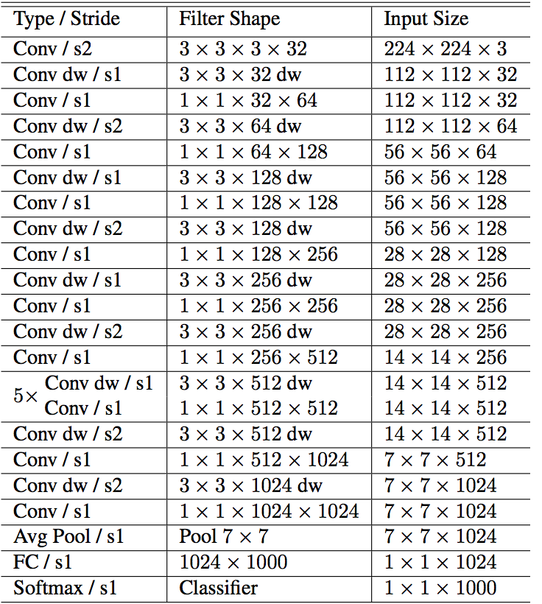
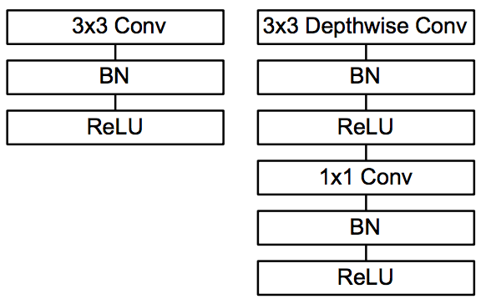
MobileNet
Depthwise convolution
28 layers
ImageNet Top-5 Error rate: 12.81%
4.2M parameters
https://arxiv.org/abs/1704.04861
3rd Winter School on Data Analytics (DA 2018)

Slide 14
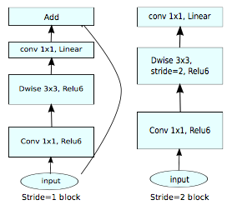
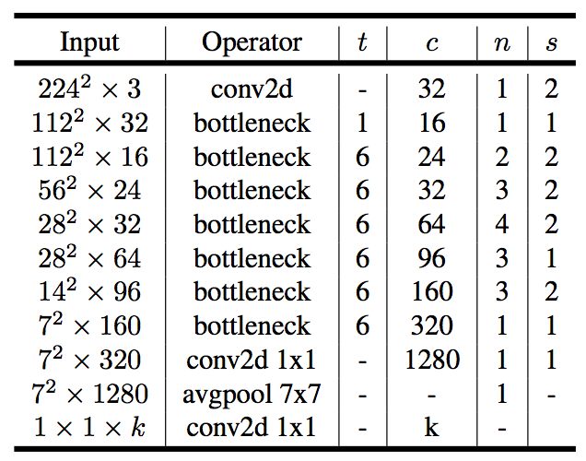
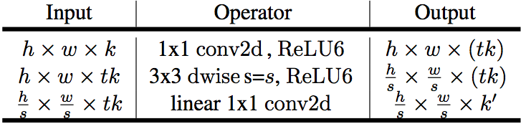
MobileNet v2
Bottleneck residual block
Each line describes a sequence of 1 or more identical (modulo stride) layers, repeated n times.
ImageNet Top-1 Accuracy: 74.7% vs 70.6% for MobileNet v1
6..9M parameters
http://arxiv.org/abs/1801.04381
3rd Winter School on Data Analytics (DA 2018)

Slide 15
CNN compression
[Han et al. 2016] Deep Compression: Compressing Deep Neural Networks with Pruning, Trained Quantization and Huffman Coding – ICLR16 Best paper
Pruning
[Han et al. 2016], [Molchanov et al. 2016]
Distillation The Knowledge (FitNet)
[Hinton et al. 2014], [Romero et al. 2014]
Weights Hashing / Quantization
  [Chen et al. 2015], [Han et al. 2016]
Tensor Decompositions
[Lebedev et al. 2015], [Kim et al. 2015], [Novikov et al. 2015], [Garipov et al. 2016]
Binarization
[Courbariaux / Hubara et al. 2016], [Rastegari et al. 2016], [Merolla et al. 2016], [Hou et al. 2016]
Architectural tricks
[Hong et al. 2016], [Iandola et al. 2016], [Teerapittayanon et al. 2016]
3rd Winter School on Data Analytics (DA 2018)

Slide 16
Difficulties of offline mobile AI
Memory!?
64-256 Gb on Samsung S9+ and IPhoneX
Computational complexity!?
MobileNet inference time:
50-60 ms on Samsung S9+
20 ms on MacBook 2016
Power consumption!
Another platform (Android, iOS). Where Python?
3rd Winter School on Data Analytics (DA 2018)

Slide 17
Face identification
фото
3rd Winter School on Data Analytics (DA 2018)

Slide 18
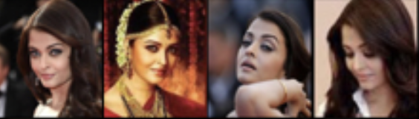
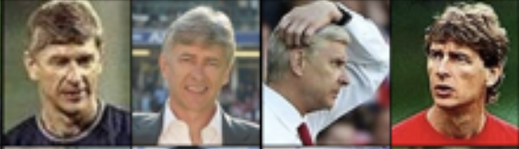
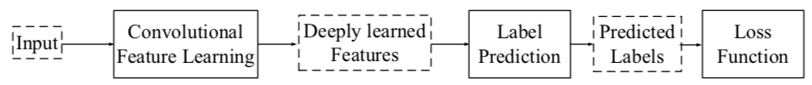
CNN and domain adaptation: Deep faces
Large training set of celebrities (VGGFace2, CASIA-WebFace, MS-Celeb-1M,…)
Representations
Fully connected layer
Deep CNN
…
[Wen et al, ECCV 2016]
3rd Winter School on Data Analytics (DA 2018)

Slide 19
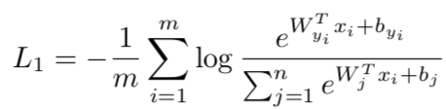
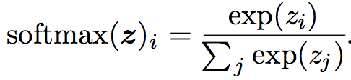
Loss functions (1). Conventional maximum log-likelihood
Softmax activations
Non-negative log-likelihood
- VGGFace (VGG16) /VGGFace2 (ResNet/SeNet-50), https://github.com/rcmalli/keras-vggface
- FaceNet (InceptionResNet v1), https://github.com/davidsandberg/facenet
- LightCNN, https://github.com/AlfredXiangWu/LightCNN
MobileNet v1, http://github.com/HSE-asavchenko/HSE_FaceRec_tf
…
3rd Winter School on Data Analytics (DA 2018)

Slide 20

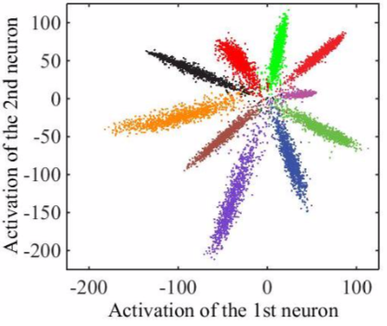
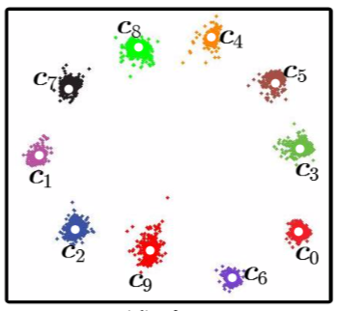
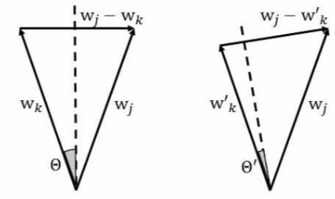


Loss functions (2). Regularization
Center loss [Wen et al, ECCV 2016] minimizes the intra-class variations
Pure softmax (λ=0)
Center loss (λ=1)
One-shot face recognition [Guo & Zhang, 2018]: the persons in the novel set Cn and the persons in the base set Cb should have similar volume sizes
Relationship between the norm of wk and the volume size of the kth class
3rd Winter School on Data Analytics (DA 2018)

Slide 21
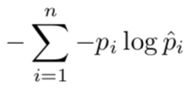
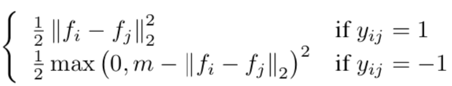
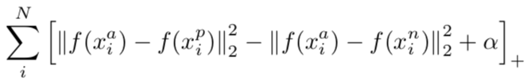
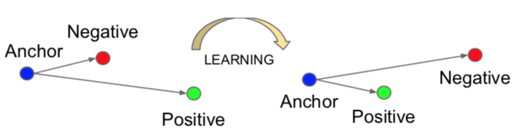
Loss functions (3). Pair training strategy
Contrastive loss in DeepID2 [Sun et al, NIPS 2014]
Identification phase (softmax)
Verification phase
Triplet loss in FaceNet [Schroff et al, CVPR 2015]: an image (anchor, a) of a specific person should be closer to all other images (positive, p) of the same person than it is to any image (negative, n) of any other person
3rd Winter School on Data Analytics (DA 2018)

Slide 22
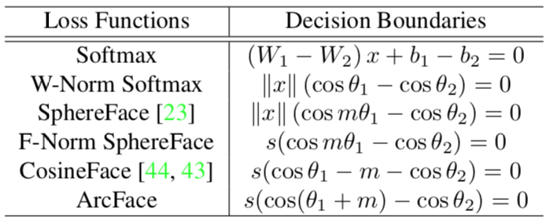
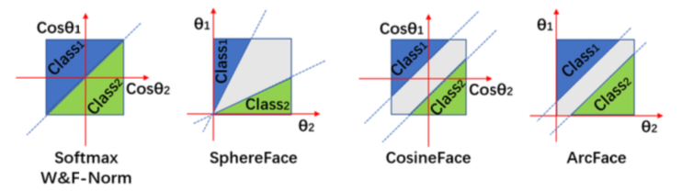
Loss functions (4). Angular and cosine margin based loss
Sphere loss [Liu et al, CVPR 2017]
Cosine loss in FaceCNN [Wang et al, CVPR 2018]
ArcFace [Deng et al, 2018], https://github.com/AIInAi/tf-insightface
Example: binary classification
θ_{i} is the angle between W_{i} and x.
Parameter m>1 in SpehereFace requires cos(m θ₁) > cos(θ₂)
m is a margin in ArcFace/CosineFace
3rd Winter School on Data Analytics (DA 2018)

Slide 23
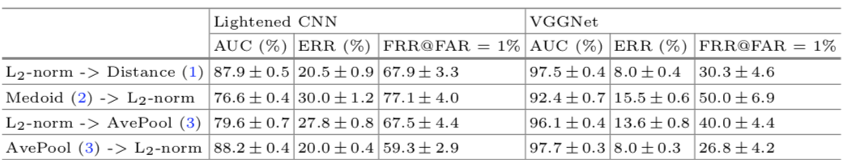
Normalization
Normalize input image
FaceNet (InceptionResNet), https://github.com/davidsandberg/facenet
Input normalization | LFW Rank-1 accuracy (%)
Prewhiten: (image-mean(image))/max(std(image),ε) | 81.6%
Fixed image standardization: (image-127.5)/128 | 95.5%
Normalize features
Results of video-based face verification, IJB-A dataset
[Sokolova, Kharchevnikova, Savchenko, Proc. of AIST 2017, LNCS]
3rd Winter School on Data Analytics (DA 2018)

Slide 24
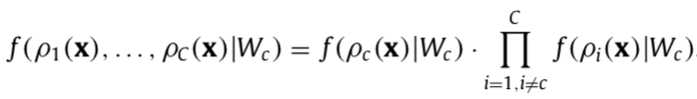
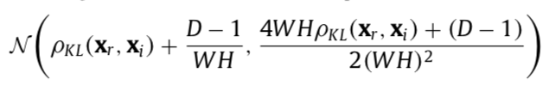
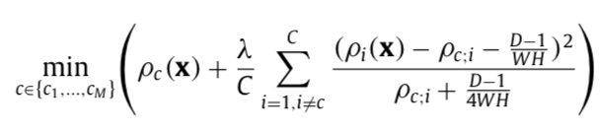
Maximum Likelihood of distances
KL divergence is asymptotically distributed as non-central chi-squared, normal approximation
Final criterion
It can be considered as adding regularization term to the nearest neighbor (NN) rule
[Savchenko, Belova, Expert Systems with Applications 2018]
3rd Winter School on Data Analytics (DA 2018)

Slide 25
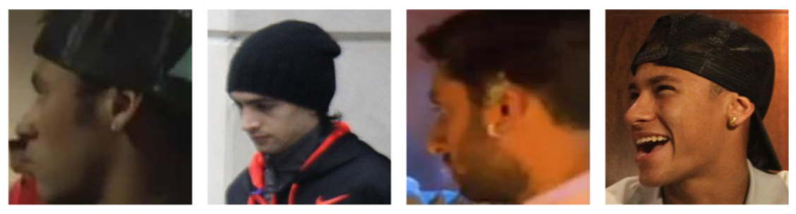
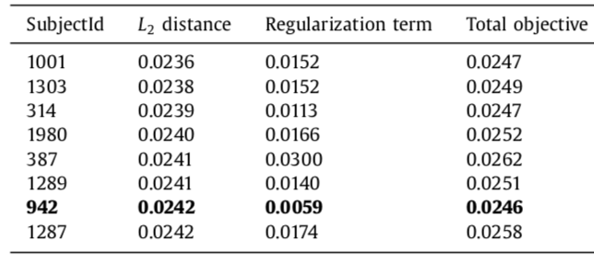
Example
Probe (SubjectId 942)
first NN (SubjectId 1001)
second NN (SubjectId 1303)
Our result (seventh NN, SubjectId 942)
3rd Winter School on Data Analytics (DA 2018)

Slide 26
Experimental study: YTF/LFW
3rd Winter School on Data Analytics (DA 2018)

Slide 27

Experimental study: IJB-A
Rank-1 accuracy (%) in 1:N identification
3rd Winter School on Data Analytics (DA 2018)

Slide 28
Video-based age and gender recognition
фото
3rd Winter School on Data Analytics (DA 2018)

Slide 29


IMDB/Wiki
VGG16-Net
DEX: Deep EXpectation of apparent age from a single image, 2015
3rd Winter School on Data Analytics (DA 2018)

Slide 30


Our simple multi-output model
Train identity features for face identification (softmax loss, VGGFace2 dataset)
Train outputs by alternating batches of data with age and gender labels
Age prediction
https://github.com/HSE-asavchenko/HSE_FaceRec_tf/tree/master/age_gender_identity
3rd Winter School on Data Analytics (DA 2018)

Slide 31




Dempster-Shafer theory for fusion of decisions for video frames
1. Training. Estimate decision templates for each class label j
2. Inference.
a) Estimate the closeness of the frame to each class j
b) Compute Dempster belief
c) Final aggregation for all frames
3rd Winter School on Data Analytics (DA 2018)

Slide 32

Experimental results: Gender recognition accuracy
3rd Winter School on Data Analytics (DA 2018)

Slide 33

Experimental results: Age recognition accuracy
3rd Winter School on Data Analytics (DA 2018)

Slide 34
Group-level emotion recognition
фото
3rd Winter School on Data Analytics (DA 2018)

Slide 35


Motivation
EmotiW2017 sub-challenge:
3 classes (positive, neutral, negative)
Training set: 3630 photos
Validation set: 2065 photos
We got the 4th place (75.4% accuracy on validation set - 23+% better than the baseline, 78.53% on test set - 25+% than the baseline)
Our ensemble based on Dlib face detector and VGGFace was too complicated
[Rassadin, A., Gruzdev, A., Savchenko, Proc. ICMI, 2017]
3rd Winter School on Data Analytics (DA 2018)

Slide 36

Fast emotion recognition
Pipeline
Small convolutional neural networks (CNNs) pre-trained on emotion recognition with FER-2013 (64x64 facial images)
[Tarasov, Savchenko, LNCS, 2018]
3rd Winter School on Data Analytics (DA 2018)

Slide 37

Practical example
The most accurate (70.9% val acc) Random Forest returns a wrong Neutral emotion. The neutral label gets a score of 0.709.
When Linear SVM (70.3% val acc) and RBF SVM (69.3% val acc) are in an ensemble, correct positive label is chosen by both SVMs and gets maximal score 1.396 (0.703+0.693).
3rd Winter School on Data Analytics (DA 2018)

Slide 38
Experimental results on EmotiW 2017 data
 | CNN-5 |  | FCN
Classifier | 7 softmax scores | 128 embeddings | 7 softmax scores | 112 embeddings
RBF SVM | 57.0 | 60.5 | 68.5 | 69.3
Gradient Boosting | 61.3 | 61.9 | 67.2 | 70.1
Extra Trees | 59.1 | 61.9 | 69.6 | 70.2
Linear SVM | 59.6 | 61.5 | 69.8 | 70.3
Bagging | 59.0 | 61.5 | 68.8 | 70.7
Random Forest (RF) | 58.0 | 59.9 | 69.0 | 70.9
AdaBoost | 57.4 | 58.1 | 69.5 | 70.9
Proposed approach (all classifiers) | 61.5 | 62.2 | 70.7 | 72.3
Proposed approach (RF, RBF SVM and Linear SVM) | 61.9 | 64.2 | 73.2 | 75.5
3rd Winter School on Data Analytics (DA 2018)

Slide 39
CNN compression. Visual emotion recognition (Radboud Faces Database)
 | Training time per epoch, ms | Inference time, ms | Model size, MB | Accuracy, %
VGG-S (baseline) | 43.7 | 33.4 | 372.2 | 97.13
SqueezeNet-1.1 (baseline) | 22.94 | 4.94 | 2.8 | 89.14
SqueezeNet-1.1, CP-Decomposition | 22.94 | 7.74 | 2.1 | 87.5
HashedNets | 294.8 | 158.2 | 68.3 | 96.31
Binary-Weight-Network (BWN) | 83.8 | 33.5 | 11.6 | 98.57
XNOR-Net | 84.3 | 34.2 | 11.6 | 58.81
XNOR-Net w/o weights activation | 43.4 | 34.1 | 11.6 | 88.32
[Rassadin, Savchenko, CEUR-WS, 2017]
3rd Winter School on Data Analytics (DA 2018)

Slide 40
Organizing Photo and Video Albums
фото
3rd Winter School on Data Analytics (DA 2018)

Slide 41


Organizing Photo and Video Albums
3rd Winter School on Data Analytics (DA 2018)

Slide 42

Experimental results: GFW (Grouping Faces in the Wild) dataset
In average, C = 46 subjects
3rd Winter School on Data Analytics (DA 2018)

Slide 43
















Example (1)
male 1987
female 1982
female 2015
female 2016
male 2009
3rd Winter School on Data Analytics (DA 2018)

Slide 44



Example (2)
3rd Winter School on Data Analytics (DA 2018)

Slide 45
Conclusion
Though facial analytics is well established industrial field, there are still plenty of research questions
AI in mobile systems is still under active research
Combination of conventional machine learning techniques with face descriptors extracted by contemporary CNNs has prooved its potential
3rd Winter School on Data Analytics (DA 2018)

Slide 46




Special thanks to my students and colleagues
Kharchevnikova Angelina
Sokolova Anastasiya
Rassadin Alex
Tarasov Alex
3rd Winter School on Data Analytics (DA 2018)

Slide 47
Thank you!

