Slide 1
Robust Data Analytics
Mario.Guarracino@cnr.it Computational and Data Science Laboratory National Research Council, Italy
Зимняя школа по аналитике данных 2018 НИУ ВШЭ - ЛАТАСС
2018 11 27

Slide 2
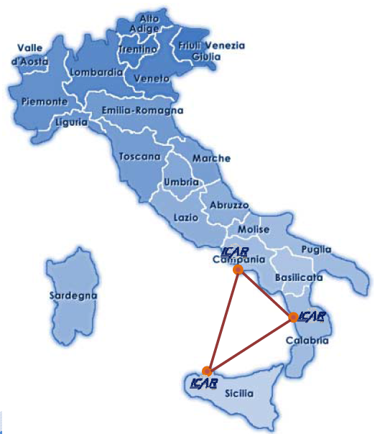
ICAR-CNR
National Research Council of Italy
7000 scientists, > 100 Institutes
High Performance Computing and Networking Institute
Three branches: Naples, Cosenza and Palermo
70 scientists (~140 persons involved)
Computational & Data Science Laboratory
7 staff scientists (~14 persons involved)

Slide 3
Naples, Italy

Slide 4
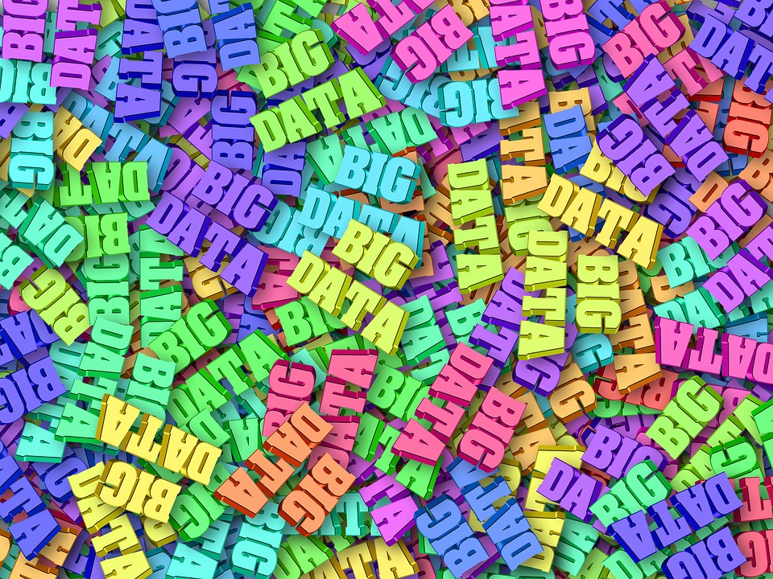
Introduction
We live in a digital world where data are produced at an unprecedented speed.
Existing data analysis techniques need to take into account data is noisy, big and with many variables.
Today we will talk about robust data analysis and its relevance in data analytics.

Slide 5
Definition: Data Analytics
Data Analytics is the process to acquire knowledge from the information contained in data, with the aid of specialized algorithms, methods and software.
It is widely used in industries to make informed business decisions and by scientists to verify (or disprove) scientific theories and hypotheses.
Its use in public bodies can enhance efficiency and efficacy of administrative and economic initiatives.

Slide 6
Data…what?
What’s difference between Data Analytics, Data Analysis, Data Mining, Data Science, Machine Learning, Big Data?

Slide 7
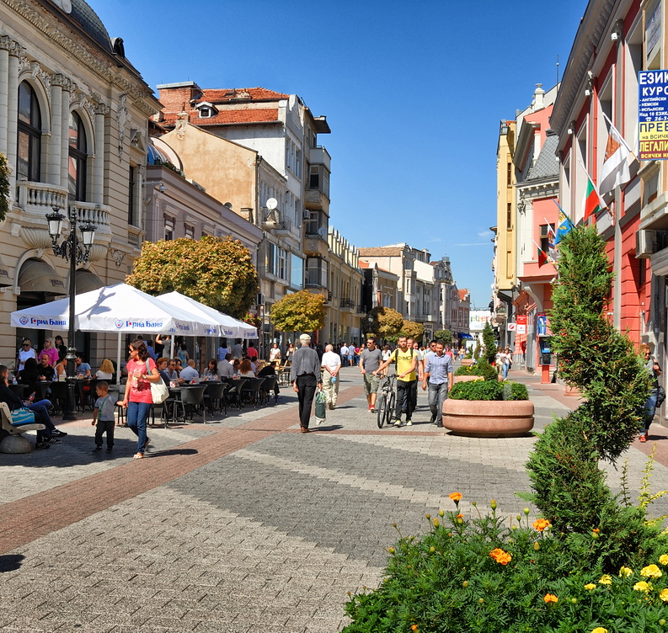
Use cases: classification
Question: Will be the right decision to introduce a new pedestrian area?
Data: economical, social, pollution indexes
Aim: Increase livable conditions
Objective: Increase initiative
success

Slide 8
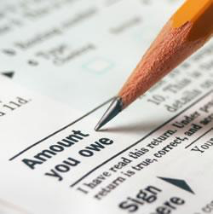
Use cases: regression
Question: How much taxes are collected in a town, and how much should be the public spending in a specific area?
Data: public taxes and spending (over time)
Aim: Balance public spending among different area
Objective: Enhance perception of public spending quality and quantity

Slide 9
Use cases: clustering
Question: What would make a certain area more similar to others (e.g. with better living conditions)?
Data: Population stratification, identification of a cost function
Aim: Improve living conditions
Objective: Reduce public spending
Notes:
Less time spent on routine activities

Slide 10
OR/Optimization
Computer science
Data analytics
Statistics
Information engineering

Slide 11
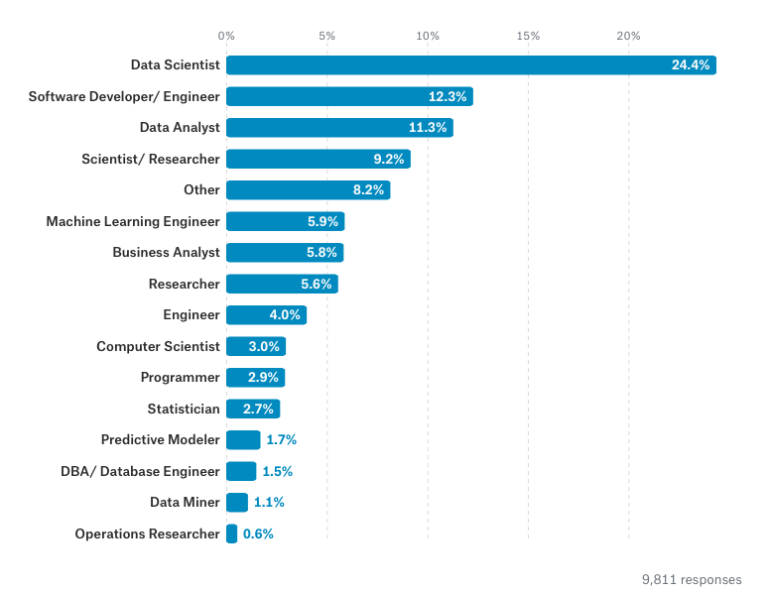
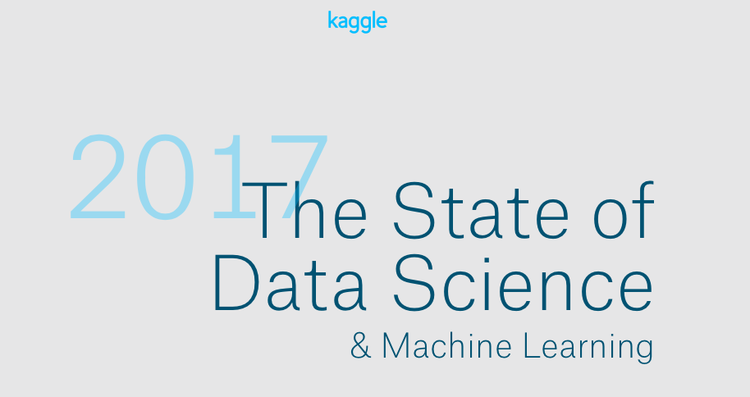
What is the title of your job?

Slide 12
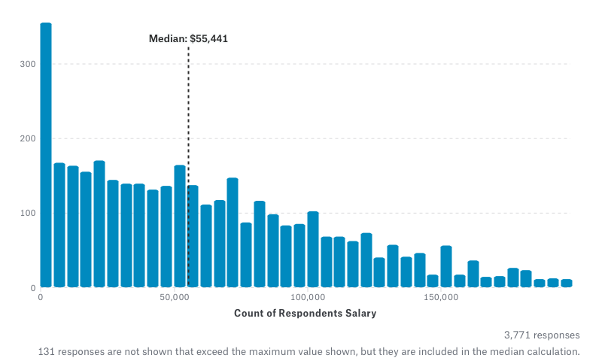
What is your full-time annual salary?

Slide 13
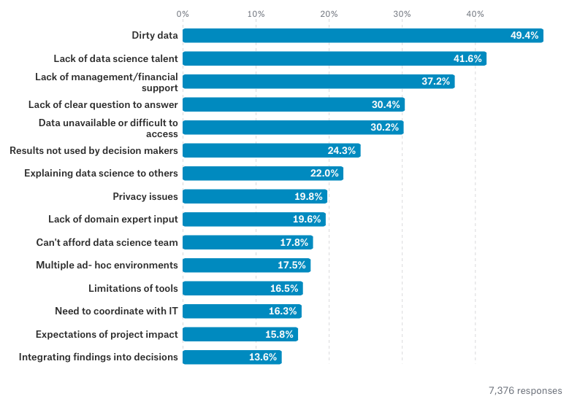
What barriers are faced at work?

Slide 14
Dirty data: outlier vs noise
Example: counting the coins and bills you have in your pocket. Outlier: you are enumerating everything you have. You found 3 dimes, 1 quarter and wow a 100 USD bill you had put there last time you bought something and totally forgot. The 100 USD bill is an outlier, as it's not commonly expected in a pocket. Noise: you have just come back from that club. You try to find some money to buy something to eat, but you have trouble reading the figures correctly on the coins. You found 3 dimes, 1 quarter and wow a 100 USD bill. But in fact, you have mistaken the quarter for a dime: this mistake introduces noise in the data you have access to. To put it otherwise,
data = true signal + noise

Slide 15
Outline
Introduction/definition
Supervised learning
Feature selection
How to make money with DA
Clustering

Slide 16
Definition: Robust Data Analytics
Robust Data Analytics is the process to acquire knowledge from the information contained in noisy data, with the aid of specialized algorithms, methods and software.
It will be needed in industries to make informed business decisions and by scientists to verify (or disprove) scientific theories and hypotheses.
Its use in public bodies can enhance efficiency and efficacy of administrative and economic initiatives.

Slide 17
Robustness
The term robust has been use for many purposes:
Robust Statistics: Statistics that work even if some distribution assumptions are slightly violated
Robust Optimization: Find the optimal solution for all the possible realizations of the dataset (existence of outliers)
Sometimes “robust” is used in a totally different way!!!

Slide 18
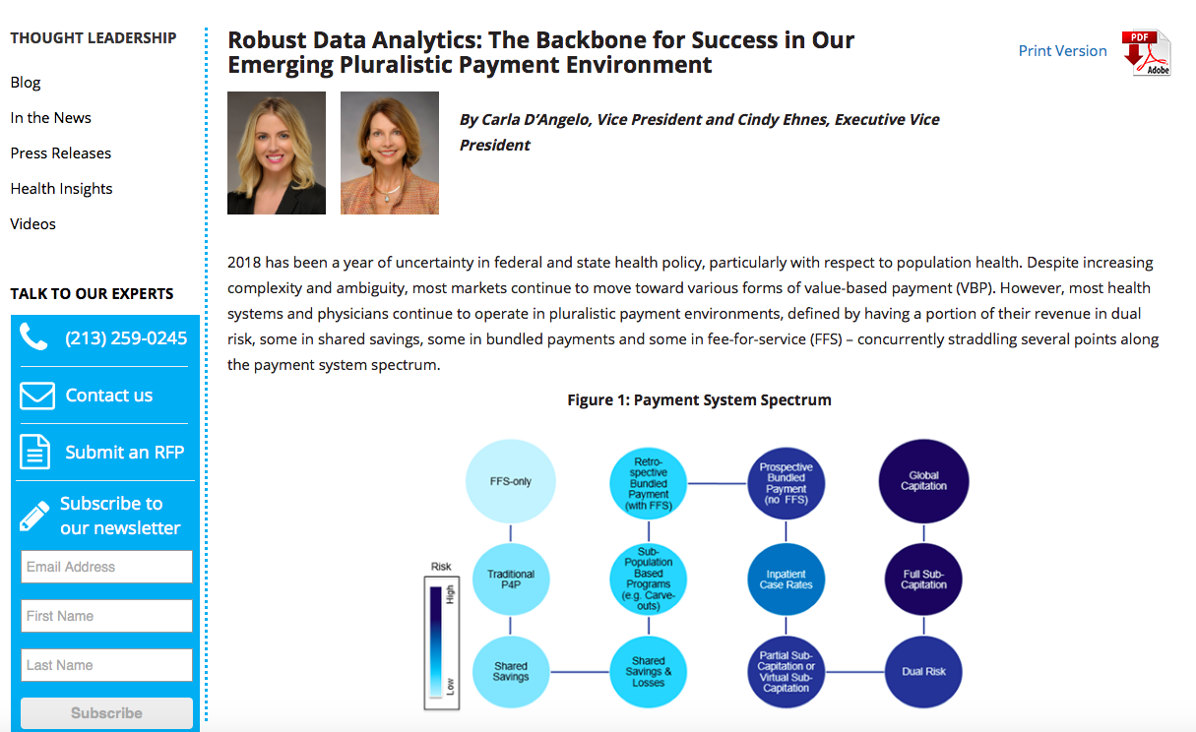
Robust data analytics

Slide 19
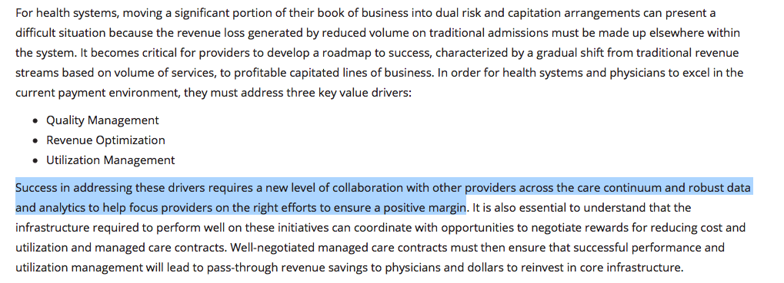
Robust data analytics
https://copehealthsolutions.com

Slide 20
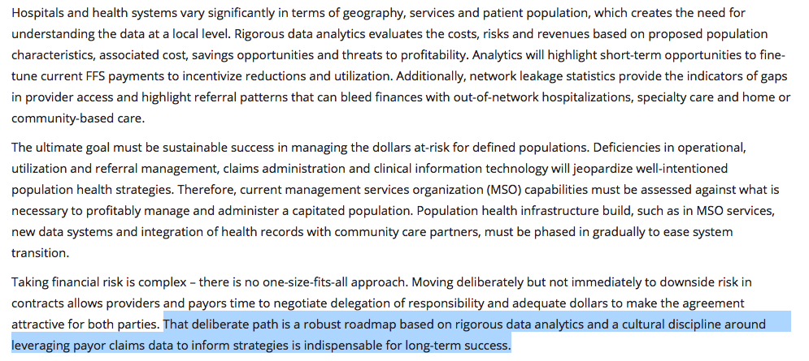
Robust data analytics
https://copehealthsolutions.com

Slide 21
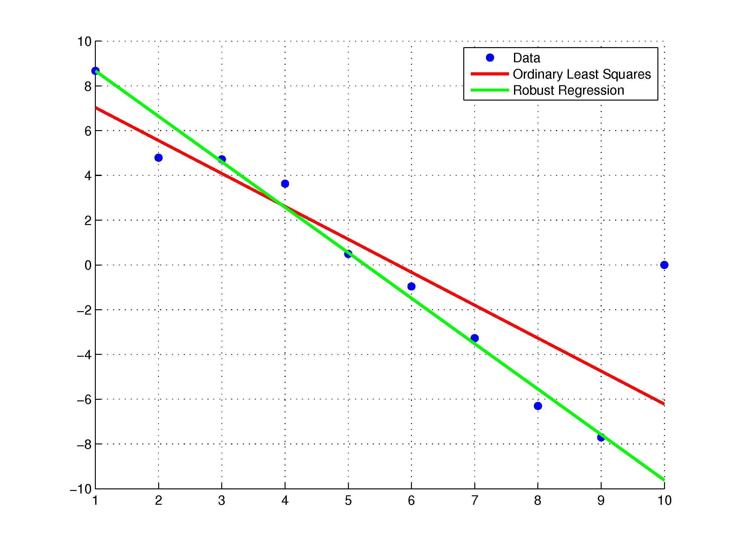
Robust statistics

Slide 22
Handling uncertainty: example

Slide 23
Linear Least Square

Slide 24
Geometrical interpretation

Slide 25
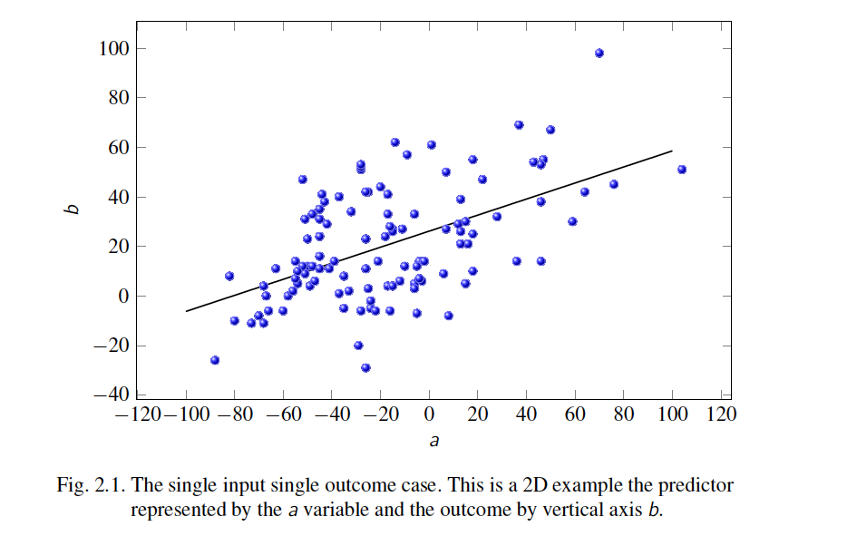
Graphical interpretation

Slide 26
LLS solution

Slide 27
Robust formulation

Slide 28
Coupled uncertainty

Slide 29
Coupled uncertainty

Slide 30
Uncoupled uncertainty

Slide 31
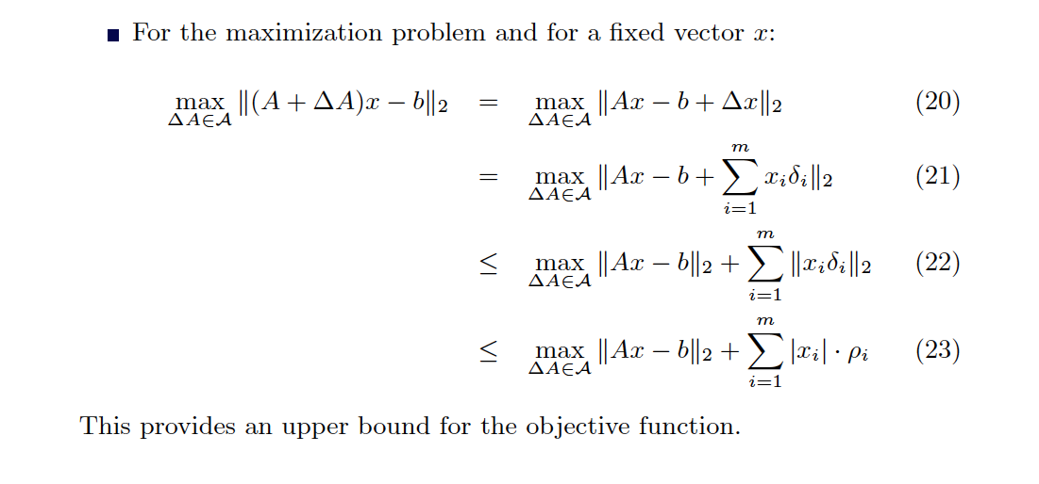
Uncoupled uncertainty

Slide 32
Uncoupled uncertainty

Slide 33
Uncoupled uncertainty

Slide 34
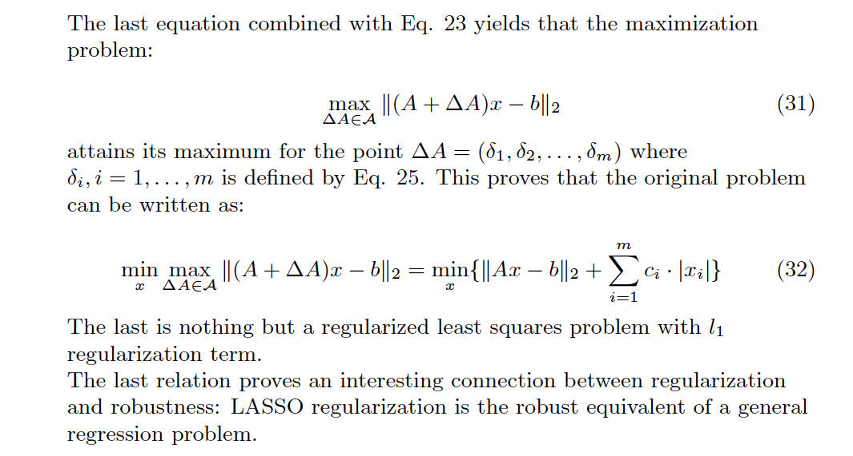
Robustness & regularization

Slide 35
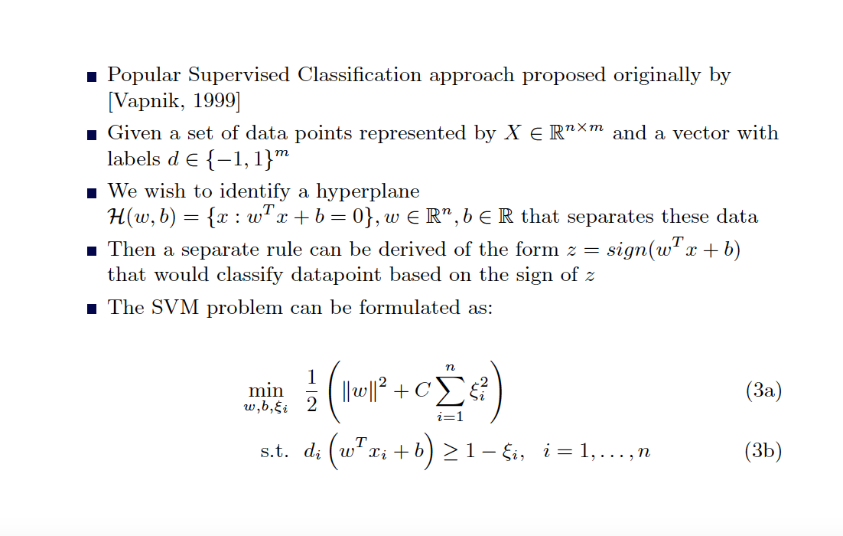
Support Vectors Machines (SVM)

Slide 36
Example: SVM

Slide 37
Example: SVM with l₂-uncertainty

Slide 38
Example: SVM with l₁-uncertainty

Slide 39
Conclusions
Data analytics workers often confront with dirty data.
The quality of the analysis strongly depends on the quality of data.
Robust data analytics aims at providing robust techniques through-out the analytics process.
The use of such robust methodologies is an essential part of the analytics process.

Slide 40
From data to…

