Slide 1
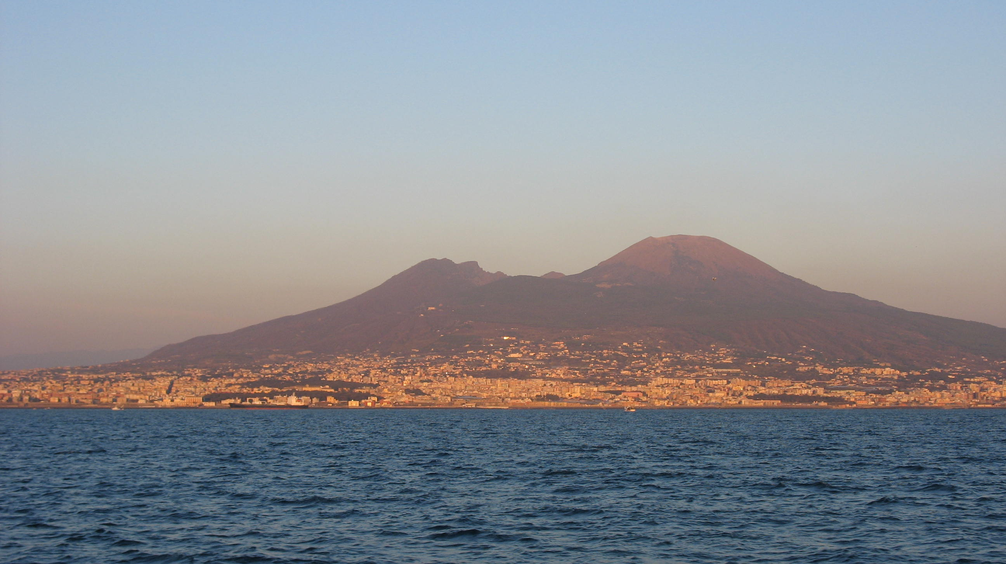
Supervised classification of noisy data
Mario Rosario Guarracino
LATNA@HSE Nizhny Novgorod, November 2018

Slide 2
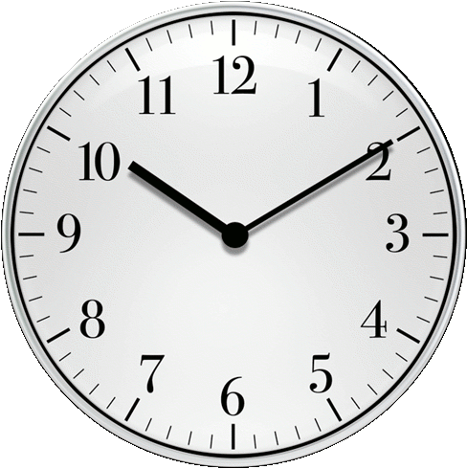
Outline
Introduction
Supervised learning:
Support vector machines
ReGEC (Regularized Generalized Eigenvalue Classifier)
Fuzzy ReGEC
Robust ReGEC
Conclusions

Slide 3
Introduction
Supervised learning refers to the capability of a system to learn from examples
The trained system is able to answer to new questions
Supervised means the desired answer for the training set is provided by an external teacher
Binary and multiclass classification are among the most successful methods for supervised learning

Slide 4
Binary classification
Every classification problem can be posed as a discrimination problem
Is the new point red or blue?
B
A

Slide 5
Applications
Classification has been successfully used in many applications:
data analytics
sentiment analysis
topic classification
risk management
bioinformatics
medical diagnoses and prognosis
Many algorithms available: no technique is successful in every and all applications!

Slide 6
Support Vector Machines
Originally proposed by Vapnik in 1999
Given a set of points and a vector with labels
We wish to identify a hyperplane
that separates the data
Points are classified on the sign of z:

Slide 7
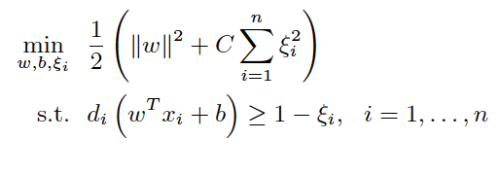
Support Vector Machines
Given a set of points and a vector with labels , find the plane that maximize the margin:

Slide 8
Generalized Eigenvalue Classifier (GEC)
x
'
0
ω
Find two lines, each the closest to one set and the furthest to the other
=
2
−
1
γ
γ
2
−
=
ω
1
0
'
x
B
A
||
A
ω
−
e
γ
||
2
min
ω,
γ
≠
0
||
B
ω
−
e
γ
||
2
O. L. Mangasarian and E. W. Wild Multisurface Proximal Support Vector Classification via Generalized Eigenvalues
IEEE Transactions on Pattern Analysis and Machine Intelligence 28(1), 2006, 69-74.

Slide 9
ReGEC formulation
||
A
ω
−
e
γ
||
2
min
Let:
G = [A –e]^{T}[A –e], H = [B –e]^{T}[B –e], z = [ω^{T} γ]^{T}
equation becomes:
Raleigh quotient of Generalized Eigenvalue Problem
G x = λ H x
ω,
γ
≠
0
||
B
ω
−
e
γ
||
2
z^{T}
G
z
min
z
≠
0
z^{T}
H
z
M.R. Guarracino, C. Cifarelli, O. Seref, P. Pardalos. A Classification Method Based on Generalized Eigenvalue Problems, OMS, 2007.

Slide 10
ReGEC assignment of new points
A new point is assigned to the class described by the closest line
B
A
|
x
'
ω
−
γ
|
dist
(
x
,
P
)
=
i
||
ω
||

Slide 11
Multiclass ReGEC
A
New Point
B
C
D
A. Irpino, M.R.G., and R. Verde – Multiclass Generalized Eigenvalue Proximal Support Vector Machines. IEEE CISIS 2010.

Slide 12
Advantages
ReGEC scales up with training set dimension
ReGEC is based on a generalized eigenvalues and its implementation is straight forward in many programming languages
Java, C++, C, Fortran…
ReGEC reduces to 1 line of code in many problem solving environments
Matlab, R, Weka,…
Easy to parallelize/distribute with existing software
ScaLAPACK, GridSolve,…

Slide 13
Challenges
Problems are big (n or/and m are large)
Data are affected by noise, uncertainty, or are inexact
In presence of noise, classification models can overfit the data

Slide 14
Fuzzy sets
Fuzzy sets (FS) were introduced by Lotfi A. Zadeh in 1965 as an extension of the classical notion of sets
In classical set theory, elements either belong or do not belong to the set
By contrast, FS theory permits the gradual assignment of elements x_{i} to a set, using a membership value s_{i} in the real unit interval [0, 1]
The FS theory can be used in a wide range of domains in which information is incomplete or imprecise, such as bioinformatics

Slide 15
Fuzziness & classification
Aim: to devise a classification model resilient to noise in data
Weighting the training points, those more relevant for the classification play a major role in determining the model
Fuzzy Regularized Generalized Eigenvalue Classier (FReGEC) advantages with respect to existing solutions:
It uses a novel fuzzy membership function, that takes into account the structure of the dataset
The weighting scheme induced by the membership function is coherent with the characteristics of the classier
It improves robustness with respect to outliers
Results show that the classification accuracy of the algorithm is competitive with that of existing methods and membership functions

Slide 16
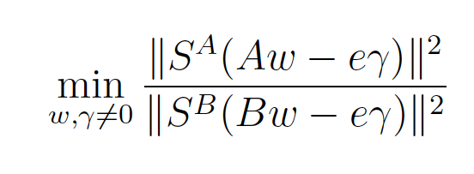
Fuzzy ReGEC
Fuzzyfication
Membership function
M.R.G., A. Irpino, R. Jasinevicius, R. Verde. Fuzzy Regularized Generalized Eigenvalue Classier with a Novel Membership Function. Information Science, 2012.

Slide 17
Fuzzy ReGEC algorithm
For each class, use k-means to determine the sets C_{A} and C_{B} of k centers.
For each training point x_{i} in A and B compute its weight S_{ii}:
Solve

Slide 18
Heat map of the membership functions
C_{A} and C_{B} are centers obtained by clustering the classes separately.

Slide 19
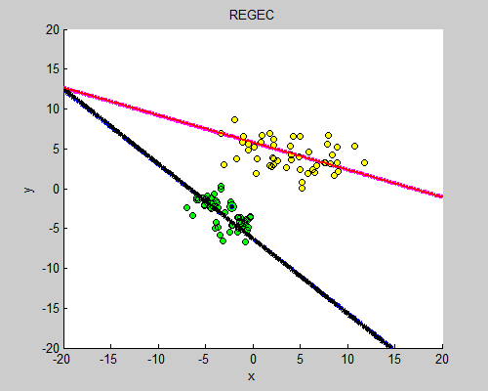
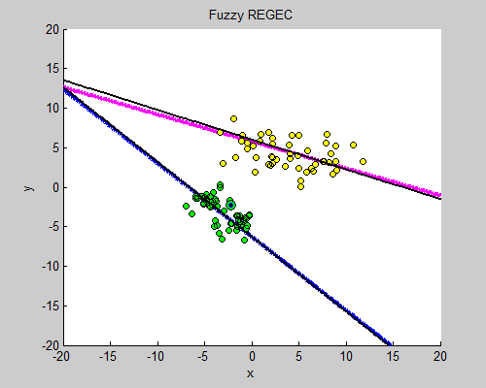
ReGEC vs Fuzzy ReGEC

Slide 20
Numerical experiments
All datasets from UCI, except for Cross-lines and Svmguide2
Mean accuracy & standard deviation of a 10-fold cross validation repeated 10 times
Grid search on validation dataset for model selection

Slide 21
Benchmark dataset
Dataset | Size | Variables | Classes
Balance-scale | 625 | 4 | 3
Cross-lines | 429 | 2 | 3
Glass | 214 | 9 | 6
Iris | 150 | 4 | 3
Segment | 2,310 | 19 | 7
Svmguide2 | 391 | 20 | 3
Thyroid | 215 | 5 | 3
Vehicle | 846 | 18 | 4
Vowel | 528 | 10 | 11
Wine | 178 | 13 | 3
Zoo | 101 | 16 | 7

Slide 22
Accuracy comparison (%)
 | Fuzzy ReGEC | ReGEC
Balance scale | 75.68±6.84 | 73.36±8.7
Cross lines | 94.87±2.7 | 94.17±3.5
Glass | 75.23±7.49 | 73.2±7.7
Iris | 98±3.06 | 97.33±3.2
Segment | 97.4±1.09 | 97.14±0.68
Svmguide2 | 81.33±6.67 | 78.26±4.47
Thyroid | 97.21±2.3 | 97.21±4.23
Vehicle | 71.28±4.26 | 70.21±4.08
Vowel | 99.43±0.87 | 99.24±1.25
Wine | 96.07±3.58 | 94.38±6.21
Zoo | 99.01±2.7 | 98.02±3.87

Slide 23
From fuzzy to robust
Fuzzy algorithms weight the contribution of training points in building the classification model
No information on noise is available/needed to build the model
If noise in data is known to be bounded, we can build more accurate classifiers using robust algorithms

Slide 24
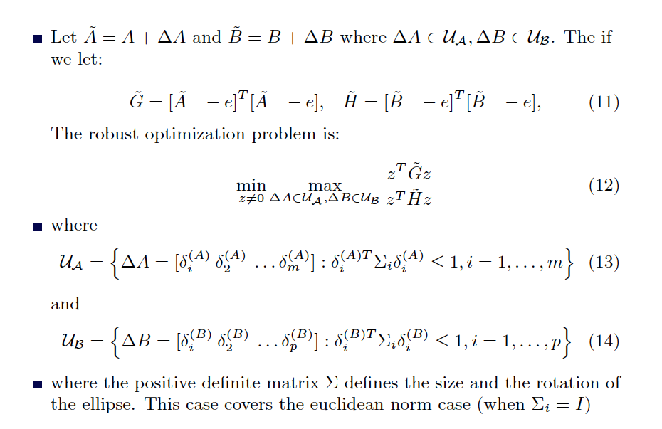
ReGEC under uncertainty
Let
and
where
Let:
The robust optimization problem is:
Where:
and
The positive definite matrix Σ defines the size and rotation of the ellipse
(Σ_{i}=I is the Euclidean norm).

Slide 25
Worst case scenario
Find the maximum (or minimum) distance from a point that belongs to the ellipse, to the hyperplane defined by
where x_{c} is the ellipse center
By solving the corresponding KKT system, we obtain the following expression for x:
The two points on the ellipse are at minimum and maximum distance

Slide 26
The robust solution
Since the solution depends on w, and therefore z, we will have for our problem:
The solution cannot be derived from the corresponding generalized eigenvalue problem
An iterative algorithm is used to compute the solution
P. Xanthopoulos, M.R.G., and P.M. Pardalos, Robust Generalized Eigenvalue Classifiers with Ellipsoidal Uncertainty, Annals of Operation Research, 2014

Slide 27
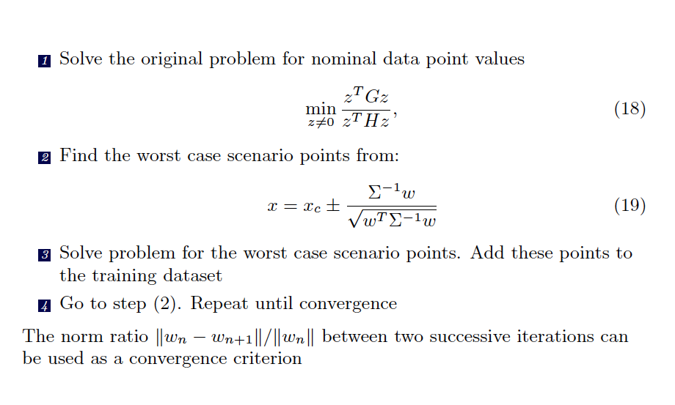
Robust algorithm

Slide 28
Adjustable models
Robust approaches can be over conservative: only optimal when the assumed worst scenario occurs
In practice, better to robustify with respect to an average case scenario, using adjustable models
We take the convex combination of nominal data and “robust” ones:
Parameter ξ determines how close the points will be to their nominal values, or to the “worst scenario”

Slide 29
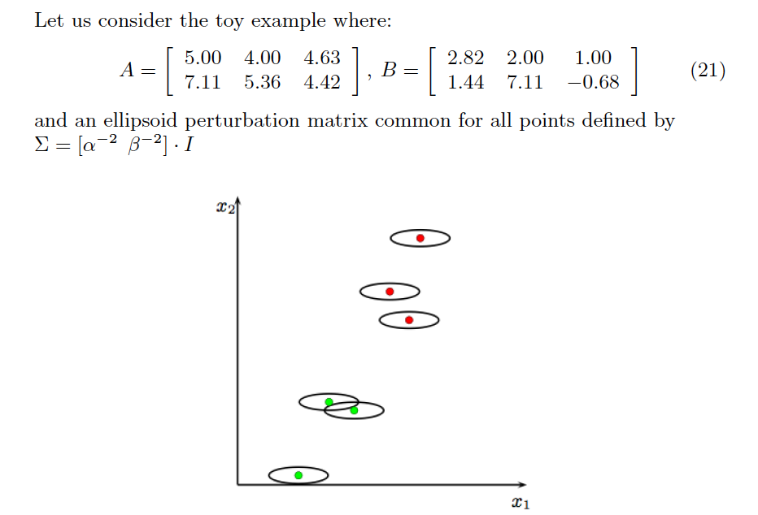
Example
Consider the following example:
And a perturbation ellipsoid common for all points, defines as

Slide 30
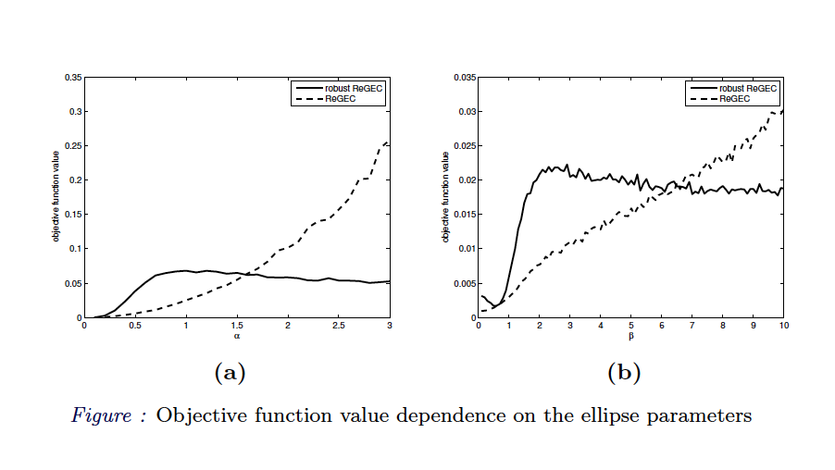
Objective function value

Slide 31
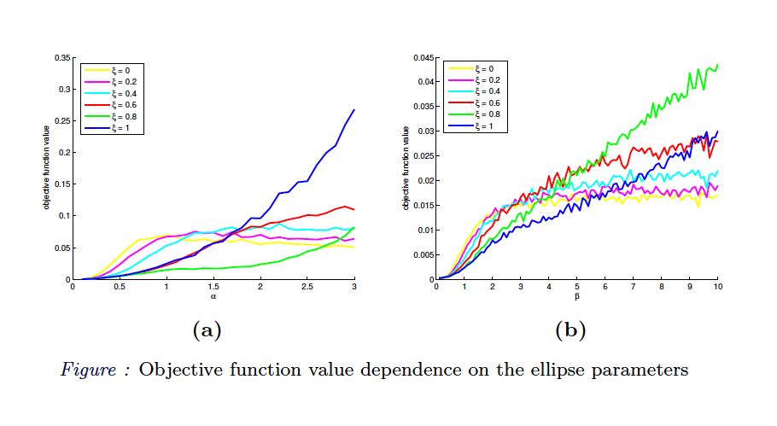
Adjusted objective function value

Slide 32
A case study
Pima Indians data: 768 instances, 8 variables.
Hold out cross validation with 50 repetitions
In every repetition 90% of the samples were used for training and 10% for testing
At each repetition we train the robust algorithm with the nominal data plus the uncertainty information
The uncertainty was kept constant and equal to 0.1 for all dimensions (features) but one, which is equal to α
All data features are initially normalized (zero mean and unit standard deviation)
Notes:
Number of times pregnant, Plasma glucose concentration, blood pressure, serum insulin,...

Slide 33
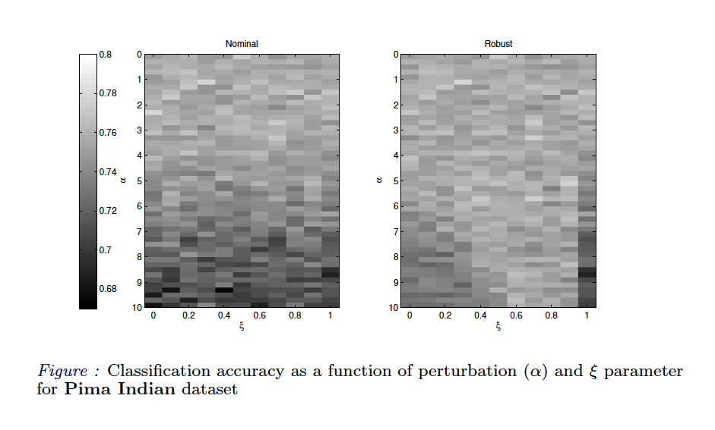
Classification results

Slide 34
Conclusions
Supervised classification can help to make predictions in many ICT and e-commerce problems
The fuzzy and robust solutions we devised have been applied to solve several problems
In case of data affected by noise, the novel algorithms produce classification models capable of accurate predictions

