Slide 1
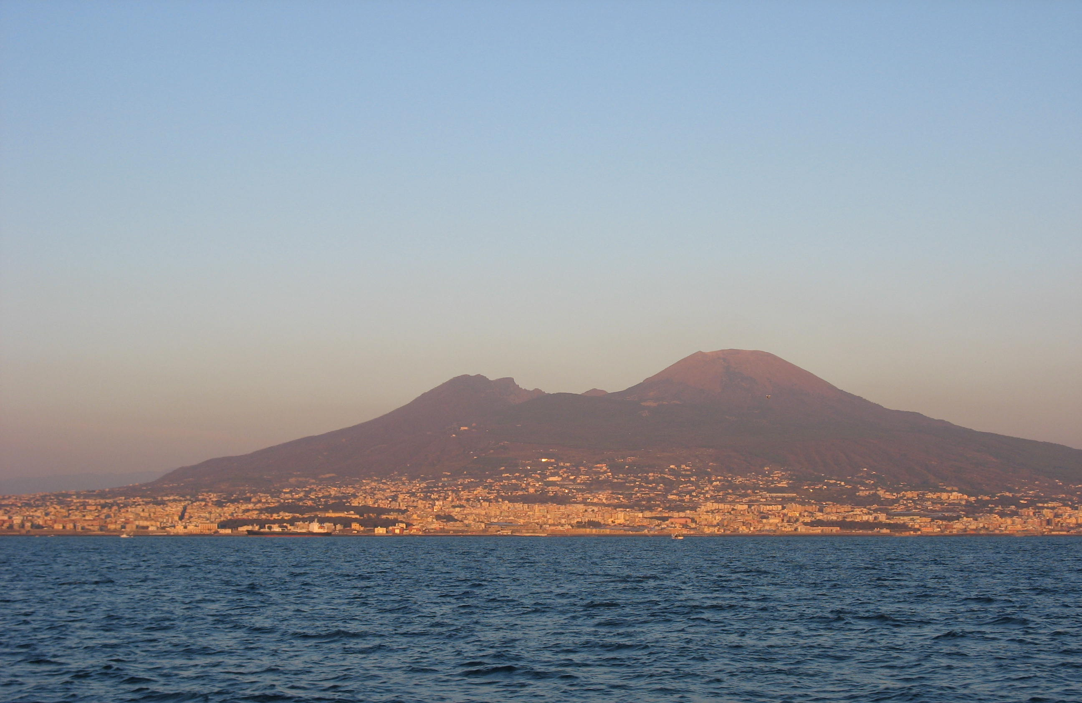
Supervised classification of network data
Mario.Guarracino@cnr.it
www.icar.cnr.it/en/laboratori-icar/scienze-computazionali-e-dei-dati-cds-lab

Slide 2
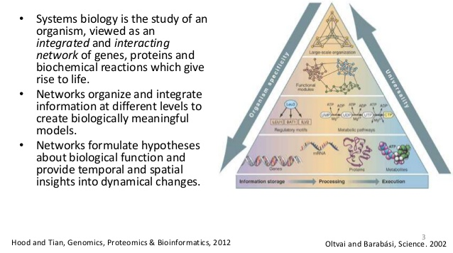
Systems Biology

Slide 3
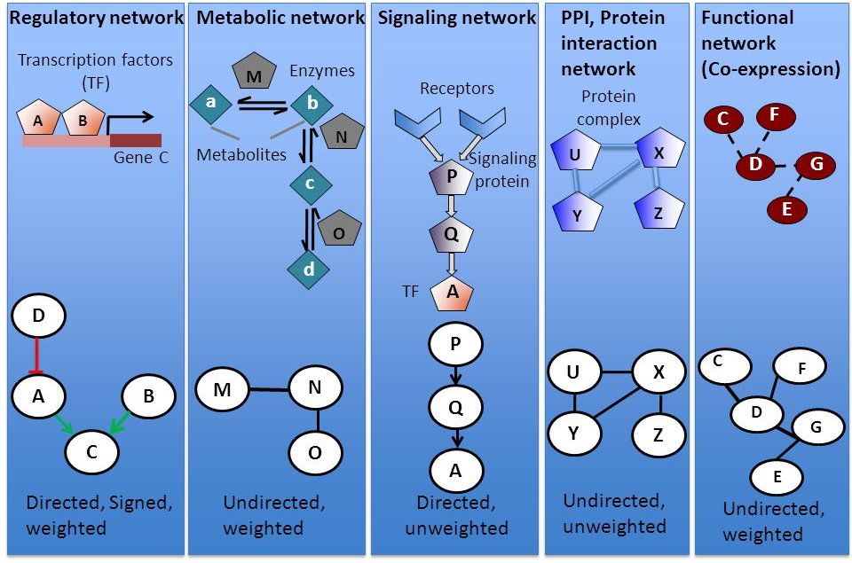
Biological Networks

Slide 4
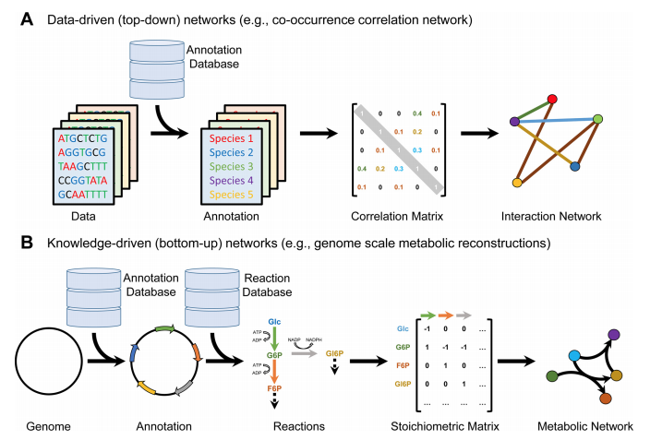
Bauer, Eugen, and Ines Thiele. "From Network Analysis to Functional Metabolic Modeling of the Human Gut Microbiota." MSystems 3.3 (2018): e00209-17.

Slide 5
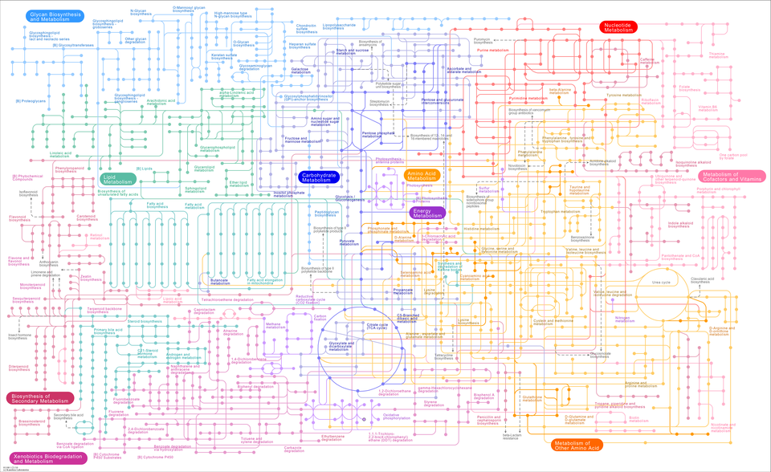
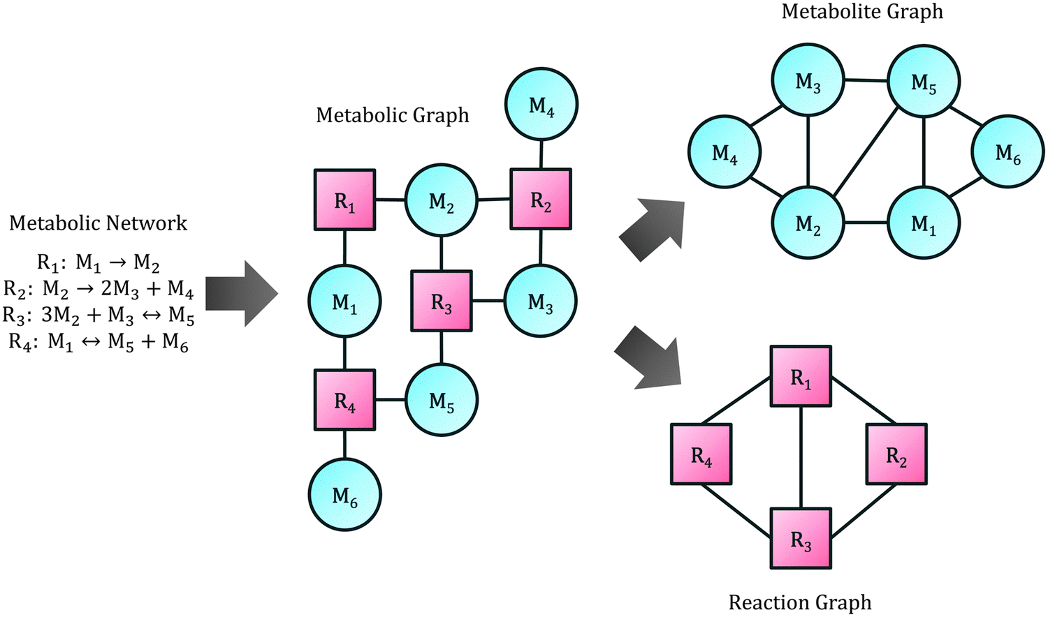
Metabolic Networks
Representation of the metabolic structure of a cell (chemical reactions, involved metabolites, and associated genes)
Several types of graphs can be generated from metabolic metworks

Slide 6
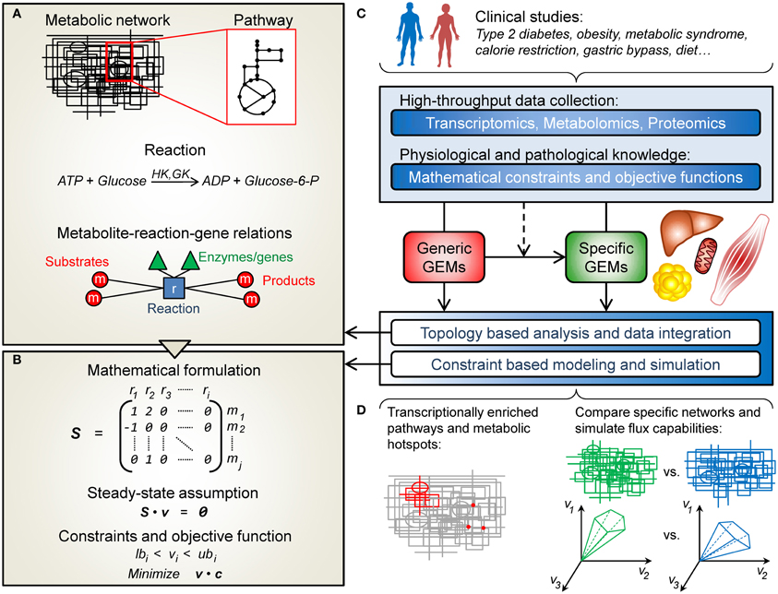
Genome Scale Metabolic Models

Slide 7
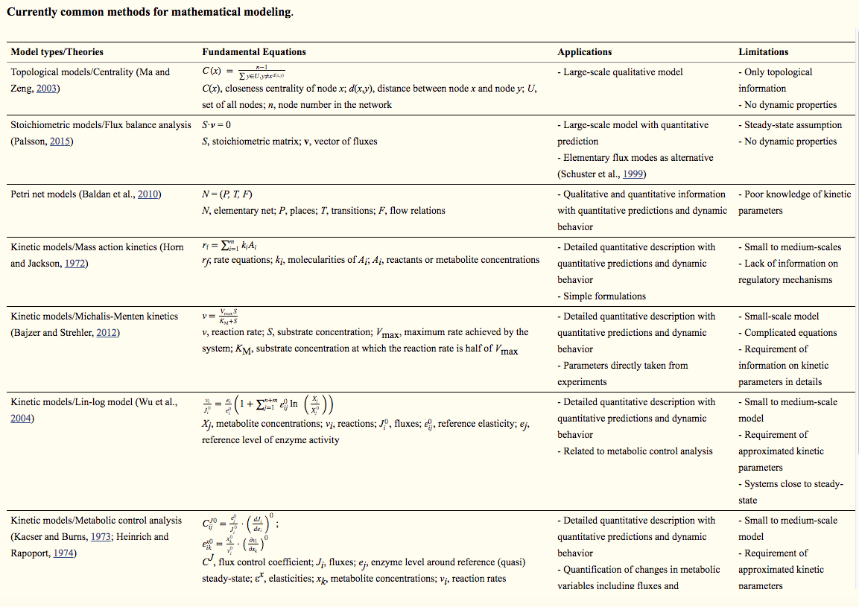
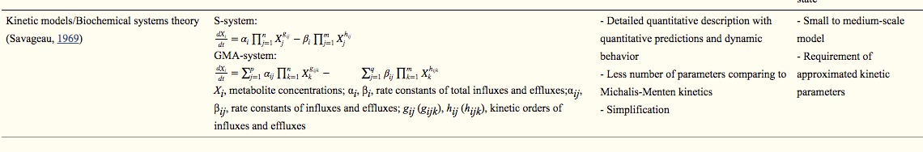
Mathematical Models

Slide 8
Mathematical Models

Slide 9
Flux Balance Analysis (FBA)
The optimization problem is governed by the choice of the objective function, which in most cases is the production of biomass and ATP associated maintenance
BUT
“ the statement of an [assumed] objective introduces a ‘user-bias’ and such objective may not be relevant to the true physiological state.”
(Becker et al. 2008)
The assumption of maximal rates of biomass represents an objective at cellular level, whereas in multicellular organisms a given cell’s objective is likely to be realised via survival at systemic level;
Different cell types have different cellular objectives.

Slide 10

Lee-12 Algorithm
Application of a purely data-driven objective
i = reactions for wich data d_{i} are available (i.e. reactions with associated genes)
σ_{i} = error in data point i calculated during the mapping

Slide 11
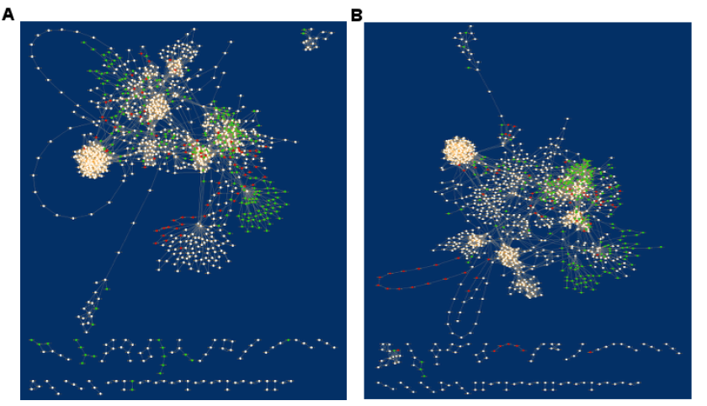
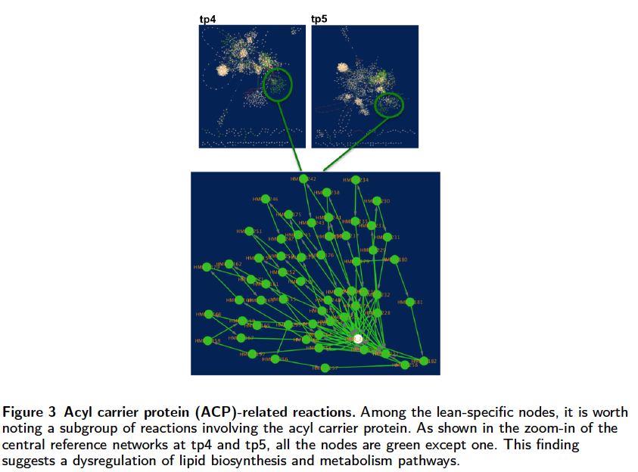
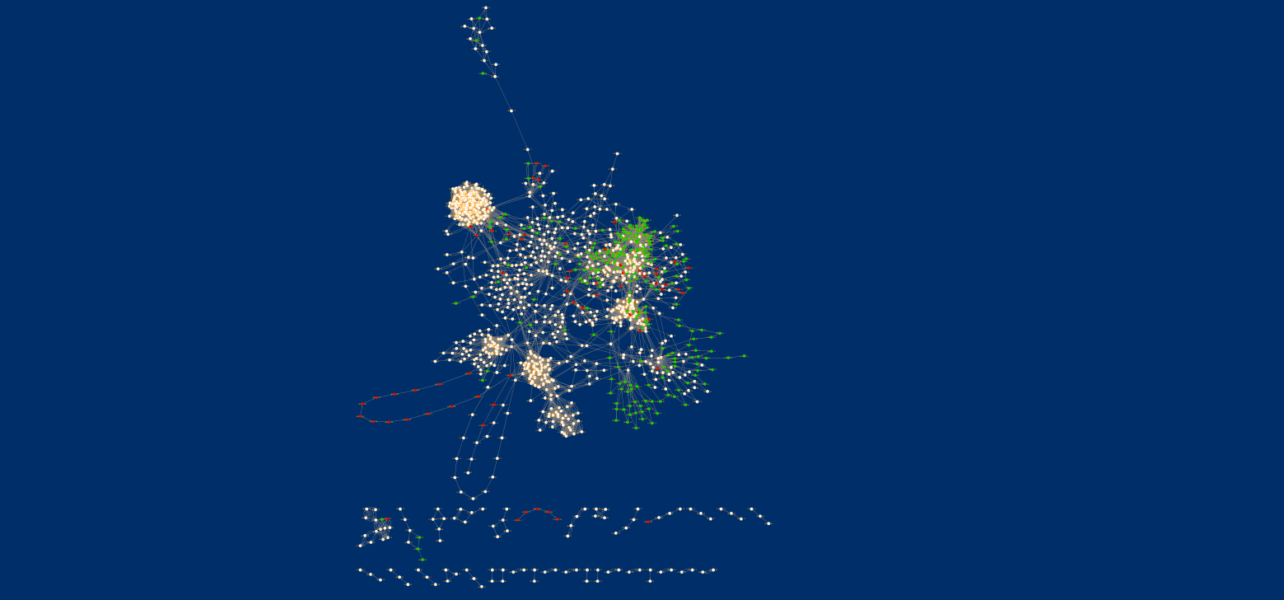
Networks comparison
tp4
tp5

Slide 12
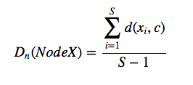
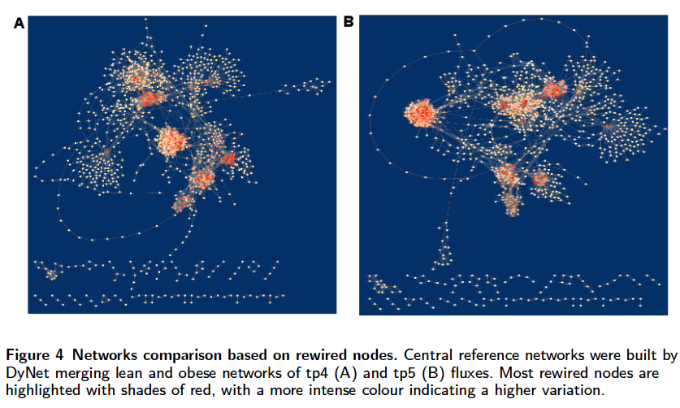
Networks comparison
The Dn-score favors high degree nodes or hubs
Top rewired nodes: Amino acid transport

Slide 13
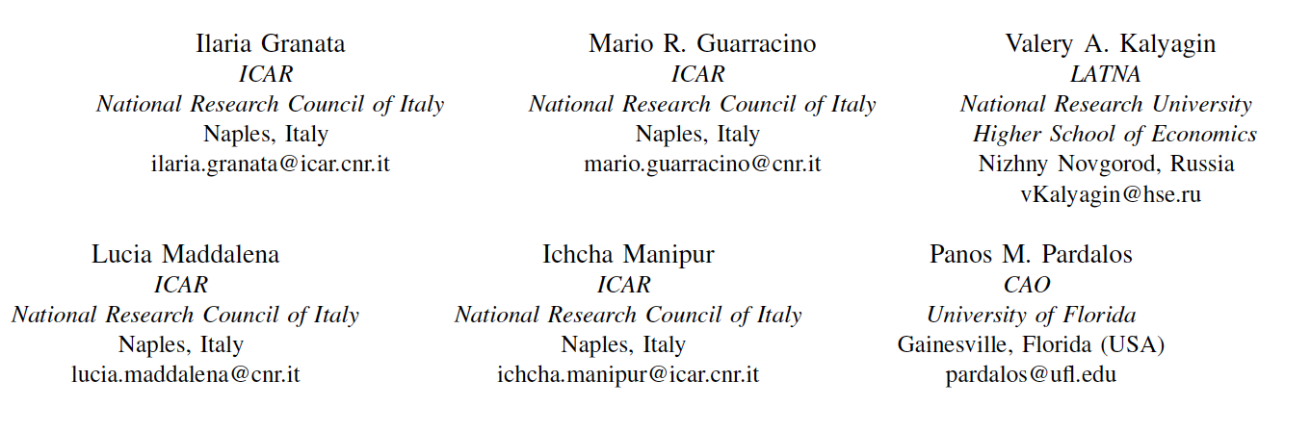
Supervised Classification of Metabolic Networks

Slide 14
Networks distance
The complexity of the mathematical representations based on networks influences the complexity of the models
The problem becomes treatable when network nodes are labeled.
When networks are used to model entities, several problems arise to measure their mutual distances
Network representation using topological features (density, average clustering coefficient, transitivity, modularity,…).
Each network is described by a feature vector, for which it is easy to define a distance.
Network represention through adjacency matrix A, in which an element a_{ij} is not null if there exist an edge between node i and node j.
Any matrix norm can induce a distance between two networks.

Slide 15
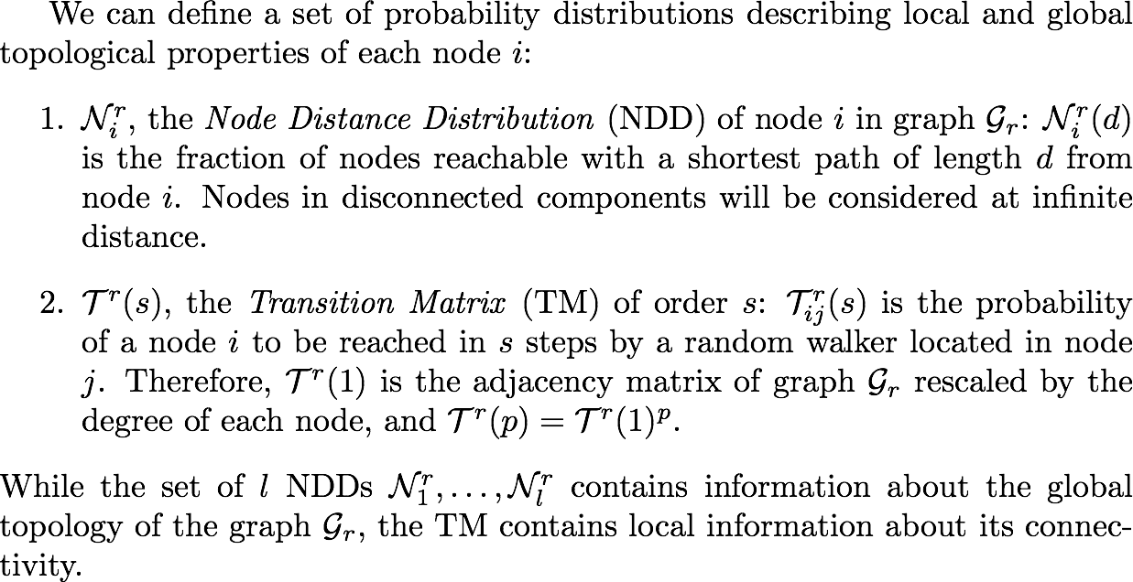

Slide 16
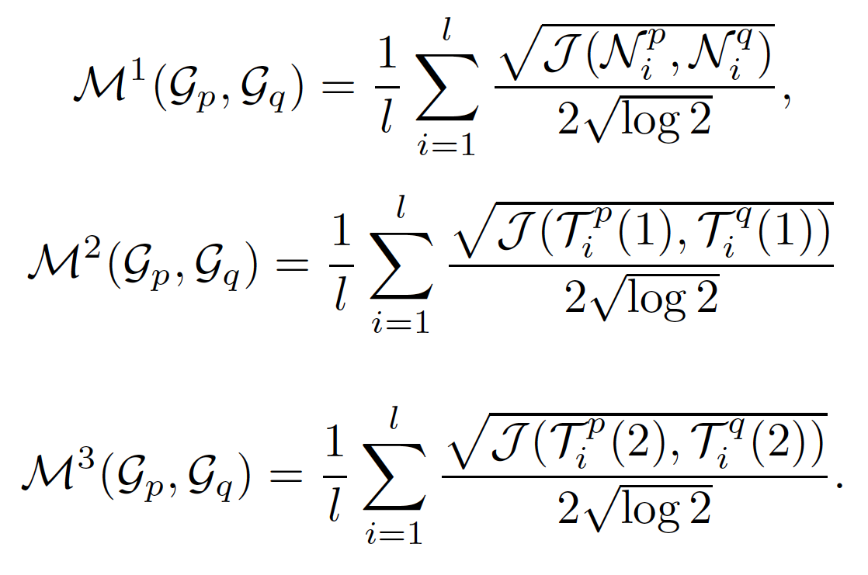
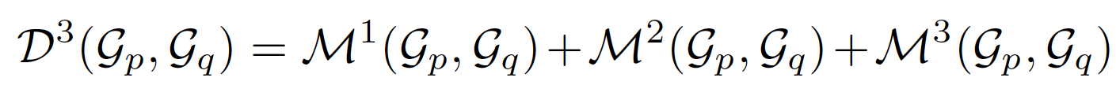
Distance Measures
Jensen-Shannon
divergence
G_{p}
G_{q}
Dist_{m} and Dist_{n} - different edges connecting two nodes are considered as a single edge, whose weight is given by the L2 norm and the mean of the edges weights.

Slide 17
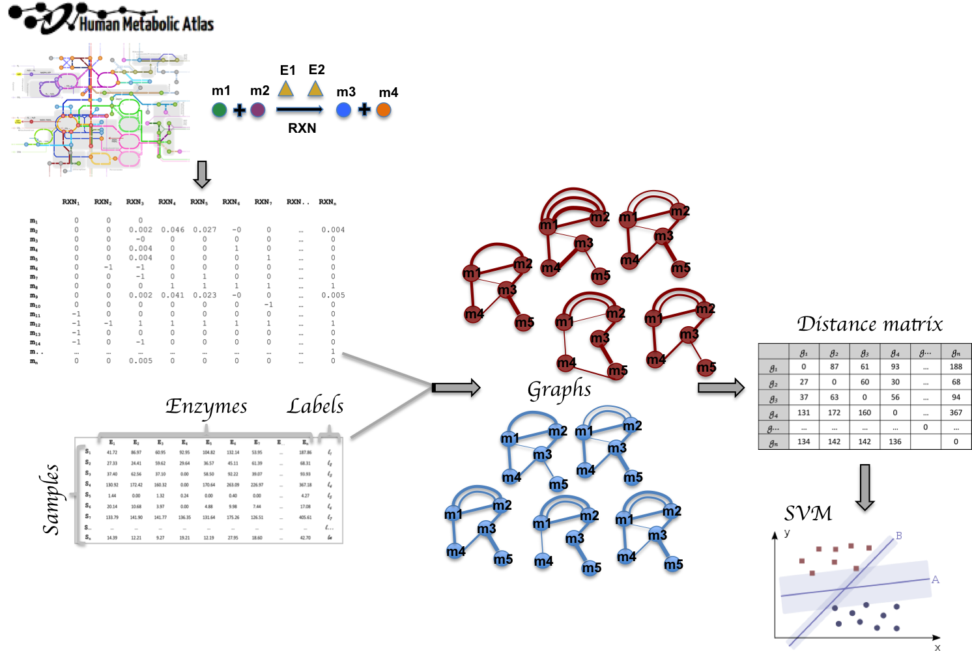
Method

Slide 18
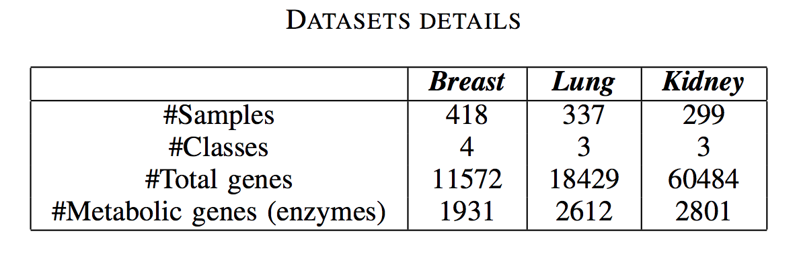
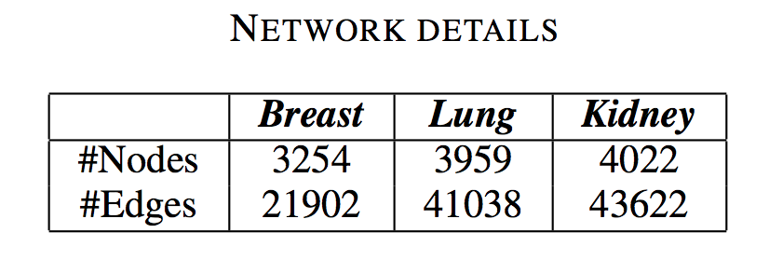
Datasets & Models
Breast cancer microarray data (GSE78958)
Lung cancer RNA-seq data (TCGA projects: LUAD, LUSC)
Kidney cancer RNA-seq data (TCGA projects: KIRC, KIRP)
INIT Breast Cancer (Reconstruction of genome-scale active metabolic networks for 69 human cell types and 16 cancer types using INIT. PLoS Comput Biol, 8:e1002518.)
Lung Tissue (Tissue-based map of the human proteome, Science, 347, 1260419.)
Kidney Tissue (Tissue-based map of the human proteome, Science, 347, 1260419.)

Slide 19
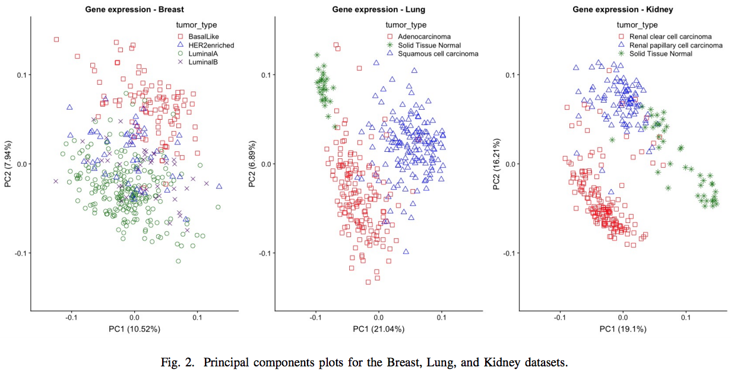
PCA

Slide 20
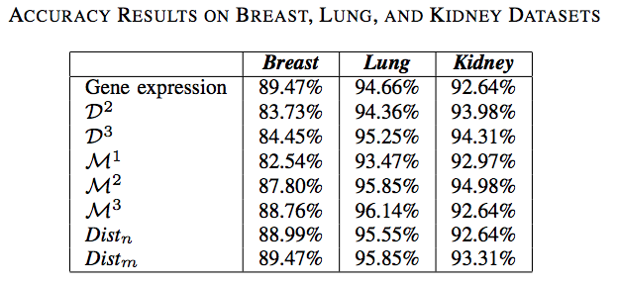
Results
The classification was obtained through the Sequential Minimal Optimization (SMO)
implementation of SVM (WEKA).
10-cross fold validation

Slide 21
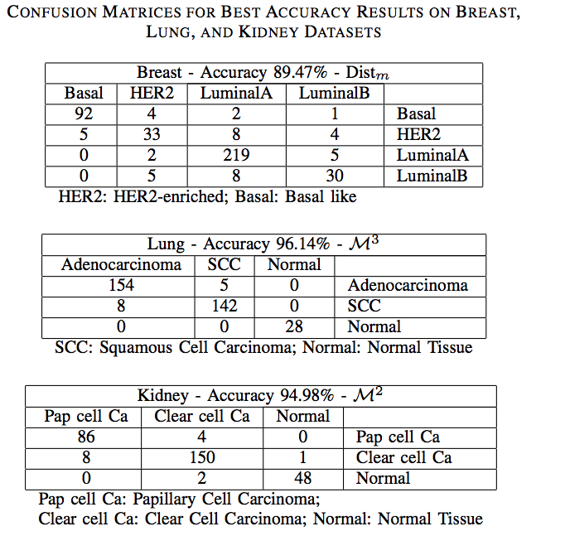

Slide 22
Considerations 1
Two alternative ways to classify data in form of networks: 1) probability distributions with distance metrics, 2) simplification of multiple edges;
Both solutions provide accurate solutions, when compared with the results obtained by raw data;
Genes with the lowest expression among multiple edges between two nodes were taken for computation of the shortest path;

Slide 23
Model Simplification for Supervised Classification of Metabolic Networks

Slide 24
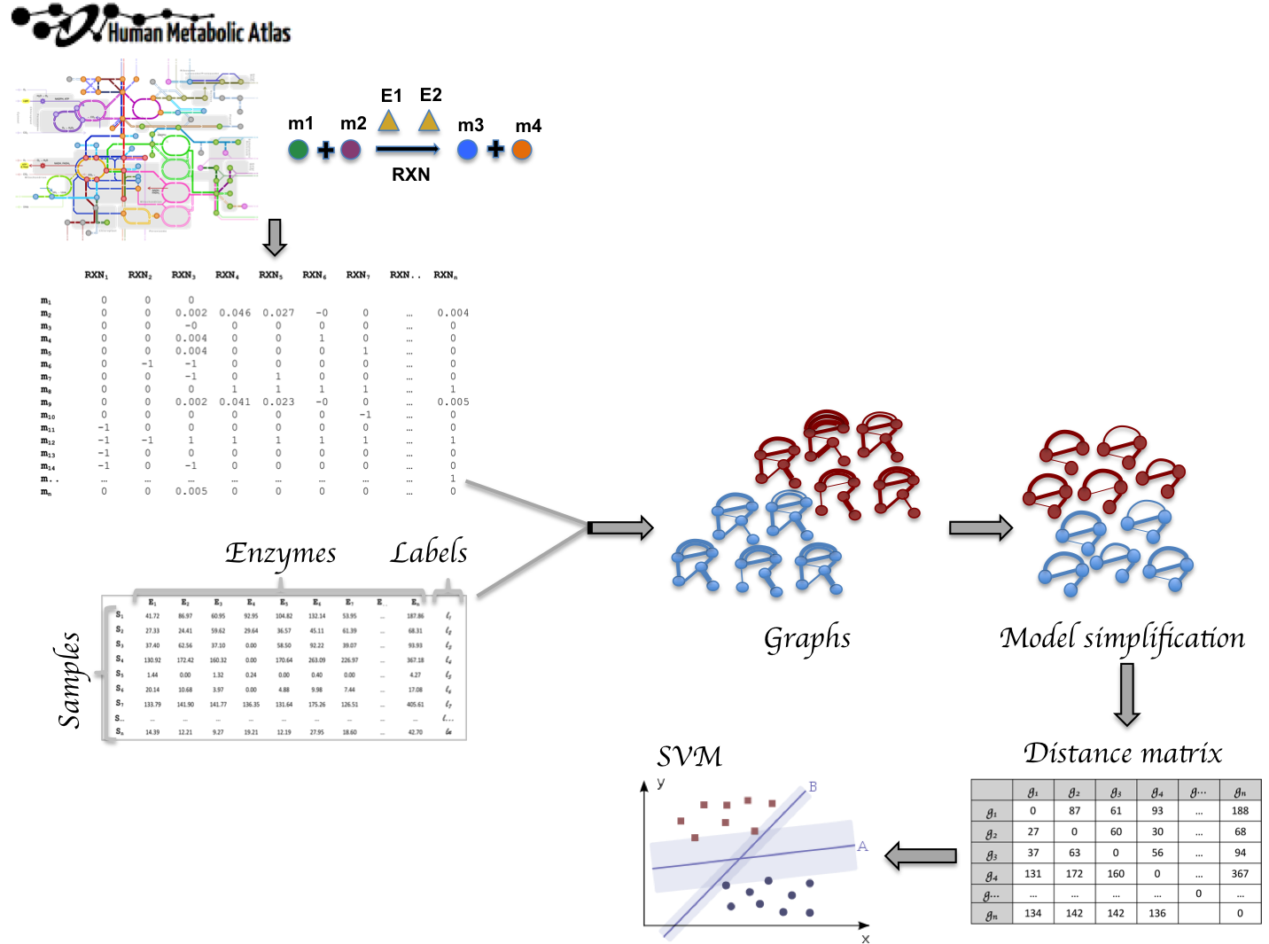
Method

Slide 25
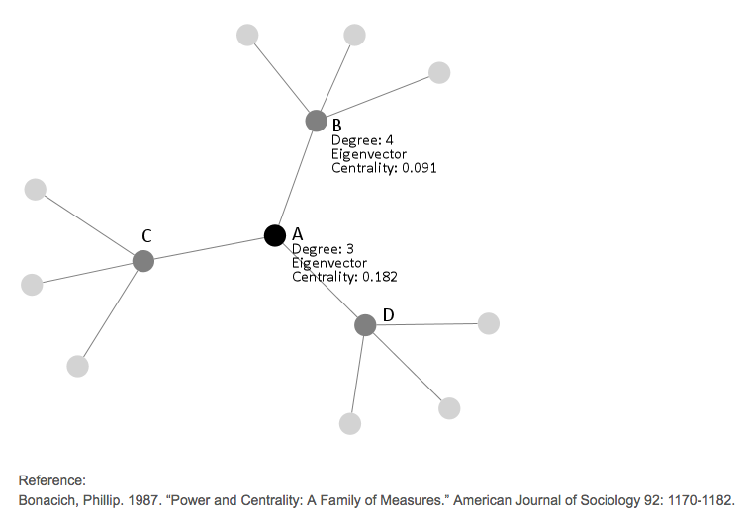
Eigen-Centrality
“A node is important if it is linked
to by other important nodes.”
A node with high eigenvector centrality is not necessarily highly linked (the node might have few but important linkers).

Slide 26
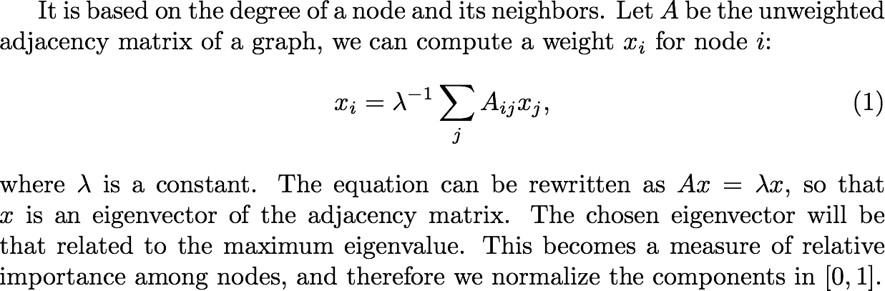
Eigen-Centrality

Slide 27
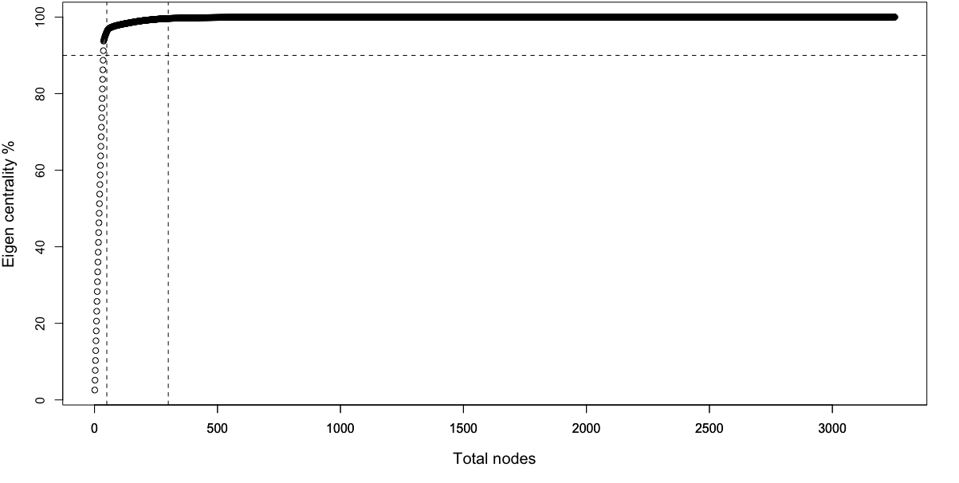
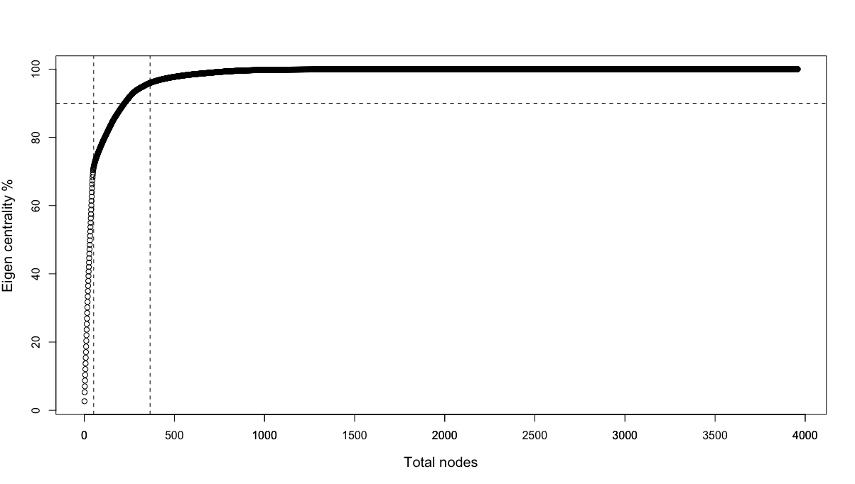

Results: cumulated eigen-centrality
BREAST
LUNG
KIDNEY

Slide 28
Results: central nodes

Slide 29
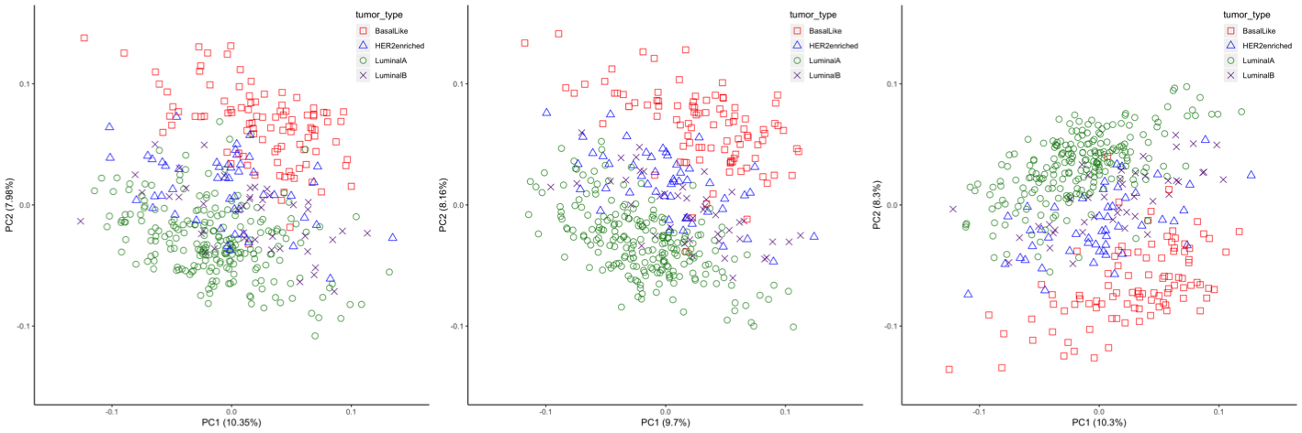
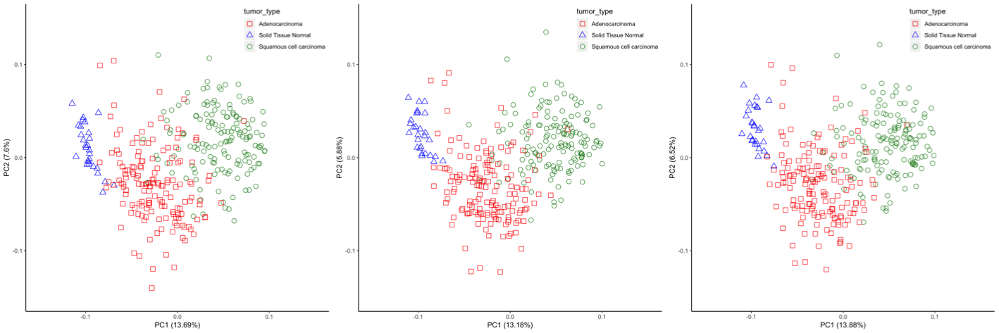
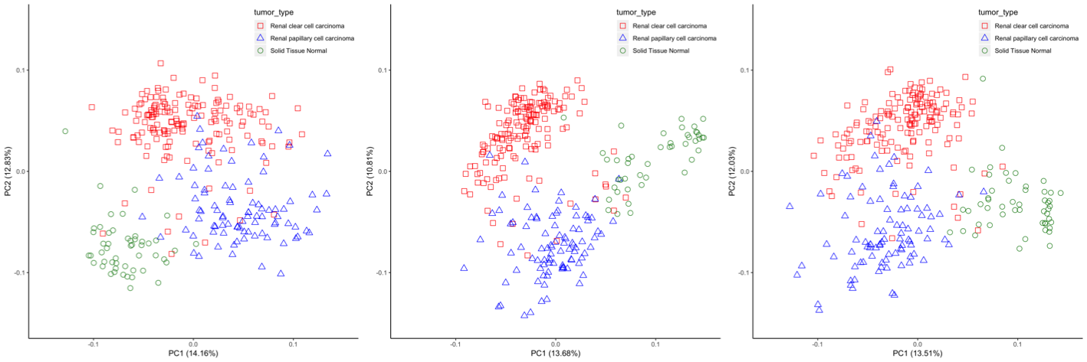
Results
BREAST
LUNG
KIDNEY

Slide 30
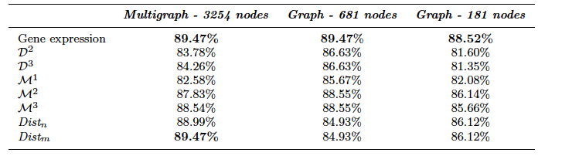
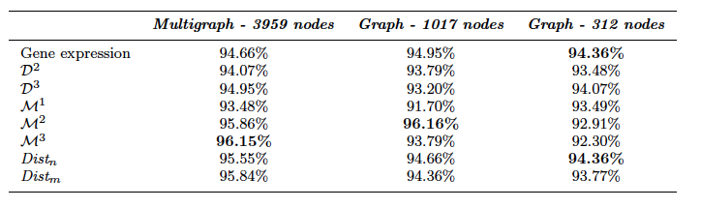
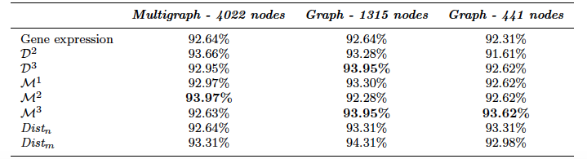
Results
BREAST
LUNG
KIDNEY

Slide 31
Considerations 2
We applied a method for the simplification of network models for supervised classification;
We used eigenvector centrality for selecting the most “important” nodes;
The reduction of the whole network did not affect the accuracy;
To our knowledge this is the first attempt to classify networks reduced in such a way that classification accuracy is not affected.

Slide 32
Clustering Analysis of Tumor Metabolic Networks

Slide 33
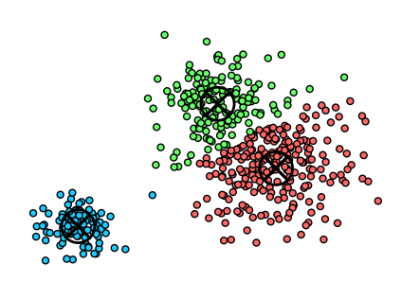
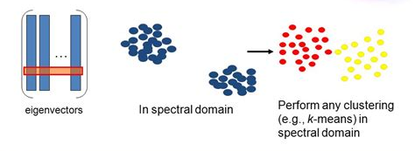
Clustering
An unsupervised machine learning approach for grouping objects based on similarity.
Enables extraction of useful biological information from clusters.
Multiple methods for clustering include k-means, spectral clustering, affinity propagation etc.
k-means
Spectral clustering

Slide 34
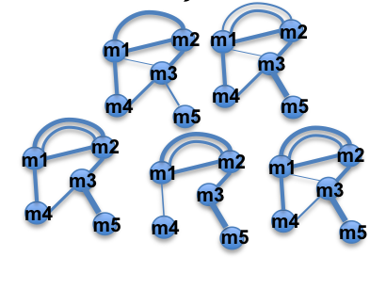
Method
Clustering
Mini batch K-means
Spectral

Slide 35
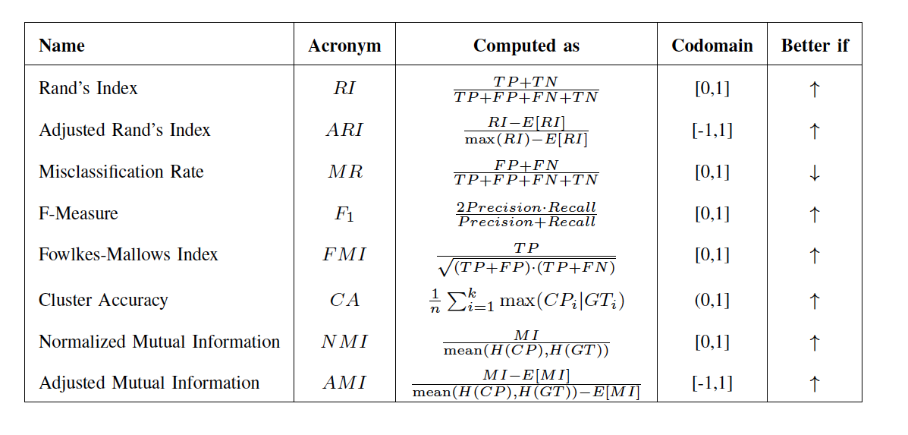
Clustering evaluation

Slide 36
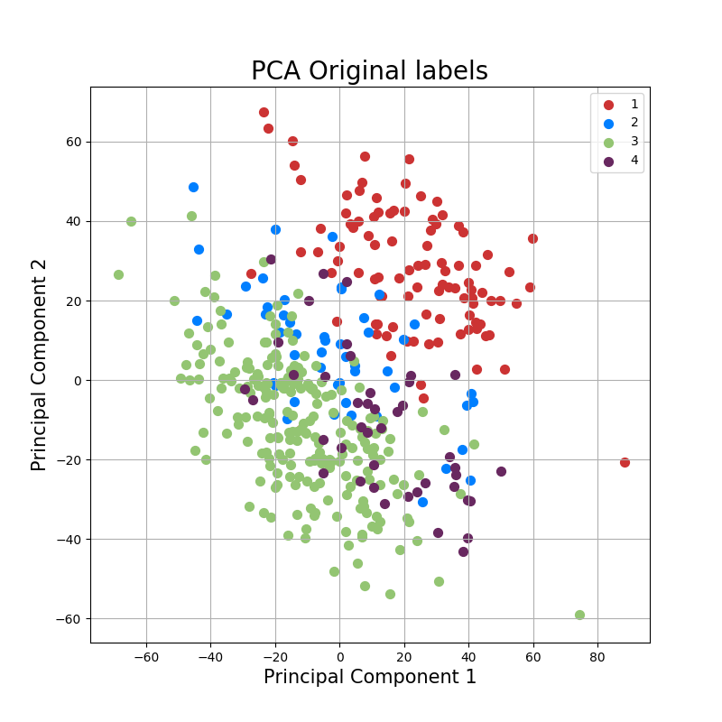
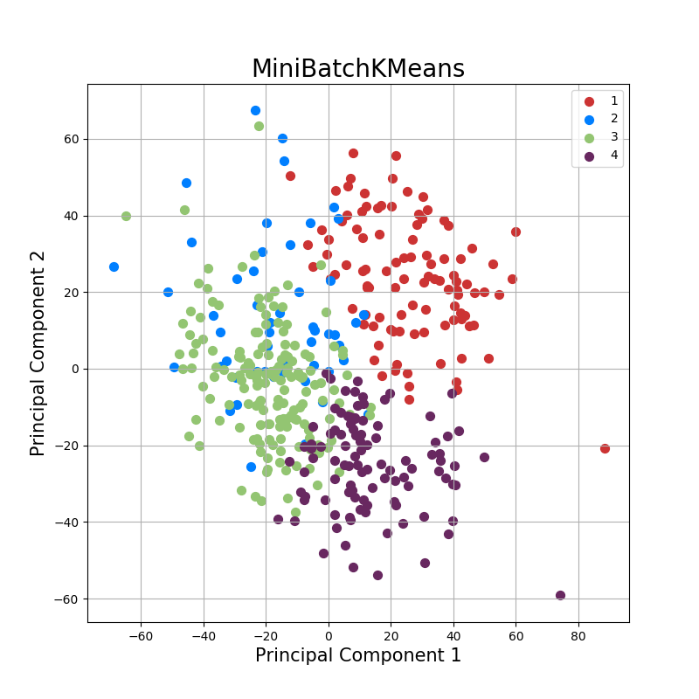
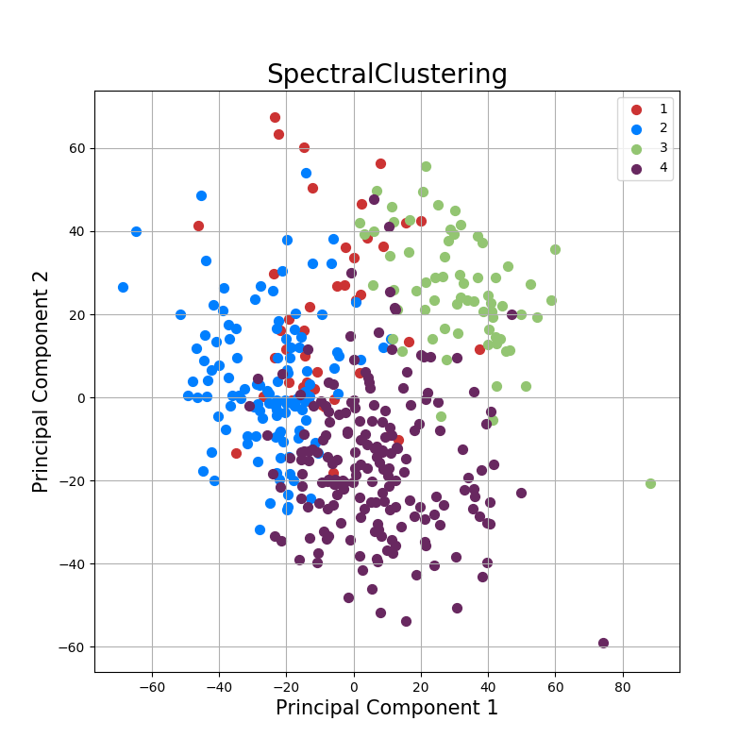
Results - Breast
Microarray gene expression data (GSE78958) from 418 patient samples.
4 classes - LuminalA, Luminal B, HER2 positive, Basal like
Basal like
HER2pos
Luminal A
Luminal B
Clustering of graphs after applying the Dist_{n} measure: PCA plots annotated with (left to right) original labels, mini batch k means and spectral clustering labels

Slide 37
Results - Breast
 | RI | ARI | MR | F1 | FMI | CA | NMI | AMI
MB-Km D³ | 62.88% | 16.12% | 37.12% | 42.67% | 43.15% | 49.76% | 15.51% | 13.77%
SC D³ | 63.37% | 16.86% | 36.63% | 42.76% | 43.33% | 45.69% | 18.92% | 16.90%
MB-Km M² | 66.32% | 23.04% | 33.68% | 46.40% | 47.20% | 52.63% | 23.49% | 21.00%
SC M² | 66.44% | 25.96% | 33.56% | 51.33% | 51.48% | 48.80% | 32.16% | 30.50%
MB-Km Dist_{m} | 73.39% | 40.31% | 26.61% | 59.72% | 60.19% | 64.83% | 40.99% | 38.06%
SC Dist_{m} | 62.90% | 18.02% | 37.10% | 45.98% | 46.14% | 48.80% | 25.00% | 23.37%
MB-Km Dist_{n} | 72.77% | 38.79% | 27.23% | 58.54% | 59.06% | 65.31% | 37.96% | 35.19%
SC Dist_{n} | 63.02% | 18.44% | 36.98% | 46.42% | 46.56% | 50.00% | 25.61% | 24.04%
MB-Km Exp | 65.70% | 21.58% | 34.30% | 45.35% | 46.14% | 45.93% | 27.54% | 24.75%
SC Exp | 53.60% | 6.13% | 46.40% | 45.38% | 45.74% | 49.28% | 20.95% | 18.41%

Slide 38
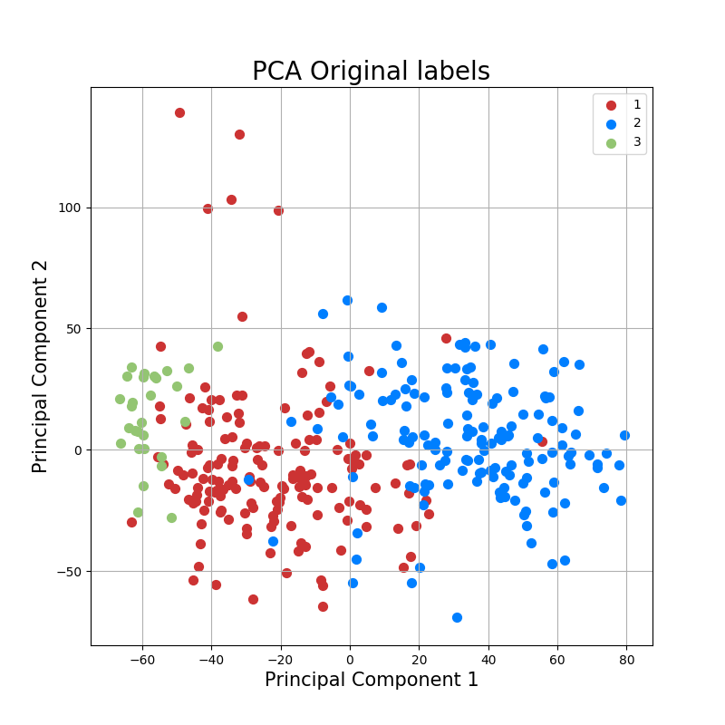
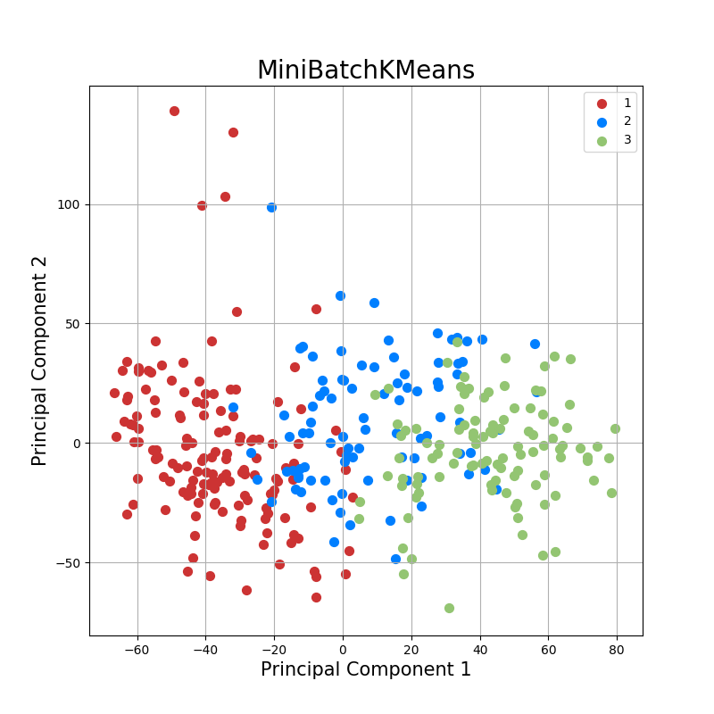
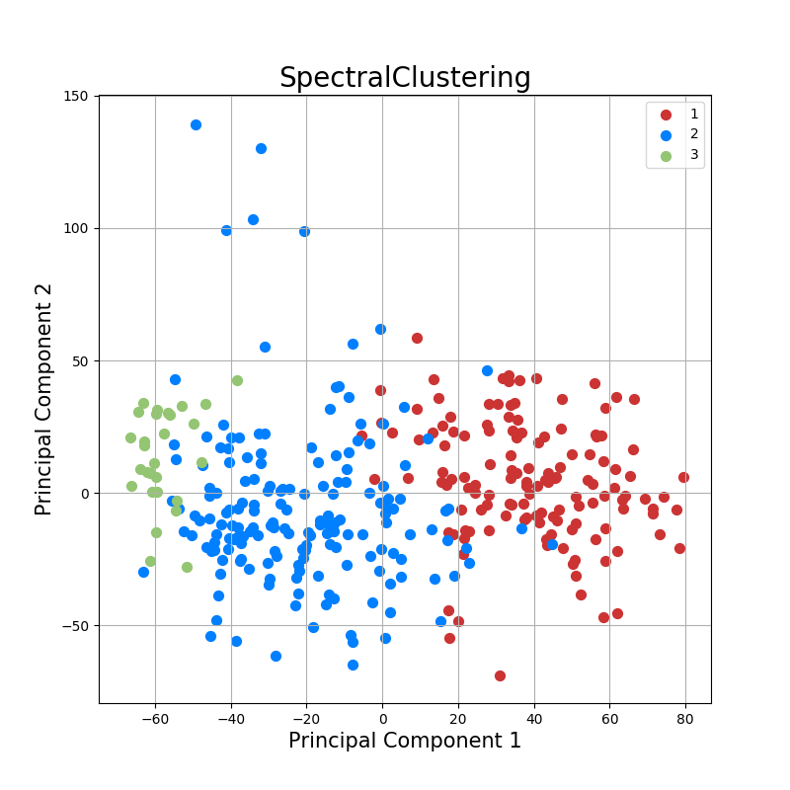
Results - Lung
RNA sequencing gene expression data (TCGA-LUSC and TCGA-LUAD) from 337 patient samples.
3 classes – Adenocarcinoma, squamous cell carcinoma, normal tissue.
Adenocarcinoma
SCC
Normal
Clustering of graphs after applying the Dist_{n} measure: PCA plots annotated with (left to right) original labels, mini batch k means and spectral clustering labels

Slide 39
Results - Lung
 | RI | ARI | MR | F1 | FMI | CA | NMI | AMI
MB-Km D³ | 65.75% | 28.74% | 34.25% | 56.92% | 57.07% | 62.61% | 29.54% | 27.41%
SC D³ | 72.78% | 43.87% | 27.22% | 66.97% | 67.01% | 70.03% | 42.74% | 40.79%
MB-Km M² | 73.05% | 44.62% | 26.95% | 67.76% | 67.77% | 71.51% | 45.03% | 43.31%
SC M² | 89.08% | 77.75% | 10.92% | 87.36% | 87.37% | 93.47% | 75.23% | 74.28%
MB-Km Dist_{m} | 75.15% | 47.79% | 24.85% | 67.46% | 67.91% | 68.55% | 47.35% | 43.24%
SC Dist_{m} | 89.32% | 78.19% | 10.68% | 87.53% | 87.54% | 93.77% | 76.54% | 76.15%
MB-Km Dist_{n} | 67.69% | 32.26% | 32.31% | 58.07% | 58.39% | 60.24% | 35.89% | 32.79%
SC Dist_{n} | 90.75% | 81.11% | 9.25% | 89.21% | 89.21% | 94.66% | 79.74% | 79.33%
MB-Km Exp | 87.84% | 74.95% | 12.16% | 85.31% | 85.35% | 91.39% | 68.81% | 66.72%
SC Exp | 90.27% | 80.14% | 9.73% | 88.66% | 88.66% | 94.36% | 79.01% | 78.57%

Slide 40
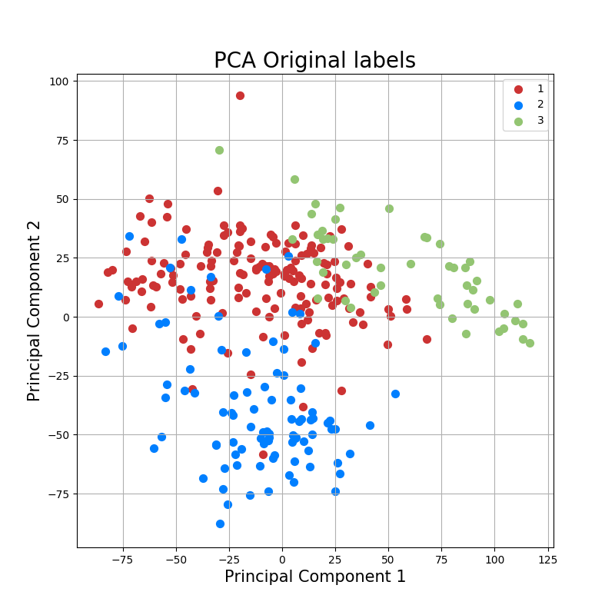
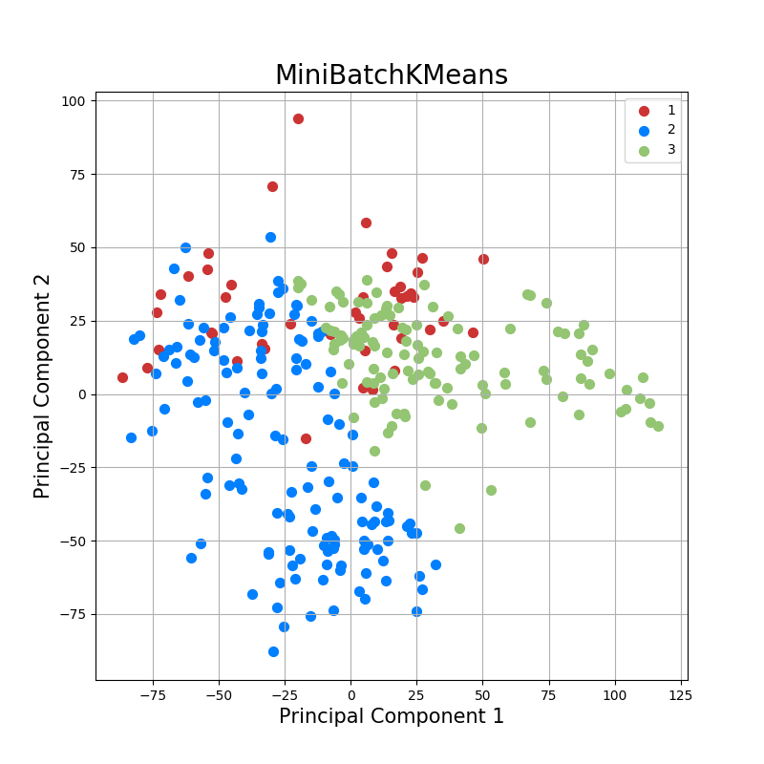
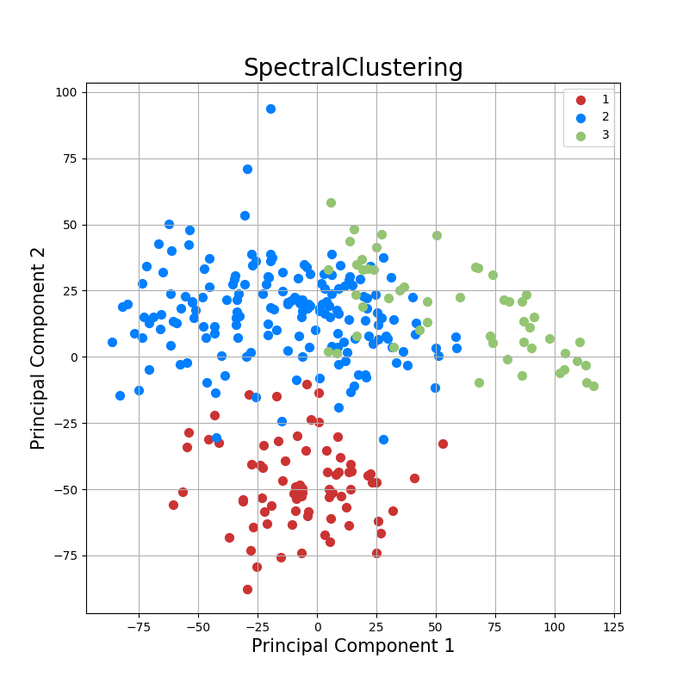
Results - Kidney
RNA sequencing gene expression data (TCGA-KIRC and TCGA-KIRP) from 299 patient samples.
3 classes – Clear cell carcinoma, papillary cell carcinoma, normal tissue.
Clear cell Ca
Papillary Ca
Normal
Clustering of graphs after applying the Dist_{m} measure: PCA plots annotated with (left to right) original labels, mini batch k means and spectral clustering labels

Slide 41
Results - Kidney
 | RI | ARI | MR | F1 | FMI | CA | NMI | AMI
MB-Km D³ | 69.28% | 35.45% | 30.72% | 60.58% | 60.60% | 61.54% | 35.85% | 35.08%
SC D³ | 75.55% | 48.53% | 24.45% | 68.47% | 68.50% | 81.27% | 57.99% | 56.90%
MB-Km M² | 74.04% | 46.53% | 25.96% | 68.61% | 68.65% | 69.57% | 42.41% | 40.27%
SC M² | 78.96% | 55.81% | 21.04% | 73.06% | 73.08% | 84.62% | 60.52% | 59.78%
MB-Km Dist_{m} | 61.30% | 18.91% | 38.70% | 50.77% | 50.78% | 58.86% | 24.79% | 24.17%
SC Dist_{m} | 89.68% | 78.70% | 10.32% | 87.45% | 87.49% | 92.98% | 73.59% | 72.34%
MB-Km Dist_{n} | 77.35% | 51.83% | 22.65% | 69.86% | 70.00% | 80.94% | 53.52% | 51.38%
SC Dist_{n} | 87.75% | 74.59% | 12.25% | 84.90% | 84.91% | 91.30% | 68.06% | 67.44%
MB-Km Exp | 85.31% | 68.99% | 14.69% | 80.89% | 80.95% | 89.30% | 64.21% | 62.56%
SC Exp | 88.62% | 76.37% | 11.38% | 85.90% | 85.90% | 91.97% | 71.10% | 70.71%

Slide 42
Conclusions
Network provides a powerful representation of many real world phenomena.
Finding useful distances is hard even for node labeled graphs.
Whenever a meaningful distance is found, any data analytics methods can be applied.

Slide 43
Conclusions
http://spikedmath.com/382.html

