Slide 1
Non-singular Morse-Smale flows with three periodic orbits on orientable 3-manifolds
Faculty of Informatics, Mathematics, and Computer Science
Laboratory of Dynamical Systems and Applications
Nizhny Novgorod
2022
Pochinka Olga, Shubin Danila
National Research University Higher School of Economics

Slide 2
Morse-Smale flows
Faculty of Informatics, Mathematics, and Computer Science
Non-singular Morse-Smale flows with three periodic orbits on orientable 3-manifolds
Nizhny Novgorod
2022
.
A flow $f^{t}:M^{n}→M^{n}$, on smooth closed (compact and with empty boundaty) connected orientable n-manifold $(n≥1$) $M^{n}$ is called Morse-Smale flow, if
its non-wandering set $Ω_{f^{t}}$ consists of a finite number of hyperbolic fixed points and periodic orbits;
the intersection of the manifolds $W_{p}^{s},W_{q}^{u}$ is transverse for any two points or periodic orbits$p, q$.

Slide 3
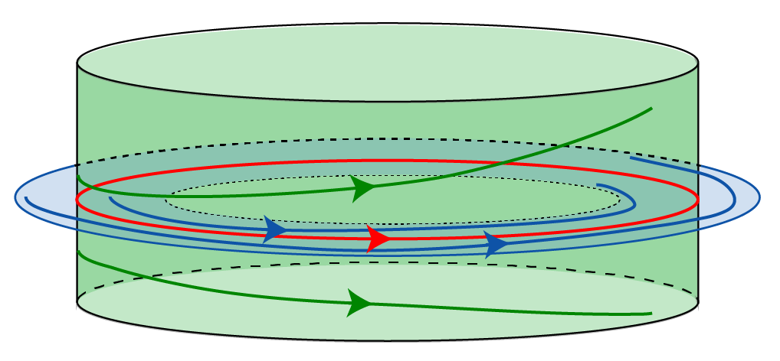
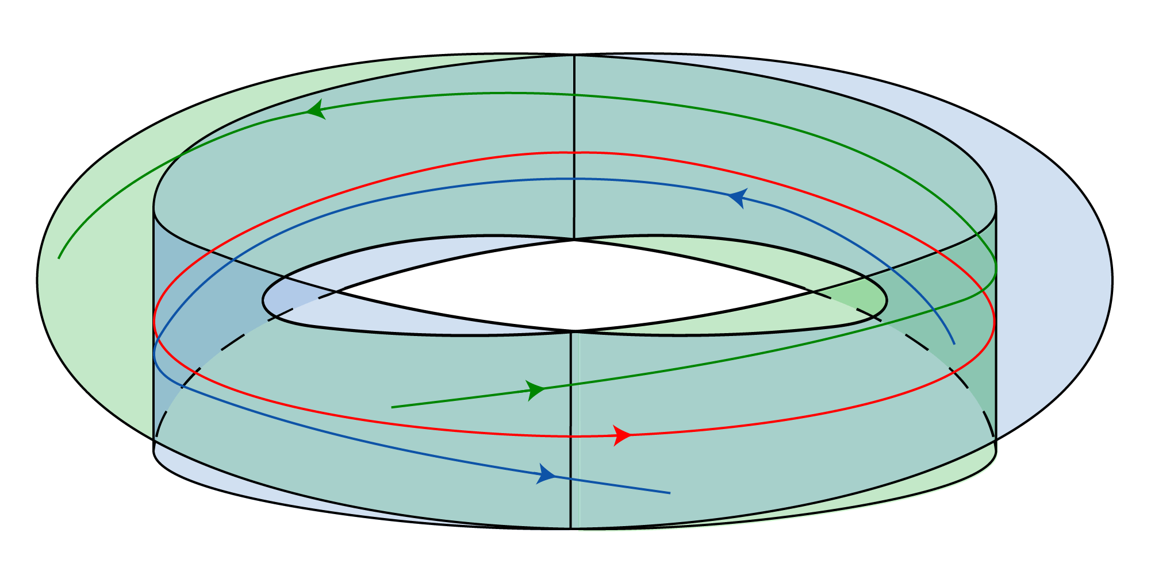
Non-singular Morse-Smale flows
Faculty of Informatics, Mathematics, and Computer Science
Non-singular Morse-Smale flows with three periodic orbits on orientable 3-manifolds
Nizhny Novgorod
2022
.
Periodic orbit of a flow is called twisted, if at least one of its invariant manifolds if non-orientable, otherwise it is called non-twisted.
Morse-Smale flow is called non-singular or NMS-flow, if it has no fixed points.
In this talk we consider nonsingular Morse-Smale flows with three periodic orbits.

Slide 4
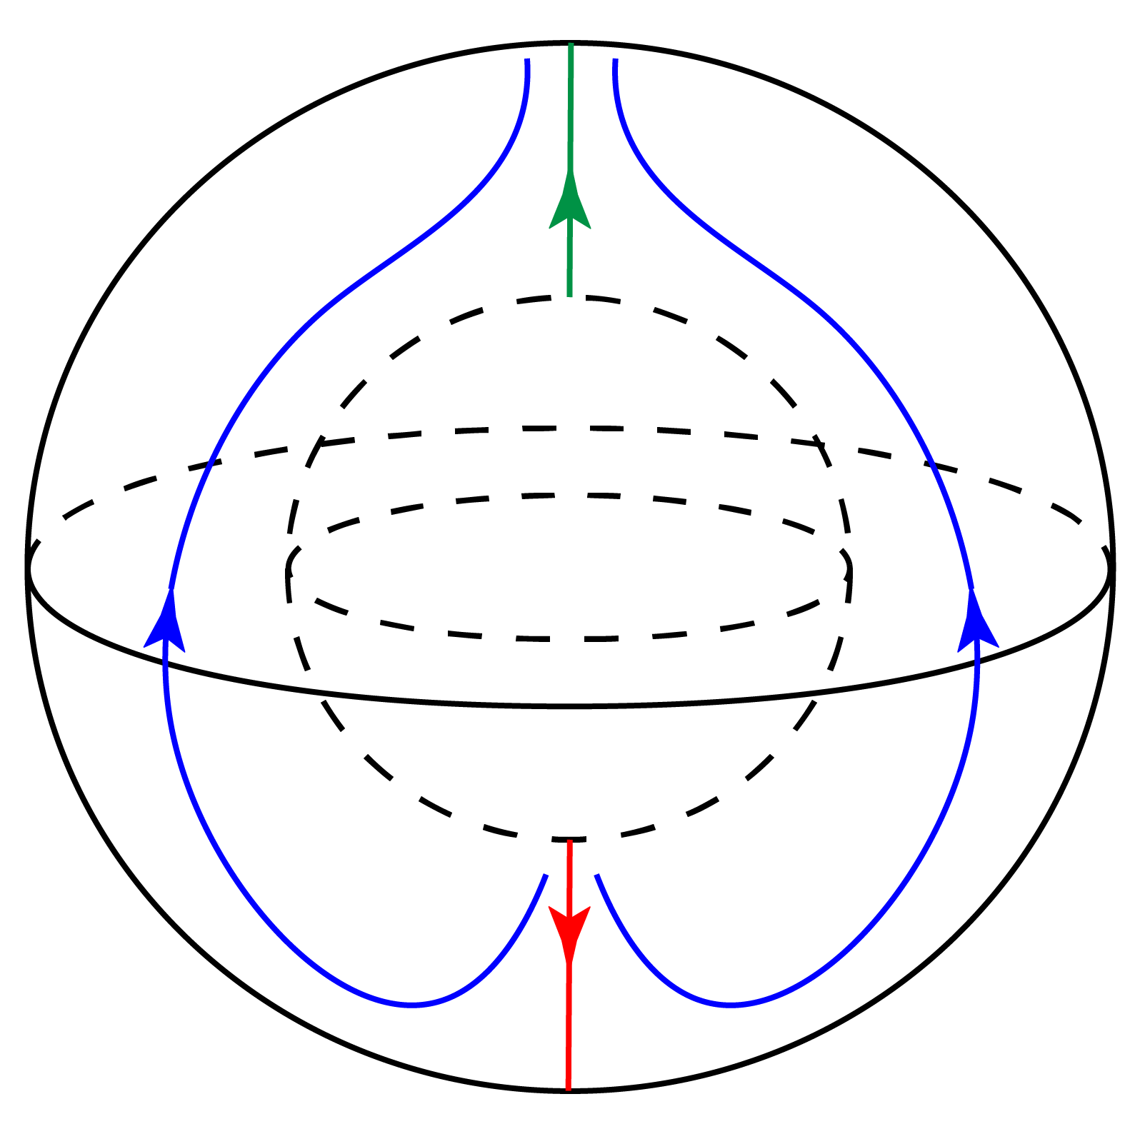
Topology of ambient manifolds
Faculty of Informatics, Mathematics, and Computer Science
Non-singular Morse-Smale flows with three periodic orbits on orientable 3-manifolds
Nizhny Novgorod
2022
.
A lens space is a manifold, which can be constructed by gluing two solid tori $D^{2}×S^{1}$along their boundary.
It is known¹, that in the case of two orbits the ambient manifold of NMS-flow is a lens space.
The three-dimensional manifold is called prime if it cannot be represented as connected sum of two three-dimensional manifolds which are not 3-spheres.
In the paper¹ proposition, stating that prime three-manifolds that admit NMS-flow with one twisted saddle orbit are also lens spaces.
An example of NMS-flow on lens space $S^{2}×S^{1}$
1. Campos, Beatriz & Cordero, Alicia & Martinez-Alfaro, Jose & Vindel, P. (2004). NMS Flows on Three-Dimensional Manifolds with One Saddle Periodic Orbit. Acta Mathematica Sinica-english Series

Slide 5
The main result
Faculty of Informatics, Mathematics, and Computer Science
Non-singular Morse-Smale flows with three periodic orbits on orientable 3-manifolds
Nizhny Novgorod
2022
.
Theorem. There exists an infinite countable family of pairwise non-homeomorphic prime three-manifolds which admit NMS-flow with three periodic orbits one of which is twisted saddle, and the manifolds are not homeomorphic to any lens space.

Slide 7
Idea Suspension
Faculty of Informatics, Mathematics, and Computer Science
Non-singular Morse-Smale flows with three periodic orbits on orientable 3-manifolds
Nizhny Novgorod
2022
.
For a diffeomorphism $f:S_{g}→S_{g}$ let $F:S_{g}×R^{1}→S_{g}×R^{1}$ be the diffeomorphism defined as
$$F\left(x,r\right)=\left(f\left(x\right),r−1\right)$$

Slide 8
Idea Suspension
Faculty of Informatics, Mathematics, and Computer Science
Non-singular Morse-Smale flows with three periodic orbits on orientable 3-manifolds
Nizhny Novgorod
2022
For a diffeomorphism $f:S_{g}→S_{g}$ let $F:S_{g}×R^{1}→S_{g}×R^{1}$ be the diffeomorphism defined as
$$F\left(x,r\right)=\left(f\left(x\right),r−1\right)$$
Let
$$M_{f}=S_{g}×R^{1}/\left\langle F\right\rangle$$
and denote the natural projection as
$$v_{f}=S_{g}×R^{1}→M_{f}$$

Slide 9
Idea. Suspension
Faculty of Informatics, Mathematics, and Computer Science
Non-singular Morse-Smale flows with three periodic orbits on orientable 3-manifolds
Nizhny Novgorod
2022
For a diffeomorphism $f:S_{g}→S_{g}$ let $F:S_{g}×R^{1}→S_{g}×R^{1}$ be the diffeomorphism defined as
$$F\left(x,r\right)=\left(f\left(x\right),r−1\right)$$
Let
$$M_{f}=S_{g}×R^{1}/\left\langle F\right\rangle$$
and denote the natural projection as
$$v_{f}=S_{g}×R^{1}→M_{f}$$
Let the flow $\overline{b^{t}}$ on $S_{g}×R^{1}$ be defined as
$$\overline{b^{t}}\left(x,r\right)=\left(x,r+t\right)$$
And the flow on $M_{f}$ be projected as
$$b^{t}=v_{f}\overline{b^{t}}v_{f}^{−1}$$

Slide 10
Idea Diffeomorphisms to consider
Faculty of Informatics, Mathematics, and Computer Science
Non-singular Morse-Smale flows with three periodic orbits on orientable 3-manifolds
Nizhny Novgorod
2022
In the paper² diffeomorphisms of closed orientable surfaces with three periodic orbits were considered. In particular, it was proved, that for any set of number in the list below there is a diffeomorphism with such periodic data:
$$m_{ω}=1;m_{σ}=2g;m_{α}=1;g>0$$
here $g$ denotes the genus of the surface.
2. T. Medvedev, E. Nozdrinova, and O. Pochinka, On Periodic Data of Dieomorphisms with One Saddle Orbit, Top. Proc. 54 (2019) pp. 49-68.

Slide 11
Idea. Gradient-like diffeomorphisms
Faculty of Informatics, Mathematics, and Computer Science
Non-singular Morse-Smale flows with three periodic orbits on orientable 3-manifolds
Nizhny Novgorod
2022
Note, that the considered diffeomorphisms are gradient-like, it means³ that each of them is topologically conjugated to the diffeomorphism of the form $φ_{g}χ_{g}^{1}$, where $φ_{g}$ is periodic homeomorpgism of the closed surface with genus$g$, and$χ_{g}^{1}$ is 1-time shift of some gradient-like flow$χ_{g}^{t}$.
It means that the homeomorphisms $φ_{g}$ and f are homotopic, which implies⁴ that manifolds $M_{f}$ and${ M}_{φ_{g}}$are homeomorphic.
3. Bezdenezhnykh A. N., Grines V. Z. Realization of gradient-like diffeomorphisms of two-dimensional manifolds // Differential and integral equations. – 1985. – С. 33-37.
4. Hatcher A. Notes on basic 3-manifold topology. – 2007.

Slide 13
Seifert Manifolds
Faculty of Informatics, Mathematics, and Computer Science
Non-singular Morse-Smale flows with three periodic orbits on orientable 3-manifolds
Nizhny Novgorod
2022
An ordinary fibered torus is solid torus $D^{2}×S^{1}$ which is split into fibers of the form $\{x\}×S^{1}$.

Slide 14
Seifert Manifolds
Faculty of Informatics, Mathematics, and Computer Science
Non-singular Morse-Smale flows with three periodic orbits on orientable 3-manifolds
Nizhny Novgorod
2022 г.
.
An ordinary fibered torus is solid torus $D^{2}×S^{1}$ which is split into fibers of the form $\{x\}×S^{1}$.
Consider the solid torus as solid cylinder$D^{2}×\left[0,1\right]$ with the bases identified by rotation on rational angle$2π\frac{α}{ν}$. The unions of segments $\{x\}×\left[0,1\right]$ whose ends are identified will form fibers. The solid torus with this fibers we will call exceptional torus.

Slide 15
Seifert Manifolds
Faculty of Informatics, Mathematics, and Computer Science
Non-singular Morse-Smale flows with three periodic orbits on orientable 3-manifolds
Nizhny Novgorod
2022
An ordinary fibered torus is solid torus $D^{2}×S^{1}$ which is split into fibers of the form $\{x\}×S^{1}$.
Consider the solid torus as solid cylinder$D^{2}×\left[0,1\right]$ with the bases identified by rotation on rational angle$2π\frac{α}{ν}$. The unions of segments $\{x\}×\left[0,1\right]$ whose ends are identified will form fibers. The solid torus with this fibers we will call exceptional torus.
Three-dimensional compact orientable manifold is Seifert manifold if it can be represented as union of disjoint circles (fibers) and each fiber has tubular neighborhood consisting of other fibers which is homeomorphic to a standard torus with respect to fibers. The number$α$which corresponds to each fiber will be called multiplicity.

Slide 16
Idea
Faculty of Informatics, Mathematics, and Computer Science
Non-singular Morse-Smale flows with three periodic orbits on orientable 3-manifolds
Nizhny Novgorod
2022
Points of the non-wandering set correspond to points of the period less, than period of the homeomorphism which correspond to exceptional fibers of Seifert manifolds. Using the results³ we deduce, that multiplicities of exceptional fibers are 4g, 4g, 2.
Moreover, all manifolds${ M}_{φ_{g}}$ have universal covering by three-dimensional space $R^{3}$ which implies that Seifert fibering on each manifold${ M}_{φ_{g}}$ is unique⁴.
There are no lens spaces which can be represented as Seifert manifold with three exceptional fibers⁵.
3. Bezdenezhnykh A. N., Grines V. Z. Realization of gradient-like diffeomorphisms of two-dimensional manifolds // Differential and integral equations. – 1985. – С. 33-37.
4. Hatcher A. Notes on basic 3-manifold topology. – 2007.
5. M. Jankins and W. D. Neumann, Lectures on Seifert Manifolds, Brandeis Lecture Notes 2, Brandeis University, Waltham, MA (1983);

Slide 17
The Result
Faculty of Informatics, Mathematics, and Computer Science
Non-singular Morse-Smale flows with three periodic orbits on orientable 3-manifolds
Nizhny Novgorod
2022
Theorem. There exists an infinite countable family of pairwise non-homeomorphic prime three-manifolds which admit NMS-flow with three periodic orbits one of which is twisted saddle, and the manifolds are not homeomorphic to any lens space.
Moreover these manifolds are Seifert fibered spaces with three exceptional fibers.

Slide 18
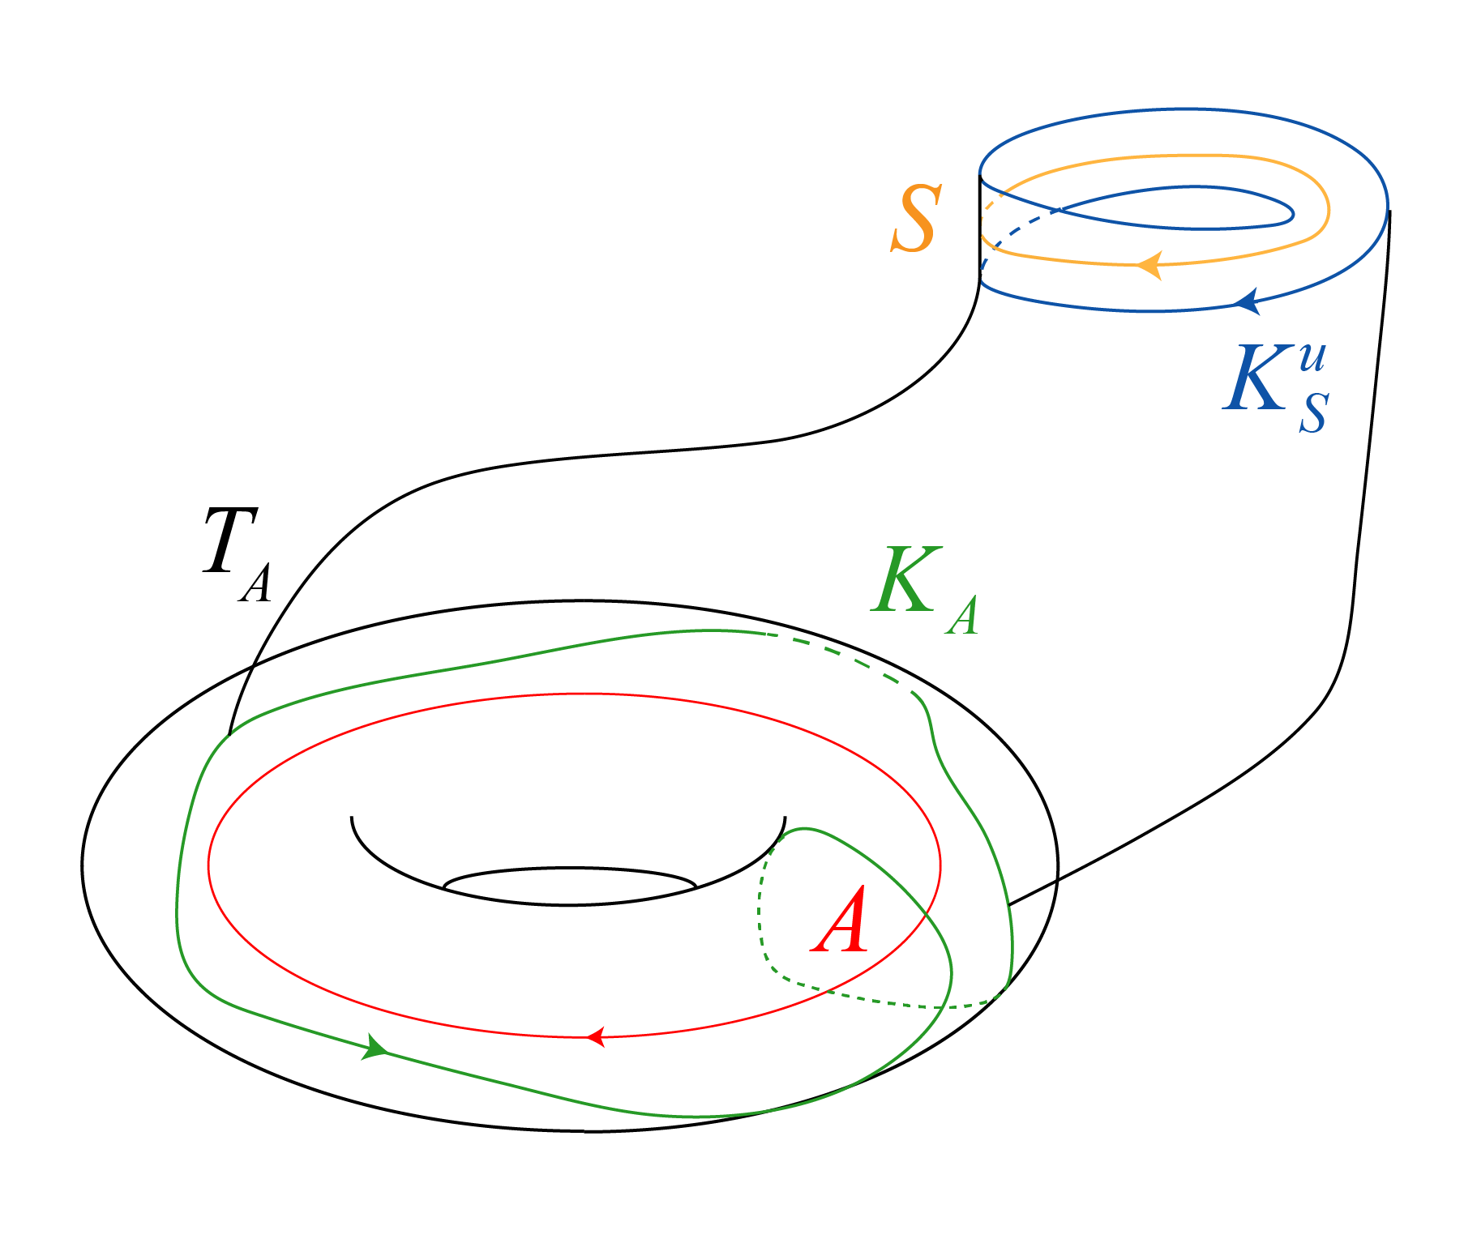
Topological Classification (untwisted orbit)
Faculty of Informatics, Mathematics, and Computer Science
Non-singular Morse-Smale flows with three periodic orbits on orientable 3-manifolds
Nizhny Novgorod
2022
A – attracting orbit
S – saddle orbit
$T_{A},T_{S}$ – canonical tubular neighborhood boundaries
$$K_{S}^{u}=W_{S}^{u}∩T_{S}$$
$$K_{A}=W_{S}^{u}∩T_{A}$$
Invariant: $C_{f^{t}}=\left(l_{A},m_{A },{ l}_{R},m_{R})\right)$

Slide 19
then
(untwisted orbit)
impossible!
then

Slide 20
Topological Classification (untwisted orbit)
Faculty of Informatics, Mathematics, and Computer Science
Non-singular Morse-Smale flows with three periodic orbits on orientable 3-manifolds
Nizhny Novgorod
2022
A – attracting orbit
S – saddle orbit
$T_{A},T_{S}$ – canonical tubular neighborhood boundaries
$$K_{S}^{u}=W_{S}^{u}∩T_{S}$$
$$K_{A}=W_{S}^{u}∩T_{A}$$
Invariant: $C_{f^{t}}=\left(l_{A},m_{A }\left(mod l_{A}\right),{ l}_{R},m_{R} (mod l_{R})\right)$

Slide 21
Faculty of Informatics, Mathematics, and Computer Science
Non-singular Morse-Smale flows with three periodic orbits on orientable 3-manifolds
Nizhny Novgorod
2022
.
Topological Classification (untwisted orbit)
A – attracting orbit
S – saddle orbit
$T_{A},T_{S}$ – canonical tubular neighborhood boundaries
$$K_{S}^{u}=W_{S}^{u}∩T_{S}$$
$$K_{A}=W_{S}^{u}∩T_{A}$$
Invariant: $C_{f^{t}}=\left(l_{A},m_{A },{ l}_{R},m_{R}\right)$
Conditions of consistency:
$l_{A}=l_{A}^{′}, l_{R}=l_{R}^{′}$
If $l_{A}≠0$, then $m_{A}≡m_{A}^{′}\left(modl_{A}\right), m_{R}≡m_{R}^{′}\left(modl_{R}\right)$
If $l_{A}=0$, then $m_{A}=±m_{A}^{′},m_{R}=±m_{R}^{′}$

Slide 22
Faculty of Informatics, Mathematics, and Computer Science
Non-singular Morse-Smale flows with three periodic orbits on orientable 3-manifolds
Nizhny Novgorod
2022
.
Topological Classification (untwisted orbit)
A – attracting orbit
S – saddle orbit
$T_{A},T_{S}$ – canonical tubular neighborhood boundaries
$$K_{S}^{u}=W_{S}^{u}∩T_{S}$$
$$K_{A}=W_{S}^{u}∩T_{A}$$
Invariant: $C_{f^{t}}=\left(l_{A},m_{A },{ l}_{R},m_{R}\right)$
Conditions of consistency:
$l_{A}=l_{A}^{′}, l_{R}=l_{R}^{′}$
If $l_{A}≠0$, then $m_{A}≡m_{A}^{′}\left(modl_{A}\right), m_{R}≡m_{R}^{′}\left(modl_{R}\right)$
If $l_{A}=0$, then $m_{A}=±m_{A}^{′},m_{R}=±m_{R}^{′}$
If $l_{A}=0,m_{A}=0$, then $l_R, m_R = ⟨φ(meridian of T_A)⟩$

Slide 23
Faculty of Informatics, Mathematics, and Computer Science
Non-singular Morse-Smale flows with three periodic orbits on orientable 3-manifolds
Nizhny Novgorod
2022
$$M\left(S^{3},\left(2,1\right),\left(l_{A},m_{a}\right),\left(l_{R},m_{R}\right)\right)$$

Slide 24
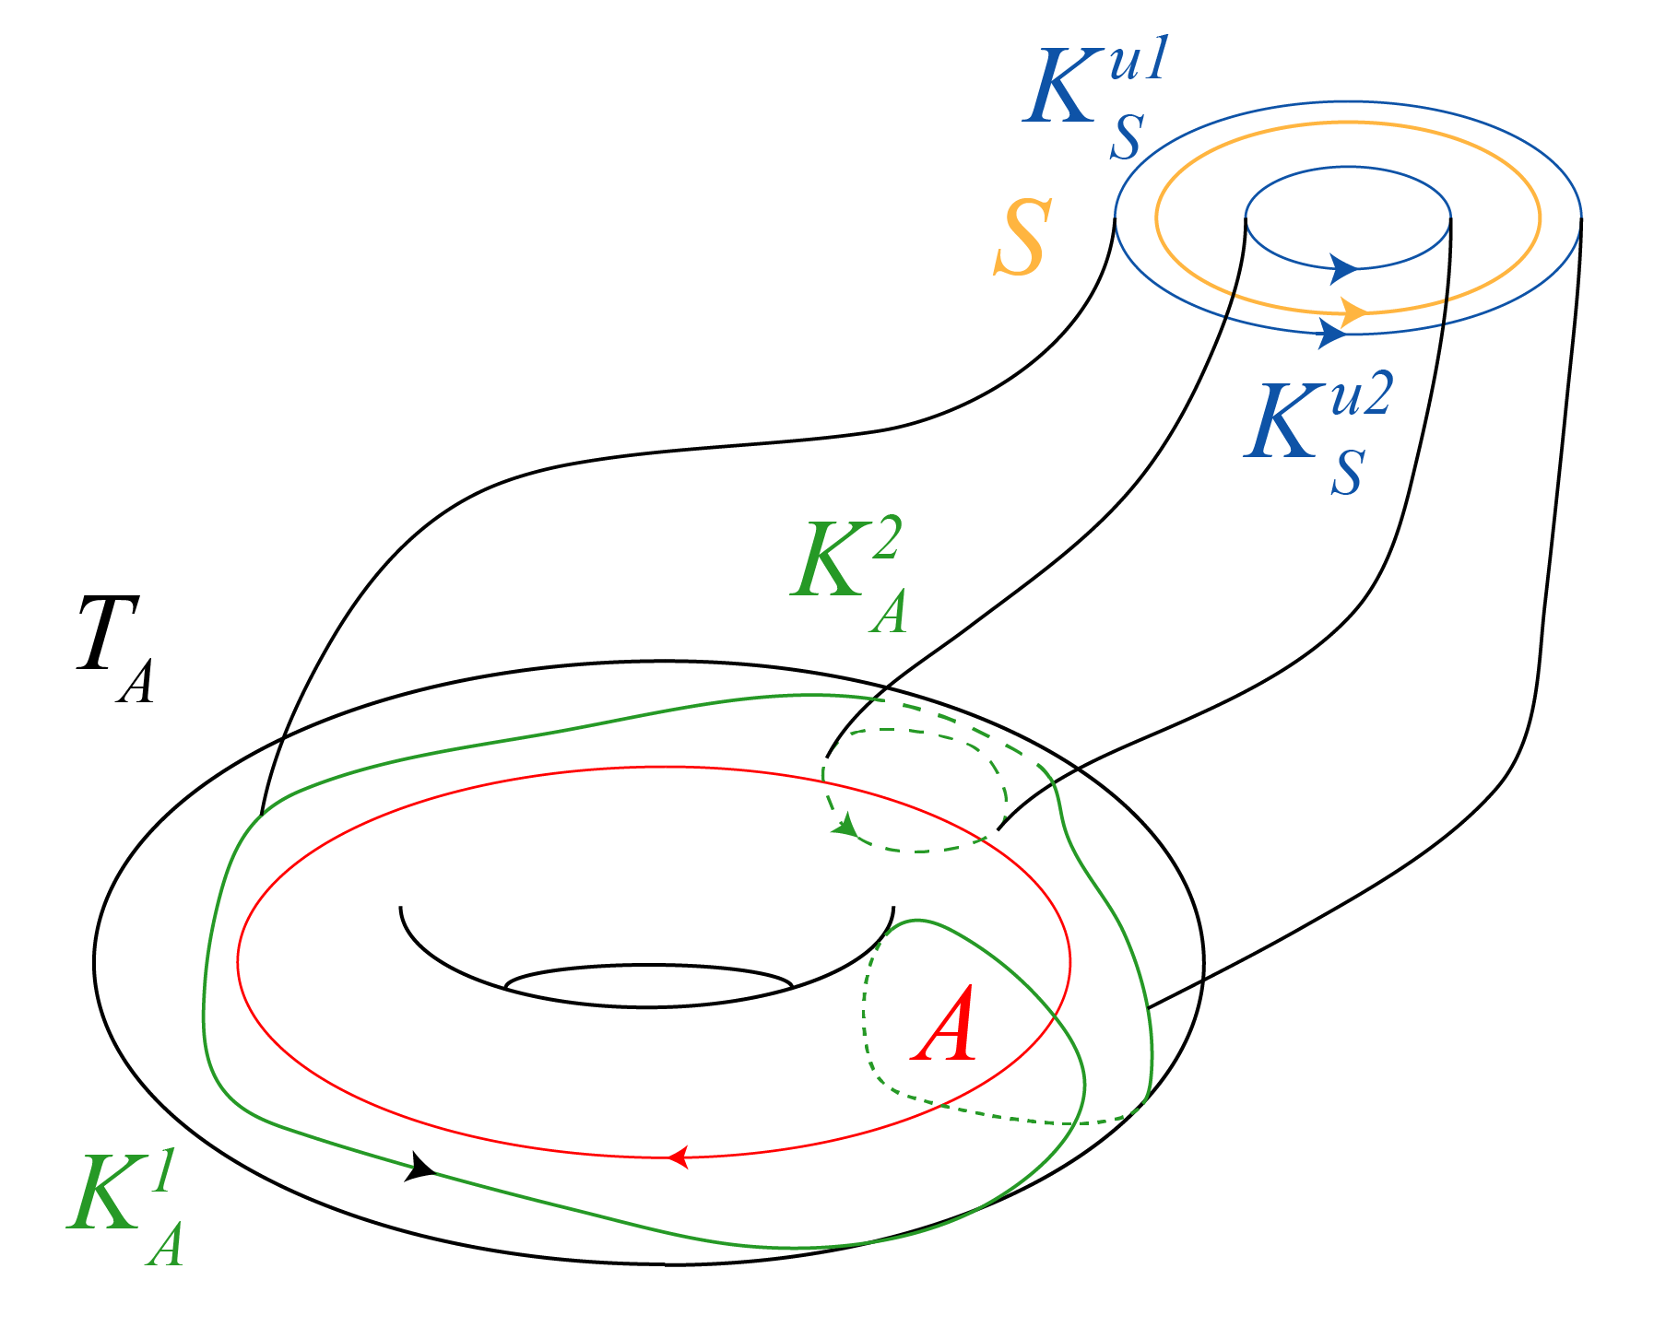
Topological classification (twisted orbit)
Faculty of Informatics, Mathematics, and Computer Science
Non-singular Morse-Smale flows with three periodic orbits on orientable 3-manifolds
Nizhny Novgorod
2022
A – attracting orbit
S – saddle orbit
$T_{A},T_{S}$ – canonical tubular neighborhood boundaries
$$K_{S}^{u1}⊔K_{S}^{u2}=K_{S}^{u}=W_{S}^{u}∩T_{S}$$
$$K_{A}^{1}⊔K_{A}^{2}=K_{A}=W_{S}^{u}∩T_{A}$$
$\left\langle K_{A}^{1}\right\rangle =\left\langle l_{A},m_{A}\right\rangle$ - unique non-trivial
Invariant: $C_{f^{t}}=\left(l_{A},m_{A },{ l}_{R},m_{R})\right)$
Conditions of consistency:
$l_{A}=l_{A}^{′}, l_{R}=l_{R}^{′}$
If $l_{A}≠0$, then $m_{A}≡m_{A}^{′}\left(modl_{A}\right), m_{R}≡m_{R}^{′}\left(modl_{R}\right)$
If $l_{A}=0$, then $m_{A}=±m_{A}^{′},m_{R}=±m_{R}^{′}$

Slide 25
The Result
Faculty of Informatics, Mathematics, and Computer Science
Non-singular Morse-Smale flows with three periodic orbits on orientable 3-manifolds
Nizhny Novgorod
2022
Theorem. There exists an infinite countable family of pairwise non-homeomorphic prime three-manifolds which admit NMS-flow with three periodic orbits one of which is twisted saddle, and the manifolds are not homeomorphic to any lens space.
Moreover, these manifolds are Seifert fibered spaces with three exceptional fibers.
Theorem. Two NMS-flows $f^{t},f^{′t}$ on 3-manifold with three periodic orbits are topologically equivalent iff the sets $C_{f^{t}},C_{f^{′t}}$ are consistent.
(untwisted orbit)
$l_{A}=l_{A}^{′}, l_{R}=l_{R}^{′}$
If $l_{A}≠0$, then $m_{A}≡m_{A}^{′}\left(modl_{A}\right), m_{R}≡m_{R}^{′}\left(modl_{R}\right)$
If $l_{A}=0$, then $m_{A}=±m_{A}^{′},m_{R}=±m_{R}^{′}$
If $l_{A}=0,m_{A}=0$, then $l_{R}, m_{R}= \left\langle φ\left(meridian of T_{A}\right)\right\rangle$
(twisted orbit)
$l_{A}=l_{A}^{′}, l_{R}=l_{R}^{′}$
If $l_{A}≠0$, then $m_{A}≡m_{A}^{′}\left(modl_{A}\right), m_{R}≡m_{R}^{′}\left(modl_{R}\right)$
If $l_{A}=0$, then $m_{A}=±m_{A}^{′},m_{R}=±m_{R}^{′}$
$l_{A}=0,m_{A}=0$ impossible!

Slide 26
Topological classification (twisted orbit)
Faculty of Informatics, Mathematics, and Computer Science
Non-singular Morse-Smale flows with three periodic orbits on orientable 3-manifolds
Nizhny Novgorod
2022
.

Slide 27
$$𝒯_{ℛ}=∂\left(𝒱_{𝒜}∪V_{S}\right)=\left(𝒯_{𝒜}∖T_{S}^{u}\right)∪T_{S}^{s}$$
Faculty of Informatics, Mathematics, and Computer Science
Non-singular Morse-Smale flows with three periodic orbits on orientable 3-manifolds
Nizhny Novgorod
2022
.

Slide 28
$$𝒯_{ℛ}=∂\left(𝒱_{𝒜}∪V_{S}\right)=\left(𝒯_{𝒜}∖T_{S}^{u}\right)∪T_{S}^{s}$$
Faculty of Informatics, Mathematics, and Computer Science
Non-singular Morse-Smale flows with three periodic orbits on orientable 3-manifolds
Nizhny Novgorod
2022
.

Slide 29
$$𝒯_{ℛ}=∂\left(𝒱_{𝒜}∪V_{S}\right)=\left(𝒯_{𝒜}∖T_{S}^{u}\right)∪T_{S}^{s}$$
Faculty of Informatics, Mathematics, and Computer Science
Non-singular Morse-Smale flows with three periodic orbits on orientable 3-manifolds
Nizhny Novgorod
2022
.

